Slide 1
09/04

Slide 2
Project Goal
To build a robust machine learning model that can accurately classify different subgroups of Parkinson's Disease (PD) patients and Healthy Controls based on their turning kinematics.
Primary Subgroups of Interest:
  Healthy Control
  PD - Off Medication, No DBS
  PD - On Medication, No DBS
  PD - On Medication, DBS On
Potential Impact: Develop objective, data-driven biomarkers to aid in clinical assessment.

Slide 3
The Challenge: Data Scarcity in Key Subgroups
A major challenge for building an accurate 4-class model is severe class imbalance.
When filtering for the specific conditions (90-degree pivot turns), some groups were significantly underrepresented.
For example, the PD_Off_Med_No_DBS group, a critical baseline for assessing medication effects, had very few samples.
Why is this a problem? A model trained on imbalanced data will be biased towards the majority classes and will perform poorly when trying to identify the rare, minority classes.

Slide 4
Our Strategy: Smart Data Generation
To solve this, we moved beyond simple oversampling. Our strategy was Statistically-Informed Synthetic Data Generation.
The core idea: Don't just make more data, make smarter data.
Our three-step approach:
IDENTIFY: Use statistical tests to find the key kinematic features that are significantly different between a patient subgroup and the control group.
GENERATE: Create new, artificial data points that statistically mimic the "blueprint" of the underrepresented patient group.
AMPLIFY: Subtly emphasize the significant differences in the generated data to make the unique characteristics of that group clearer to the model.

Slide 5
Methodology 1: Finding the "Statistical Fingerprint"
To find the key differences, we used the Mann-Whitney U test.
This test compares two independent groups (e.g., Control vs. PD_Off_Med_No_DBS) for a specific feature.
It tells us if the difference in their distributions is statistically significant (P-Value < 0.05).

Slide 6
Methodology 2: Generating Directionally-Informed Data
We wrote a Python script to generate new samples with two key steps:
Establish a Blueprint: For the target subgroup, we calculated the mean (average) and standard deviation (spread) for each kinematic feature.
Generate with a Directional Shift:
  We used numpy.random.normal() to create new, unique values that follow the blueprint's statistics.
  Crucially, for the significant features, we first compared the subgroup's mean to the Control group's mean.
  We then "pushed" the mean of our new synthetic data in the correct direction (either higher or lower) to amplify the real, observed differences. This makes the synthetic data more potent for training.

Slide 7
Implementation & Results
We successfully applied this methodology to all underrepresented PD subgroups.
Generated: 200 new synthetic samples for each of the three PD subgroups.
Combined: The new data was appended to the original dataset.
Outcome: A new, larger, and much more balanced dataset ready for model training.

Slide 8
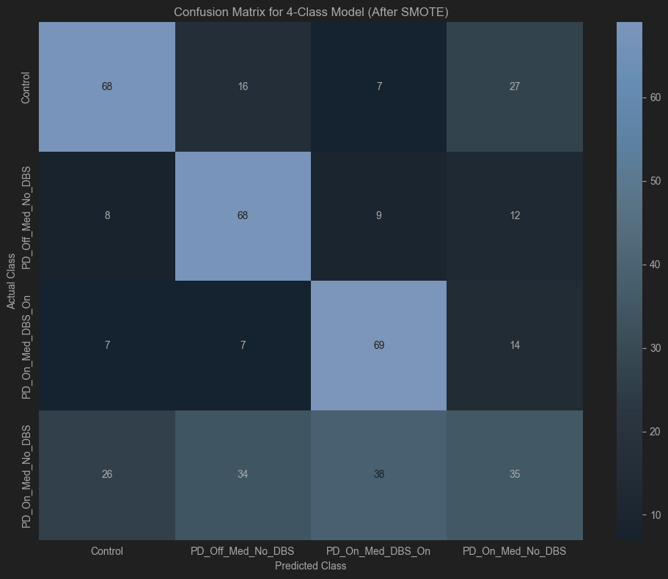
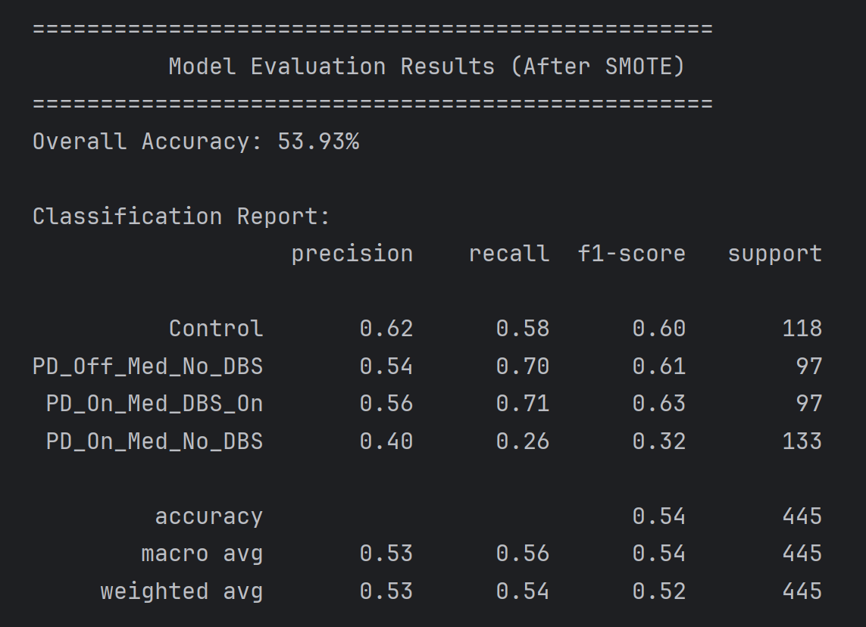
Model

Slide 9
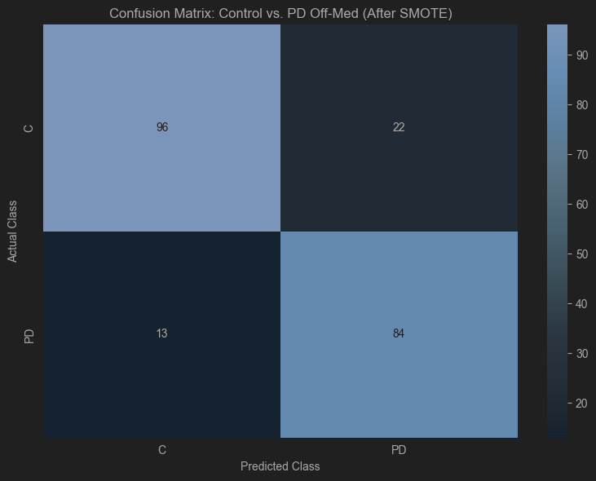
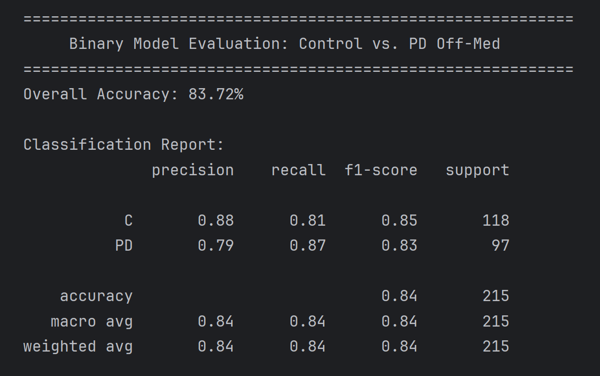
Model

Slide 10
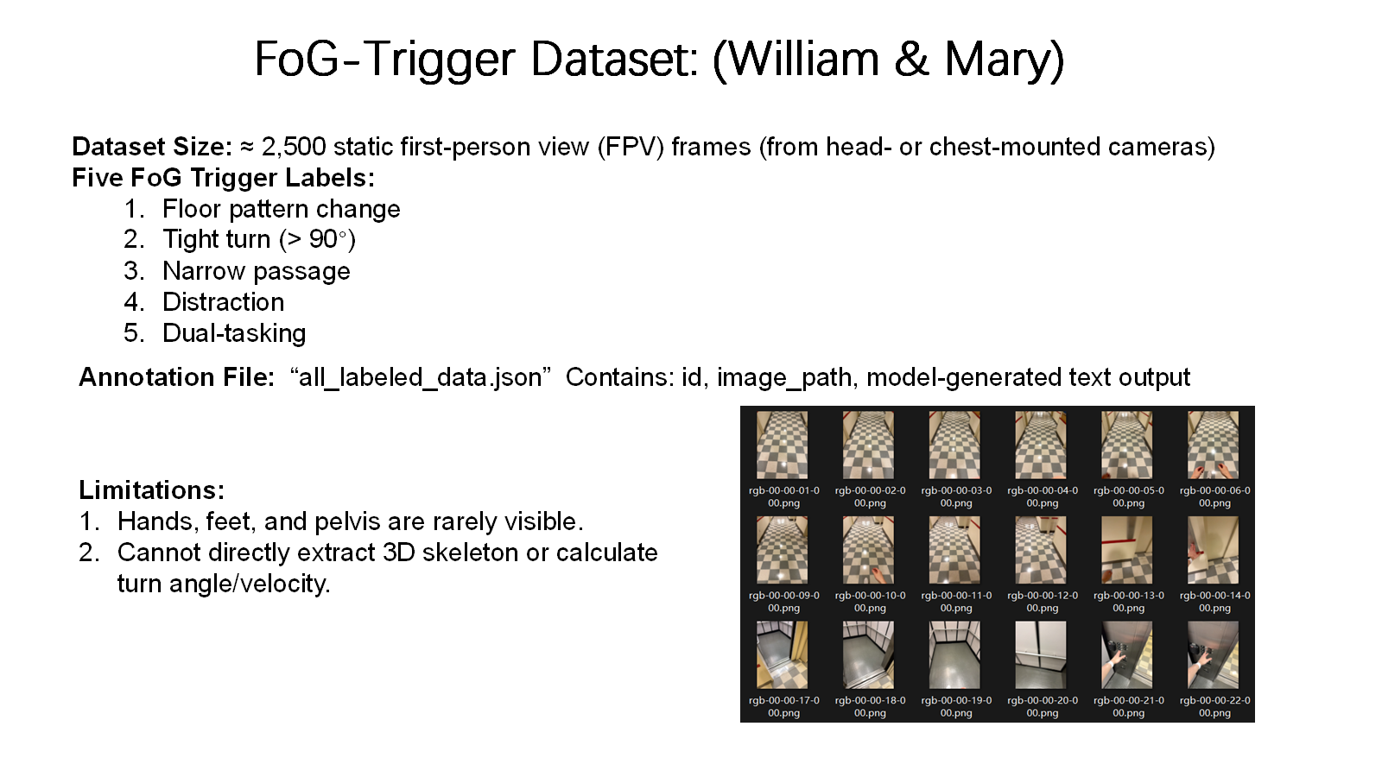

Slide 11
