Slide 1
09/25

Slide 2
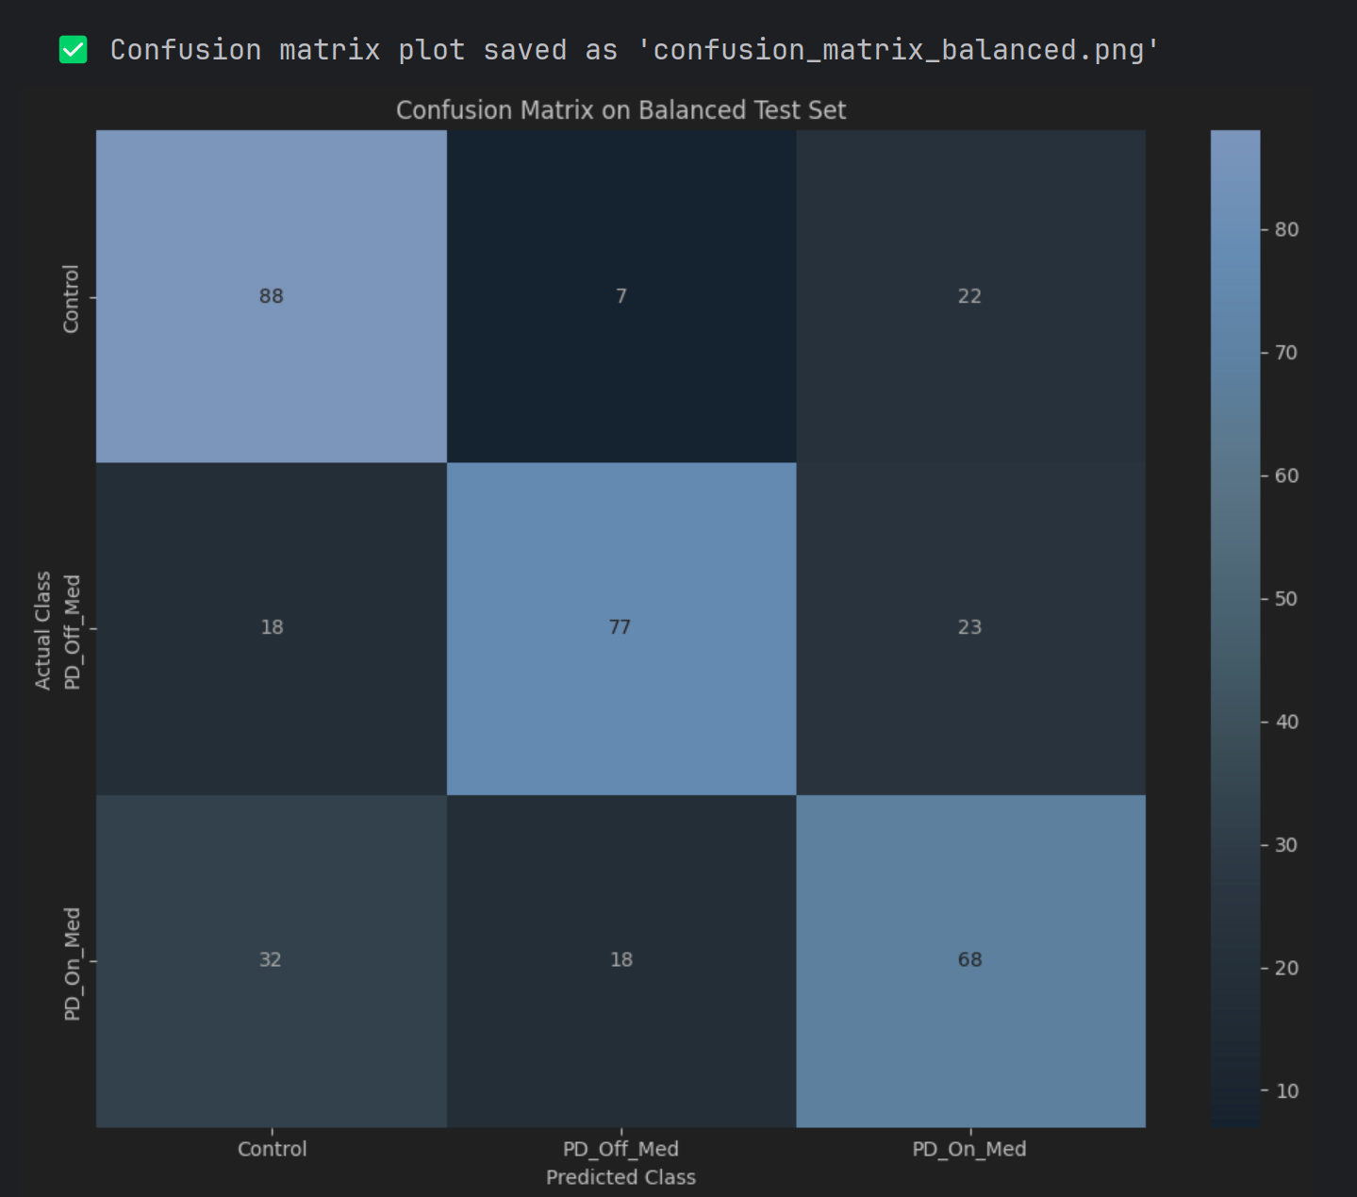
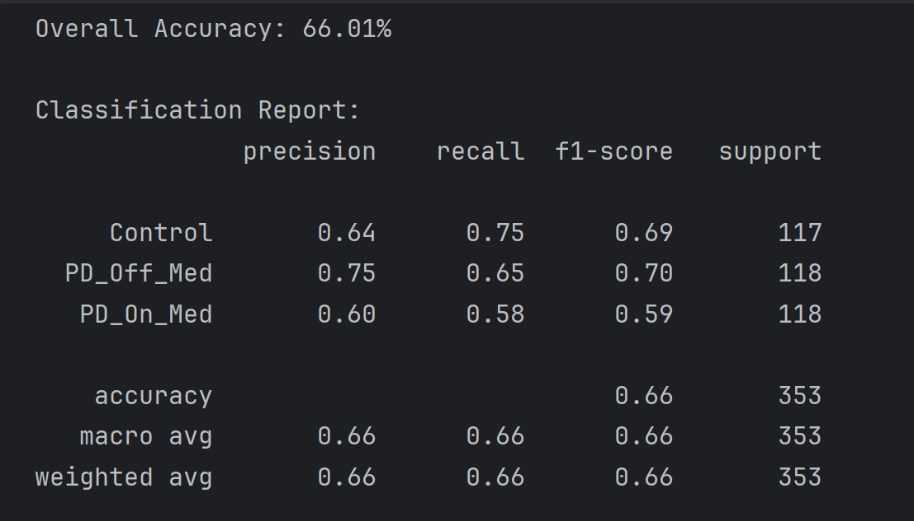
Control vs PD_ON_Med vs PD_Off_Med

Slide 3
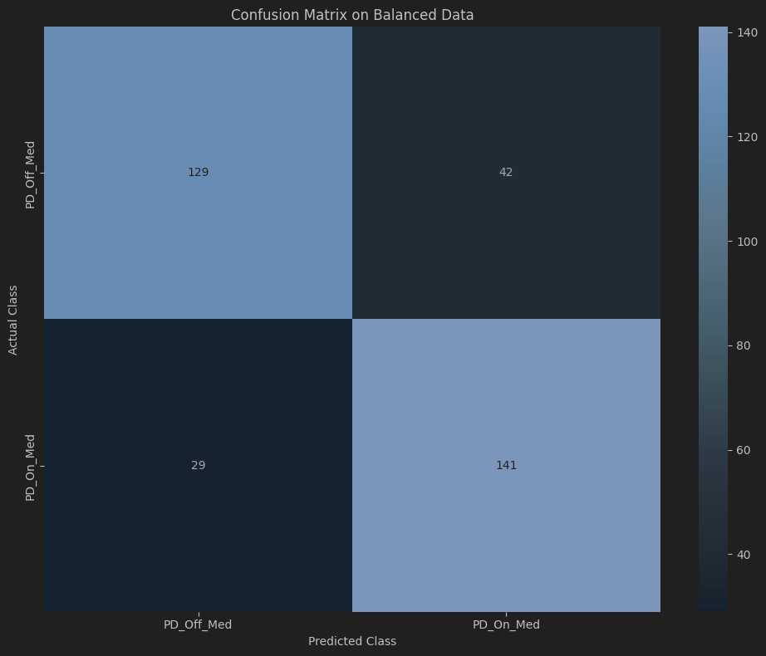
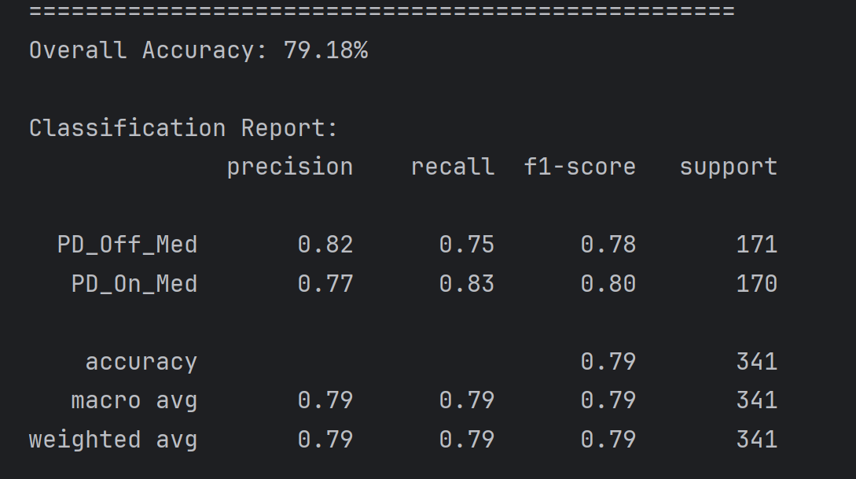
PD_ON_Med vs PD_Off_Med

