Slide 1
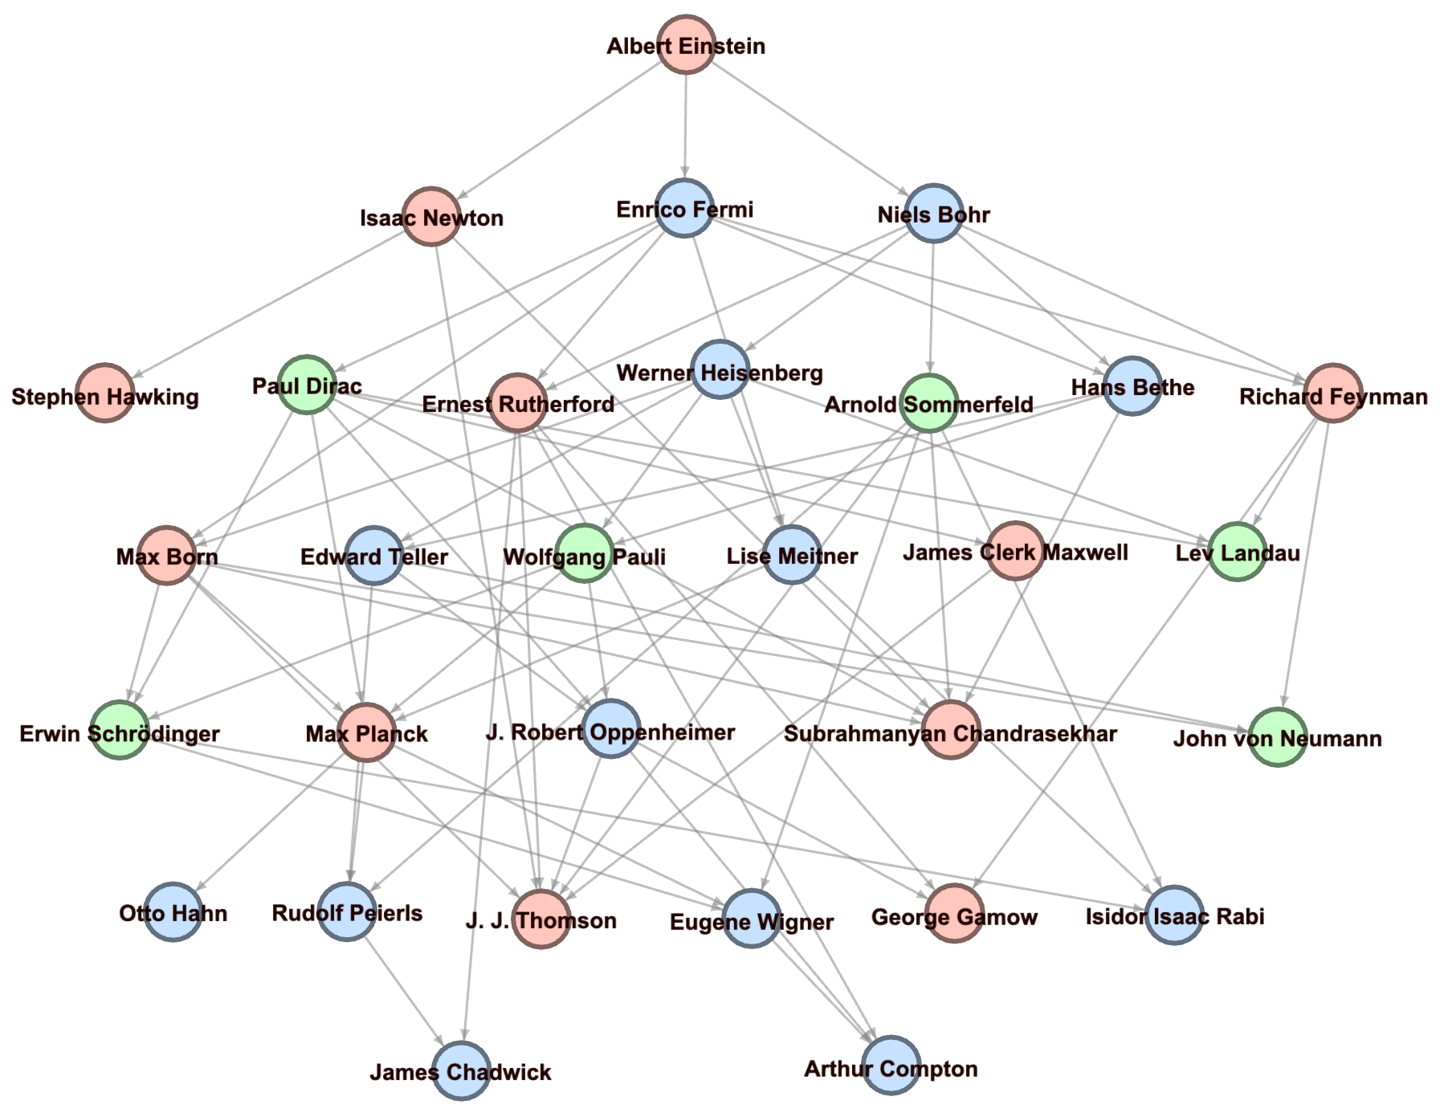
Cluster 3
Cluster 4
Cluster 1

Slide 2
