Slide 1
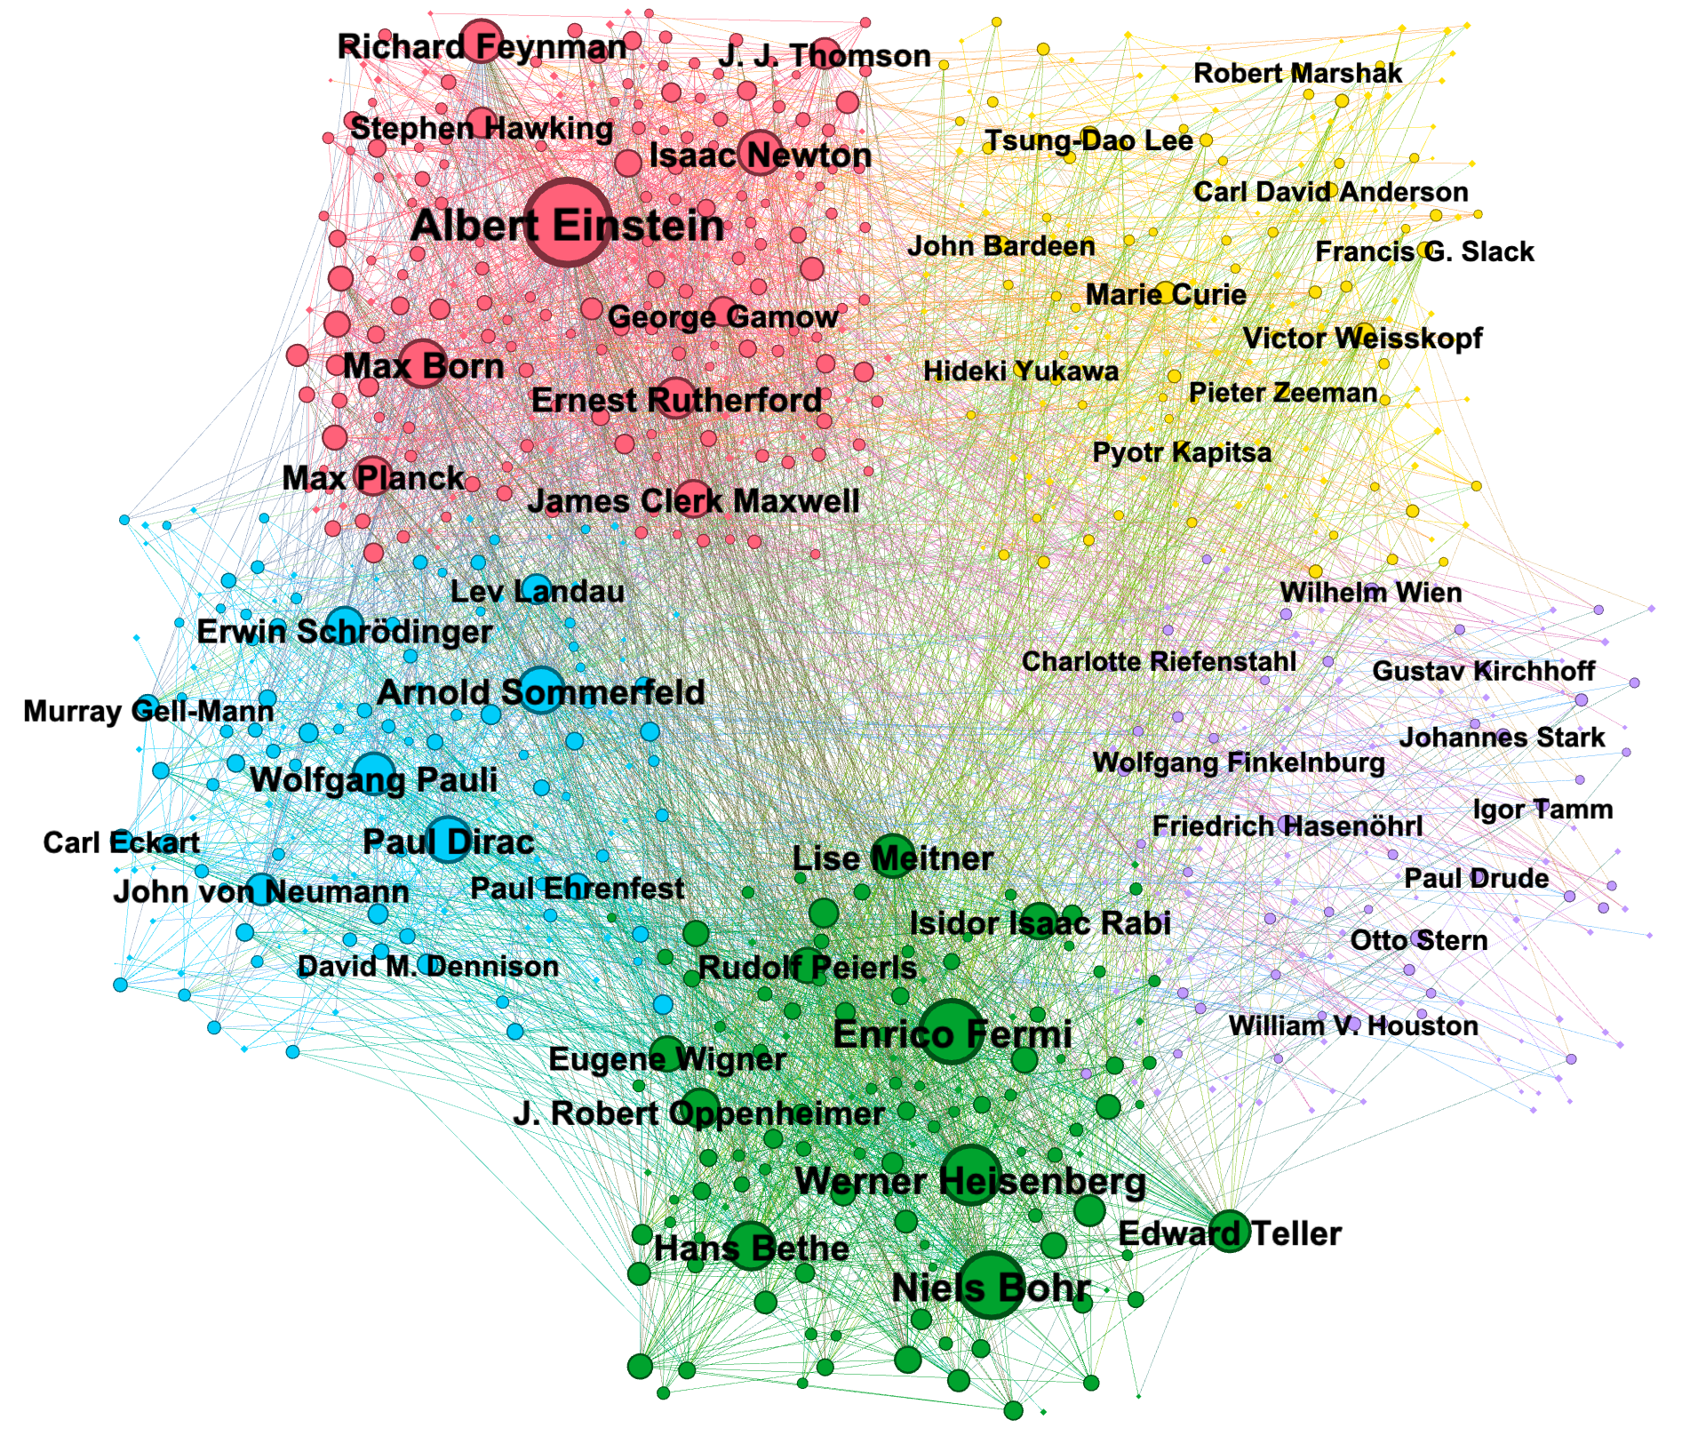
Cluster 0
Cluster 1
Cluster 2
Cluster 3
Cluster 4

