Slide 1
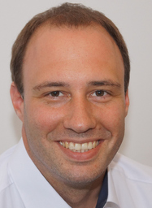



Programming OpenMP
Christian Terboven
Michael Klemm

Slide 2
Agenda (in total 7 Sessions)
Session 1: OpenMP Introduction
Session 2: Tasking
Session 3: Optimization for NUMA and SIMD
Session 4: What Could Possibly Go Wrong Using OpenMP
Session 5: Introduction to Offloading with OpenMP
Session 6: Advanced Offloading Topics
Session 7: Miscellaneous Topics
Review of Session 6, Q&A
Review of Homework Assignments
SIMD, Part 2
Task Affinity
Real World Applications Case Study: NWChem
Hybrid Programming: MPI + OpenMP

Slide 3
Programming OpenMP
Review
Christian Terboven
Michael Klemm

Slide 4
Questions?

Slide 5
Jacobi

Slide 6
Example solution: Jacobi basic
while ( err > tol && iter < iter_max ) {
err = 0.0;
#pragma omp target teams distribute parallel for reduction(max:err)\
schedule(nonmonotonic:static,1) map(to:A[0:n*m]) map(from:Anew[0:n*m], err)
for( j = 1; j < n-1; j++) {
for( i = 1; i < m-1; i++ ) {
Anew[j *m+ i] = 0.25 * ( A[j *m+ (i+1)] + A[j *m+ (i-1)]
+ A[(j-1) *m+ i] + A[(j+1) *m+ i]);
err = fmax(err,fabs(Anew[j*m+i]-A[j*m+i]));
}
}
for( j = 1; j < n-1; j++) {
for( i = 1; i < m-1; i++ ) {
A[j *m+ i] = Anew[j *m+ i];
}
}
…
iter++;
} // end while

Slide 7
Example solution: Jacobi data
#pragma omp target data map(to:A[0:n*m]) map(alloc:Anew[0:n*m])
while ( err > tol && iter < iter_max ) {
err = 0.0;
#pragma omp target teams distribute parallel for reduction(max:err) \
schedule(nonmonotonic:static,1)
for( j = 1; j < n-1; j++) {
for( i = 1; i < m-1; i++ ) {
Anew[j *m+ i] = 0.25 * ( A[j *m+ (i+1)] + A[j *m+ (i-1)]
+ A[(j-1) *m+ i] + A[(j+1) *m+ i]);
err = fmax(err,fabs(Anew[j*m+i]-A[j*m+i]));
}
}
#pragma omp target teams distribute parallel for schedule(nonmonotonic:static,1)
for( j = 1; j < n-1; j++) {
for( i = 1; i < m-1; i++ ) {
A[j *m+ i] = Anew[j *m+ i];
}
}
…
iter++;
} // end while

Slide 8
Example solution: Jacobi unstructure data
int main(int argc, char** argv)
{
…
initialize(A, Anew, m, n);
…
while ( error > tol && iter < iter_max )
{
error = calcNext(A, Anew, m, n);
swap(A, Anew, m, n);
if(iter % 100 == 0) printf("%5d, %0.6f\n", iter, error);
iter++;
}
deallocate(A, Anew, m, n);
return 0;
}

Slide 9
Example solution: Jacobi unstructure data
void initialize(double *restrict A, double *restrict Anew, int m, int n)
{
for(int i = 0; i < m; i++){
A[i] = 1.0; Anew[i] = 1.0;
}
#pragma omp target enter data map(to:A[:m*n],Anew[:m*n])
}
double calcNext(double *restrict A, double *restrict Anew, int m, int n)
{
double error = 0.0;
#pragma omp target teams distribute parallel for simd collapse(2) \
map(to:A[:m*n]) map(from:Anew[:m*n]) map(tofrom:error) reduction(max:error)
for( int j = 1; j < n-1; j++)
{
for( int i = 1; i < m-1; i++ )
{
Anew[OFFSET(j, i, m)] = 0.25 * ( A[OFFSET(j, i+1, m)] + A[OFFSET(j, i-1, m)]
+ A[OFFSET(j-1, i, m)] + A[OFFSET(j+1, i, m)]);
error = fmax( error, fabs(Anew[OFFSET(j, i, m)] - A[OFFSET(j, i , m)]));
}
}
return error;
}

Slide 10
Example solution: Jacobi unstructure data
void swap(double *restrict A, double *restrict Anew, int m, int n)
{
#pragma omp target teams distribute parallel for simd collapse(2) \
map(to:A[:m*n]) map(from:Anew[:m*n])
for( int j = 1; j < n-1; j++)
{
for( int i = 1; i < m-1; i++ )
{
A[OFFSET(j, i, m)] = Anew[OFFSET(j, i, m)];
}
}
}
void deallocate(double *restrict A, double *restrict Anew, int m, int n)
{
#pragma omp target exit data map(from:A[:m*n],Anew[:m*n])
free(A);
free(Anew);
}

Slide 11
Programming OpenMP
SIMD, Part 2
Christian Terboven
Michael Klemm
Members of the OpenMP Language Committee

Slide 12
SIMD on x86 Architectures (Recap)
Width of SIMD registers has been growing in the past:
128 bit
2 x DP
SSE
4 x SP
256 bit
4 x DP
AVX
8 x SP
512 bit
8 x DP
AVX-512
16 x SP

Slide 13
Auto-vectorization (Recap)
Compilers offer auto-vectorization as an optimization pass
Usually, part of the general loop optimization passes
Code analysis detects code properties that inhibit SIMD vectorization
Heuristics determine if SIMD execution might be beneficial
If all goes well, the compiler will generate SIMD instructions
Example: clang/LLVM GCC Intel Compiler
-fvectorize -ftree-vectorize -vec (enabled w/ -O2)
-Rpass=loop-.\* -ftree-loop-vectorize -qopt-report=vec
-mprefer-vector-width=<width> -fopt-info-vec-all
?

Slide 14
In a Time Before OpenMP 4.0
Support required vendor-specific extensions
Programming models (e.g., Intel® Cilk Plus)
Compiler pragmas (e.g., #pragma vector)
Low-level constructs (e.g., _mm_add_pd())
#pragma omp parallel for #pragma vector always #pragma ivdep
for (int i = 0; i < N; i++) { a[i] = b[i] + ...;
}
You need to trust your compiler to do the “right” thing.

Slide 15
SIMD Loop Construct
Vectorize a loop nest
Cut loop into chunks that fit a SIMD vector register
No parallelization of the loop body
Syntax (C/C++) #pragma omp simd [clause[[,] clause],…] for-loops
Syntax (Fortran) !$omp simd [clause[[,] clause],…] do-loops [!$omp end simd]

Slide 16
Example
float sprod(float *a, float *b, int n) {
float sum = 0.0f;
#pragma omp simd reduction(+:sum)
for (int k=0; k<n; k++)
sum += a[k] * b[k];
return sum;
}
vectorize

Slide 17
Data Sharing Clauses
private(var-list): Uninitialized vectors for variables in var-list
firstprivate(var-list): Initialized vectors for variables in var-list
reduction(op:var-list): Create private variables for var-list and apply reduction operator op at the end of the construct
x:
42
?
?
?
?
x:
42
42
42
42
42
12
5
8
17
x:
42

Slide 18
SIMD Loop Clauses
safelen (length)
Maximum number of iterations that can run concurrently without breaking a dependence
In practice, maximum vector length
linear (list[:linear-step])
The variable’s value is in relationship with the iteration number
x_{i} = x_{orig} + i * linear-step
aligned (list[:alignment])
Specifies that the list items have a given alignment
Default is alignment for the architecture
collapse (n)

Slide 19
SIMD Worksharing Construct
Parallelize and vectorize a loop nest
Distribute a loop’s iteration space across a thread team
Subdivide loop chunks to fit a SIMD vector register
Syntax (C/C++) #pragma omp for simd [clause[[,] clause],…] for-loops
Syntax (Fortran) !$omp do simd [clause[[,] clause],…] do-loops [!$omp end do simd [nowait]]

Slide 20
Example
float sprod(float *a, float *b, int n) {
float sum = 0.0f;
#pragma omp for simd reduction(+:sum)
for (int k=0; k<n; k++)
sum += a[k] * b[k];
return sum;
}
parallelize
Thread 0
Thread 1
Thread 2
Remainder Loop
Peel Loop
vectorize

Slide 21
Be Careful What You Wish For…
You should choose chunk sizes that are multiples of the SIMD length
Remainder loops are not triggered
Likely better performance
In the above example …
and AVX2, the code will only execute the remainder loop!
and SSE, the code will have one iteration in the SIMD loop plus one in the remainder loop!
float sprod(float *a, float *b, int n) {
float sum = 0.0f;
#pragma omp for simd reduction(+:sum) \
schedule(static, 5)
for (int k=0; k<n; k++)
sum += a[k] * b[k];
return sum;
}

Slide 22
OpenMP 4.5 Simplifies SIMD Chunks
Chooses chunk sizes that are multiples of the SIMD length
First and last chunk may be slightly different to fix alignment and to handle loops that are not exact multiples of SIMD width
Remainder loops are not triggered
Likely better performance
float sprod(float *a, float *b, int n) {
float sum = 0.0f;
#pragma omp for simd reduction(+:sum) \
schedule(simd: static, 5)
for (int k=0; k<n; k++)
sum += a[k] * b[k];
return sum;
}

Slide 23
SIMD Function Vectorization
float min(float a, float b) { return a < b ? a : b; }
float distsq(float x, float y) { return (x - y) * (x - y); }
void example() {
#pragma omp parallel for simd
for (i=0; i<N; i++) { d[i] = min(distsq(a[i], b[i]), c[i]); } }

Slide 24
SIMD Function Vectorization
Declare one or more functions to be compiled for calls from a SIMD-parallel loop
Syntax (C/C++):
#pragma omp declare simd [clause[[,] clause],…]
[#pragma omp declare simd [clause[[,] clause],…]]
[…]
function-definition-or-declaration
Syntax (Fortran):
!$omp declare simd (proc-name-list)

Slide 25
SIMD Function Vectorization
#pragma omp declare simd
float min(float a, float b) { return a < b ? a : b; }
#pragma omp declare simd
float distsq(float x, float y) { return (x - y) * (x - y); }
void example() {
#pragma omp parallel for simd
for (i=0; i<N; i++) { d[i] = min(distsq(a[i], b[i]), c[i]); } }
_ZGVZN16vv_min(%zmm0, %zmm1): vminps %zmm1, %zmm0, %zmm0
ret
_ZGVZN16vv_distsq(%zmm0, %zmm1): vsubps %zmm0, %zmm1, %zmm2 vmulps %zmm2, %zmm2, %zmm0 ret
vmovups (%r14,%r12,4), %zmm0
vmovups (%r13,%r12,4), %zmm1 call _ZGVZN16vv_distsq vmovups (%rbx,%r12,4), %zmm1
call _ZGVZN16vv_min

Slide 26
SIMD Function Vectorization
simdlen (length)
generate function to support a given vector length
uniform (argument-list)
argument has a constant value between the iterations of a given loop
inbranch
function always called from inside an if statement
notinbranch
function never called from inside an if statement
linear (argument-list[:linear-step])
aligned (argument-list[:alignment])

Slide 27
inbranch & notinbranch
#pragma omp declare simd inbranch
float do_stuff(float x) { /* do something */ return x * 2.0; }
void example() { #pragma omp simd
for (int i = 0; i < N; i++) if (a[i] < 0.0) b[i] = do_stuff(a[i]); }
vec8 do_stuff_v(vec8 x, mask m) { /* do something */ vmulpd x{m}, 2.0, tmp return tmp; }
for (int i = 0; i < N; i+=8) { vcmp_lt &a[i], 0.0, mask b[i] = do_stuff_v(&a[i], mask);
}

Slide 28
SIMD Constructs & Performance
M.Klemm, A.Duran, X.Tian, H.Saito, D.Caballero, and X.Martorell. Extending OpenMP with Vector Constructs for Modern Multicore SIMD Architectures. In Proc. of the Intl. Workshop on OpenMP, pages 59-72, Rome, Italy, June 2012. LNCS 7312.

Slide 29
Programming OpenMP
NUMA
Christian Terboven
Michael Klemm
Members of the OpenMP Language Committee

Slide 30
Improving Tasking Performance:
Task Affinity

Slide 31
Motivation
Techniques for process binding & thread pinning available
OpenMP thread level: OMP_PLACES & OMP_PROC_BIND
OS functionality: taskset -c
OpenMP Tasking:
In general: Tasks may be executed by any thread in the team
Missing task-to-data affinity may have detrimental effect on performance
OpenMP 5.0:
affinity clause to express affinity to data

Slide 32
affinity clause
New clause: #pragma omp task affinity (list)
Hint to the runtime to execute task closely to physical data location
Clear separation between dependencies and affinity
Expectations:
Improve data locality / reduce remote memory accesses
Decrease runtime variability
Still expect task stealing
In particular, if a thread is under-utilized

Slide 33
Code Example
Excerpt from task-parallel STREAM
Loops have been blocked manually (see tmp_idx_start/end)
Assumption: initialization and computation have same blocking and same affinity
1 #pragma omp task \
2 shared(a, b, c, scalar) \
3 firstprivate(tmp_idx_start, tmp_idx_end) \
4 affinity( a[tmp_idx_start] )
5 {
6 int i;
7 for(i = tmp_idx_start; i <= tmp_idx_end; i++)
8 a[i] = b[i] + scalar * c[i];
9 }

Slide 34
Selected LLVM implementation details
Encounter task region …
Task with data affinity?
No
Push to local queue
A map is introduced to store location information of data that was previously used
Yes
No
Location
for data reference in map?
Identify NUMA domain where data is stored
Jannis Klinkenberg, Philipp Samfass, Christian Terboven, Alejandro Duran, Michael Klemm, Xavier Teruel, Sergi Mateo, Stephen L. Olivier, and Matthias S. Müller. Assessing Task-to-Data Affinity in the LLVM OpenMP Runtime. Proceedings of the 14th International Workshop on OpenMP, IWOMP 2018. September 26-28, 2018, Barcelona, Spain.
Yes
Select thread pinned to NUMA domain
Save
{reference, location} in map
Push task into other threads queue
end

Slide 35
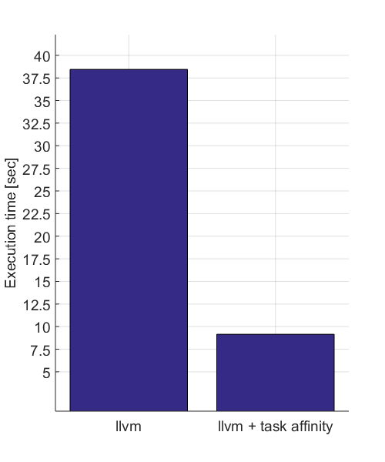
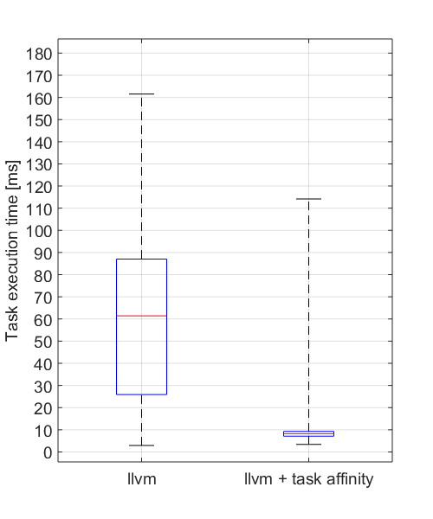
Evaluation
Program runtime
Median of 10 runs
Distribution of single
task execution times
Speedup of 4.3 X
LIKWID: reduction of remote data volume from 69% to 13%

Slide 36
Summary
Requirement for this feature: thread affinity enabled
The affinity clause helps, if
tasks access data heavily
single task creator scenario, or task not created with data affinity
high load imbalance among the tasks
Different from thread binding: task stealing is absolutely allowed

Slide 37
Case Study: NWChem TCE CCSD(T)
TCE: Tensor Contraction Engine CCSD(T): Coupled-Cluster with Single, Double, and perturbative Triple replacements

Slide 38
NWChem
Computational chemistry software package
Quantum chemistry
Molecular dynamics
Designed for large-scale supercomputers
Developed at the EMSL at PNNL
EMSL: Environmental Molecular Sciences Laboratory
PNNL: Pacific Northwest National Lab
URL: http://www.nwchem-sw.org

Slide 39
Finding Offload Candidates
Requirements for offload candidates
Compute-intensive code regions (kernels)
Highly parallel
Compute scaling stronger than data transfer, e.g., compute O(n³) vs. data size O(n²)

Slide 40
Example Kernel (1 of 27 in total)
subroutine sd_t_d1_1(h3d,h2d,h1d,p6d,p5d,p4d,
1 h7d,triplesx,t2sub,v2sub)
c Declarations omitted.
double precision triplesx(h3d*h2d,h1d,p6d,p5d,p4d)
double precision t2sub(h7d,p4d,p5d,h1d)
double precision v2sub(h3d*h2d,p6d,h7d)
!$omp target „presence?(triplesx,t2sub,v2sub)"
!$omp teams distribute parallel do private(p4,p5,p6,h2,h3,h1,h7)
do p4=1,p4d
do p5=1,p5d
do p6=1,p6d
do h1=1,h1d
do h7=1,h7d
do h2h3=1,h3d*h2d
triplesx(h2h3,h1,p6,p5,p4)=triplesx(h2h3,h1,p6,p5,p4)
1 - t2sub(h7,p4,p5,h1)*v2sub(h2h3,p6,h7)
end do
end do
end do
end do
end do
end do
!$omp end teams distribute parallel do
!$omp end target
end subroutine
All kernels have the same structure
7 perfectly nested loops
Some kernels contain inner product loop (then, 6 perfectly nested loops)
Trip count per loop is equal to “tile size” (20-30 in production)
Naïve data allocation (tile size 24)
Per-array transfer for each target construct
triplesx: 1458 MB
t2sub, v2sub: 2.5 MB each
1.5GB data transferred (host to device)
1.5GB data transferred (device to host)

Slide 41
Invoking the Kernels / Data Management
Simplified pseudo-code
Reduced data transfers:
triplesx:
allocated once
always kept on the target
t2sub, v2sub:
allocated after comm.
kept for (multiple) kernel invocations
!$omp target enter data map(alloc:triplesx(1:tr_size))
c for all tiles
do ...
call zero_triplesx(triplesx)
do ...
call comm_and_sort(t2sub, v2sub)
!$omp target data map(to:t2sub(t2_size)) map(to:v2sub(v2_size))
if (...)
call sd_t_d1_1(h3d,h2d,h1d,p6d,p5d,p4d,h7,triplesx,t2sub,v2sub)
end if
c same for sd_t_d1_2 until sd_t_d1_9
!$omp target end data
end do
do ...
c Similar structure for sd_t_d2_1 until sd_t_d2_9, incl. target data
end do
call sum_energy(energy, triplesx)
end do
!$omp target exit data map(release:triplesx(1:size))
Allocate 1.5GB data once, stays on device.
Update 2x2.5MB of data for (potentially) multiple kernels.

Slide 42
Invoking the Kernels / Data Management
Simplified pseudo-code
subroutine sd_t_d1_1(h3d,h2d,h1d,p6d,p5d,p4d,
1 h7d,triplesx,t2sub,v2sub)
c Declarations omitted.
double precision triplesx(h3d*h2d,h1d,p6d,p5d,p4d)
double precision t2sub(h7d,p4d,p5d,h1d)
double precision v2sub(h3d*h2d,p6d,h7d)
!$omp target „presence?(triplesx,t2sub,v2sub)"
!$omp teams distribute parallel do private(p4,p5,p6,h2,h3,h1,h7)
do p4=1,p4d
do p5=1,p5d
do p6=1,p6d
do h1=1,h1d
do h7=1,h7d
do h2h3=1,h3d*h2d
triplesx(h2h3,h1,p6,p5,p4)=triplesx(h2h3,h1,p6,p5,p4)
1 - t2sub(h7,p4,p5,h1)*v2sub(h2h3,p6,h7)
end do
end do
end do
end do
end do
end do
!$omp end teams distribute parallel do
!$omp end target
end subroutine
!$omp target enter data map(alloc:triplesx(1:tr_size))
c for all tiles
do ...
call zero_triplesx(triplesx)
do ...
call comm_and_sort(t2sub, v2sub)
!$omp target data map(to:t2sub(t2_size)) map(to:v2sub(v2_size))
if (...)
call sd_t_d1_1(h3d,h2d,h1d,p6d,p5d,p4d,h7,triplesx,t2sub,v2sub)
end if
c same for sd_t_d1_2 until sd_t_d1_9
!$omp target end data
end do
do ...
c Similar structure for sd_t_d2_1 until sd_t_d2_9, incl. target data
end do
call sum_energy(energy, triplesx)
end do
!$omp target exit data map(release:triplesx(1:size))
Allocate 1.5GB data once, stays on device.
Presence check determines that arrays have been allocated in the device data environment already.
Update 2x2.5MB of data for (potentially) multiple kernels.

Slide 43
Programming OpenMP
OpenMP and MPI
Christian Terboven
Michael Klemm
Members of the OpenMP Language Committee

Slide 44
Motivation

Slide 45
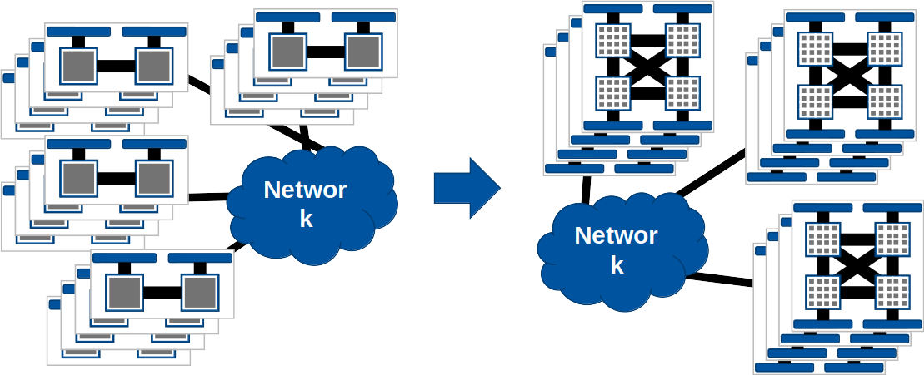
Motivation for hybrid programming
Increasing number of cores per node

Slide 46
Hybrid programming
(Hierarchical) mixing of different programming paradigms
CUDA / OpenMP
CUDA / OpenMP
GPGPU
GPGPU
OpenMP
OpenMP
Shared memory
Shared memory
0
1
2
3
4
0
1
2
3
4
5
6
7
8
9
5
6
7
8
9
MPI

Slide 47
MPI and OpenMP

Slide 48
MPI – threads interaction
MPI needs special initialization in a threaded environment
Use MPI_Init_thread to communicate thread support level
Four levels of threading support
MPI_THREAD_MULTIPLE may incur significant overhead inside an MPI implementation
Level identifier | Description
MPI_THREAD_SINGLE | Only one thread may execute
MPI_THREAD_FUNNELED | Only the main thread may make MPI calls
MPI_THREAD_SERIALIZED | Any one thread may make MPI calls at a time
MPI_THREAD_MULTIPLE | Multiple threads may call MPI concurrently with no restrictions
Higher levels
Notes:
Higher levels have higher valued numerical constant. Technically in most cases MPI_THREAD_SINGLE gives the same level of support as MPI_THREAD_FUNNELED, but the standard still differentiates between them.

Slide 49
MPI – Threading support levels
MPI_THREAD_SINGLE
Only one thread per MPI rank
MPI Communication
Thread Synchronization
MPI_Init
MPI_Init
MPI_Send
MPI_Recv
MPI_Recv
MPI_Send
MPI_Barrier
MPI_Barrier
MPI_Finalize
MPI_Finalize

Slide 50
MPI – Threading support levels
MPI_THREAD_FUNNELED
Only one thread communicates
MPI Communication
Thread Synchronization
MPI_Init
MPI_Init
MPI_Send
MPI_Recv
MPI_Recv
MPI_Send
MPI_Barrier
MPI_Barrier
MPI_Finalize
MPI_Finalize

Slide 51
MPI – Threading support levels
MPI_THREAD_SERIALIZED
Only one thread communicates at a time
MPI Communication
Thread Synchronization
MPI_Init
MPI_Init
MPI_Send
MPI_Recv
MPI_Recv
MPI_Send
MPI_Barrier
MPI_Barrier
MPI_Finalize
MPI_Finalize

Slide 52
MPI – Threading support levels
MPI_THREAD_MULTIPLE
All threads communicate concurrently without synchronization
MPI Communication
Thread Synchronization
MPI_Init
MPI_Init
MPI_Send
MPI_Recv
MPI_Recv
MPI_Send
MPI_Send
MPI_Recv
MPI_Send
MPI_Recv
MPI_Recv
MPI_Send
MPI_Recv
MPI_Send
MPI_Send
MPI_Recv
MPI_Send
MPI_Recv
MPI_Recv
MPI_Send
MPI_Recv
MPI_Send
MPI_Send
MPI_Recv
MPI_Recv
MPI_Send
MPI_Finalize
MPI_Finalize

