Slide 1
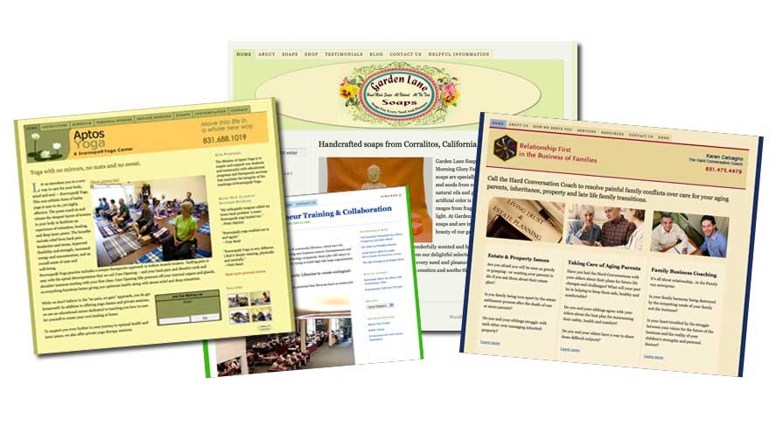
Creating a WordPress Website
Is WordPress for You?

Slide 2
Today’s Presentation Objectives
About Me
Our Audience: What’s your Comfort-Level with WordPress? Please raise your hand if…
What is a Content Management System (CMS)?
Assessing Your Business Needs/Time/Money
WordPress: Website or Blog?
Advanced: How WordPress Works

Slide 3
About Melody
15 years designing/developing websites
Not a coder but does know css intimately
Previous lives: Writer, author, magazine editor, independent books sales rep, flack for Cabrillo College.
New Skillsets: Dreamweaver, Photoshop, Illustrator, HTML, Filemaker—all at Cabrillo.

Slide 4
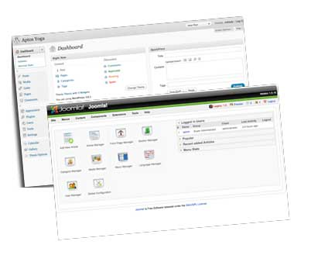
What is CMS?
Drupal, Joomla, Wordpress use a database (tables) to store information
CMS uses a different technology than standard
html/css sites
The technology is open-source (free!)
Allows people to update their owns sites
You are the master of your own domain!
Drawback: The one-night website fallacy

Slide 5
WordPress or Traditional Technology?
Are you a Luddite? (destroy the loom)
How often do you plan to change your website?
Did your nephew build your existing site?
Do you like taking photos and videos?
Do you have more time than money?
Do want functionality or flare?

Slide 6
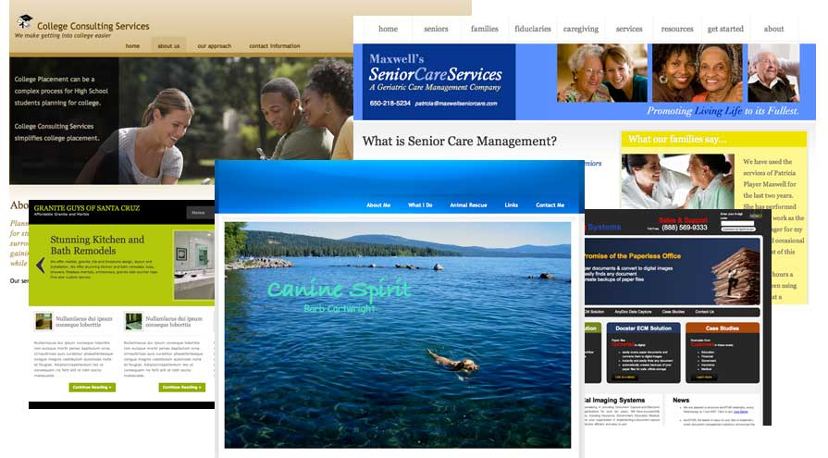
CMS: Benefits vs Creativity

Slide 7
Is it a Blog? Is it a Website?
Are you confused? Of course, because it’s confusing. Now a Blog = Website.
But why can’t it do this? Because websites are hard work.
WordPress has become a cult. It’s the future.
SEO problems do occur with CMS vs standard files
Hot Tip: You can add a blog feature to your existing site.
About WordPress: Yes, the dashboard is intimidating.

Slide 8
Themes vs Templates vs Frameworks
Templates can be used with HTML websites (yeah, let’s save 100+ hours of programming.
Themes are used with CMS
Frameworks: Built on a solid core theme with quality code that includes a lot of “inbuilt” functionality; continually being updated and improved; easier customization; doesn’t break.
Thesis, Genesis highly rated themes.

Slide 9
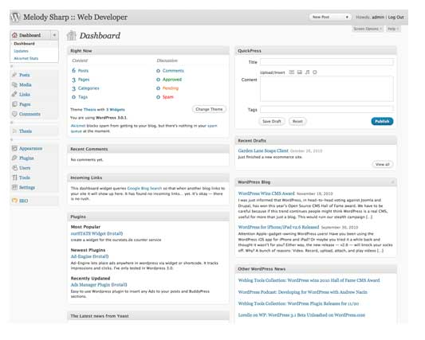
The Dashboard
Link to Melody’s microsite
How to access a WordPress Site

Slide 10
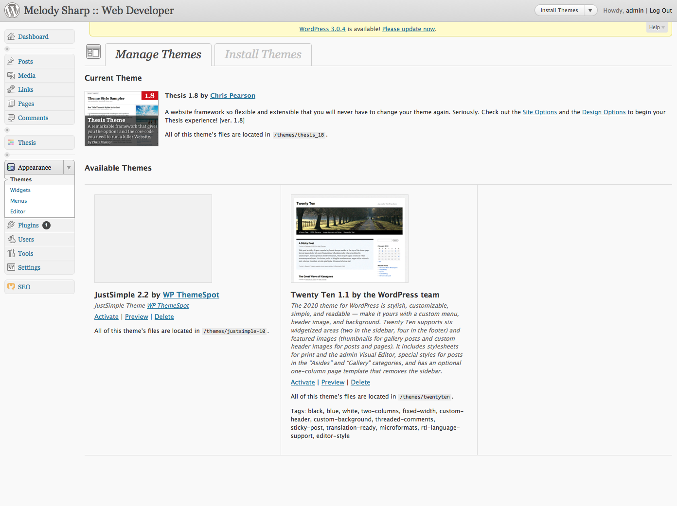
WordPress Appearance

Slide 11
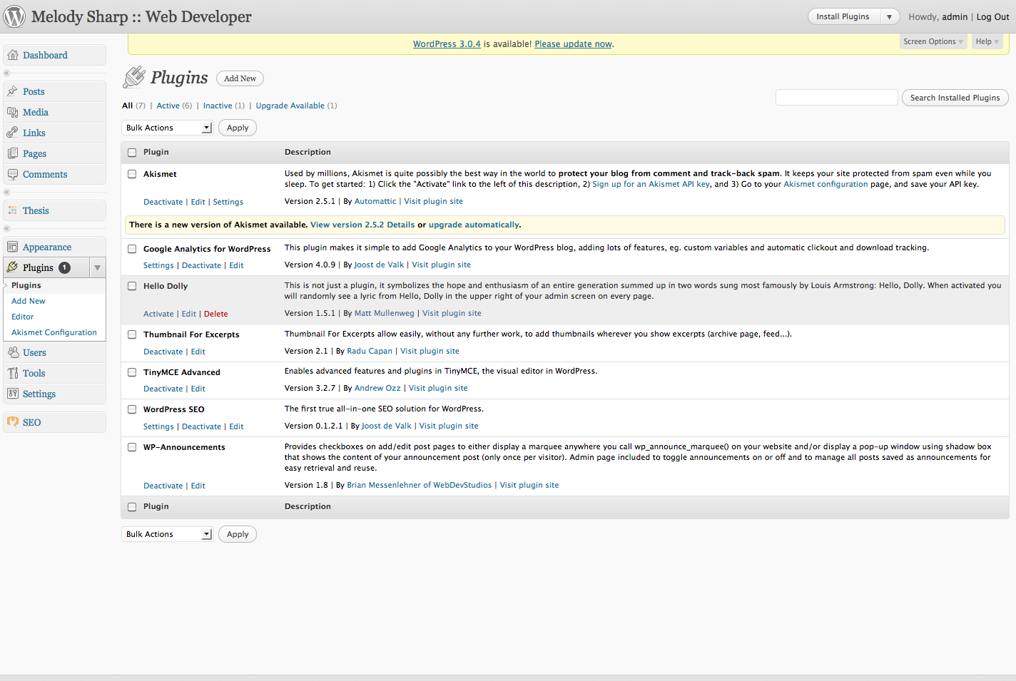
WordPress Plugins

Slide 12
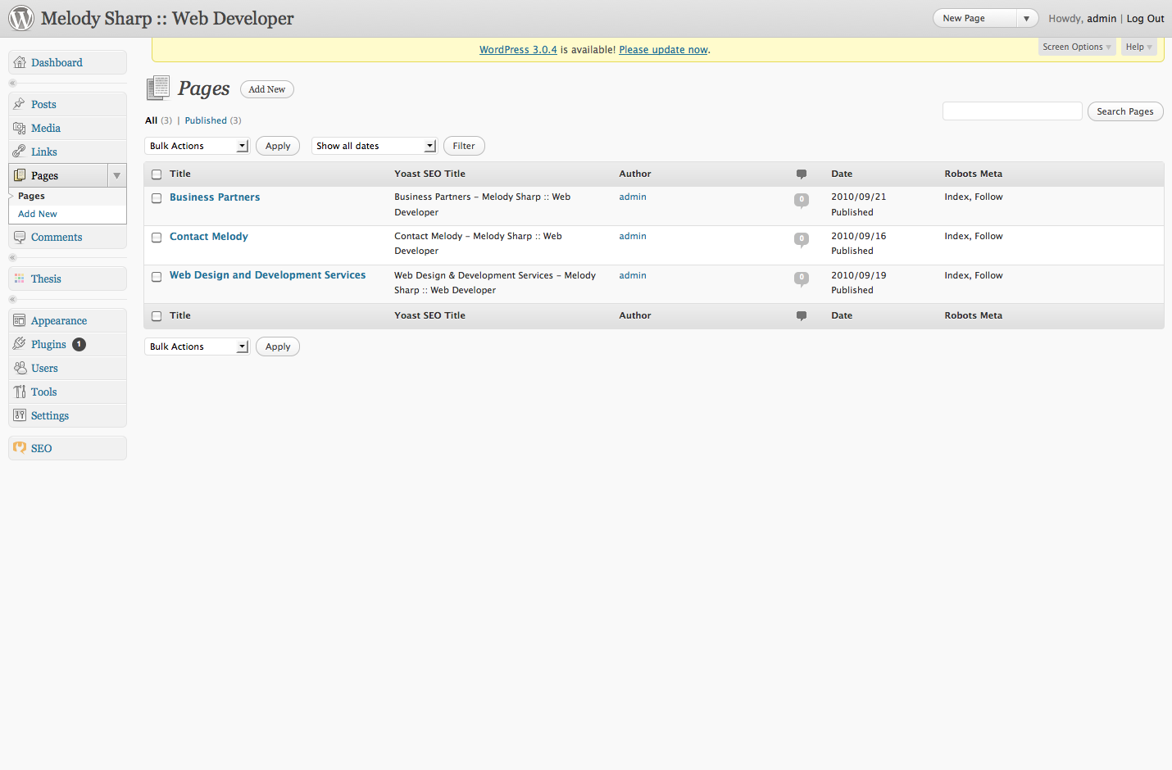
WordPress Pages

Slide 13
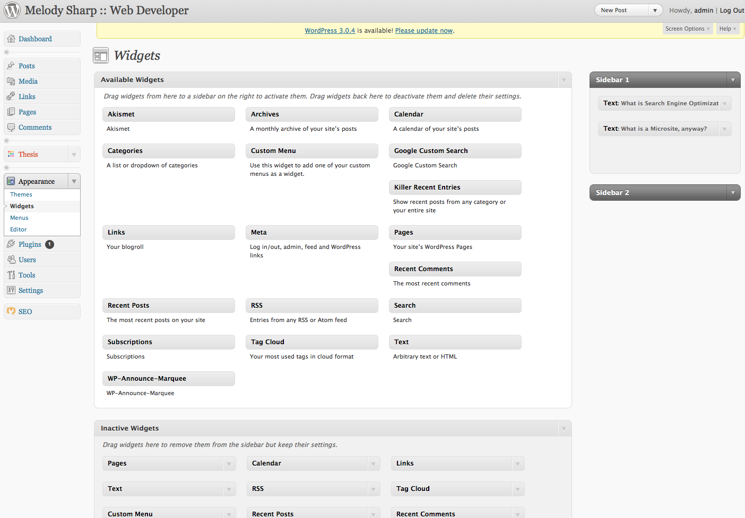
WordPress Widgets

Slide 14
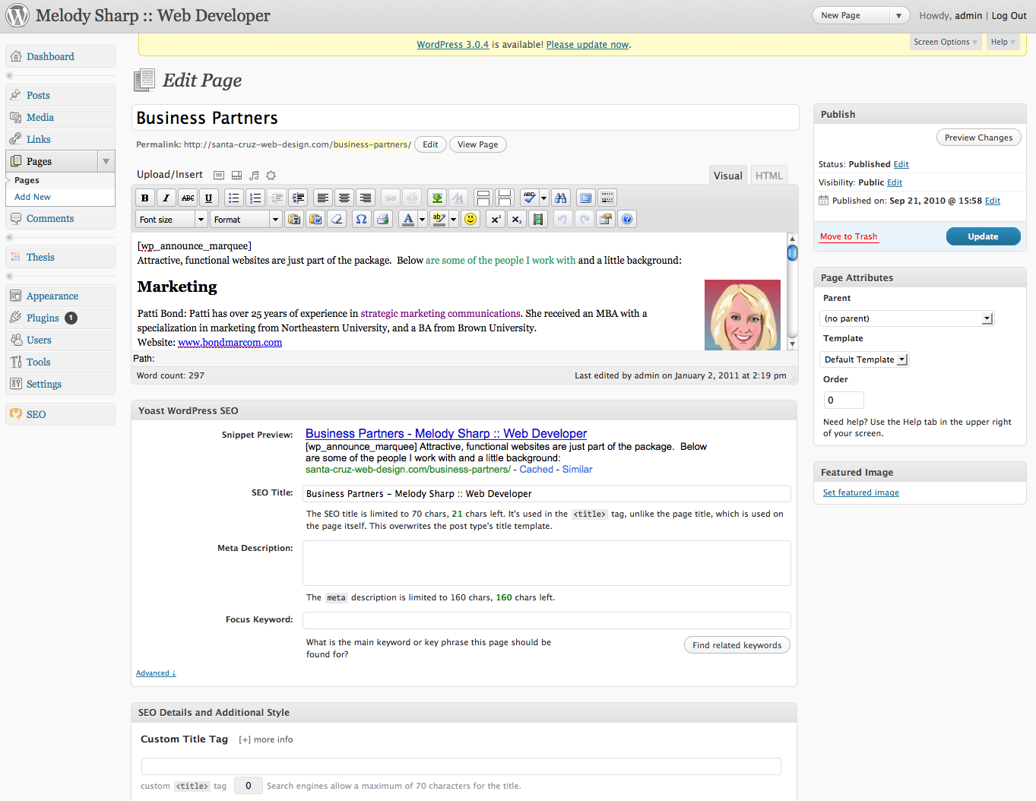
Search Engine Optimization

Slide 15
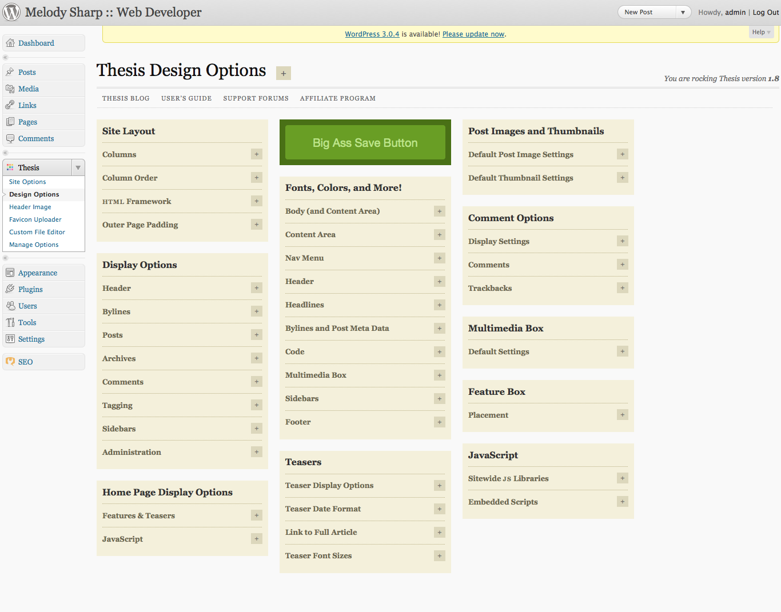
Designing with Thesis

Slide 16
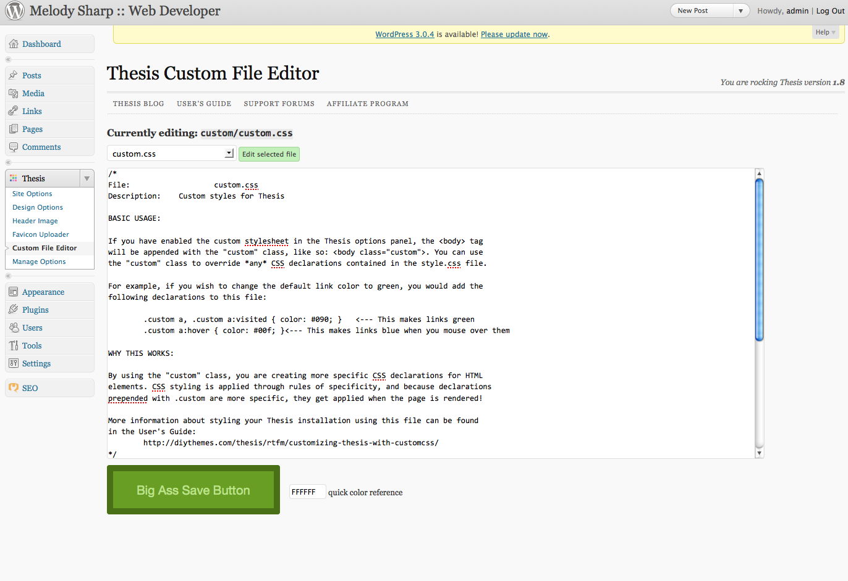
WordPress Customization

Slide 17
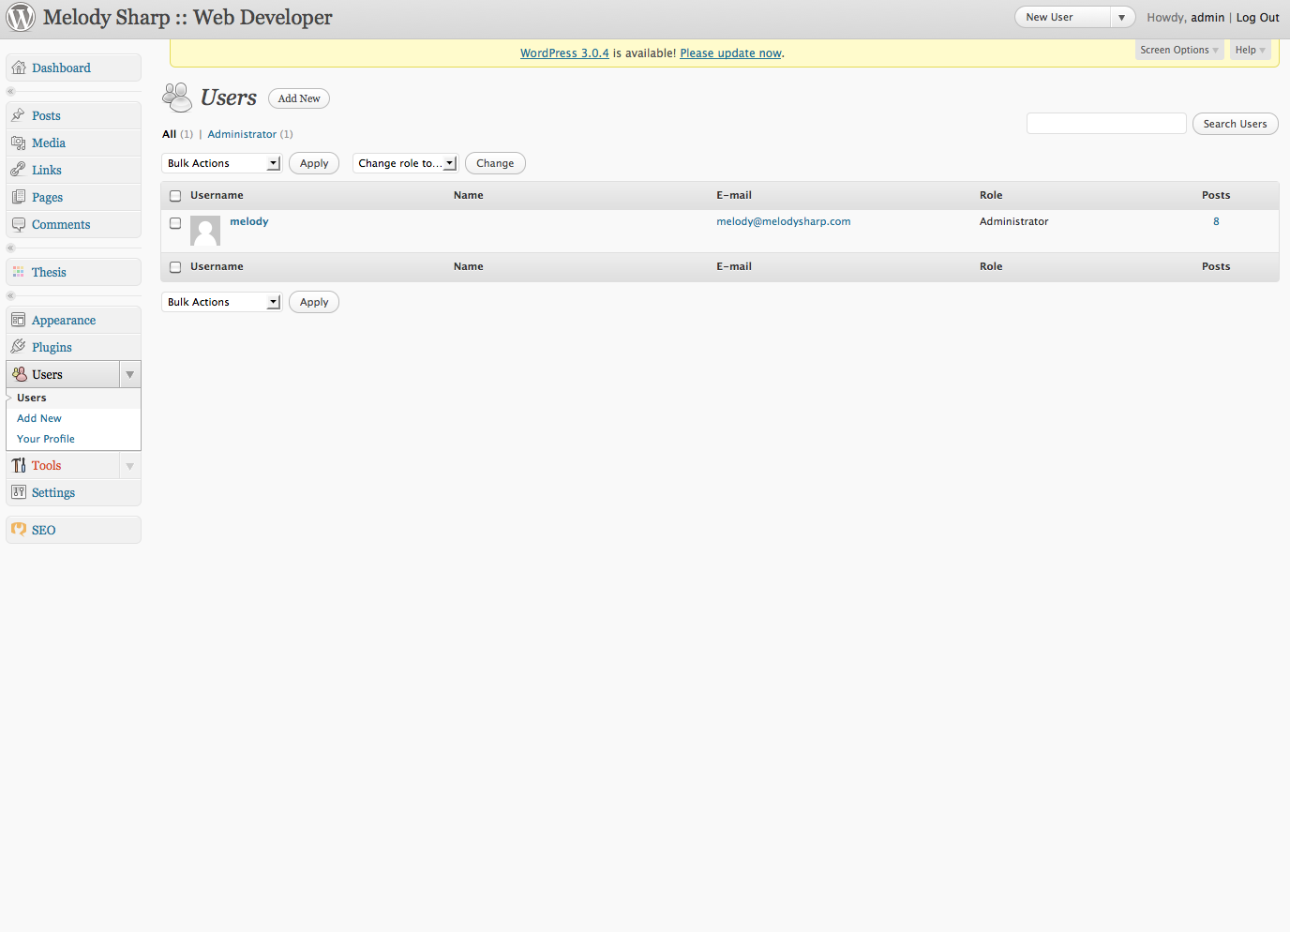
WordPress Administration

