Slide 1

MeteorJS
An easy way to do anything
Peter Ilfrich – IBM Research Australia

Slide 2
Overview
Client
MiniMongo in-memory / in-browser database
Blaze templates using mustache tags {{..}}
HTTP support, call to server methods (AJAX)
Session support
Browser
iOS
Android
Server
NodeJS server, support for server-side methods, publications, routes and DDP connections to the client
Persistent Storage
MongoDB, document-based DB, support for most query elements, optional packages for aggregation and “joins”
Command Line
Create application, add packages, access database, build for mobile, deployment

Slide 3
Client
Helpers
Templates
Template.foo.helpers()
collection.find()
{{helper}}, {{helper.attribute}}
{{#each}}, {{#if}}
MiniMongo
Events
Meteor.subscribe()
Template.foo.events()
Meteor.call()
Publications
Methods
Server

Slide 4
Mobile
Xcode
Android Studio
Simulator
AppStore
Simulator
Device
AppStore
Cordova
iOS xcodeproj
Android apk
Client CSS
JavaScript
Compiled Templates
Client-only JS
Shared JS

Slide 5
Server
Client
Tracker / Autorun
Configuration
Security
Methods
Publications
Meteor.methods()
Meteor.publish()
DB Initialization
DB Migration
MongoDB

Slide 6
Command Line
Create Project
meteor create <appname>
Add & Remove Packages
meteor add|remove <packagename>
Start Server
meteor [--port xxxx]
Access Database
meteor mongo
Reset Project
meteor reset
Add Mobile Platform
meteor add-platform <platform>
Bundle for Mobile
meteor build [--server http://..]
Deploy to meteor.com
meteor deploy

Slide 7
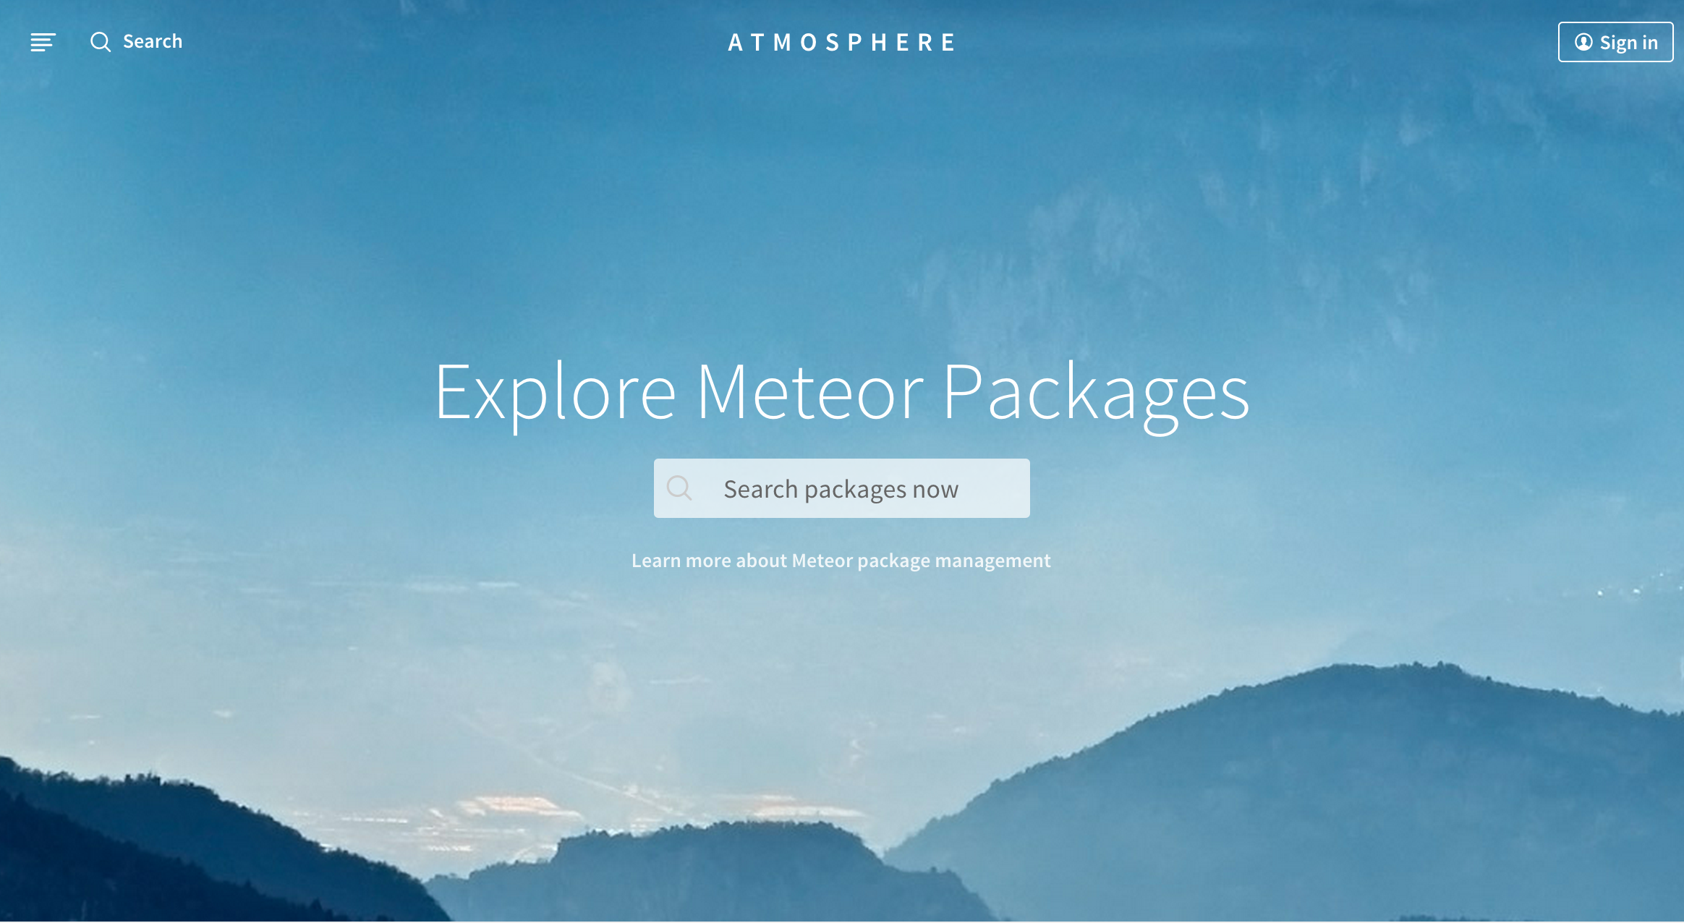
Packages
Shared Packages
Mobile Packages
Client-Side Packages
Routing
iron:router
Data
reactive-var tmeasday:publish-counts
aldeed:collection2
Authentication
accounts-password
Utilities
momentjs:moment
johdirr:meteor-git-rev
mdg:geolocation
mdg:camera
Basics
jquery
mizzao:bootstrap-3
fortawesome:fontawesome
Visualization
peernohell:c3
sergeyt:d3
dburles:googlemaps
Utilities
less
mrt:filesaver http
Server-Side Packages
email
browser-policy
nimble:restivus

