Slide 1
A Pipeline for Open-Weight LLMs in Free Text Classification
Kaizhong Mu
Supervisor: Alyssa Bilinski

Slide 2
CONTENTS
Introduction
Pipeline
Shiny app demo
Findings
Conclusion

Slide 3
INTRODUCTION
Private equity (PE) ownership in healthcare is a growing concern with mixed perceptions among stakeholders, including physicians, patients, and policymakers. Analyzing how these perceptions are expressed in free-text comments can inform regulatory decisions and public debates. However, classifying free text is resource-intensive.

Slide 4
One goal is to explore how to efficiently use ChatGPT-like LLMs to help us analyze PE-related text. In other words, we aim to improve the quality of prompts used in communicating with ChatGPT, so that ChatGPT can better summarize and interpret such text.
Another goal is to explore how those existing LLMs (e.g., ChatGPT, DeepSeek, Gemini, etc ) perform in analyzing the Pe-related text.
To achieve those goals, I develop an automated program/pipeline that can automatically provide the analysis of how far the AI-annotation is different from Ground Truth (human-annotation) for each prompt usage or LLM model usage.

Slide 5
Use Case 1: Exploring High-Quality Prompts With our program, users do not need to repeatedly write code to analyze the difference between AI annotations and human annotations after each change of the prompt. So, the exploration of high-quality prompts through the pipeline — check difference → revise prompt → check difference → revise prompt — becomes faster
Use Case 2: Exploring High-Quality LMM models:
In the future, when we want to explore different LLM models for PE-related text analysis, we won’t need to rewrite the code for comparing each model’s results against the ground truth every time we switch models. I also plan to develop an automated system that can provide comparative performance analyses across multiple LLM models efficiently.

Slide 6


Pipeline
Step 1
Step 2
Step 3
Step 4
Step 5
Web-scraping the comments about PE
Human Annotation
Drafting Prompts for LLM:
LLM Annotation
Compare Human with LLM annotation

Slide 7
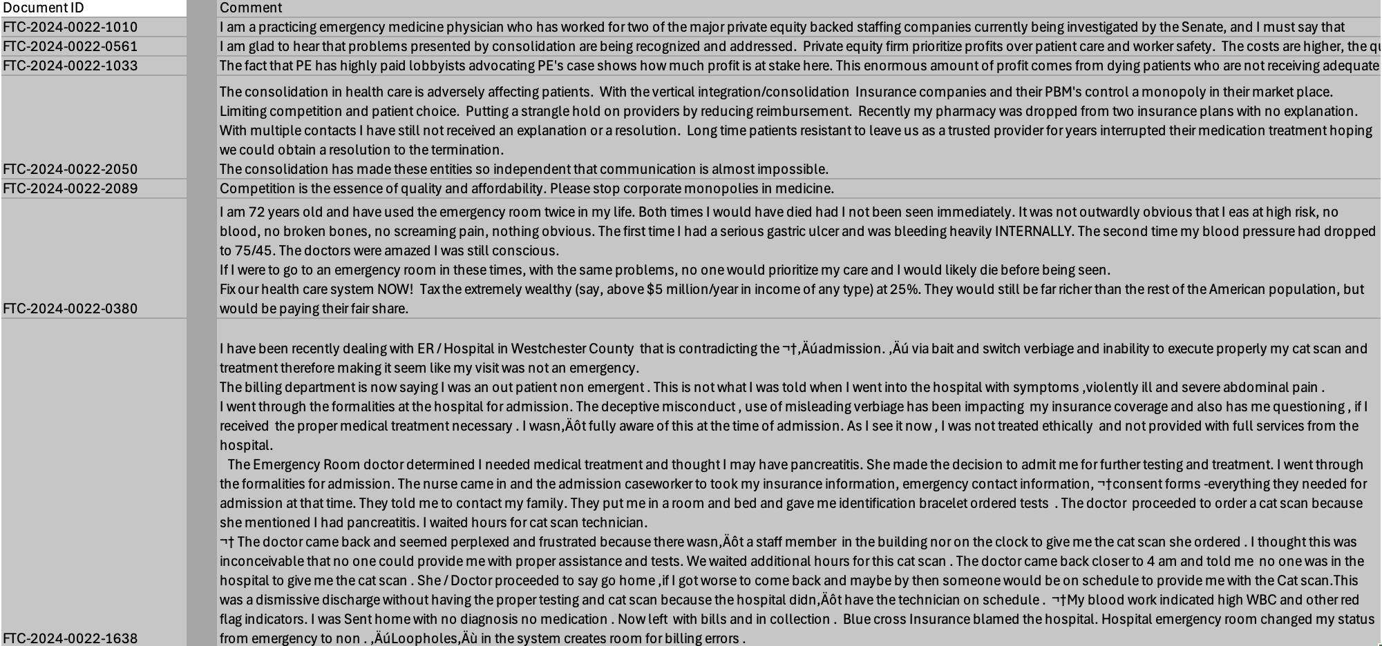
A brief look at the comment

Slide 8
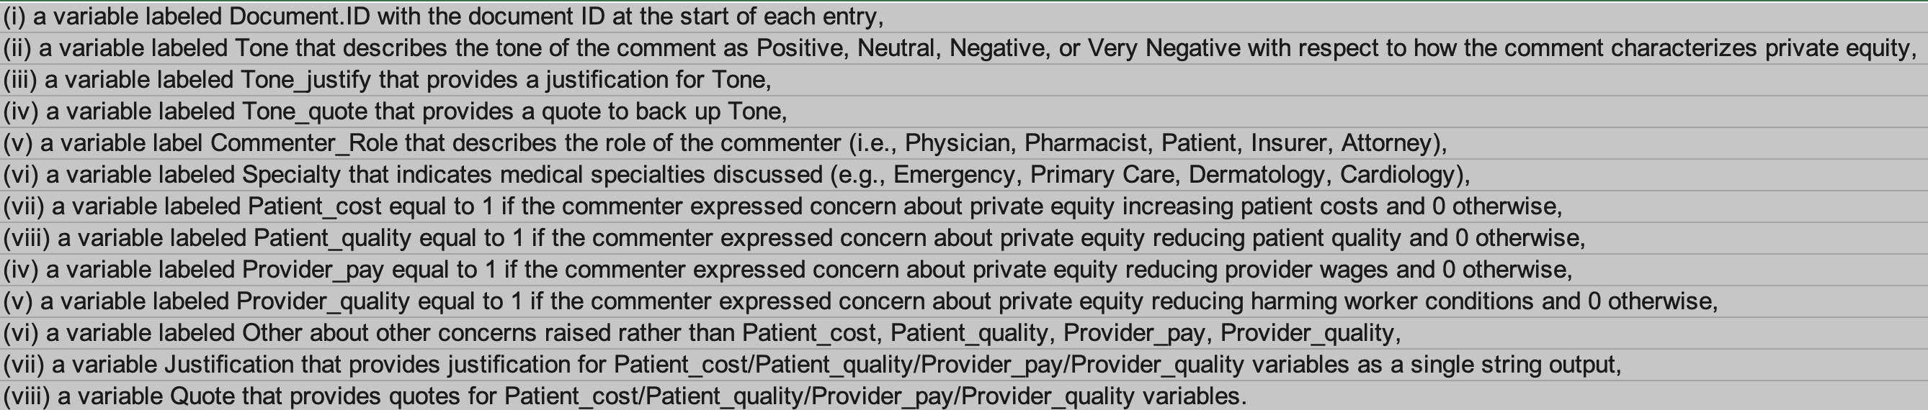
Human-labeled
All the collected comments on PE (Private Equity) were manually reviewed, based on the HUMAN EXPERIENCE and Ground TRUTH. Then, the key information reflected in each review was summarized and manually filled into the following variables below.
At this stage, no AI tools were involved in maintaining clean ground truth data for evaluation

Slide 9
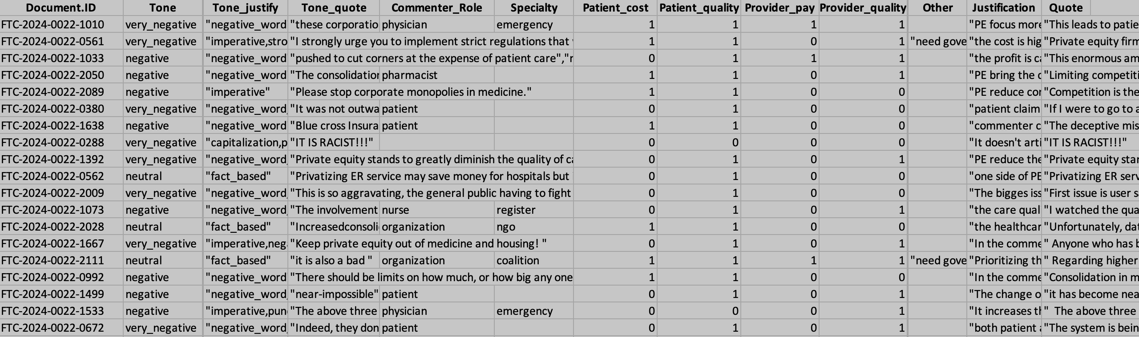
Human-labeled Data

Slide 10
AI-labeled
All the collected comments on PE (Private Equity) were reviewed by LLM based on the prompt. Then, the key information reflected in each review was summarized and filled into the same set of variables as in the human annotation.

Slide 11
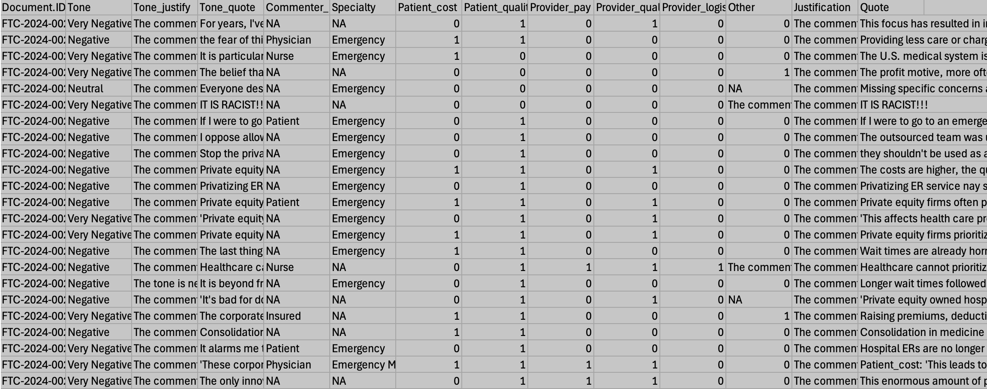
AI-labeled Data

Slide 12
Shiny app demo
demo

Slide 13
Findings

Slide 14
Over-identify
If the prompt doesn’t clearly offer all reasonable options/details, the AI tends to over-guess. The high-quality prompt is important
For example, in identifying the commenter’s role — say, between “Provider” and “Physician” — if we don’t tell the AI that it’s okay to just choose “Provider” when it can’t tell the exact role, it’ll try to guess anyway and might wrongly label it as “Physician.”

Slide 15
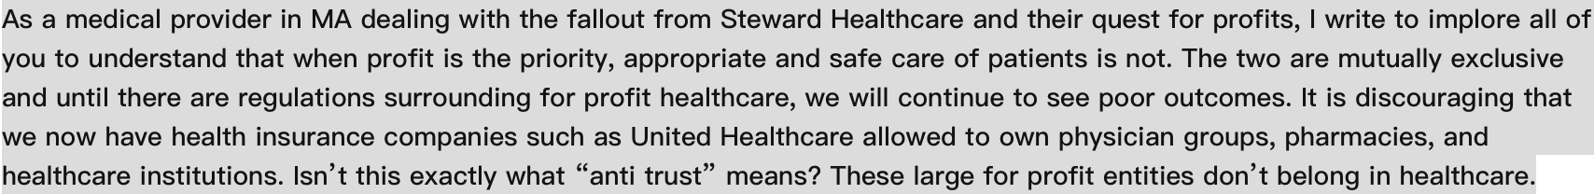
Over-identify
Provider -> Physician case:

Slide 16
Under-identify
GPT tends to assign fewer concerns per comment, often stopping at 0 or 1. In contrast, human annotators are more likely to spot multiple concerns in one comment.
This suggests that GPT’s recall is lower — it may miss relevant issues even when they are present — when analyzing the effect of PE from text.

Slide 17
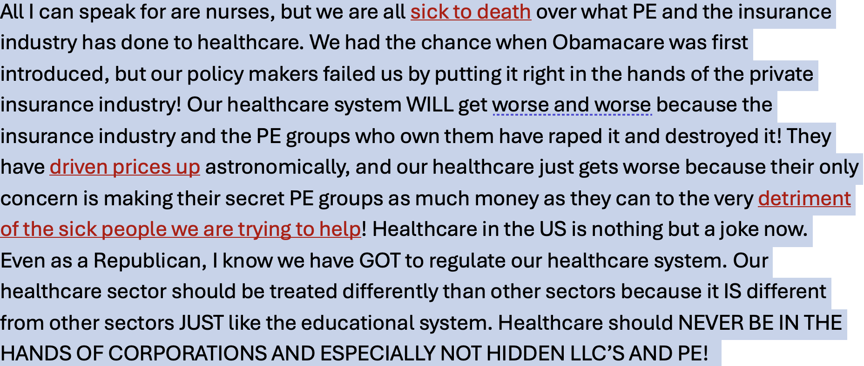
under-identify
Miss concern categories (3->2) case:

Slide 18
conculsion

Slide 19
High-quality prompt matters
A high-quality prompt means clearly explaining your task and expectations to the AI. But to write a good prompt, you first need a deep understanding of the task yourself.
For example, GPT did well on identifying tone, because the prompt gave detailed instructions on how to tell different tone types. On the other hand, it didn’t perform as well on identifying commenter roles, because the prompt is not clear enough(e.g., provider-> physician case)

Slide 20
Parameter-tunning matters
Aside from prompting, the LLM’s poor performance in identifying comments about the effects of private equity might suggest that for certain complex or domain-specific tasks, the model might need fine-tuning or more targeted training to really understand the context.

Slide 21
THANK YOU
Kaizhong Mu
Biostatistics Department, School of Public Health, Brown University
Kaizhong_mu@browm.edu

