Slide 1
IEDA 5230 Deterministic Models in Operations Research
Lecture 9
Fall 2023

Slide 2
Agenda
Review of computational complexity
Concepts of NP-complete
Proof of NP-completeness
Methods for handling NP-hard problems
Dynamic program in pseudo-polynomial time
Approximation
Relaxation

Slide 3
Classification
NP
NP hard
P
NP complete
NP problem
Yes/No answer, able to verify a Yes answer in polynomial time
P problem
able to find an answer in polynomial time
NP complete problem
All NP problems transform, in polynomial time, to an NP complete problem
Implication: NP complete is the most difficult in NP
NP hard
All NP problems reduce, in polynomial time, to an NP hard problem
Interpretation: The optimization version of an NP complete problem

Slide 4
Problem Transformation
Definition
If for every instance A1 of problem A, we can construct in polynomial-time an instance B1 of B, such that A1 has a Yes answer if and only if B1 has a Yes answer, then we say A polynomially transforms to B
Implication
If problem A is NP-complete, and A polynomially transform to problem B, then B is also NP-complete
B (to be proved NPC)
A (known NPC)
B1
A1
B2
A2

Slide 5
Constrained Shortest Path (CSP)
Each arc (j,k) has two cost terms, distance cost c_{jk}, time cost t_{jk}
Find path P from node u to node v, with given constants C and T, such that Σ_{(j,k) in P} c_{jk} ≤ C, and Σ_{(j,k) in P} t_{jk} ≤ T
Partition (known NP complete)
Given n numbers a₁,a₂,…,a_{n}, a₁+a₂+…+a_{n}=b, find set B such that Σ_{ai in B} a_{i} = b/2
Partition transforms to CSP
To define a CSP by using the parameters of Partition
A Yes answer to Partition 1-1 maps to a Yes answer to CSP
(c_{jk}, t_{jk})
(b-a₁,a₁)
1
(b-a₂,a₂)
2
(b-a₃,a₃)
(0, 0)
n
(0, 0)
3
u
v
(b-a₂,a₂)
(b-a₃,a₃)
(b, 0)
(b, 0)
n’
(b, 0)
1’
2’
3’
(0, 0)
(b, 0)
(b, 0)
(0, 0)

Slide 6
Partition transforms to CSP
Step 1. Given an instance of Partition, a₁,a₂,…,a_{n}, we construct an instance of CSP where each a_{j} corresponds to two nodes j and j’,
c_{j-1,j}= c_{j’-1,j} =b-a_{j}, t_{j-1,j}= t_{j’-1,j} =a_{j}, t_{j-1,j’}= t_{j’-1,j’} =b, t_{j-1,j’} = c_{j’-1,j’} =0.
Let the cost bounds C=nb-b/2 and T=b/2.
Step 2. Show that a feasible B corresponds to a feasible CSP
Step 3. Show that a feasible CSP corresponds to a feasible B
Demonstration example
Partition: a₁=5, a₂=7, a₃=12,
hence b=24
Yes answer B={a₁,a₂}
Feasible CSP u,1,2,3’,v
(c_{jk}, t_{jk})
(b-a₁,a₁)
1
(b-a₂,a₂)
2
(b-a₃,a₃)
(0, 0)
3
u
v
(b-a₂,a₂)
(b-a₃,a₃)
(b, 0)
(b, 0)
(b, 0)
1’
2’
3’
(b, 0)
(b, 0)
(0, 0)

Slide 7
Concept Checking
Given TSP is NP-complete
TSP transforms to an Integer Linear Programming (ILP), so ILP is NP-complete (Yes/No?)
Longest Path problem can be formulated by ILP, so Longest Path problem is NP-complete (Yes/No?)
Shortest Path problem can be formulated by ILP, so Shortest Path problem is NP-complete (Yes/No?)

Slide 8
Dynamic Programming for CSP
Assume that all time values t_{ij} are integers
Let d(j,a) be the shortest distance cost from node u to node j subject to condition that the total time cost is no more than a.
Initial condition: d(u,0)=0 and d(j,0)=∞ for j≠u.
Optimal solution: d(v, T)
DP Recursion
d(j, a)=min{ d(j, a-1), min_{k}{ d(k, a-t_{kj})+c_{kj} | k≠j} }
Complexity
O(n²T)
CSP is weakly NP-hard

Slide 9
Parallel Machine Scheduling
There are n jobs to be processed on m machines
Each job j has a processing time p_{j}
In a schedule, each job j will have a completion time C_{j}
Objective: a function of job completion time
Cmax = max{C₁,…,C_{n}}
ΣCj = C₁+…+C_{n}
Example of n=7 jobs and m=3 machines
Processing time p_{j}=(2, 2, 4, 5, 5, 8,9)
C₁=2, C₂=2, C₃=4
C₄=p₁+p₄=7
C₅=7
C₆=12
C₇=16
1
4
7
2
5
3
6

Slide 10
Pm | | Cmax (m machines, min Cmax)
NP-completeness of P2 | | Cmax
Consider a given instance of Partition with n items a₁,a₂,…, a_{n}.
Construct an instance of P2 || Cmax with n jobs,
Processing time p_{j}=a_{j}, j=1,2,…, n.
Objective: a schedule with Cmax no more than (a₁+a₂+…+a_{n})/2?
A feasible solution to Partition, denoted by (A₁, A₂), is equivalent to a feasible schedule for P1 || Cmax
jobs on machine 1 correspond to items in A₁
jobs on machine 2 correspond to items in A₂
Weakly NP-complete
An algorithm for Pm || Cmax in pseudo-polynomial time
A DP in O(nmP^{m}) time, P=p₁+p₂+…+p_{n}

Slide 11
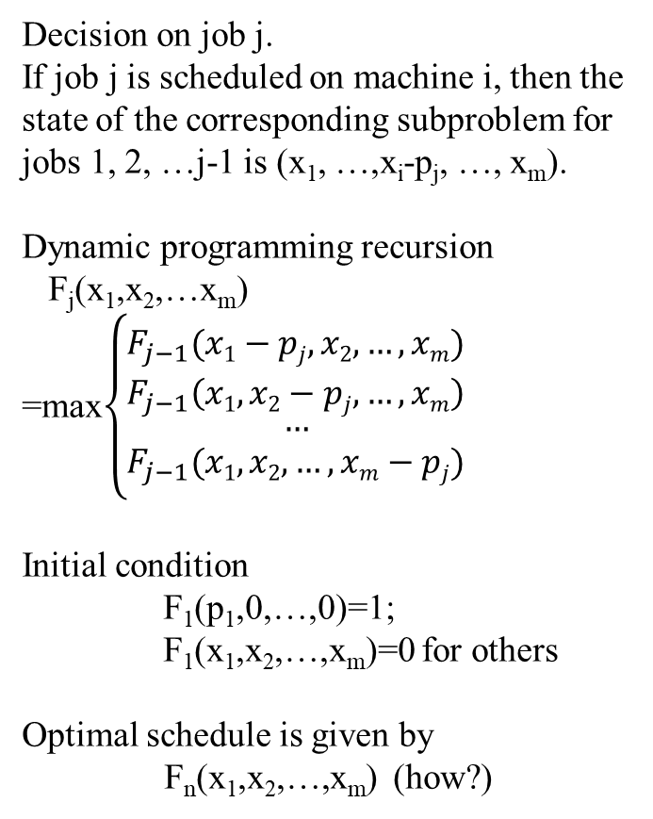
Pm | | Cmax by Dynamic Programming
Stage: j=1, 2, …n
A sub problem for jobs 1, 2, …j
State: (x₁, x₂, …x_{m})
The total processing time of jobs scheduled on machine i, i=1, 2, ..m
Decision
The schedule of job j
Value function:
F_{j}(x₁,x₂,…x_{m}) existence of the state
F_{j}(x₁,x₂,…x_{m}) =1 state existed
F_{j}(x₁,x₂,…x_{m}) =0 for otherwise
Decision on job j.
If job j is scheduled on machine i, then the state of the corresponding subproblem for jobs 1, 2, …j-1 is (x₁, …,x_{i}-p_{j}, …, x_{m}).
Dynamic programming recursion
F_{j}(x₁,x₂,…x_{m})
=max$\left\{\begin{matrix}F_{j−1}(x1−pj,x2,…,xm) \\ F_{j−1}\left(x1,x2−pj,…,xm\right) \\ \begin{aligned}… \\ F_{j−1}(x1,x2,…,xm−pj)\end{aligned}\end{matrix}\right.$
Initial condition
F₁(p₁,0,…,0)=1;
F₁(x₁,x₂,…,x_{m})=0 for others
Optimal schedule is given by
F_{n}(x₁,x₂,…,x_{m}) (how?)
x₁
x₂
x_{m}

Slide 12
Pm | | Cmax by List Scheduling
Algorithm of List Scheduling
Schedule jobs sequentially to the earliest available machine
Evaluation
Let Cmax be the solution of List schedule
Let C* be the optimal solution
Bound 1: Cmax ≤ 2 C*
Bound 2: Cmax ≤ (2-1/m) C*
x₁
x₂
x_{m} p_{k}
Cmax
Assume Cmax is achieved on machine m, and job k is the last job on machine m
Meanomh that there is no idle machine before time Cmax-p_{k}
Bound 1: Cmax = (Cmax – p_{k}) + p_{k} ≤ 2 C*
Bound 2: m(Cmax – p_{k}) + p_{k} ≤ p₁+p₂+…+p_{n} ≤ mC*
Cmax ≤ C*+(1-1/m)p_{k} ≤ (2-1/m) C*

Slide 13
Revisit the Wagner and Whitin Model
Discrete Time Production Planning problem (Dynamic Lot Sizing)
Production cost f_{t}(x_{t})=K+cx_{t} if x_{t}>0, and f_{t}(0)=0
Inventory cost h_{t}(y_{t})=hy_{t}
Solvable in O(T²) by dynamic programming
Production capacity for each period u₁, u₂, …, u_{T}, i.e., x_{t}≤u_{t}
NP-complete, Partition transforms to Capacitated Dynamic Lot Sizing Problem (CDLS)
Ideas of proof: Partition (a₁, a₂,…, a_{n})
→ CDLS of T=n periods with d₁=…=d_{T-1}=0 and d_{T}=B
1
y₁
2
y₂
3
y₃
T-1
T
d₁
d₂
d₃
d_{T-1}
d_{T}

Slide 14
Bounding by Relaxation
For two optimization problems P1and P2
P1: Min{ F(x) | x in X₁}.
P2: Min{ G(x) | x in X₂}.
P2 is called a relaxation of P1 if
(1) X₁ is a subset of X₂, and
(2) F(x)≥G(x) for any x in X₁
P2 gives a lower bound of P1
F(x_{f}*) ≥ G(x_{g}*)

Slide 15
Lagrangian Relaxation (max problem)
For any λ≥0, z_{LR}(λ) is a relaxation of z_{IP}
z_{LR}(λ) ≥ z_{IP}
Any z_{LR}(λ) gives an upper bound of z_{IP}
We are interested in the best λ* so that z_{LR}(λ*) gives the best upper bound
Z_{LD}=min{z_{LR}(λ) | λ ≥0}
The problem is referred to as the Lagrangian Dual

Slide 16
Lagrangian Relaxation
Maximize 4x₁+9x₂+6x₃
Subject to 5x₁+8x₂+6x₃≤12
x₁,x₂,x₃ are binary variables
Lagrangian relaxation Z_{LR}(λ)
Maximize 4x₁+9x₂+6x₃+λ(12-5x₁-8x₂-6x₃)
Subject to x₁,x₂,x₃ are binary variables
For example:
Z_{LR}(0) = 19, Z_{LR}(0.5) = 15.5, Z_{LR}(1) = 13,
Z_{LR}(1.5) = 18, Z_{LR}(2) = 24, ……

Slide 17
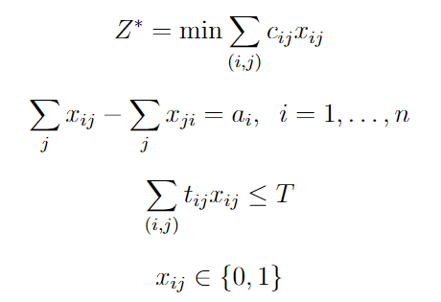
An Example: Constrained Shortest Paths
Given: a network G = (N,A)
c_{ij} cost for arc (i,j)
t_{ij} traversal time for arc (i,j)

Slide 18
Example
Find the shortest path (measured by c_{ij}) from node 1 to node 6 with a transit time (measured by t_{ij}) at most 10
$c_{ij}, t_{ij}
i
j
2
$1,1
4
$1,10
$2,3
$1,7
1
$1,2
$10,1
6
$5,7
$10,3
$2,2
3
5
$12,3

Slide 19
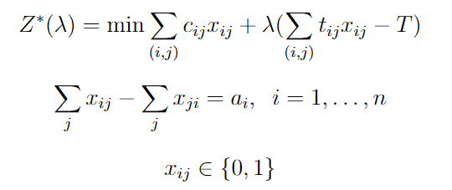
Shortest Paths with Transit Time Restrictions
Lagrangian relaxation: Penalize violation of some constraints in the objective function, and remove those constraints from formulation
Note: z*(λ) ≤ z* ∀λ ≥ 0

Slide 20
What is the effect of varying λ?
Case 1: λ = 0
2
$1,1
4
$1,10
$2,3
$1,7
1
$1,2
$10,1
6
$5,7
2
1
4
$10,3
$2,2
1
3
5
1
2
$12,3
1
1
10
6
5
c_{ij} + λ t_{ij}
i
j
10
2
3
5
12
P = 1-2-4-6
P =
c(P) = 3
c(P) =
t(P) = 18
t(P) =

Slide 21
Let λ = 1
Case 2: λ = 1
2
$1,1
4
$1,10
$2,3
$1,7
1
$1,2
$10,1
6
$5,7
2
2
4
$10,3
$2,2
8
3
5
11
5
$12,3
1
11
6
3
12
13
4
3
5
15
P = 1-2-5-6
P =
c(P) = 5
c(P) =
t(P) = 15
t(P) =

Slide 22
Let λ = 2
Case 3: λ = 2
2
$1,1
4
$1,10
$2,3
$1,7
1
$1,2
$10,1
6
$5,7
2
3
4
$10,3
$2,2
15
3
5
21
8
$12,3
1
12
6
5
19
16
6
3
5
18
P = 1-2-5-6
P =
c(P) = 5
c(P) =
t(P) = 15
t(P) =

Slide 23
And alternative shortest path when λ = 2
2
$1,1
4
$1,10
$2,3
$1,7
1
$1,2
$10,1
6
$5,7
2
3
4
$10,3
$2,2
15
3
5
21
8
$12,3
1
12
6
5
19
16
6
3
5
18
P = 1-3-2-5-6
P =
c(P) = 15
c(P) =
t(P) = 10
t(P) =

Slide 24
Let λ = 5
Case 4: λ = 5
2
$1,1
4
$1,10
$2,3
$1,7
1
$1,2
$10,1
6
$5,7
2
6
4
$10,3
$2,2
36
3
5
51
17
$12,3
1
15
6
11
40
25
12
3
5
27
P = 1-3-5-6
P =
c(P) = 24
c(P) =
t(P) = 8
t(P) =

Slide 25
A parametric analysis
Toll | modified cost | Cost | Transit Time | Modified cost -10λ
0 ≤ λ ≤ ⅔ | 3 + 18λ | 3 | 18 | 3 + 8λ
⅔ ≤ λ ≤ 2 | 5 + 15λ | 5 | 15 | 5 + 5λ
2 ≤ λ ≤ 4.5 | 15 + 10λ | 15 | 10 | 15
4.5 ≤ λ < ∞ | 24 + 8λ | 24 | 8 | 24 - 2λ
A lower bound on z*
The best value of λ is the one that maximizes the lower bound.

Slide 26
Costs
Modified Cost – 10λ
Transit Times
λ
λ

Slide 27
The Lagrangian Multiplier Problem
L* = max {L(λ) : λ ≥ 0}.
Lagrangian Multiplier Problem
Theorem. L(λ) ≤ L* ≤ z*.

Slide 28
Application to constrained shortest path
L(λ) = min
Let c(P) be the cost of path P that satisfies the transit time constraint.
Corollary. For all λ, L(λ) ≤ L* ≤ z* ≤ c(P).
If L(λ’) = c(P), then L(λ’) = L* = z* = c(P). In this case, P is an optimal path and λ’ optimizes the Lagrangian Multiplier Problem.

Slide 29
LP and Lagrangian Relaxation
LP (1) and its Dual (2)
Z* = min{ cx | Ax=b, Dx=e, x≥0} (1)
Z* = max{ ub+ve | uA+vD ≤ c } (2)
optimal solution x* to (1) and (u*, v*) to (2) satisfying
(u*A+v*D – c )x* = 0 (3)
Lagrangian Relaxation of (1)
L(λ) = min{ cx + λ(b – Ax) | Dx=e, x≥0} (4)
Lagrangian Dual problem, find λ*
L(λ*) = max L(λ) = max min{ cx + λ(b – Ax) | Dx=e, x≥0 } (5)
Equivalence of LP dual and Lagrangian dual: u* solves (5), i.e.,
L(u*) = max L(λ) = Z*
------------------------------------------------------------------------------------------------
To explain why u* solves (5), consider L(u*) and its LP dual
L(u*) = min{ (c – u*A)x + u*b) | Dx=e, x≥0} (6)
max{ye | yD ≤ c – u*A } (7)
Let x’ and y’ be the optimal solution to (6) and (7), the complementary slackness
(y’D – (c – u*A))x’=0 or (u*A + y’D – c)x’=0 (8)
Comparing (3) and (8) gives y’=v* and x’=x*, which means x* solves (6). So,
L(u*) = (c – u*A)x* + u*b = v*Dx* + u*b = v*e + u*b = cx*
Given L(λ) is a lower bound of cx* and L(u*)=cx*, it means u* solves (5).

