Slide 1
IEDA 5230
Deterministic Models in Operations Research
Lecture 10
Fall 2023

Slide 2
Agenda
Basic convexity theory
Search algorithm
K-T condition

Slide 3
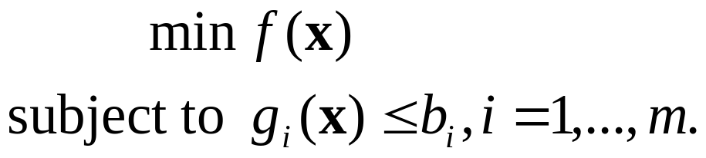
Nonlinear Programming (NLP)
x=(x₁,x₂,…,x_{n}) is an n-dimensional vector
f(x) = f(x₁,x₂,…,x_{n}) is the objective function
g_{i}(x) = g_{i}(x₁,x₂,…,x_{n}) is a constraint
When m=0, the problem is called unconstrained NLP
  The EOQ model
  Linear regression

Slide 4
Local and Global Optima
A local minimum of an NLP is any x’ in the feasible region such that f(x’)≤f(x) for any x in a small neighborhood of x’.
A global minimum of an NLP is any x⁰ in the feasible region such that f(x⁰)≤f(x) for any x in the entire feasible region.
One dimension example
f(x)
x
Local minimum
Global minimum

Slide 5
Convex Function
A function f(x) is convex if and only if
  f(αx₁+(1-α)x₂) ≤ αf(x₁)+(1-α)f(x₂)
for all 0< α <1, and x₁ and x₂ in the feasible region.
One dimension example
f(x)
αf(x₁)+(1-α)f(x₂)
f(αx₁+(1-α)x₂)
x₁
ax₁+(1-a)x₂
x₂
x

Slide 6
Convex Set
A set S of x is convex if for any x₁ and x₂ in S, we have αx₁+(1-α)x₂ must be also in S for any 0<a<1.
One-dimensional example:
  [1,100]: convex set, [1,100]U[200,300]: non-convex set
Two-dimensional examples x=(x₁,x₂)
x₂
Convex sets
Non-convex set
x₁
x₂
x₁

Slide 7
Convex Programming
For an NLP, if its feasible region is a convex set, and the objective is to minimize a convex function, then any local minimum must be a global minimum.
Why convex feasible region is needed?
F(x)
Local minima
x
Feasible region is not convex

Slide 8
Maximizing a Concave Function
What about maximization problem?
  A function f(x) is concave if −f(x) is convex
  For an NLP to maximize a concave function with a convex feasible region, any local maximum must be a global maximum
Note:
  “convex” is used in “convex function” and “convex set” with different meanings
  We do not define “concave set”
f(x)
f(αx1+(1-α)x2)
αf(x1)+(1-α)f(x2)
x₁
ax₁+(1-a)x₂
x₂
x

Slide 9
When a feasible region is convex?
If each g_{i}(x) is a convex function
  the feasible region S={x | g_{i}(x)≤b_{i}, i=1,…,m} is convex
For LP:
  A linear function is both convex and concave
  Feasible region of an LP is convex
  Local optima must be global optima

Slide 10
When a function is convex?
One dimension case
  A function f(x) is convex if its second derivative is nonnegative, f ’’(x)≥0.
  f(x)=2x²+3x+1: f ‘(x)=4x+3, and f ‘‘(x)=4 > 0
  g(x)=x³+3x+1: g‘(x)=3x²+3, and g‘‘(x)=6x,
    g(x) is not convex for -∞<x<+∞
    g(x) is convex for x>0
  A function f(x) is concave if its second derivative is non-positive, f ’’(x)≤0.
  f(x)=-2x²+3x+1: f ‘(x)=-4x+3, and f ‘‘(x)=-4 < 0

Slide 11
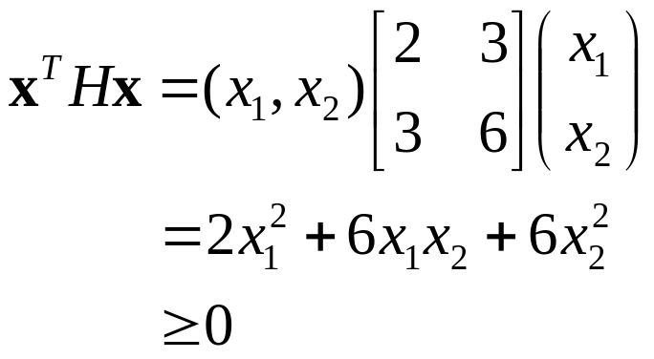
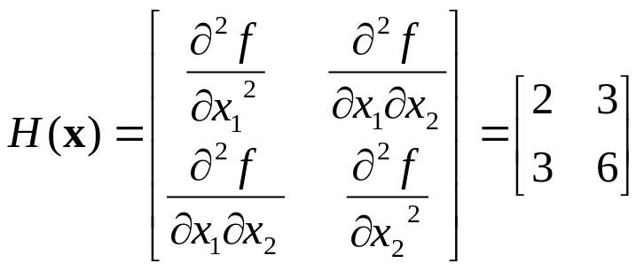
When a function is convex?
Multiple-dimension case
  A function f(x) is convex if its Hessian matrix H(x) is positive semi-definite for all x.
  Hessian matrix H(x) is a nxn matrix of the second partial derivatives of f(x)
  Positive semi-definite means x^{T}Hx≥0 for all x.
Example: f(x)=3x₁x₂+x₁²+3x₂²

Slide 12
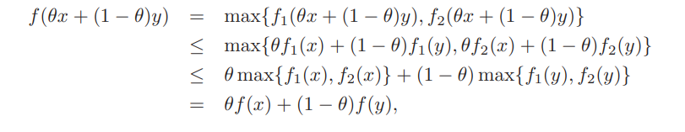
Operations that preserve convexity
Suppose f₁(x), f₂(x), …, f_{m}(x) are convex functions.
  w₁f₁(x) + w₂f₂(x)…+ w_{m}f_{m}(x) is convex if w₁, w₂, ..w_{m} are non-negative constant.
  max{f₁(x), f₂(x)…, f_{m}(x)} is convex
  Proof for the case with m=2, where f(x)=max{f₁(x), f₂(x)}

Slide 13
Compositions that preserve convexity
Consider f(x)=h(g(x))
  f is convex if h is convex and nondecreasing, and g is convex,
  f is convex if h is convex and nonincreasing, and g is concave,
  f is concave if h is concave and nondecreasing, and g is concave,
  f is concave if h is concave and nonincreasing, and g is convex.
Examples
  If h(x) = 1/x, g(x) = ln x, then f(x)= 1/ln x is _convex___
  If h(x)=ln x, g(x)=ln(x), then f(x)=ln ln (x) is _concave___

Slide 14
How to Find the Minimum?
First order necessary condition
  A point x* is a stationary point if f ‘(x)=0.
  A stationary point may be a local minimum, or a local maximum, or neither of them (called saddle point)
Second order sufficient condition
  A stationary point x* is a local minimum if f(x) is convex at the neighborhood of x*, or equivalently, the Hessian of f(x) is positive semi-definite at the neighborhood
  One dimensional case: the sufficient condition is f ‘‘(x) is non-negative

Slide 15
Example
f(x)=8x³+15x²+9x+6
Set f ‘(x)=24x²+30x+9=0, we get two stationary points: x_{a}=-0.5, and x_{b}=-0.75
Consider f ‘‘(x)=48x+30
  For x_{a}=-0.5, f ‘‘(x_{a})=6 > 0, so x_{a} is local minimum
  For x_{b}=-0.75, f ‘‘(x_{b})=-6<0, so x_{b} is local maximum
x_{a}=-0.5 is global minimum if we have a constraint of 48x+30≥0
x_{a}=-0.75 is global maximum if we have a constraint of 48x+30≤0

Slide 16
If f ‘(x) and f ‘‘(x) are unknown,…
A function f(x) is unimodal in the interval [a,b] if
  it has a unique minimum x*,
  f(x) is strictly increasing in [x*,b], and
  f(x) is strictly decreasing in [a,x*]
A (strict) convex function must be unimodal, but a unimodal function may not be convex
f(x)
f(x)
x*
x
x*
x

Slide 17
Observations
For a unimodal function f(x) defined over [a,b]
Let x₁<x₂ be two points in [a, b], compare f(x₁), f(x₂)
  f(x₁)<f(x₂): x* must be in [a, x₂]
  f(x₁)>f(x₂): x* must be in [x₁,b]
  f(x₁)=f(x₂): x* must be in [x₁, x₂]
f(x)
f(x)
f(x)
x₁
x₂
x₁
x₂
x
a
x₁
x₂
a
b
x
a
b
b

Slide 18
Searching Algorithm
Before evaluating f(x₁) and f(x₂), we only know the minimum x* is in [a, b]
After evaluating f(x₁) and f(x₂), we know x* is in a smaller interval than [a, b]
  [a,x₂] or [x₁,b] or[x₁,x₂]
Repeatedly doing this, the interval is reduced step by step, until we achieve the desired accuracy
Different implementations to choose x₁ and x₂ in each iteration

Slide 19
Golden Section Search
Let γ = 0.618
Let x₁=a+(1-γ)(b-a), x₂=a+ γ(b-a)
Repeat the following steps until (b−a) is less than the desired accuracy
  Compare f(x₁) and f(x₂)
  If f(x₁) > f(x₂), let a=x₁, x₁=x₂, and x₂=a+ γ(b-a)
  If f(x₁) ≤ f(x₂), let b=x₂, x₂=x₁, and x₁=a+(1-γ)(b-a)
a
x₁
x₂
b
a
x₂
Interval length is reduced to γ(b-a)
x₁
b
a
x₁
x₂
b

Slide 20
Golden Section Search
The minimum of f(x) must be in final [a,b]
The smaller one of f(x₁) and f(x₂) can be an approximation of the minimum of f(x)
How fast the algorithm is?
  Let L_{k} be the length of interval after the k-th iteration
  L_{k} = γ L_{k-1}, or L_{k}= γ^{k}L₀, where is L₀ is the initial length of the interval [a,b]

Slide 21
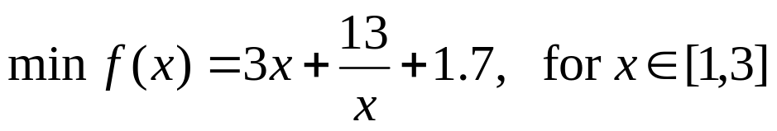
Example
Iteration | a | b | x₁ | x₂ | f(x₁) | f(x₂)
1 | 1 | 3 | 1.7639 | 2.2361 | 14.3617 | 14.2220
2 | 1.7639 | 3 | 2.2361 | 2.5279 | 14.2220 | 14.4263
3 | 1.7639 | 2.5279 | 2.0557 | 2.2361 | 14.1910 | 14.2220
4 | 1.7639 | 2.2361 | 1.9443 | 2.0557 | 14.2191 | 14.1910
5 | 1.9443 | 2.2361 | 2.0557 | 2.1246 | 14.1910 | 14.1926
6 | 1.9443 | 2.1246 | 2.0132 | 2.0557 | 14.1970 | 14.1910

Slide 22
Newton’s Method
Golden Section Search
  For any x_{k}, we need to evaluate f(x_{k})
Newton’s Method:
  For any x_{k}, assume we can evaluate f(x_{k}), f ‘(x_{k}), and f ‘‘(x_{k})
  The motivation of Newton’s Method is to use a quadratic function q(x) to approximate f(x) at point x_{k}
  q(x) = f(x_{k}) + f ‘(x_{k})(x−x_{k})+0.5f ‘‘(x_{k})(x−x_{k})²
  We have
  q(x_{k}) = f(x_{k})
  q‘(x) = f ‘(x_{k})+f ‘‘(x_{k})(x−x_{k}), and q‘(x_{k}) = f ‘(x_{k})
  q‘‘(x) = f ‘‘(x_{k})
  At x_{k}, q(x) and f(x) have the same objective function value, derivative, and second derivative.

Slide 23
Newton’s Method
If we want to minimize q(x), we should find a point x_{k+1} such that
  q‘(x_{k+1}) = f ‘(x_{k})+f ‘‘(x_{k})(x_{k+1}−x_{k})=0
  i.e.,
  x_{k+1}= x_{k} − f ‘(x_{k}) / f ‘‘(x_{k})
Newton’s Method
  Start from an initial point x₀, and calculate x_{k+1} from x_{k} until the series converges.

Slide 24
Example
x_{k+1}= x_{k} − f ‘(x_{k}) / f ‘‘(x_{k})
Iteration No. | x | f(x) | f'(x) | f''(x)
1 | 2 | 14.2 | -0.25 | 3.25
2 | 2.076923 | 14.190028 | -0.01372 | 2.902098
3 | 2.08165 | 14.189996 | -4.7E-05 | 2.882374
4 | 2.081666 | 14.189996 | -5.4E-10 | 2.882307
5 | 2.081666 | 14.189996 | 0 | 2.882307

Slide 25
Global Optimization
If the objective function is not unimodal, local minimum may not be global minimum
Either Golden Section Search, or Newton’s method may terminate at a local minimum
To find the global minimum, we can start from different initial points, and hopefully different local minimum can be found each time

Slide 26
Multi-start Searching

Slide 27
General Descent Algorithm
Observation from Newton’s Algorithm
  x_{k+1}= x_{k} − f ‘(x_{k}) / f ‘‘(x_{k})
When moving from x_{k} to x_{k+1},
  f ‘(x_{k}) gives the moving direction, i.e., x_{k} should be increased or decreased
    f ‘‘(x_{k}) is always positive for a convex function
  f ‘‘(x_{k}) determines how far to move along the direction
This will lead to a general descent algorithm for a minimization problem
  x_{k+1} = x_{k} – t_{k} d_{k} where d_{k} is an increasing direction, and t_{k} is step size

Slide 28
Steepest Descent
For minimizing a multivariable function f(x)
Let g(x) be its partial derivative (gradient)
g(x)=(∂f/∂x₁, ∂f/∂x₂,…, ∂f/∂x_{n})
Choose a start point x⁰
Let x^{k+1}= x^{k} – t_{k} g(x^{k}), where t_{k} is found by minimizing f(x^{k} – t_{k} g(x^{k}))
  This is a one-dimensional minimization problem
  t_{k} minimizes f(x) along the g(x^{k}) direction by moving as far as possible

Slide 29
Example of Steepest Descent
f(x₁,x₂)=32 – 8x₁ – 16x₂ + x₁² + 4x₂²
Gradient g(x₁,x₂) = (2x₁– 8, 8x₂ – 16)
Start point x⁰=(0,0), when determining x¹, we have g(x₁,x₂)=(–8, –16).
To get the step size t₀, we minimize
  f(x⁰–t g(x⁰) ) = f(8t, 16t)=64(17t²–5t)
Thus the step size t₀= 5/34 = 0.147
  So x¹= (0.147*8, 0.147*16) = (1.176, 2.352)
We continue to find x², x³, …

Slide 30
minimize | f(x)=32-8x1-16x2+x1^2+4x2^2
k | x1 | x2 | f(x1,x2) | g(x1) | g(x2) | t
0 | 0 | 0 | 32 | -8 | -16 | 0.147
1 | 1.176 | 2.352 | 8.470592 | -5.648 | 2.816 | 0.313
2 | 2.943824 | 1.470592 | 2.236599 | -2.11235 | -4.23526 | 0.147
3 | 3.25434 | 2.093176 | 0.590736 | -1.49132 | 0.745406 | 0.313
4 | 3.721123 | 1.859864 | 0.156325 | -0.55775 | -1.12109 | 0.147
5 | 3.803113 | 2.024664 | 0.041198 | -0.39377 | 0.197312 | 0.313
6 | 3.926364 | 1.962905 | 0.010926 | -0.14727 | -0.29676 | 0.147
7 | 3.948013 | 2.006529 | 0.002873 | -0.10397 | 0.052229 | 0.313
8 | 3.980557 | 1.990181 | 0.000764 | -0.03889 | -0.07855 | 0.147
9 | 3.986273 | 2.001728 | 0.0002 | -0.02745 | 0.013825 | 0.313
10 | 3.994866 | 1.997401 | 5.34E-05 | -0.01027 | -0.02079 | 0.147

Slide 31
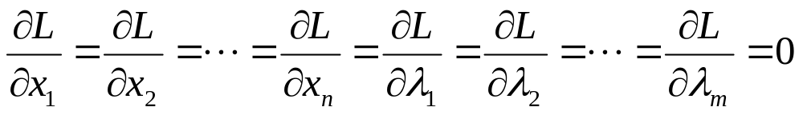
NLP with Equality Constraints
Minimize f(x) subject to g_{i}(x)=0 for i=1,…,m
  f(x) and g_{i}(x) are twice differentiable
Define Lagrangian function
L(x,λ)= f(x)+ λ₁g₁(x)+λ₂g₂(x)+…+λ_{m}g_{m}(x)
  Where λ=(λ₁, λ₂,…, λ_{m})
  So we have defined an unconstrained NLP to minimize L(x,λ)
  The necessary condition of a stationary point is

Slide 32
Example
Minimize f(x₁,x₂)=3x₁²+x₂² subject to x₁+x₂=6
Lagrangian function
  L(x₁,x₂,λ)=3x₁²+x₂²+ λ(x₁+x₂−6)
First order condition
  6x₁+λ=0, 2x₂+λ=0, x₁+x₂−6=0
  Solution: x₁=1.5, x₂=4.5, λ=−9
  f(x₁,x₂)=27
Is (x₁=1.5, x₂=4.5) a local or global minimum?
  f(x₁,x₂) is convex, feasible region is a convex region
  So, (x₁=1.5, x₂=4.5) is a global minimum.

Slide 33
Understanding Lagrangian Multiplier
Minimize f(x₁,x₂)=3x₁²+x₂² subject to x₁+x₂=6+δ
Lagrangian function
  L(x₁,x₂,λ)=3x₁²+x₂²+ λ(x₁+x₂−6−δ)
First order condition
  6x₁+λ=0, 2x₂+λ=0, x₁+x₂−6−δ=0
  Solution: x₁=1.5+0.25δ, x₂=4.5+0.75δ, λ=−9−1.5 δ
  Min f(x₁,x₂)=0.75(6+ δ)²
The changing rate of min f(x₁,x₂) with δ is 1.5(6+ δ)
  At δ=0, λ=−9: when δ increases by a small amount, the objective function changes at the rate of 9

Slide 34
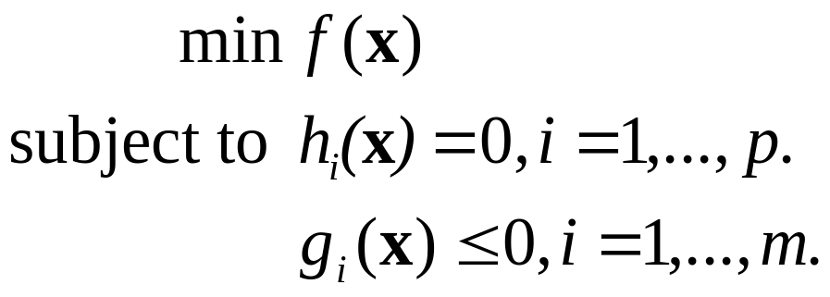
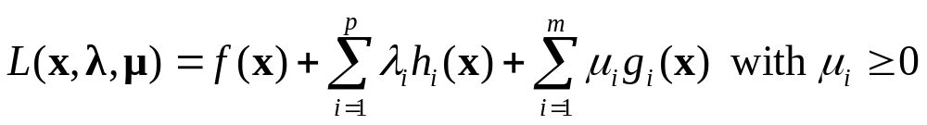
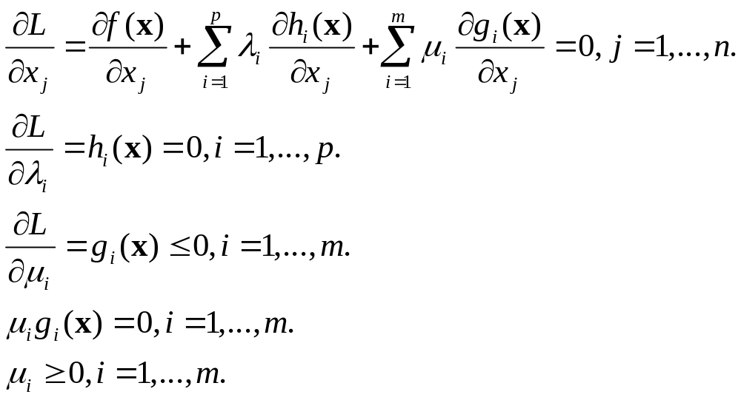
NLP with Inequality Constraints
Lagrangian function
Kuhn-Tucker necessary conditions:

Slide 35
Example
Minimize f(x₁,x₂)=3x₁²+x₂² subject to x₁+x₂≥6
Lagrangian function
  L(x₁,x₂, μ)=3x₁²+x₂²+ μ(6-x₁-x₂)
K-T conditions
  6x₁-μ=0, 2x₂-μ=0, x₁+x₂≥6, μ(6-x₁-x₂)=0, μ≥0
  Solution: x₁=1.5, x₂=4.5, μ=9
  f(x₁,x₂)=27
What about if the constraint is x₁+x₂≤6?
  Optimal solution x₁=0, x₂=0, (μ=0)

Slide 36
More Examples
Min f(x₁,x₂)=2(x₁+1)²+3(x₂−4)²
Subject to x₁²+ x₂² ≤ 9, x₁+ x₂ ≥ 2
L(x₁,x₂,μ₁,μ₂)
=2(x₁+1)²+3(x₂−4)²+ μ₁(x₁²+ x₂²− 9)+μ₂(− x₁ − x₂ + 2)
K-T conditions
  4(x₁+1)+μ₁(2x₁) −μ₂= 0, 6(x₂ −4)+μ₁(2x₂) −μ₂= 0,
  x₁²+ x₂² ≤ 9, x₁+ x₂ ≥ 2
  μ₁(x₁²+ x₂² − 9)=0, μ₂(− x₁ − x₂ + 2)=0,
  μ₁≥0, μ₂≥0
Solutions x₁=-0.646, x₂=2.9297, μ₁=1.097, μ₂=0.
  There are 4 cases to consider with respect to μ₁ and μ₂

Slide 37
More on Constrained NLP
K-T conditions hold under certain regularity conditions
Solving the K-T condition may not be easy
  Any Lagrangian multiplier may be 0 or positive
  Links to integer programming
Lagrangian multipliers can be regarded as the shadow price of a constraint
  Similar to the duality theory in LP

