Slide 1
IEDA 5230 Deterministic Models in Operations Research Lecture 4
Fall 2023

Slide 2
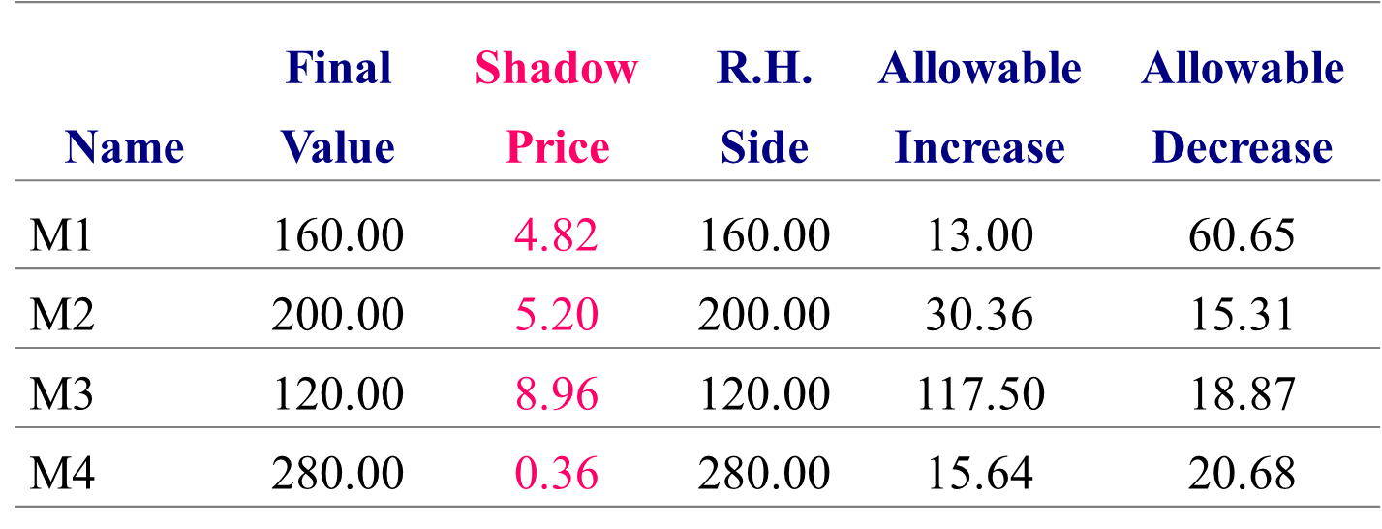
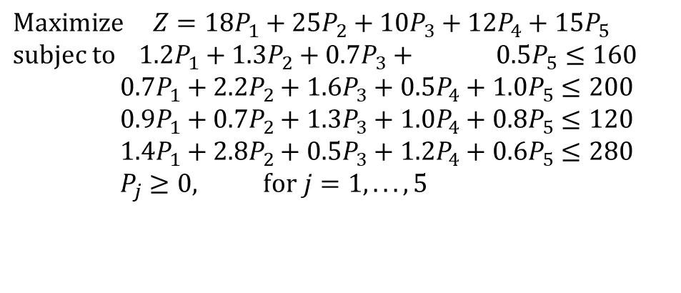
Review 1: Constraint Analysis & Shadow Price
$$\text{Maximize} Z=18P_{1}+25P_{2}+10P_{3}+12P_{4}+15P_{5} \\ \text{subjec} \text{to} 1.2P_{1}+1.3P_{2}+0.7P_{3}+ 0.5P_{5}≤160 \\ 0.7P_{1}+2.2P_{2}+1.6P_{3}+0.5P_{4}+1.0P_{5}≤200 \\ 0.9P_{1}+0.7P_{2}+1.3P_{3}+1.0P_{4}+0.8P_{5}≤120 \\ 1.4P_{1}+2.8P_{2}+0.5P_{3}+1.2P_{4}+0.6P_{5}≤280 \\ P_{j}≥0, \text{for} j=1,...,5$$
Shadow Price indicates the marginal objective function value change when the right-hard side of each constraint changes.

Slide 3
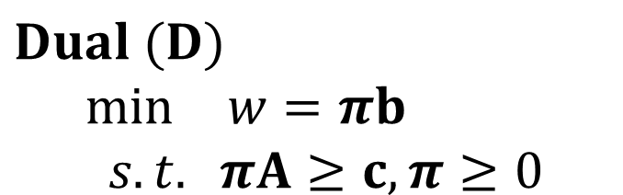
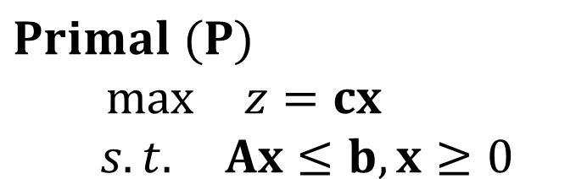
Review 2: LP Duality
$$Primal (P)$$
$\max{ } z=cx$ $$s.t. Ax≤b,x≥0$$
$$Dual (D)$$
$\min{ } w=πb$ $$s.t. πA≥c,π≥0$$
The dual of (D) is (P)
Weak duality: for any feasible x and π, z ≤ w
Strong duality: for optimal x* and π*, z = w

Slide 4
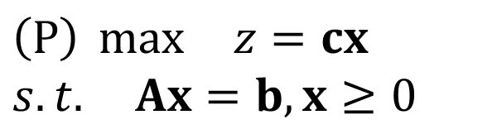
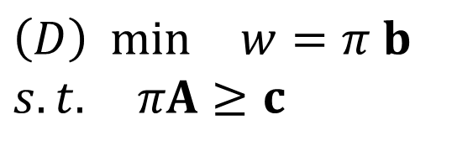
Strong Duality with (P) in standard form
$$\left(P\right) \max{ } z=cx \\ s.t. Ax=b,x≥0$$
$$\left(D\right) min{ } w=π b \\ s.t. πA≥c$$
For primal, suppose x*=(x_{B},x_{N}) is an optimal solution
Reduced cost for non-basic variables ≥0
c_{B}B⁻¹N−c_{N} ≥0, c_{B}B⁻¹N ≥ c_{N}
Let π=c_{B}B⁻¹, we have
πA= π(B N)=(c_{B}, c_{B}B⁻¹N) ≥ (c_{B}, c_{N})=c
π is feasible to the dual
πb=c_{B}B⁻¹b=c_{B}x_{B}=cx*
π is optimal to the dual
Implication of z*=w* on shadow price
Shadow price of (P): the marginal increase of z* change when b changes
From the proof, z*=c_{B}B⁻¹b, shadow price is given by c_{B}B⁻¹
This is exactly the optimal solution to (D) constructed in the proof
Shadow price of a constraint is the optimal dual variable

Slide 5
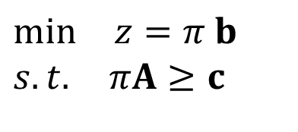
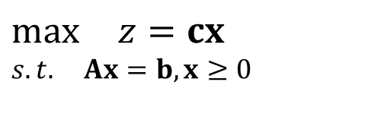
Complementary Slackness
$$\max{ } z=cx \\ s.t. Ax=b,x≥0$$
$$\min{ } z=π b \\ s.t. πA≥c$$
For any feasible solution x to the primal and π to the dual, they both are optimal solutions if and only if for any i,
1) x_{i} >0 → (πA)_{i}=c_{i}
2) x_{i}=0 ← (πA)_{i} > c_{i} (why leftarrow? If xi is basic variable, piA=c, is non-basic,>)
Proof: If 1) and 2) are true, we have ((πA)_{i} – c_{i}) x_{i}=0 for all i. Then (πA – c) x=0.
That means πAx =cx, or πb=cx (why?). From strong duality, both x and π are optimal.
If x and π are optimal, we have πb=cx and (πA- c)x=0, which implies 1) and 2). (why?)

Slide 6
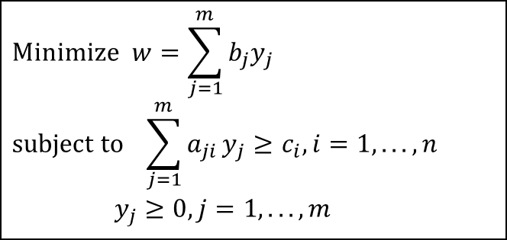
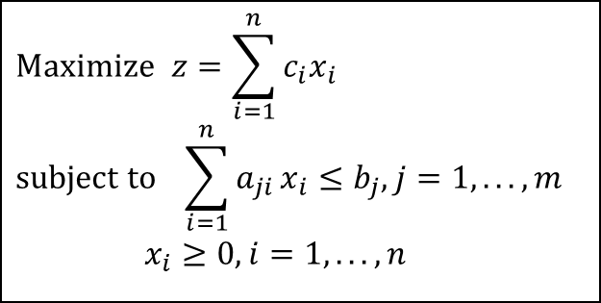
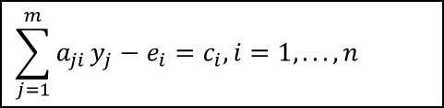
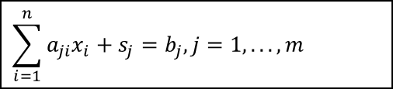
Complementary Slackness (Different form)
$$\text{Maximize} z=\sum_{i=1}^{n}{c_{i}x_{i}} \\ \text{subject} \text{to} \sum_{i=1}^{n}{a_{ji}}x_{i}≤b_{j},j=1,...,m \\ x_{i}≥0,i=1,...,n$$
$$\text{Minimize} w=\sum_{j=1}^{m}{b_{j}y_{j}} \\ \text{subject} \text{to} \sum_{j=1}^{m}{a_{ji}}y_{j}≥c_{i},i=1,...,n \\ y_{j}≥0,j=1,...,m$$
Define Slack variables for both Primal (s_{j}) and Dual (e_{i}):
$$\sum_{i=1}^{n}{a_{ji}x_{i}}+s_{j}=b_{j},j=1,...,m$$
$$\sum_{j=1}^{m}{a_{ji}}y_{j}−e_{i}=c_{i},i=1,...,n$$
Theorem. The solution of (x₁,…,x_{n},s₁,…,s_{m}) is optimal to the Primal and (y₁,…,y_{m},e₁,…,e_{n}) is optimal to the Dual if and only if
(1) s_{j}y_{j}=0 for all j; and (2) e_{i}x_{i}=0 for all i.

Slide 7
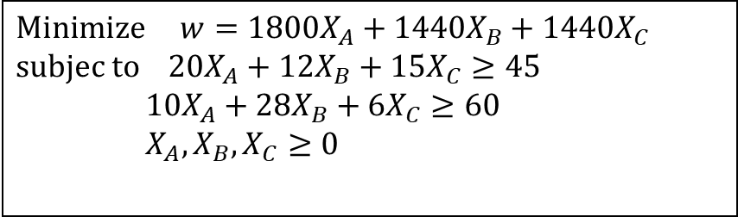
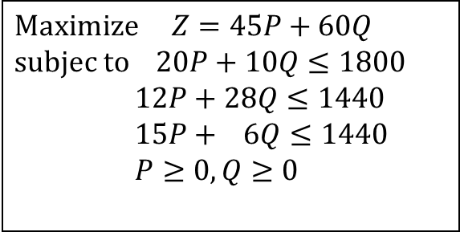
Interpretation and Example
If in an optimal solution of the Primal, a constraint is not tight (slack variable >0 ), then in the optimal solution of the Dual, the corresponding variable must be 0
$$\text{Maximize} Z=45P+60Q \\ \text{subjec} \text{to} 20P+10Q≤1800 \\ 12P+28Q≤1440 \\ 15P+ 6Q≤1440 \\ P≥0,Q≥0$$
$$\text{Minimize} w=1800X_{A}+1440X_{B}+1440X_{C} \\ \text{subjec} \text{to} 20X_{A}+12X_{B}+15X_{C}≥45 \\ 10X_{A}+28X_{B}+6X_{C}≥60 \\ X_{A},X_{B},X_{C}≥0$$
P*=81.82,Q*=16.36,Z*=4663
20P+10Q=1800
12P+28Q=1440
15P+ 6Q=1325<1440
X_{A}=1.228, X_{B}=1.705, X_{C}=0,w*=4663
20X_{A}+12X_{B}+12X_{C}=45
10X_{A}+28X_{B}+6X_{C}=60

Slide 8
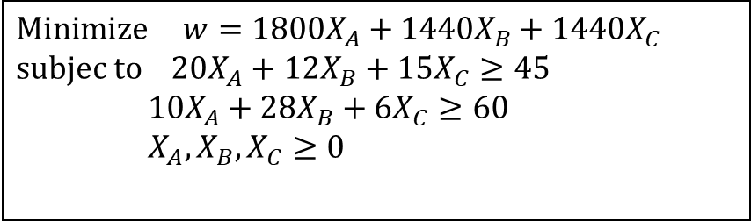
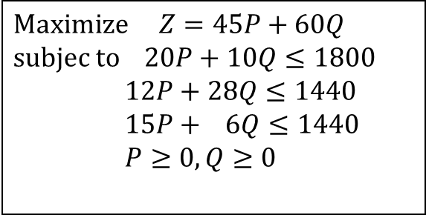
Another Economic Meaning of Duality
$$\text{Maximize} Z=45P+60Q \\ \text{subjec} \text{to} 20P+10Q≤1800 \\ 12P+28Q≤1440 \\ 15P+ 6Q≤1440 \\ P≥0,Q≥0$$
$$\text{Minimize} w=1800X_{A}+1440X_{B}+1440X_{C} \\ \text{subjec} \text{to} 20X_{A}+12X_{B}+15X_{C}≥45 \\ 10X_{A}+28X_{B}+6X_{C}≥60 \\ X_{A},X_{B},X_{C}≥0$$
P*=81.82, Q*=16.36, Z*=4663
20P+10Q=1800 (Shadow price = 1.228)
12P+28Q=1440 (shadow price=1.705)
15P+ 6Q=1325<1440 (shadow price=0)
X_{A}=1.228, X_{B}=1.705, X_{C}=0, w*=4663
20X_{A}+12X_{B}+12X_{C}=45 (Shadow price=81.82)
10X_{A}+28X_{B}+6X_{C}=60 (shadow price=16.36)

Slide 9
A Transportation Problem
Three production plants serving four markets
Unit transportation cost c_{ij}
Transportation decision x_{ij}
Total transportation cost Σc_{ij}x_{ij}
Example with given supply and demand
20 10 25
1
5
2
3
1
2
3
3
7
6
9
4
14*4
1
1
9*3
2*3
8*1
11*4
6
4
5
11*1
3
4
5
6
7
4
5
6
7
Cost structure c_{ij}
11 13 17 14
Total cost=152

Slide 10
How much cost will it increase?
The workload is increased. Let us estimate the new cost.
20 10 25
20 12 25
1
5
2
3
1
5
2
3
3
7
6
9
4
3
7
6
9
4
1
1
4
5
1
1
4
5
6
3
6
3
4
5
6
7
4
5
6
7
11 13 17 14
13 13 17 14
(a)
Cost=152
(b)
Cost= ???

Slide 11
Transportation Problem
We wish to ship goods (all identical) from
m warehouses to n destinations.
warehouses
Supply
Markets
Demand
San Francisco
350
New York
325
Warehouse i has s_{i} units available i = 1, …, m
destination j has a demand of d_{j}, j = 1, …,n.
Unit shipping cost from warehouse i to destination j is c_{ij}
Los Angeles
600
Chicago
300
Austin
275
Unit Shipping Costs
From/To
NY
Chicago
Austin
SF
2.5
1.7
1.8
LA
2.2
1.8
1.4
325
NY
325
350
SF
25
0
CHI
300
0
275
AUS
275
600
LA
275

Slide 12
Total supply = 950, total demand = 900
Not balanced
To maintain balance, we can create
a dummy destination with a demand of 50
a dummy arc with unit cost of 0
LP formulation
Variables
Shipping quantity x_{ij}: from supplier i to destination j
Objective function
Min 2.5x_{SN}+ 1.7x_{SC}+ 1.8x_{SA}+ 2.2x_{LN}+ 1.8x_{LC}+1.4 x_{LA}
Constraints
SF: x_{SN}+x_{SC}+x_{SA}+x_{SD} = 350
LA: x_{LN}+x_{LC}+x_{LA}+x_{LD} = 600
NY: x_{SN}+x_{LN} = 325
CHI: x_{SC}+x_{LC} = 300
AUS: x_{SA}+x_{LA} = 275
DUM: x_{SD}+x_{LD} = 50
325
NY
25
325
SF
0
350
0
CHI
300
0
275
275
AUS
LA
275
600
50
DUM
50
If the total supply is less than the total demand, how can we model the situation?

Slide 13
Each destination has an additional optional demand of 30
The unit value of the optional demand at the three cities, e_{NY} , e_{CHI}, e_{AUS}.
Question: what is the optimal schedule considering
transportation cost
value from satisfying the optional demand?
Transport cost – optional Demand value
NY’
30
NY
325
SF
350
CHI’
30
CHI
300
LA
AUS’
30
600
AUS
275
40
DUM
This model has an implicit assumption. Find it out!

Slide 14
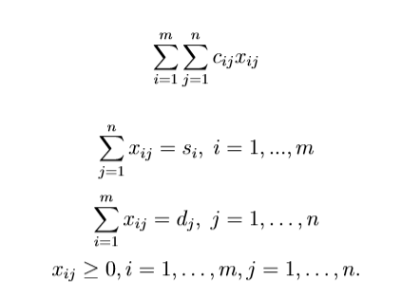
Transportation Problem
Problem statement
a set of sources with known supplying capacity: s_{i}
a set of destinations with known demand: d_{j}
unit cost for each pair of (source, destination): c_{ij}
Decision
a transportation plan x_{ij} with the minimum cost: Σc_{ij} x_{ij}

Slide 15
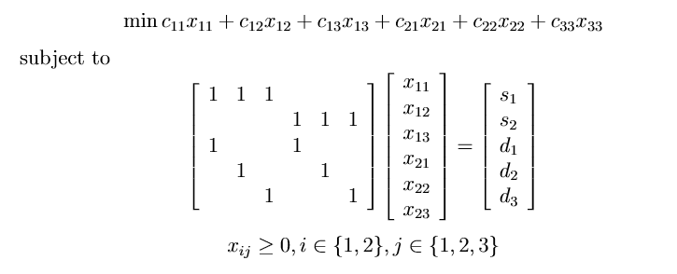
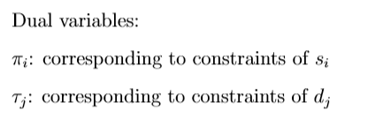
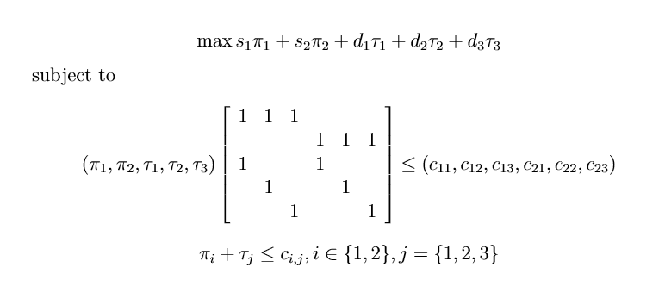
Duality of Transportation Problem: An Example
π₁ + τ₁ ≤ c₁₁, π₁ + τ₂ ≤ c₁₂, π₁ + τ₃ ≤ c₁₃,
π₂ + τ₁ ≤ c₂₁, π₂ + τ₂ ≤ c₂₂, π₂ + τ₃ ≤ c₂₃,

Slide 16
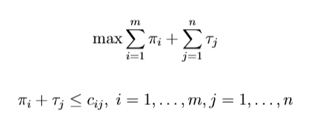
General Form of Duality of Transportation Problems
Subject to
Subject to
Interpretation of the dual problem:
Pay π_{i}s_{i} at supply site i and τ_{j}d_{j} at demand site j.
Duality can be used to solve a cooperative game of transportation problems.

Slide 17
Example of Cooperative Game
There are 3 players, each having a job to do
The cost of each working individually
V({1}) = V({2}) = V({3}) = 10
The cost of any two working collaboratively
V({1,2}) = V({1,3}) = V({2,3}) = 14
The cost of all three working collaboratively
V({1,2,3}) = 18
Question: are the three willing to work collaboratively?
We need a way of sharing the cost V({1,2,3}) = 18 among the players
How about the following ways of sharing cost?
{6,6,6}
{7,7,4}
{8,6,4}
{4,4,10},…

Slide 18
The Formulation
We need a way of sharing the cost V({1,2,3}) = 18 among the players,{x₁, x₂, x₃}, satisfying
x₁ ≤ 10,
x₂ ≤ 10,
x₃ ≤ 10,
x₁ + x₂ ≤ 14,
x₁ + x₃ ≤ 14,
x₂ + x₃ ≤ 14,
x₁+x₂+x₃ = 18.
All are feasible solutions
{6,6,6}, {7,7,4}, {8,6,4},{4,4,10},…
They are said to be in the core of the game

Slide 19
The Core may be empty
Suppose that
V({1}) = V({2}) = V({3}) = 10
V({1,2}) = V({1,3}) = V({2,3}) = 14
V({1,2,3}) = 22
Then we can verify that there is no feasible solution to the following constraints
x₁ ≤ 10, x₂ ≤ 10, x₃ ≤ 10,
x₁ + x₂ ≤ 14, x₁ + x₃ ≤ 14, x₂ + x₃ ≤ 14
x₁+x₂+x₃ = 22
For example, consider
an allocation (7,7,8), then players 2 and 3 share a cost > V({2,3})
an allocation (8,6,8), then players 1 and 3 share a cost > V({1,3})

Slide 20
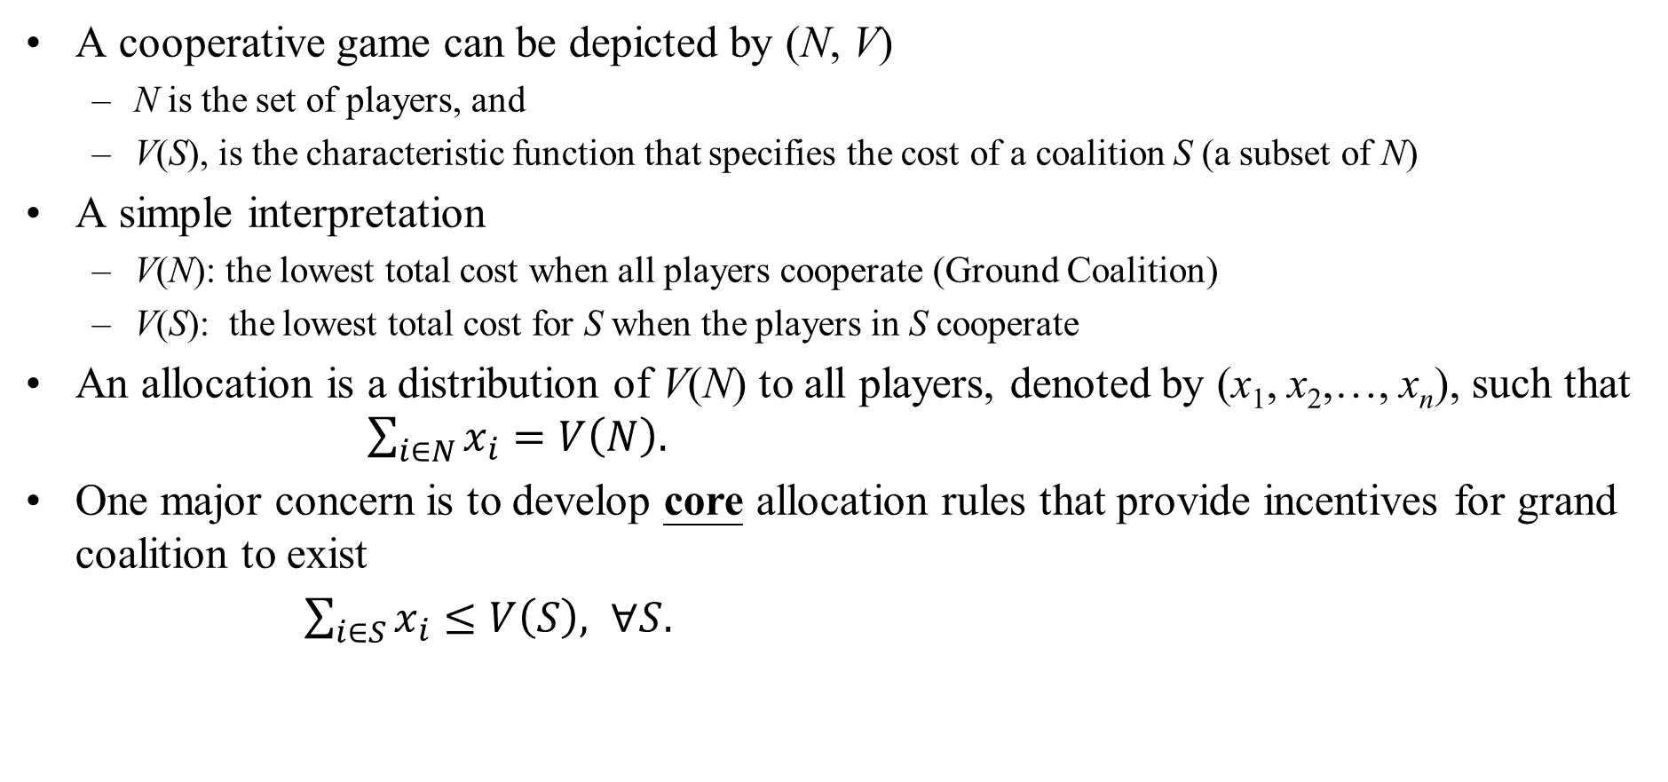
Concepts in Cooperative Game
A cooperative game can be depicted by (N, V)
N is the set of players, and
V(S), is the characteristic function that specifies the cost of a coalition S (a subset of N)
A simple interpretation
V(N): the lowest total cost when all players cooperate (Ground Coalition)
V(S): the lowest total cost for S when the players in S cooperate
An allocation is a distribution of V(N) to all players, denoted by (x₁, x₂,…, x_{n}), such that $\sum_{i∈N}{x_{i}=V\left(N\right).}$
One major concern is to develop core allocation rules that provide incentives for grand coalition to exist
$\sum_{i∈S}{x_{i}≤V\left(S\right), ∀S.}$
Notes:
₂₀

Slide 21
A Transportation Problem
8
8
C_{ij} | 1 | 2 | 3 | 4
1 | 3 | 3 | 4 | 4
2 | 7 | 5 | 6 | 7
3 | 6 | 6 | 2 | 2
10
2
7
7
25
10
10
8
10
20
Firm 1, the optimal transportation plan with cost of 203
A transportation problem faced by firm 1
From 3 supply sites to 4 markets
Given the supply and demand
The unit transportation cost c_{ij}

Slide 22
Transportation plan for two firms, and their coalition
8
10
18
8
20
18
10
2
7
20
25
30
2
32
7
5
30
25
10
5
30
10
10
10
5
5
15
8
15
10
20
30
20
5
5
15
25
Firm 1, cost=203
Firm 2, cost=165
The cost of the optimal transportation plan for the two firms is 310
By coalition, the two firms save cost:
203+165-310=58
How do they share the saving?

Slide 23
When there are 4 firms
8
10
8
8
2
10
20
2
7
20
25
5
3
8
7
5
5
25
10
5
5
10
10
5
5
6
8
8
8
10
20
20
20
5
5
6
6
Firm 1, cost=203
Firm 2, cost=165
Firm 3, cost=104
6
32
32
4
6
35
1
46
6
45
2
10
45
2
9
9
32
30
20
70
9
9
40
40
Firm 4, cost=106
Grand coalition cost=472
Try to design a cost allocation among the 4 firms

Slide 24
The cost for all possible coalitions
Cost of different coalitions
{1} | {2} | {3} | {4}
203 | 165 | 104 | 106
{1,2} | {1,3} | {1,4} | {2,3} | {2,4} | {3,4}
310 | 271 | 291 | 269 | 263 | 204
{1,2,3} | {1,2,4} | {1,3,4} | {2,3,4}
384 | 398 | 371 | 367
{1,2,3,4}
472
What is the number of coalitions?

Slide 25
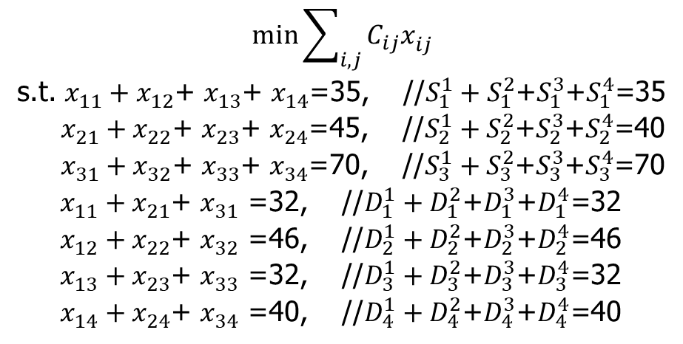
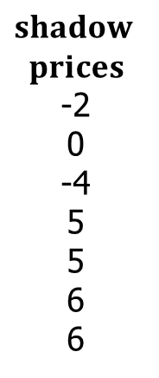
LP for the grand coalition
$$\min{\sum_{i,j}{C_{ij}x_{ij}^{}}}$$
s.t. $x_{11}^{}+x_{12}^{}$+ $x_{13}^{}$+ $x_{14}^{}$=35, //$S_{1}^{1}+S_{1}^{2}$+$S_{1}^{3}$+$S_{1}^{4}$=35
$x_{21}^{}+x_{22}^{}$+ $x_{23}^{}$+ $x_{24}^{}$=45, //$S_{2}^{1}+S_{2}^{2}$+$S_{2}^{3}$+$S_{2}^{4}$=40
$x_{31}^{}+x_{32}^{}$+ $x_{33}^{}$+ $x_{34}^{}$=70, //$S_{3}^{1}+S_{3}^{2}$+$S_{3}^{3}$+$S_{3}^{4}$=70
$x_{11}^{}+x_{21}^{}$+ $x_{31}^{}$ =32, //$D_{1}^{1}+D_{1}^{2}$+$D_{1}^{3}$+$D_{1}^{4}$=32
$x_{12}^{}+x_{22}^{}$+ $x_{32}^{}$ =46, //$D_{2}^{1}+D_{2}^{2}$+$D_{2}^{3}$+$D_{2}^{4}$=46
$x_{13}^{}+x_{23}^{}$+ $x_{33}^{}$ =32, //$D_{3}^{1}+D_{3}^{2}$+$D_{3}^{3}$+$D_{3}^{4}$=32
$x_{14}^{}+x_{24}^{}$+ $x_{34}^{}$ =40, //$D_{4}^{1}+D_{4}^{2}$+$D_{4}^{3}$+$D_{4}^{4}$=40
$$shadow$$
$$prices$$
-2
0
-4
5
5
6
6
Price of sending
Price of receiving
Cost allocation based on shadow prices
x₁ = (-2)*10 + 0*25 + (-4)*10 + 5*8 + 5*7 + 6*10 + 6*20 = 195
x₂ = (-2)*20 + 0*5 + (-4)*20 + 5*10 + 5*25 + 6*5 + 6*5 = 115
x₃ = (-2)*5 + 0*5 + (-4)*20 + 5*8 + 5*8 + 6*8 + 6*6 = 74
x₄ = (-2)*0 + 0*10 + (-4)*20 + 5*6 + 5*6 + 6*9 + 6*9 = 88

Slide 26
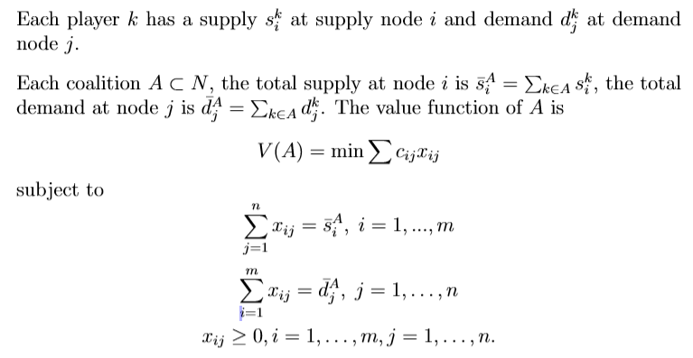
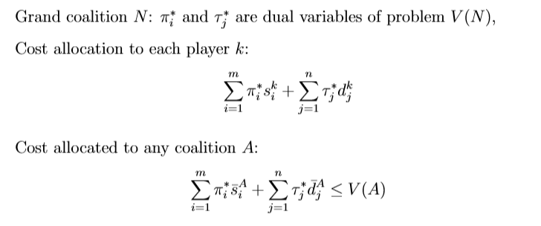
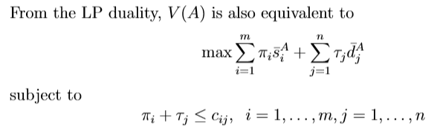
Analysis
Why?

Slide 27
Does more flow imply higher cost? A revisit
20 10 25
20 12 25
1
5
2
3
1
5
2
3
3
7
6
9
4
3
7
6
9
4
1
1
4
5
1
1
4
5
6
3
6
3
4
5
6
7
4
5
6
7
11 13 17 14
13 13 17 14
(a)
Cost=152
(b)
Cost=150

Slide 28
Equivalent problems of (a) and (b)
u: capacity of an arc
55
57
s
s
u=20 u=10 u=25
u=20 u=12 u=25
1
5
2
3
1
5
2
3
3
7
6
9
4
3
7
6
9
4
1
1
4
5
1
1
4
5
6
3
6
3
4
5
6
7
4
5
6
7
u=11 u=13 u=17 u=14
u=13 u=13 u=17 u=14
t
t
55
57

Slide 29
A Simpler Example
200
100
Plant in China
Plant in US
200
200
Demand in China
Demand in US
Plant in China
Plant in US
100
200
Demand in China
Demand in US
200
200

Slide 30
Maximum Flow Problems
The capacity of a network

Slide 31
The Max Flow Problem
G = (N,A)
x_{ij} = flow on arc (i,j)
U_{ij} = capacity of flow in arc (i,j)
s = source node
t = destination node
The flow value v(x) is the sum of flow sent from source node s to destination node t. We want to find the maximum flow v(x).
1
8,
7
10
,
8
s
1,
1
t
6,
5
10,
6
2
An example: Capacities and a non-optimal flow. The flow quantity is v(x)=8+5=13

Slide 32
Motivating example for maximum flow algorithm
Assuming each arc has a capacity of 5
5
5
We plan to have an iterative algorithm in which each iteration finds a path and sends some flows
5
5
5
5
original network
Optimal solution
5
5
5
5
5
5
5
5
5
Remedy: let the first 5 units of flow change to a new path: We need to remember flows that have been sent previously
First find one path to send 5 units of flow: difficult to send more flows

Slide 33
The Residual Network (for given flow x)
1
8,
7
10
,
8
s
1,
1
t
x
i
ij
j
u
ij
6,
5
10,
6
2
The original network G and a feasible flow x
u - x
ij
ij
i
j
x
ij
2
1
1
We let r_{ij} denote the residual capacity of arc (i,j)
r_{ij}=u_{ij}-x_{ij} for original arcs
r_{ji}=x_{ij} for new arcs
8
7
s
1
t
1
4
5
2
6
The Residual Network G(x)

Slide 34
A Useful Idea: Augmenting Paths
An augmenting path P is a path from s to t in the residual network.
The residual capacity of the augmenting path P is d(P) = min{r_{ij} : (i,j) ∈ P}.
To augment along P is to send d (P) units of flow along each arc of path P. We modify x and the residual capacities appropriately.
r_{ij} := r_{ij} - d(P) and r_{ji} := r_{ji} + d(P) for (i,j) ∈ P.
2
1
1
2
1
8
7
8
8
s
1
t
s
1
t
1
4
4
5
2
6
6
2
6

Slide 35
Why can flow be sent along augmenting path?
Case 1: The direction of an arc on the augmenting path is the same as the direction of the original arc
→ We use the remaining capacity of the original arc to send flow
Case 2: The direction of an arc on the augmenting path is opposite to the direction of the original arc
→ We reduce the flow that was sent previously on the original arc
Residual network is one way to help remember the flows that have been assigned on the network.

Slide 36
Why can flow be sent along augmenting path?
Assuming each arc has a capacity of 5
5
5
5
original network
send 5 units of flow
residual network
5
5
5
5
5
5
5
5
5
5
5
5
5
5
5
5
5
send 10 units of flow: there are two equivalent views
View 1: the first 5 units of flow change to a new path
View 2: the second 5 units of flow are sent on the residual network

Slide 37
The Ford Fulkerson Maximum Flow Algorithm
Begin
x := 0;
create the residual network G(x);
while there is some directed path from s to t in G(x) do
begin
let P be a path from s to t in G(x);
Δ := d(P);
send Δ units of flow along P;
update the r's;
end
end {the flow x is now maximum}.
How to find this?

Slide 38
Ford-Fulkerson Max Flow
4
2
5
3
1
1
1
2
2
s
4
t
3
2
1
3
This is the original network, as well as the initial residual network.

Slide 39
Ford-Fulkerson Max Flow (Iteration 1)
4
2
5
3
1
1
1
2
2
s
4
t
3
2
1
3
Find any s-t path in G(x). For example, (s,3,4,t), with path capacity
Δ =min{3,1,2}=1.

Slide 40
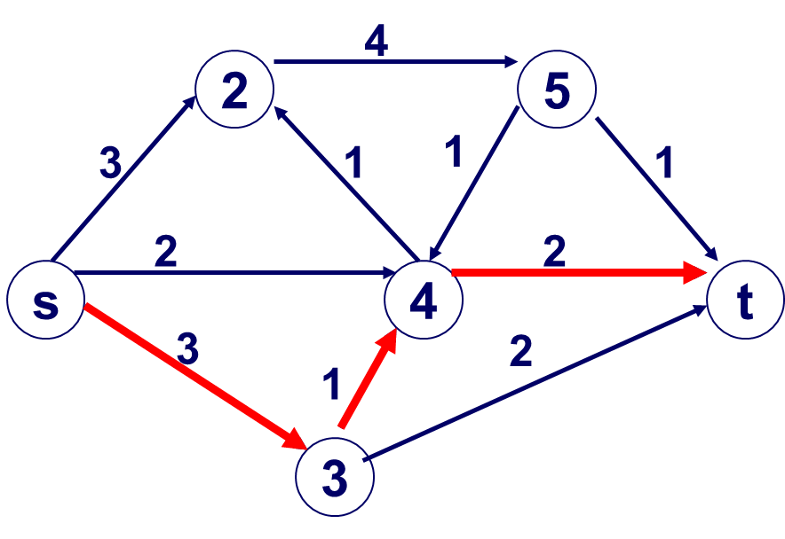
Ford-Fulkerson Max Flow (Iteration 1)
4
2
5
3
1
1
1
2
1
s
4
1
t
2
1
Send Δ=1 unit of flow in the path just found. Update residual capacities.
2
1
3

Slide 41
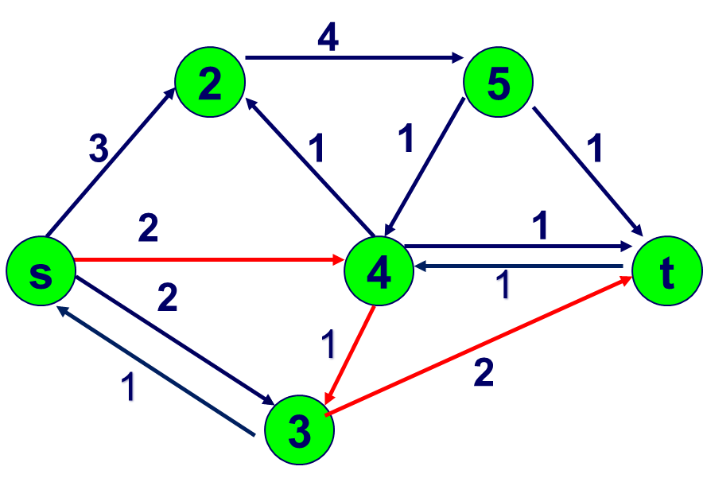
Ford-Fulkerson Max Flow (Iteration 2)
4
2
5
3
1
1
1
1
1
s
4
t
1
1
2
1
1
1
1
Find any s-t path, for example,
(s,4,3,t) with Δ=min{2,1,2} = 1
Note: (4,3) is actually a reversed arc, but it makes no difference in the algorithm.
3
Send Δ=1 unit of flow in the path. Update residual capacities.

Slide 42
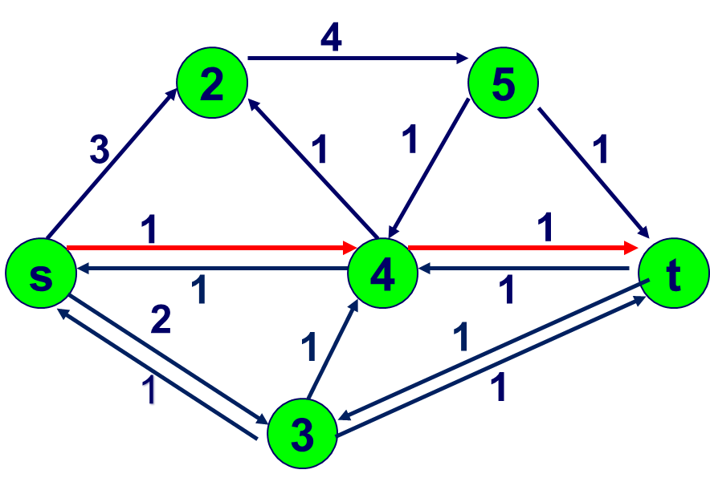
Ford-Fulkerson Max Flow (Iteration 3)
4
2
5
3
1
1
1
s
4
t
2
2
2
1
1
1
1
3
Find any s-t path, for example,
(s,4,t) with Δ= min{1,1} = 1
Send Δ=1 unit of flow in the path. Update residual capacities.

Slide 43
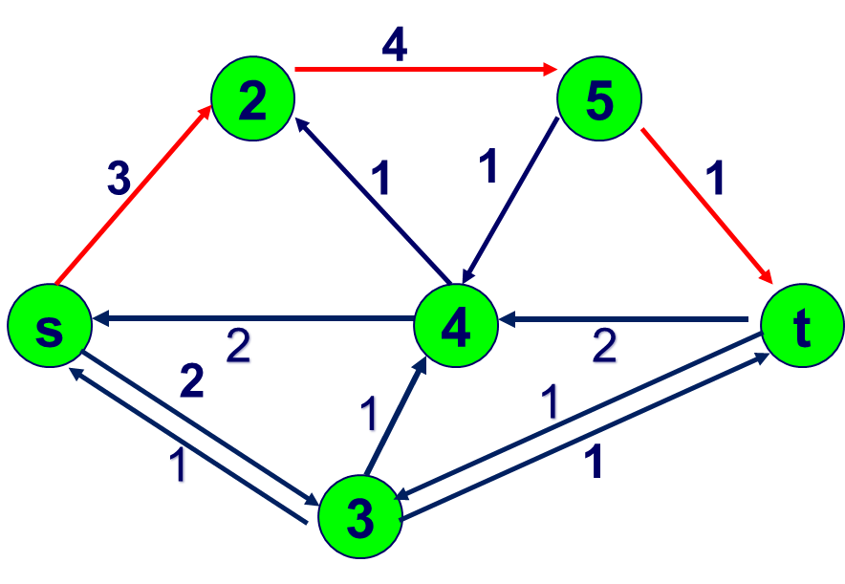
Ford-Fulkerson Max Flow (Iteration 4)
3
2
5
1
2
1
1
1
1
s
4
t
2
2
2
1
1
1
1
3
Find any s-t path, for example,
(s,2,5,t) with
Δ= min{3,4,1} = 1
Send Δ=1 unit of flow in the path. Update residual capacities.

Slide 44
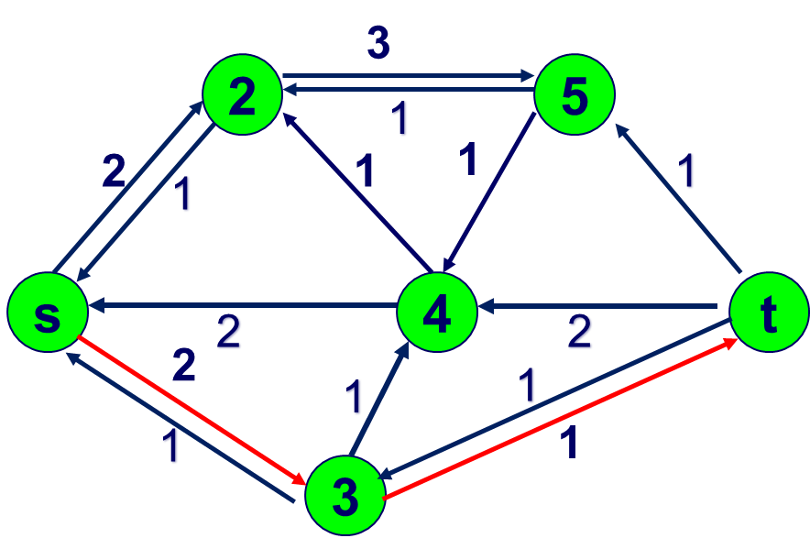
Ford-Fulkerson Max Flow (Iteration 5)
3
2
5
1
2
1
1
1
1
s
4
t
2
2
1
2
1
2
3
Find any s-t path, for example,
(s,3,t) with Δ= min{2,1} = 1
Send Δ=1 unit of flow in the path. Update residual capacities.

Slide 45
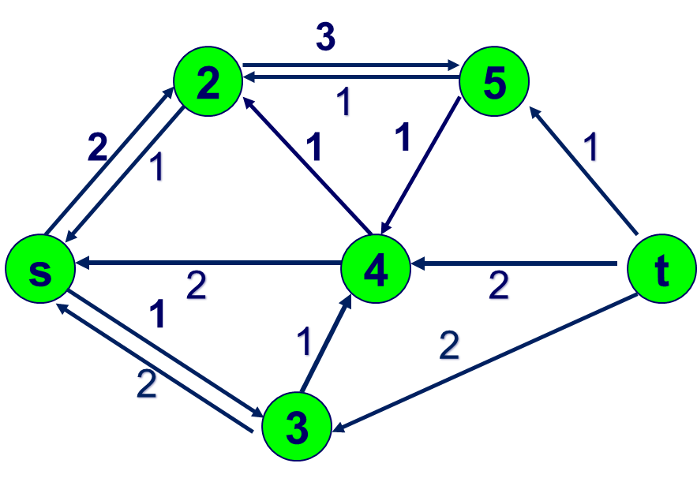
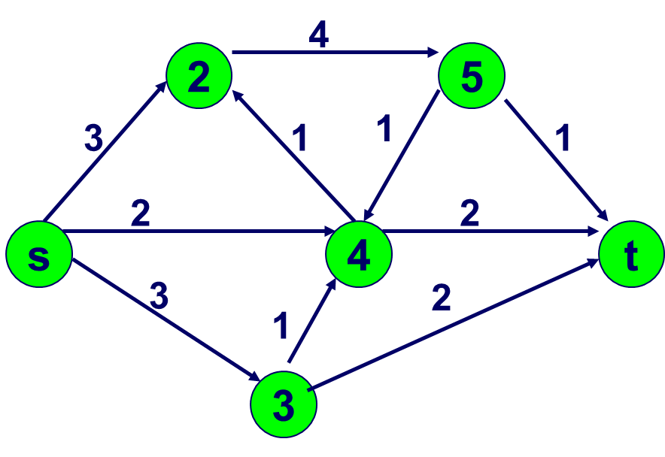
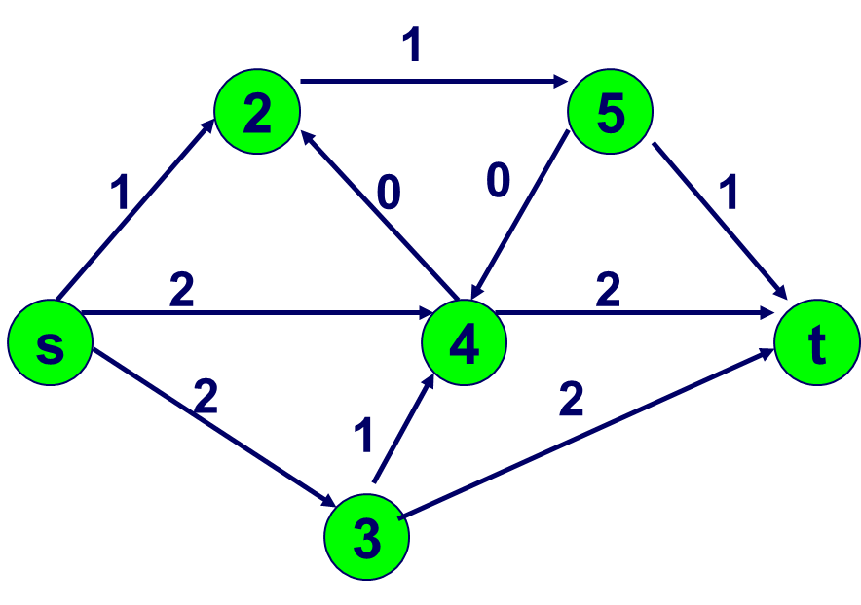
Ford-Fulkerson Max Flow
Original network
Residual network
There is no s-t path in the residual network. Algorithm stops.
The flow is the difference between the original network and the residual network. Is it the max flow?
0
Flow

Slide 46
Ford-Fulkerson Max Flow
1
2
5
1
1
2
2
s
4
t
2
2
3
Here is the optimal flow

Slide 47
How do we know when a flow is optimal?
1
8,
8
10
,
9
s
1,
1
t
6,
6
10,
7
2
METHOD. There is no augmenting path in the residual network. But, why?
reachable from s in G(x)
1
8
1
s
9
1
t
not reachable from s in G(x)
3
6
7
2

Slide 48
Correctness of Ford Fulkerson Algorithm
The algorithm iteratively sends flows on the residual network
Find an augmenting path, and send flows
Sending flows on residual network implies that we can send MORE flows on the original network
Update residual network
The algorithm is correct when the following two statements are equivalent:
1. A flow x is maximum.
2. There is no augmenting path in G(x).
1→2 is easy: Suppose that x is maximum, but there is still an augmenting path in G(x). Then x is not maximum because we can send more flows.
We need an additional concept to prove 2→1

Slide 49
Maximum flow and minimum cut
A duality theory, and a proof of the correctness of the maximum flow algorithm

Slide 50
A Cut
1
s
t
2
3
An (s,t)-cut in a network G = (N,A) is a partition of N into two disjoint subsets S and T such that s ∈ S and t ∈ T, e.g., S = { s, 1 } and T = { 2, 3, t }.
In the given cut (S,T),
an arc (i,j) is a forward arc if i ∈S and j ∈T, e.g., (1,t), (1,2), (s,2)
an arc (i,j) is a backward arc if j ∈S and i ∈T, e.g., (3,s)

Slide 51
Cut Capacity
1
8
1
8
s
1
t
s
t
6
6
3
2
2
3
3
The capacity of a cut (S,T) is the sum of capacities of all forward arcs
CAP(S,T) = ∑_{i∈S}∑_{j∈T}u_{ij}
In the example, the cut capacity of S=(s,1) is 6+1+8=15
the cut capacity of S=(s,1,2) is 8+3=11
Min-Cut problem is to find a cut with the smallest capacity

Slide 52
Weak Duality Theorem for the Max Flow Problem
Theorem. If x is any feasible flow and if (S,T) is an (s,t)-cut, then the flow value v(x) from source to destination in x is at most CAP(S,T).
Ideas for proof: We define the flow across the cut (S,T) to be all flow on forward arcs minus all flow on backward arcs
F_{x}(S,T) = ∑_{i∈S}∑_{j∈T} x_{ij} - ∑_{i∈S}∑_{j∈T} x_{ji}
1
8,
8
If S = {s}, then the flow across (S, T) is 9 + 6 = 15.
10
,
9
s
1,
1
t
6,
6
10,
7
2

Slide 53
Flows Across Cuts
1
8,
8
10
,
9
If S = {s,1}, then the flow across (S, T) is 8+1+6 = 15.
s
1,
1
t
6,
6
10,
7
2
1
8,
8
10
,
9
If S = {s,2}, then the flow across (S, T) is 9 + 7 - 1 = 15.
s
1,
1
t
6,
6
10,
7
2

Slide 54
More on Flows Across Cuts
Claim 1: Let (S,T) be any s-t cut. Then F_{x}(S,T) = v = flow into t.
In simple words, the flow sent from s to t across any cut (S,T) is F_{x}(S,T), forward flow minus backward flow
Claim 2: The flow across (S,T) is at most the capacity of a cut.
This happens only when all backward flow is 0

Slide 55
Strong Duality: Max Flow Min Cut Theorem
Theorem. (Optimality conditions for max flows). The following are equivalent.
1. A flow x is maximum.
2. There is no augmenting path in G(x).
3. There is an s-t cut (S, T) whose capacity is the flow value of x.
Corollary. (Max-flow Min-Cut). The maximum flow value is the minimum value of a cut.
Proof of Theorem. 1 → 2.
Suppose that there is an augmenting path in G(x). Then x is not maximum.

Slide 56
Continuation of the proof.
3 ⇒ 1. Let v = F_{x}(S, T) be the flow from s to t. By assumption, v = CAP(S, T). By weak duality, the maximum flow is at most CAP(S, T). Thus the flow is maximum.
2 ⇒ 3. Suppose there is no augmenting path in G(x).
Claim: Let S be the set of nodes reachable from s in G(x). Let T = N\S. Then there is no arc in G(x) from S to T.
Thus i ∈ S and j ∈ T ⇒ x_{ij} = u_{ij}
i ∈ T and j ∈ S ⇒ x_{ij} = 0.
So we find a cut (S, T).

