Slide 1
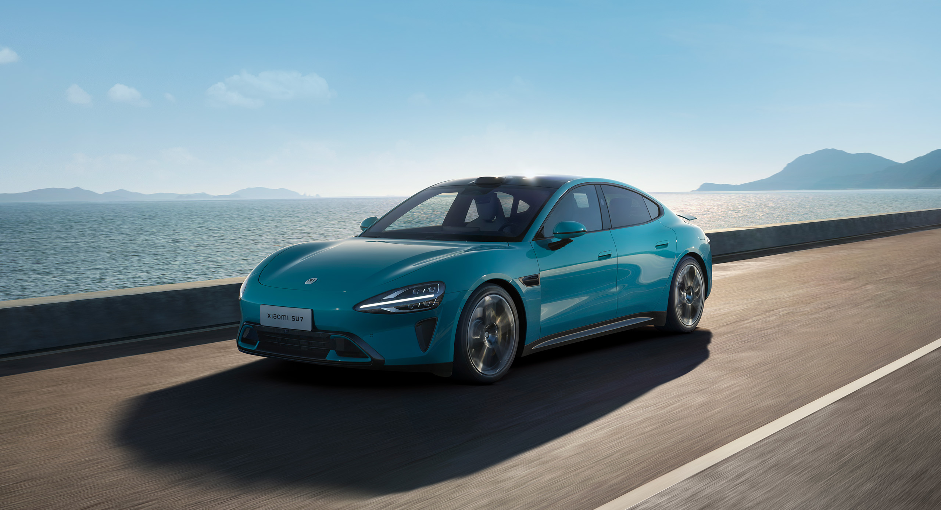
https://www.xiaomiev.com/su7

Slide 2
Machine Learning Approaches for Electric Vehicle Charging Behavior

Slide 3
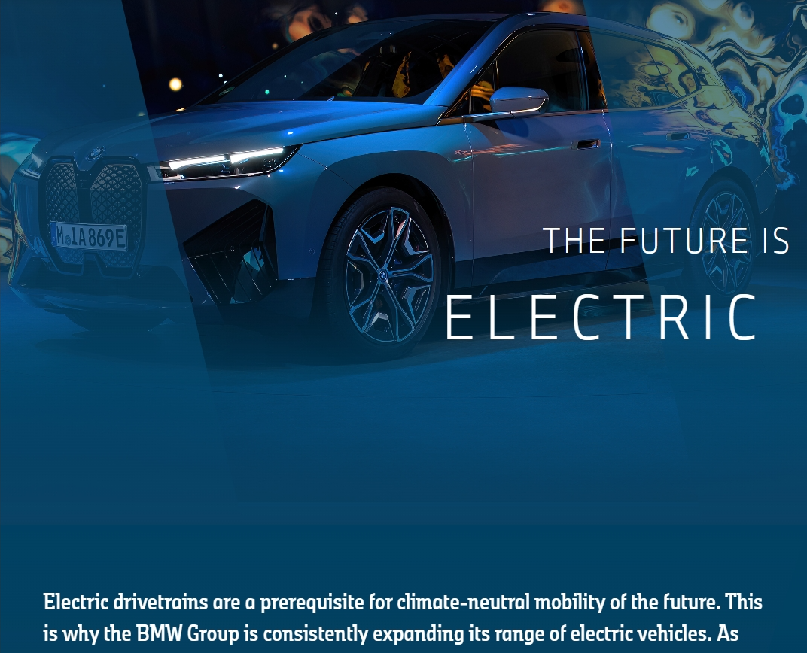
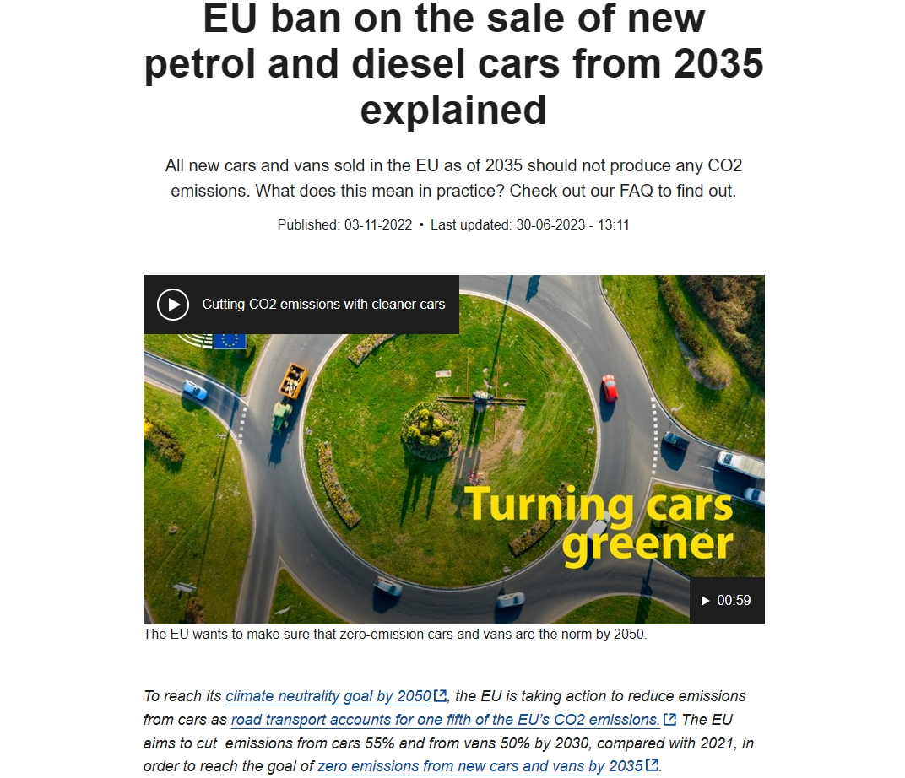
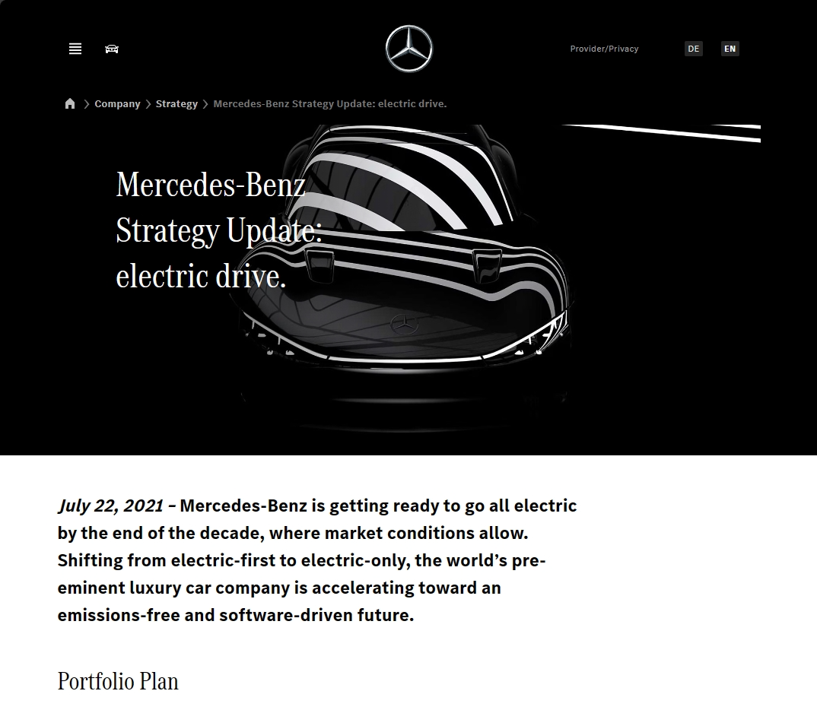
[EU]https://www.europarl.europa.eu/topics/en/article/20221019STO44572/eu-ban-on-sale-of-new-petrol-and-diesel-cars-from-2035-explained
[Benz] https://group.mercedes-benz.com/company/strategy/mercedes-benz-strategy-update-electric-drive.html
[BWM]https://www.bmwgroup.com/en/report/2021/bmw-group-report/the-future-is-electric/index.html

