Slide 1
IEDA 5230 Deterministic Models in Operations Research
Lecture 8
Fall 2023

Slide 2
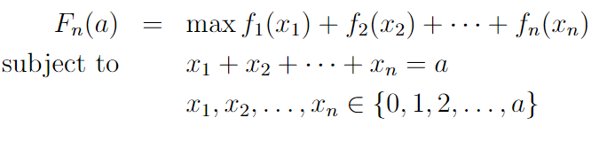

Dynamic Program: Complexity Analysis
Solution by direct enumeration:
How many combinations of (x₁, x₂,…, x_{n}) to be evaluated?
Solution by dynamic programming (implicit enumeration): How many states F_{k}(∙) to be evaluated?

Slide 3
How to Evaluate an Algorithm?
What is an algorithm?
A set of instructions of basic operations to solve a problem
Basic operations: assignment, arithmetic (+,-,*,/), logic (to compare)
For example, simplex method is an algorithm for solving LP
What does a good algorithm mean?
Time efficiency
Space efficiency
Measurements of efficiency
As a function of problem size, or more accurately, problem input size
In an LP max{cx | Ax=b}, the problem size is measured by
The dimension of A, b and c
In network flow problems, a problem size is naturally measured by
Number of nodes: denoted by n
Number of arcs: denoted by m
Anything else?

Slide 4
Example I
Given an array of numbers A={a₁,a₂,…,a_{n}} and another number x, determine whether x is in A.
Algorithm:
Step 1: Let k=1
Step 2: If a_{k}=x, report that x is in A and stop.
Step 3: Let k = k+1. If k≤n, goto step 2.
Step 4: Report that x is not in A and stop.
In the worst case, the algorithm has to take n iterations
In each iteration, we need two comparisons, one addition, one assignment
We say that the worst-case time complexity of the algorithm is in the order of n, denoted by O(n)
That means we ignore the details of each iteration since it takes the same constant time
But the algorithm may stop earlier, thus taking less than n iterations.

Slide 5
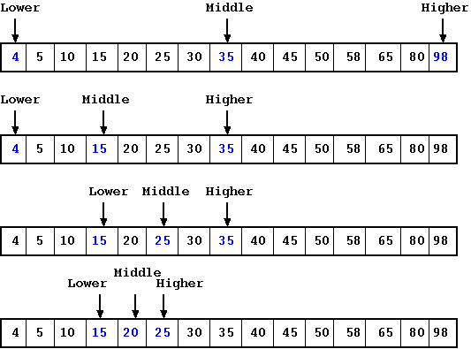
Example II
Given a sorted array of numbers A={a₁≤a₂ ≤ … ≤ a_{n}} and another number x, determine whether x is in A.
We already have an algorithm in O(n) time
A faster algorithm (known as binary search):
Step 1: Let k=n/2, s=1, t=n
Step 2: If a_{k}=x, report that x is in A and stop.
Step 3: If s>t, report that x is not in A and stop.
Step 4: If a_{k}<x, let s=k+1, k = (s+t)/2. Goto step 2.
Step 5: Let t=k-1, k = (s+t)/2. Goto step 2.
In the worst case, the algorithm needs to take no more than 1+log₂n iterations
The worst-case time complexity is in O(log n).

Slide 6
The Big O Notation
An algorithm is said to run in O( f(n) ) time if for some numbers c and n₀, the time taken by the algorithm (on all problem instances) is at most cf(n) for all n≥n₀
g(n)=100n+10 is in O(n)
When c=101, n₀=10, we have g(n)=100n+10 ≤ 101n for n≥n₀
g(n)=n²+2n is in O(n²)
When c=2 and n₀=2, we have g(n)=n²+2n ≤ 2n² for n≥n₀
The big O notation is about an upper bound of the time complexity
When using the Big-O notation, we always ignore some constant factors as well as terms of lower orders
O(n) may actually be 2n, even 100n
O(n³) may actually be 0.001n³+100n²

Slide 7
Big Ω and Big θ Notation
An algorithm is said to run in Ω( f(n) ) time if for some numbers c and n₀ and all n≥n₀, the algorithm takes at least cf(n) time on some problem instance.
This gives a lower bound on the worst case.
An algorithm is said to be θ ( f(n) ) if the algorithm is both O(f(n)) and Ω( f(n) ).
This is an accurate measure.

Slide 8
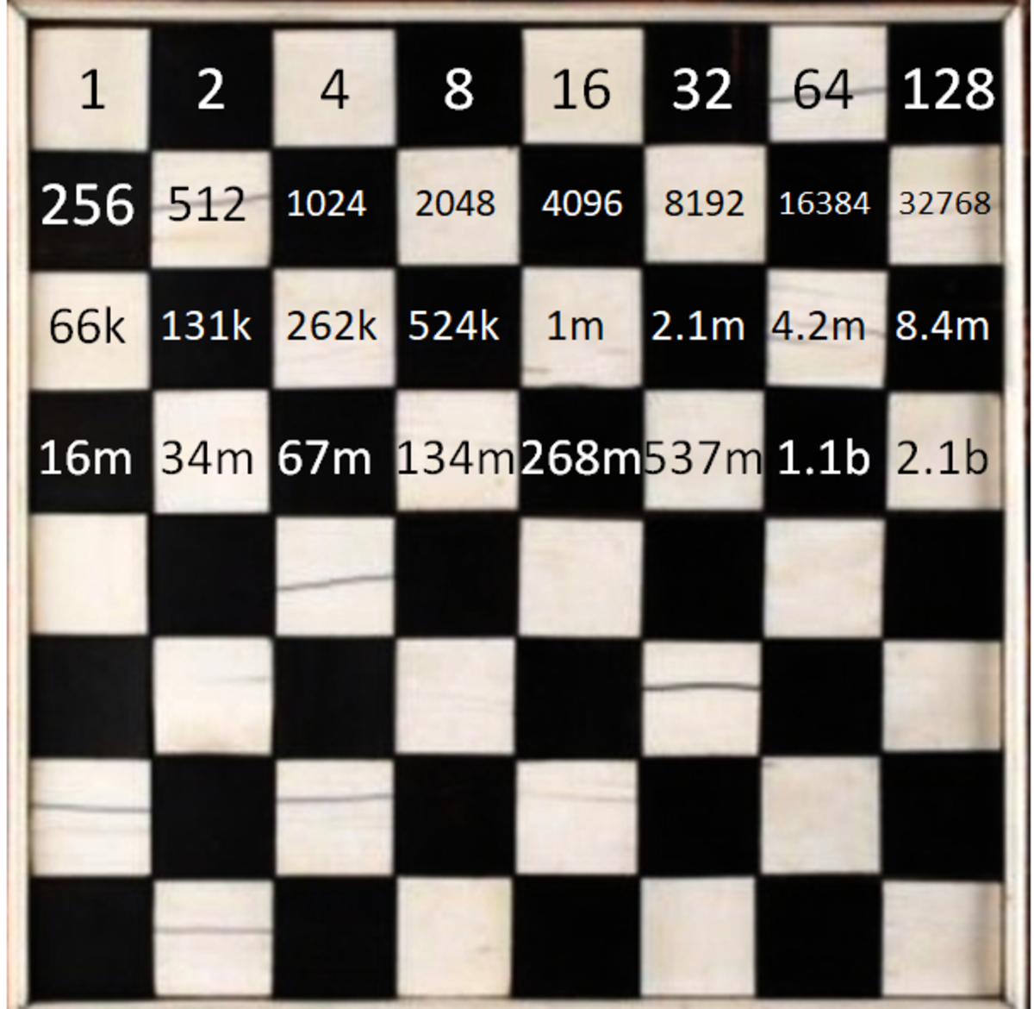
“Good” and “Bad” Algorithms
If the algorithm has a time complexity that is a polynomial function, or an even lower order, of the problem size, we say it is a good algorithm
O(n), O(n²), O(n²log n), …, O(n¹⁰⁰)
If the algorithm has a time complexity that cannot be bounded by a polynomial function of the problem size, we say it is in exponential time, implying a “bad” algorithm
O(e^{n}), O(n2^{n}), O(n!), O(n ^{log n}), …

Slide 9
Algorithm for Searching a Network
Given a network G=(N, A) and a source node s in N, we want to find all nodes that are reachable from s
A node t is reachable from s if there is a directed path from node s to t.
Basic idea
We can start to check each arc starting from s to find all nodes that are directly reachable from s
We call these nodes marked
Similarly, we can check all arcs that start from each marked node in order to find more nodes that are indirectly reachable from s
We have more nodes marked (meaning reachable from s)
We do this until no more nodes can be marked

Slide 10
Breadth-first Search (source node s=1)
2
5
2
5
1
6
1
6
3
4
7
3
4
Iteration 1: from node 1, nodes 2 and 3 are marked
Iteration 2: from node 2, nodes 5 and 4 are marked
Note: node 3 is also reachable from node 2, but node 3 has already been marked before, so we do not market it again
Iteration 3: from node 3, no new nodes are marked
Iteration 4: from node 5, node 6 is marked
Iteration 5: from node 4, no new nodes are marked
Iteration 6: from node 6, no new nodes are marked
Now, all marked nodes are checked. Algorithm stops.
Node 7 is not reachable from node 1

Slide 11
Breadth-first Search: Complexity
In the algorithm, at each marked node, we check all arcs that start from the node
This is called breadth-first search
The algorithm takes at most n iterations
Each iteration visits one node
A rough analysis
In each iteration, we check all arcs starting the node, which takes at most O(n) time
So the time complexity is in O(n²)
A more careful analysis
Let the number of arcs starting from node j be |A(j)|
Recall that A(j) is called adjacency list of node j, i.e., the set of arcs starting from node j
Then each iteration has |A(j)| operations
The total operations over all iterations is
|A(1)|+|A(2)|+…+|A(n)| ≤ m, total number of arcs
Time complexity is O(m)
Does it matter, O(n²) or O(m)?

Slide 12
Network Representations
Node-Node Adjacency Matrix
Representing network topology in an n x n matrix
Also able to represent cost and capacity for each arc
Advantage: simple and easy
Disadvantage: less efficient for sparse network
Visiting all arcs needs O(n²) time
 | 1 | 2 | 3 | 4 | 5 | 6 | 7
1 | 0 | 1 | 1 | 0 | 0 | 0 | 0
2 | 0 | 0 | 1 | 1 | 1 | 0 | 0
3 | 0 | 0 | 0 | 1 | 0 | 0 | 0
4 | 0 | 0 | 0 | 0 | 0 | 1 | 0
5 | 0 | 0 | 0 | 1 | 0 | 1 | 0
6 | 0 | 0 | 0 | 0 | 0 | 0 | 0
7 | 0 | 0 | 0 | 1 | 0 | 0 | 0
2
5
1
6
3
4
7

Slide 13
Network Representations
Adjacency List
For each node i, we store the information of its adjacency list A(i)
By using special data structures
Advantage: more efficient for sparse network
Visiting all arcs needs O(m), which may be much smaller than O(n²)
Disadvantage: implementation more complicated
nodes | Adjacency list
1 | →2(cost,capacity)→3(c,u)
2 | →3(c,u)→4(c,u)→5(c,u)
3 | →4(c,u)
4 | →6(c,u)
5 | →4(c,u)→6(c,u)
6
7 | →4(c,u)
2
5
1
6
3
4
7

Slide 14
Depth-first Search
2
5
2
5
1
6
1
6
3
4
7
3
4
At each marked node, we only check one arc
We always want to go to further nodes if possible: depth-first search
Iteration 1: node 2 is reachable from node 1
Iteration 2: node 3 is reachable from node 2
Iteration 3: node 4 is reachable from node 3
Iteration 4: node 6 is reachable from node 4
Iteration 5: back from node 6 to node 4, then back to node 3, node 2
Finally, node 5 is reachable from node 2
Time complexity for the depth-first search algorithm is still O(m)

Slide 15
Search Trees
2
5
2
5
1
6
1
6
3
4
3
4
Breadth-first search tree
Depth-first search tree
Property:
In the breadth-first search tree, a path from the source node to any other node is a shortest path if all arcs have the same cost.

Slide 16
Detecting Strong Connectivity
How to detect whether a network is strongly connected?
A network is strongly connected if there exists a directed path from every node to every other node
Algorithm 1
starting from every node, do a search of the network
Time complexity: O(nm)
Algorithm 2
Step 1: Randomly select a node s as the source, and do a search of the network – to see if every node is reachable from s
Step 2: Change the direction of all arcs in the network, and do a search of the network from node s – to see if s is reachable from every node
Time complexity: O(m)
Why is this algorithm correct?

Slide 17
Road Map
Time complexity of an algorithm
Efficiency of an algorithm
Time complexity of a problem
What efficiency of an algorithm can be designed for solving a given problem

Slide 18
Recognition Version of Optimization
Given an optimization problem P1 of minimizing f(x), we can define its recognition problem P2
with the same input as P1 and another parameter k
where we ask whether there exists a solution x₀ to P2 such that f(x₀)≤k.
P2 has only two answers, Yes or No.
If P1 can be solved, then P2 is immediately solved
If P2 can be solved, then P1 can also be solved
Suppose the possible range of f(x) is in [a,b]
We can call the algorithm for P2 multiple times by changing the k values over a binary search on [a,b]
It needs at most O(log b) times

Slide 19
Problem Reduction
Problem P1 polynomially reduces to problem P2
if there exists a polynomial-time algorithm that solves P1 by using the algorithm for solving P2 at unit cost
i.e., by calling the algorithm for P2 polynomial times
Examples
An optimization problem polynomially reduces to its (properly defined) recognition version problem
Detecting network connectivity polynomially reduces to breadth-first search of a network
If P2 can be solved in polynomial time and P1 polynomially reduces to P2, then P1 can also be solved in polynomial time

Slide 20
Problem Transformation
Problem P1 polynomially transforms to problem P2
if for every instance I1 of P1, we can construct in polynomial-time an instance of I2 such that I1 has a Yes answer if and only if I2 has a Yes answer
A special polynomial reduction where P1 can be solved by calling the algorithm for P2 just once
Implication
Suppose that P1 polynomially transforms to P2
If P1 is hard to solve, then P2 must also be hard to solve
If P1 is easy to solve, then ?

Slide 21
Problem Classification
P problem
A recognition problem belongs to class P if some polynomial-time algorithm solves the problem
NP problem
A recognition problem belongs to class NP if a Yes answer to a problem instance can be verified in polynomial time
NP stands for Non-deterministic Turing machine Polynomial time
Any P problem is in NP
NP-complete
A recognition problem P1 is NP-complete if (1) P1 is in NP, and (2) all other problems in class NP polynomially transform to P1.
If one NP-complete problem can be solved in polynomial time, then all NP-complete problems can be solved in polynomial time
Open question: P=NP?
NP-hard
A problem P1 is NP-hard if all other problems in class NP polynomially reduce to P1.

Slide 22
Some NP-complete Problems
Hamiltonian cycle problem
Statement: Does a given directed network G=(N,A) contain a directed cycle that visits each node exactly once?
It is in NP, because a YES answer to an instance can be verified in O(n) time
It is also NP-complete
Partition problem
Statement: Given a finite set N of elements with each element j having a value w(j), does some subset S satisfy that
It is in NP and NP-complete

Slide 23
Proving a problem is NP-complete
To prove a problem P2 is NP-complete, we need
(1) show that P2 is in NP
(2) find another problem P1 which is known to be NP-complete, and polynomially transform P1 to P2
The first known NP-complete problem (Cook Theorem)
Satisfiability problem

Slide 24
Traveling Salesman Problem (TSP)
TSP: given a directed graph G=(N,A), an integer arc length c_{ij} associated with every arc (i,j) in A, and an integer k, does there exist a directed cycle that
visits each node exactly once (called a tour), and
has the total arc cost no more than k?
(1) TSP is in NP
(2) Hamiltonian cycle problem (HCP) polynomially transforms to TSP
Given an instance of HCP with G=(N,A), we construct an instance of TSP with G=(N,A) and c_{ij}=1 for all arc (i,j) in A, and the integer k=n.
A Hamiltonian cycle in HCP is equivalent to a tour in TSP with total cost being n(=k).

Slide 25
Longest Path Problem (LPP)
Does a network G=(N,A) contain a path from node s to node t with total cost no less than L?
Note that a path does not have any cycles
(1) LPP is in NP
(2) Hamiltonian cycle problem (HCP) polynomially transforms to LPP
Given an instance of HCP with G=(N,A), we construct an instance of LPP
network G’ inheriting G except that G’ has on more node n+1 and all arcs (j,1) in G are replaced by arcs (j,n+1),
each arc in G’ having a cost being 1, and
node s being node 1, node t being node n+1, and L=n
→ If HCP has a Hamiltonian cycle on G, then such a cycle corresponds to a path from node 1 to node n+1 on G’ with total cost being n.
← If LPP has a path from node 1 to node n+1 on G’ with total cost no less than n, then this path must visit each of the other nodes exactly once (due to the unit cost of each arc). Thus this path corresponds to a Hamiltonian cycle on G.

Slide 26
Dynamic Program for Partition Problem
Partition problem: Given a finite set N of elements with each element j having a value w(j), does some subset S satisfy that
Assume w(1)+…+w(n)=2B
Consider elements N_{j}={1,2,…,j}. Define f(j,x)=1 if there is a subset S_{j} of N_{j} such that
By definition, the partition problem has a Yes solution if and only if f(n,B)=1.
Dynamic programming recursion:
Time complexity: O(nB). Polynomial time? verse NP-completeness?

Slide 27
Time Complexity of a Number
C is not a polynomial function of the input size of a number C
When C is input as a number into a computer, it is represented in a binary form, which takes log₂C bits.
For example, 100=(1100100)₂. It takes 7 bits
So the input size of 100 is 7, rather than 100
The input of 1024=2¹⁰. The input size is log₂1024=10
Therefore, it is logC that is a polynomial function of the problem input size
C is an exponential function of the input size log C
If an algorithm has a time complexity that is a polynomial function of a number, then the algorithm is called in pseudo-polynomial time
It maybe practically efficient if the number is not very large (similarity assumption)

Slide 28
Weakly and Strongly NP-completeness
A problem is strongly NP-complete if it is NP-complete even under the similarity assumption
Hamiltonian cycle, TSP, longest path, integer linear programming, …
A problem is weakly NP-complete if it is NP-complete but has a pseudo-polynomial time algorithm
Partition, knapsack, …

