Slide 1
IEDA 5230
Deterministic Models in Operations Research
Fall 2023

Slide 2
Basic Information
Professor: Xiangtong Qi
  Office: 5594
  Email: ieemqi@ust.hk
  Office hour: 10:00am – 11:00am, Wed, or stop by any time my door is open
TA: Mr. Zikang Li
  Email: zligr@connect.ust.hk
  Office hour: 3:00pm – 5:00pm, Tue
Textbook: David G. Luenberger, and Yinyu Ye.
Linear and Nonlinear Programming, 4th edition, Springer.
References: Lecture Notes, Any book of Operation Research
Software: Gurobi, https://www.gurobi.com/ (For self study)

Slide 3
Assessment
Grading
  Homework: 20%, Midterm exam: 30%, Final exam: 50%.
Homework:
  Standard problem solving
  Mini project
Exams:
  Both exams are closed-book.
  A one-page single-side A4-sized note is allowed.
  The final exam is comprehensive.

Slide 4
Deterministic Models in Operations Research
Operations
  Activities carried out in an organization related to the attainment of its goals
  About decision making over various options
Research
  Scientific methods to study the operations.
Other names
  Management Science
  Operational Research
  Prescriptive Analytics

Slide 5
Operations Research Methodology
Formulate the problem
Construct a mathematical model
Solve the model
Validate the model and solution
Implement the solution
Solving
Real-world
Problems
Modeling
OR
Models
Methods
Interpretation
Solution

Slide 6
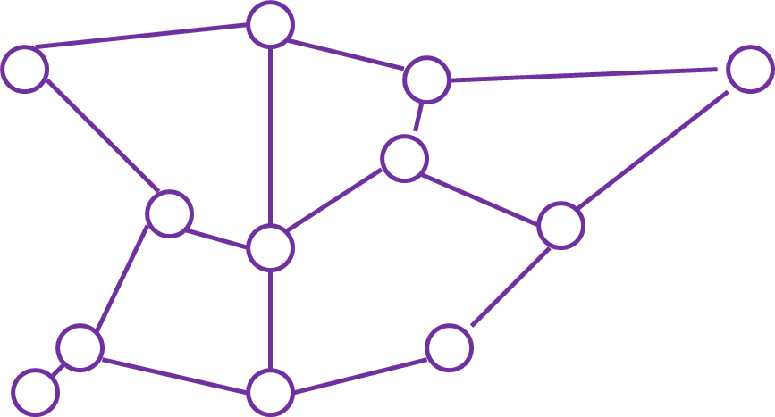
Types of Models
Graph/Network model
Deterministic vs. Stochastic
Linear vs. Nonlinear
  F(x)=ax+b
  F(x)=x²
Continuous vs. Discrete
  x is in [0,100]
  x is in {0,1,2,…,100}
Question: Is f(x)=|x+3| a linear function?

Slide 7
Linear Programming: An Example
A firm producing 3 types of products P, Q, and R
  Unit profit of each product: ($45, $60, $50) for P, Q, and R
Decision: the amount of each product to produce for a week
  Decision variables: P, Q, R
Objective: the maximum total profit
Constraints
  Production capacity
  Market demand
  What else?

Slide 8
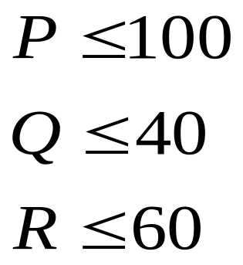
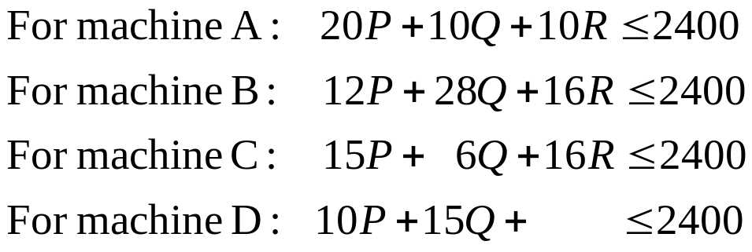
Constraints
Production capacity:
Each product needs 4 machines, A,B,C,D
Market Demand:
Each type of product may have a maximum market demand (upper bound of a variable)
 | Unit processing time (min) |  |  | Availability
 | Product P | Product Q | Product R | (min)
Machine A | 20 | 10 | 10 | 2400
Machine B | 12 | 28 | 16 | 2400
Machine C | 15 | 6 | 16 | 2400
Machine D | 10 | 15 | 0 | 2400

Slide 9
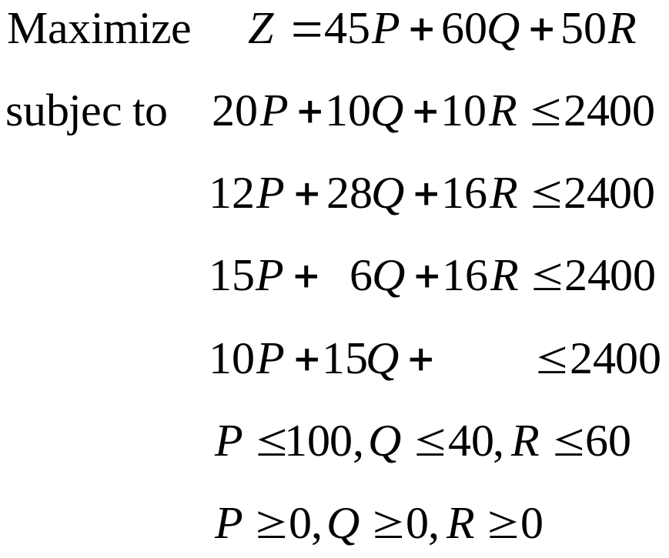
Complete Linear Programming Model and Optimal Solution
Optimal solution:
  P=81.28, Q=16.36, R=60
Optimal objective function value:
  Z = 7664

Slide 10
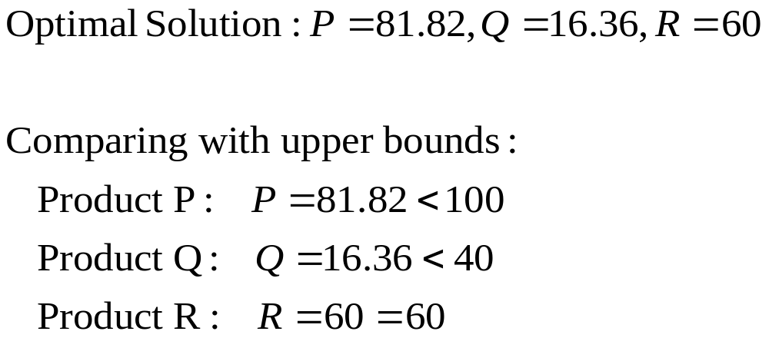
Practical Implication
Observation: Product R reaches its upper bound, implying we should produce R as many as possible.
Any comment on Products P and Q?

Slide 11
Additional Discussion
Question 1: The company plans to make some advertisement to increase potential market demand. Which type of product should the company invest to advertise?
Question 2: If we can increase the maximum market demand of product R, how much should we increase it?
LP Model: drop the constraint: R<=60
New optimal solution: P=78.42, Q=10.69, R=72.48, with total profit=7794.
Question 3: Is it useful to increase the demand of R to 73, or more?
Question 4: If increasing market demand of R to 72.48 costs some money, how much the company would like to pay for it?
No more than 7794 – 7664 = $130

Slide 12
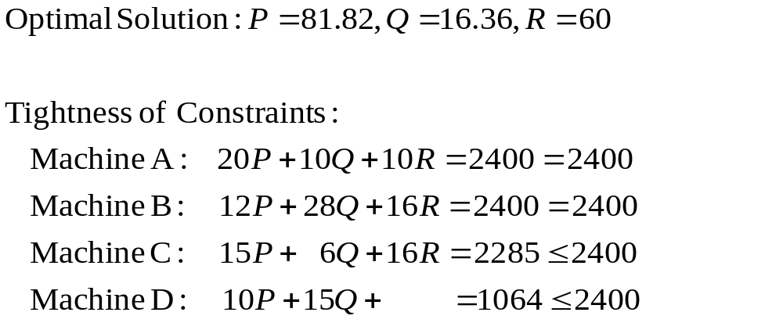
On Production Capacity
Used Available
Question: If the company can make certain efforts to increase the available time of some of the machines, which machine(s) should be given the extra available time?

Slide 13
Limitations of the Model
Linear assumption
  Profit function may not be linear
Continuous assumption
  Production units may have to be integers
Certainty
  Maximum demand may be random
  Machine may subject to failure
Too simple abstraction
  We may not be able to find a schedule to run the machines

Slide 14
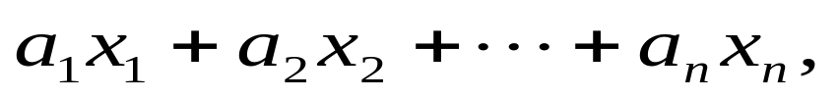
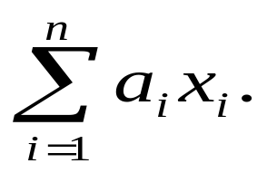
Important Assumptions in Linear Programming
Divisibility (continuous model)
  Decision variables can be real numbers
Proportionality (linear model)
  Objective functions and constraints are linear functions of decision variables
where a_{i} are fixed parameters in the problem, and x_{i} are decision variables. Also written as:

Slide 15
Example 2: Blending Problem
We need to use 3 materials to produce one type of animal feed fix. The question is to determine the percentage of each material in the final product.
Limestone
+
Corn
+
Soybean
=
Final product
? % + ? % + ? % = 100%

Slide 16
Nutrition Constraints
Nutrition Table
 | Calcium | Protein | Fiber
Limestone | 0.38 | 0 | 0
Corn | 0.001 | 0.09 | 0.02
Soybean | 0.002 | 0.50 | 0.08
Nutrition Requirement
 | Calcium | Protein | Fiber
Minimum | 0.008 | 0.22
Maximum | 0.012 |  | 0.05

Slide 17
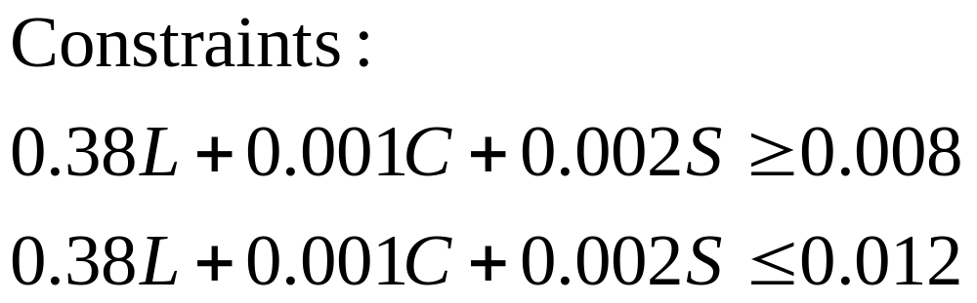
Formulate Constraints
 | Calcium
Limestone | 0.38
Corn | 0.001
Soybean | 0.002
 | Calcium
Minimum | 0.008
Maximum | 0.012

Slide 18
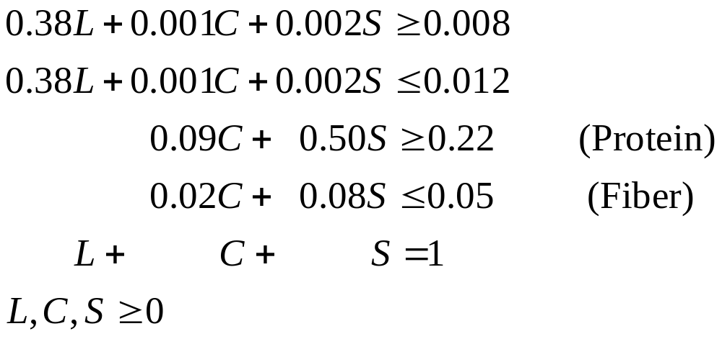
All Constraints

Slide 19
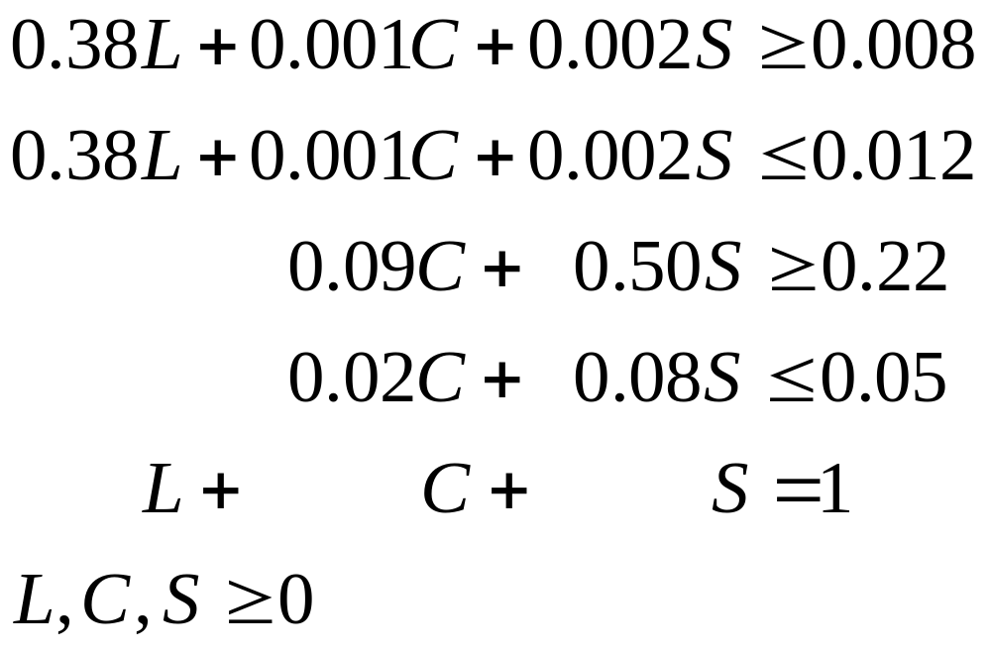
Goal: To use the minimum cost to obtained the final product
 | Limestone | Corn | Soybean
Unit cost | 10 | 30.5 | 90

Slide 20
Example 3: Fleet Planning
A logistics company rents trucks from truck manufacturers or truck dealers
Available leasing plans
  Three months: $18000 per truck
  Four months: $22000 per truck
  Five months: $25000 per truck
Demand for each month
  Jan Feb Mar Apr May June
  340 350 470 520 240 330
  Assuming no truck is needed after June
What is a minimum cost rental plan?

Slide 21
Leasing Planning: IP Formulation
x₁₃, x₂₄, x₃₅, x₄₆: the number of trucks leased under 3-month plan starting from Jan, Feb, Mar and April
y₁₄, y₂₅, y₃₆: the number of trucks leased under 4-month plan starting from Jan, Feb and Mar
z₁₅, z₂₆: the number of trucks leased under 5-month plan starting from Jan and Feb
Objective function
  Minimize 18000Σx_{ij} + 22000Σy_{ij} + 25000Σz_{ij}

Slide 22
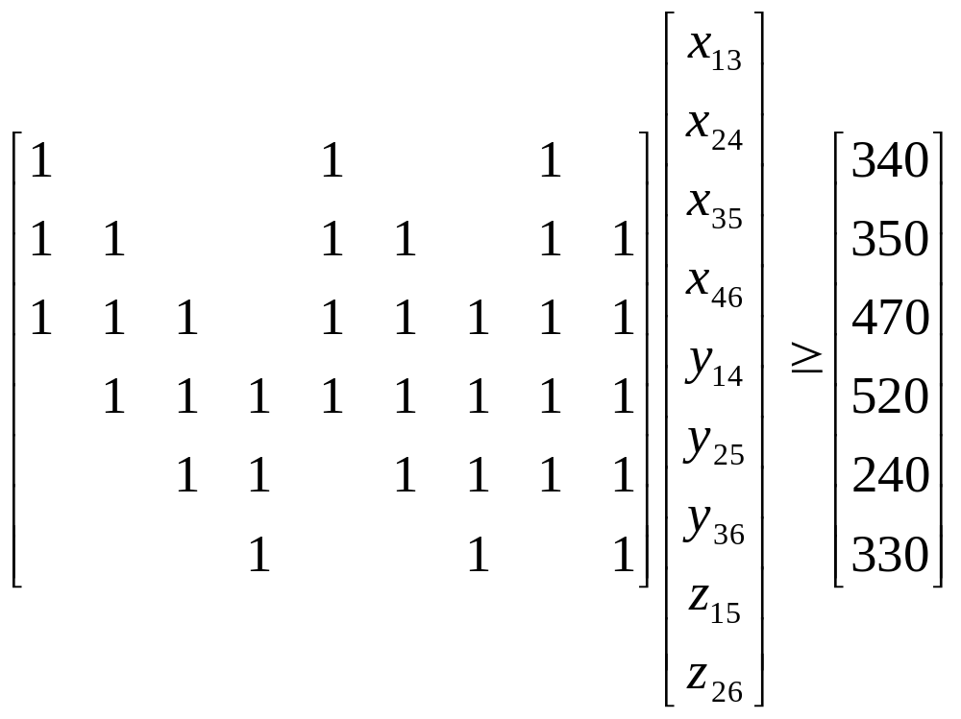
Constraints for LP Formulation
Demand for Jan
  x₁₃+y₁₄+z₁₅ ≥ 340
Demand for Feb
  x₁₃+x₂₄+y₁₄+y₂₅+z₁₅+z₂₆ ≥ 350
Demand for March
  x₁₃+x₂₄+x₃₅+y₁₄+y₂₅+y₃₆+z₁₅+z₂₆ ≥ 470
Demand for April
  x₂₄+x₃₅+x₄₆+y₁₄+y₂₅+y₃₆+z₁₅+z₂₆ ≥ 520
Demand for May
  x₃₅+x₄₆+y₂₅+y₃₆+z₁₅+z₂₆ ≥ 240
Demand for June
  x₄₆+y₃₆+z₂₆ ≥ 330
“set covering” model

Slide 23
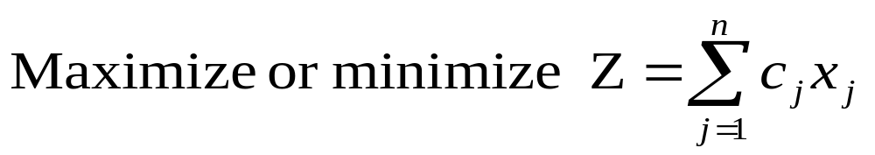
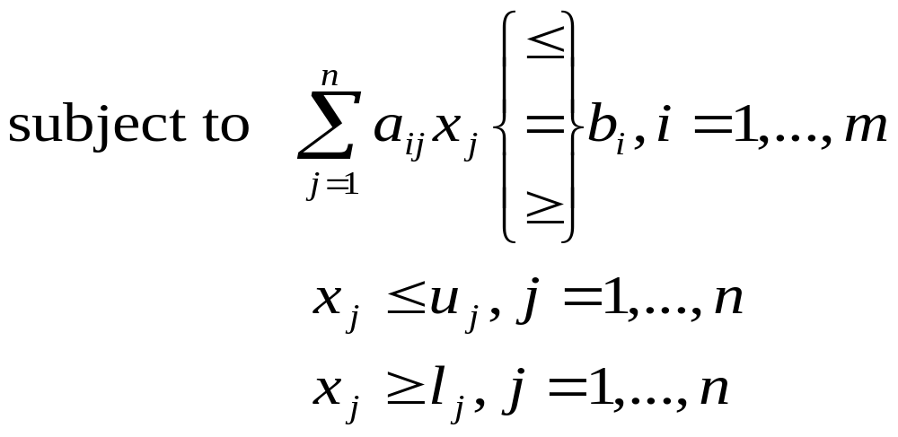
General Form of LP
The number of variables is n
The number of constraints is m (excluding lower and upper bounds)

Slide 24
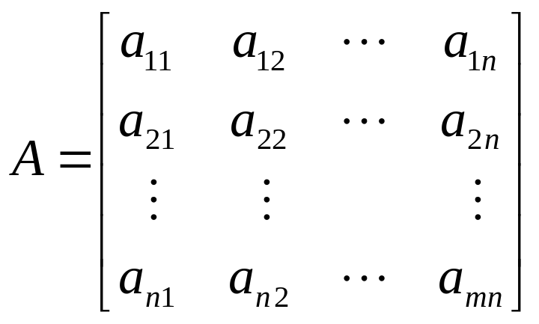
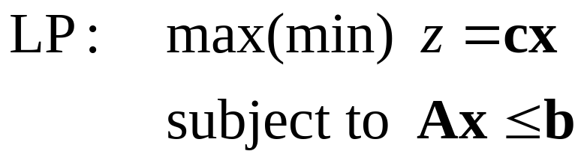
Matrix Form of an LP
Decision variables: x=(x₁,x₂,…,x_{n})^{T}
Objective coefficients: c=(c₁,c₂,…,c_{n})
Right-hand-side constraints: b=(b₁,b₂,…,b_{m})^{T}
Structural coefficients: A

Slide 25
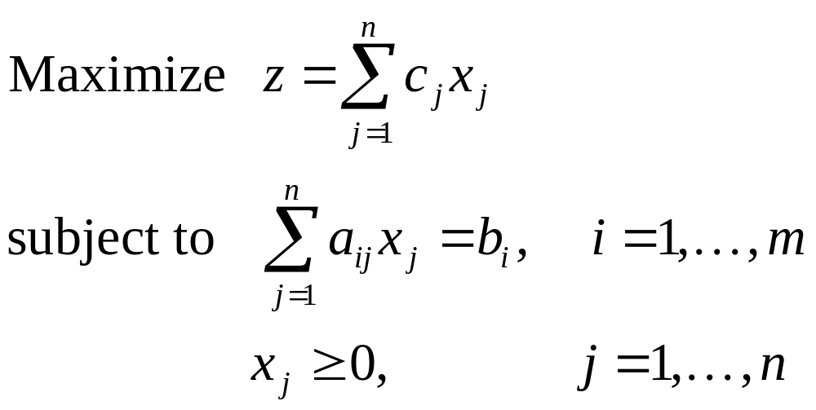
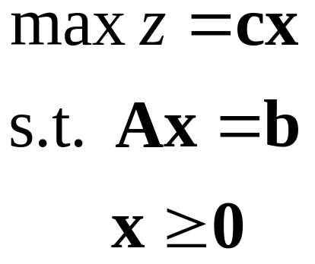
Standard Form of LP
where (1) all right-hand-side parameters b_{i} are nonnegative, and
(2) n>m. (Why n>m?)

Slide 26
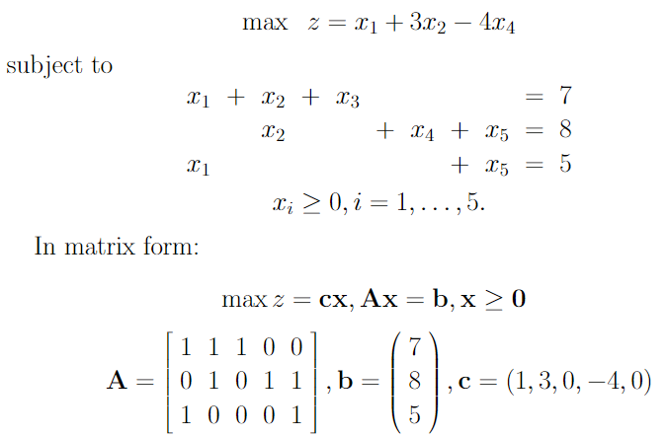
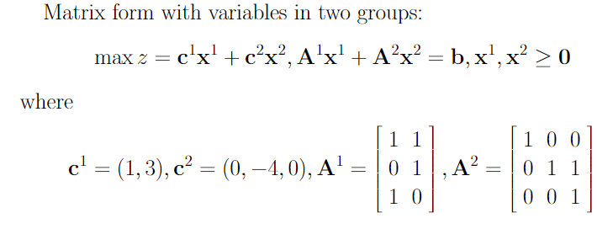
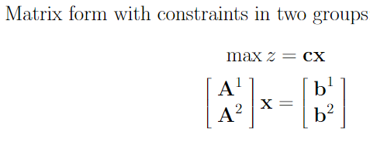
More on matrix form

Slide 27
Transforming an LP to Standard Form
When an LP, denoted by P1, is not in the standard form, we can get another LP in the standard form, denoted by P2, by making a series of transformations, such that there is a one-one mapping for the feasible solutions, as well as the optimal solutions, between problems P1 and P2.
Problem P1
Problem P2

Slide 28
Changing Objective Functions
When the objective function is to minimize
  Method: Define another objective function where the sign of all coefficients are changed
  Original: Min c₁x₁+c₂x₂+…+c_{n}x_{n}
  New: Max (–c₁)x₁+(–c₂)x₂+…+(–c_{n})x_{n}
  Reason: Z_{min}≤Z_{feasible} ⬅➔ –Z_{min}≥ – Z_{feasible}
  ⬅➔ Z_{max}≥ – Z_{feasible}

Slide 29
Bounds of Variables
Nonzero lower bound
  Suppose a variable x_{j} ≥ l_{j}, where l_{j} ≠0
  Method: Define a variable x’_{j} where x_{j}= x’_{j} + l_{j}. Then use x’_{j} + l_{j} to substitute x_{j} everywhere in the model.
  Reason: x_{j} ≥ l_{j} ⬅➔ x’_{j} + l_{j} ≥ l_{j} ⬅➔ x’_{j} ≥ 0
Non-positive upper bound
  Suppose a variable has a non-positive upper bound, i.e., x_{j} ≤ u_{j}, where u_{j} ≤ 0.
  Method: Define a variable x’_{j} where x_{j}= u_{j}– x’_{j.} Then use u_{j}– x’_{j} to substitute x_{j} everywhere in the model.
  Reason: ??

Slide 30
Unrestricted Variables
If x_{j} has neither lower nor upper bounds, it is called a free or unrestricted variable
A special case: an unrestricted variable x_{j} appears in an equality constraint
Method: we can eliminate x_{j} by solving the equality.
  Example: suppose x₁+x₂+x₃=8, and x₃ is an unrestricted variable, then we can use 8 – x₁ – x₂ to substitute x₃ everywhere in the model.
  Question: Can we do this for restricted variables?

Slide 31
Unrestricted Variables
Method 1:
  For an unrestricted variable x_{j}, define two variables x⁺_{j} and x⁻_{j}, and use x⁺_{j} – x⁻_{j} to substitute x_{j} everywhere in the model
  Add constraints x⁺_{j} ≥ 0, x⁻_{j} ≥ 0.
Method 2:
  If there are multiple unrestricted variables, we can only define an x⁺_{j} for each variable, but only a single common x⁻.
  For example, if x₁ and x₂ are unrestricted variables, then we use x⁺₁ –x⁻ to substitute x₁, use x⁺₂ –x⁻ to substitute x₂.

Slide 32
Inequality Constraints
If a constraint is in the inequality form, we can add a slack variable to get an equality.
Example 1: 3x₁+2x₂+…+8x_{n} ≥ 5
  Define slack variable s₁, s₁≥0, and re-write the constraint as
  3x₁+2x₂+…+8x_{n} –s₁= 5
Example 2: 3x₁+2x₂+…+8x_{n} ≤ 5
  Define slack variable s₁, s₁≥0, and re-write the constraint as
  3x₁+2x₂+…+8x_{n} +s₁= 5

Slide 33
Negative Right-hand-side
If the right-hand-side of a constraint is negative, multiple every term by –1.
For example:
  3x₁ – 2x₂+…+8x_{n} –s₁= – 5 should be changed to
  – 3x₁+2x₂+… –8x_{n} +s₁= 5

Slide 34
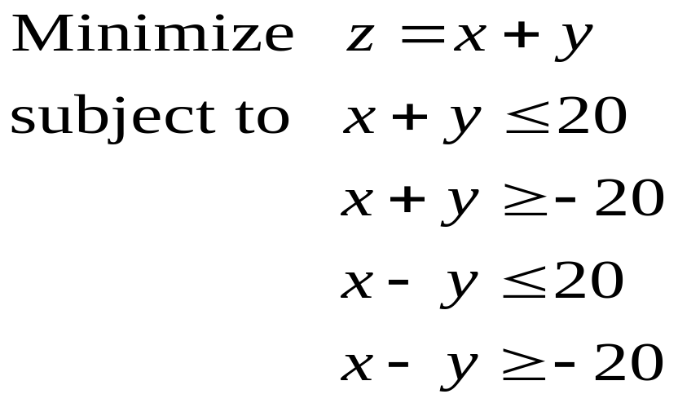
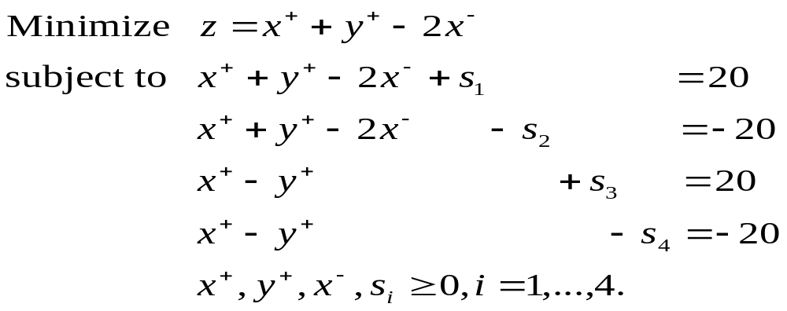
Examples
Let x=x⁺ – x–, y=y⁺ – x– , and introduce slack variables s₁, s₂, s₃, s₄.

Slide 35
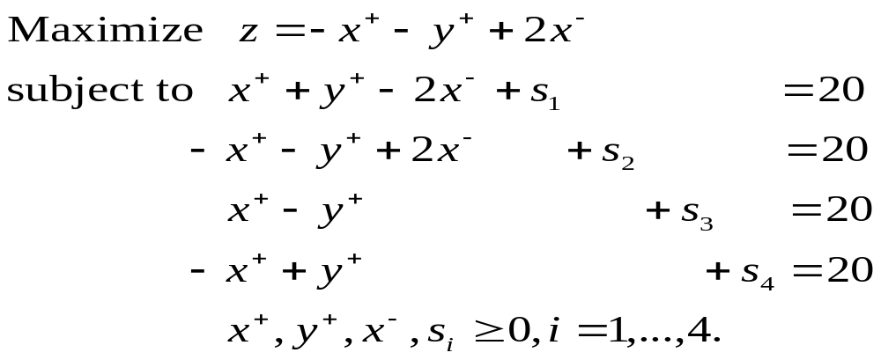
Examples
LP1
LP2

Slide 36
True or False for each of the statements:
Add a constant to the objective function does not change the optimality
Scale the objective coefficients does not change the optimality
Scale the right-hand-side coefficients does not change the optimality but the solution scaled accordingly
Reorder the decision variables (together with their corresponding objective and constraint coefficients) does not change the optimality
Reorder the constraints (together with their right-hand-side coefficients) does not change the optimality
Multiply both sides of an equality constraint by a constant does not change the optimality
Pre-multiply both sides of all equality constraints by a non-singular matrix does not change the optimality

