Slide 1
IEDA 5230 Deterministic Models in Operations Research Lecture 2
Fall 2023

Slide 2
Solving a linear programming problems
Graphic method
Fundamental Theorem of LP
Simplex method

Slide 3
Using Graph to Represent Equality
y
ax+by=Z form a family of parallel lines for different Z values
(0, Z₁/b)
Z₁ > Z₂
(0, Z₂/b)
a x + b y = Z₁
a x + b y = Z₂
x
(Z₂/a, 0)
(Z₁/a, 0)
a x + b y = Z₃

Slide 4
Using Graph to Represent Inequality
y
Question: What does the graph look like if a<0, or b<0, or Z<0?
(0, Z/b)
a x + b y > Z
Increasing direction
a x + b y = Z
decreasing
x
(Z/a, 0)
a x + b y < Z

Slide 5
P
Max Q
D
Max P
A
C
B
Q

Slide 6
P
90
45P+60Q > 4664, infeasible
Feasible region
45P+60Q=4664, Optimal
20
45P+60Q < 4664, not optimal
30
40
Q
45P+60Q=1800, not optimal

Slide 7
Constraint B
P
Optimal solution at a corner point of the feasible region, which can be obtained by solving
90
Feasible region
45P+60Q=4664, Optimal
Constraint A
20
30
40
Q

Slide 8
Solving LP by Graphic Method
Only valid for LP with two variables
Steps
Step 1. Draw feasible region by outlining each constraint
Step 2. Determine the optimal solution by moving the objective function lines (isovalue contours)
Important observation
An optimal solution, if existing, can always be found at a corner point of the feasible region.

Slide 9
Special Cases
The optimal solution is not unique

Slide 10
Special Cases
Objective function is unbounded

Slide 11
Special Cases
No feasible solution
Feasible region is empty, implying conflict constraints

Slide 12
Standard Form of LP
A=[ a_{ij} ], matrix of m row and n columns
x=[x_{j}] and b=[b_{i}], column vectors
c=[c_{j}], row vector
Discussion: why is x ≥ 0 needed?
Equivalent question:
Can all variables be unrestrictive?
where (1) all right-hand-side parameters b_{i} are nonnegative, and (2) n>m.

Slide 13
Basic Solution of LP in Standard Form
Given x=(x_{B},x_{N}) with x_{N}=0
Write A=(B,N) where
B: columns of A corresponding to variables in x_{B}
N: columns of A corresponding to variables in x_{N}
Ax=Bx_{B}+Nx_{N}= Bx_{B} =b
x_{B}=B⁻¹b
We partition n variables into two sets
x_{B} with m variables, and x_{N} with n – m variables
We set x_{N}=0. Then regarding x_{B}, we have simultaneous linear equations of m constraints and m variables
If x_{B} can be uniquely determined, then
variables in x_{B} are a set of basic variables
(x_{B},x_{N}) is a basic solution

Slide 14
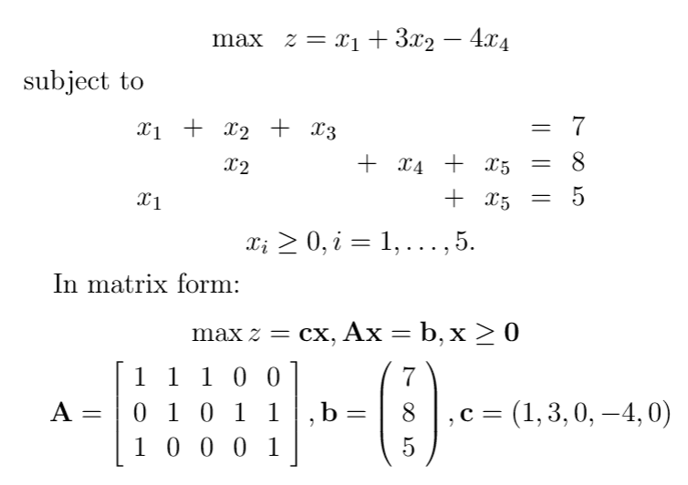
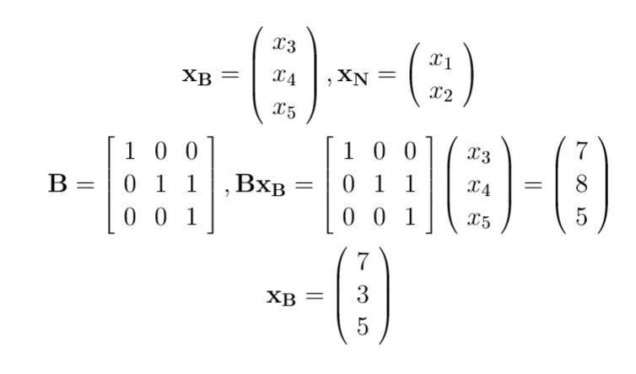
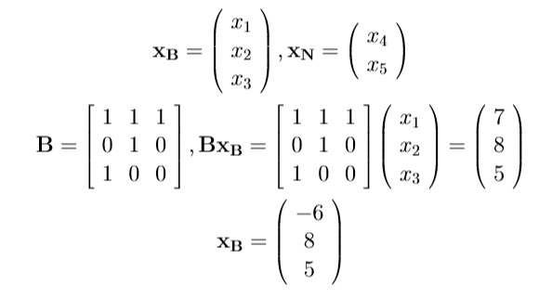

Slide 15
Basic Feasible Solution (BFS)
Definition. For an LP in the standard form, a basic solution to the m constraints is called a basic feasible solution (BFS) if it satisfies the non-negativity constraints.
Theorem. For an LP in the standard form:
If there is a feasible solution, there is a BFS.
If these is an optimal feasible solution, there is an optimal BFS.
Idea of proof
Given a feasible solution → a BFS
Given an optimal feasible solution → an optimal BFS
Additional remark
Each BFS corresponds to a corner point in the graphic representation of the LP.

Slide 16
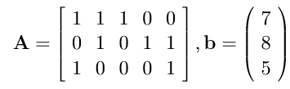

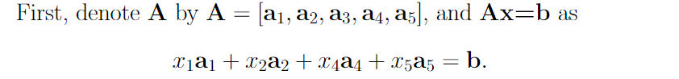
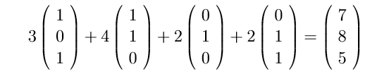
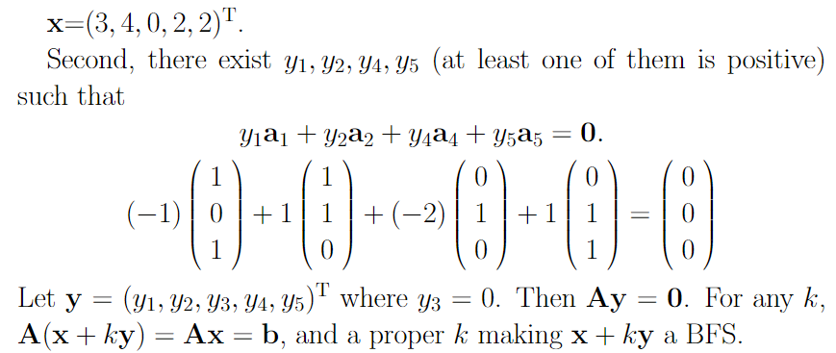
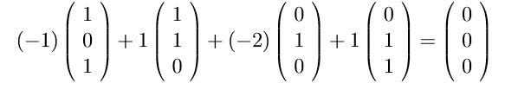
Basic ideas of proof and illustration
Assume x is a feasible solution, but not BFS. Then we can find a BFS as follows.
x + ky = (3–k, 4+k, 0, 2 – 2k, 2+k)
k=?

Slide 17
Further discussion
Assume x is a feasible solution, but not BFS. Then we can find a y making x+ky, with a proper k , to be BFS.
In fact, there are two k values k₁ and k₂, leading to two BFS
x₁= x+k₁y and x₂= x+k₂y .
Consider the objective function cx
From x to x₁, the change cx₁-cx = k₁cy
From x to x₂, the change cx₂-cx = k₂cy
This implies the existence of an optimal BFS. Why?
x + ky = (3–k, 4+k, 0, 2 – 2k, 2+k)^{T}
k₁ = 1 and k₂ = -2
k₁ is positive and k₂ is negative. Is this a coincidence?
Can you go through the above steps with
x = (1, 1, 5, 3, 4)^{T}

Slide 18
The general Idea of Solving LP
Step 1. Find a BFS
Step 2. Determine if the BFS is optimal.
Step 3. If not optimal, find another BFS, and go to Step 2.
This results in the Simplex Method.

Slide 19
Motivation of the Simplex Method

Slide 20
Simplex Form of an LP
A simplex form corresponds to a BFS:
Each basic variable corresponds to a row, and the value of the basic variable is the right-hand side of the row
The value of the objective function is equal to the right-hand side of row 0
Every basic variable appears in one and only one equation, but not row 0
Each basic variable has the coefficient 1 in the equation it appears
Each equation has only one basic variable
Variable z only appears in row 0 with coefficient 1
Simplex form:
Row 0
Row 1
Row 2
Row 3

Slide 21
Tableau of Simplex Form
 |  | Coefficients
Row | Basic | z | x₁ | x₂ | x₃ | x₄ | x₅ | RHS
0 | Z | 1 | -2 | -3 | 0 | 0 | 0 | 0
1 | x₃ | 0 | -1 | 1 | 1 | 0 | 0 | 5
2 | x₄ | 0 | 1 | 3 | 0 | 1 | 0 | 35
3 | x₅ | 0 | 1 | 0 | 0 | 0 | 1 | 20

Slide 22
Is the Current BFS Optimal?
The current BFS is optimal if and only if row 0 has no negative numbers
In row 0, x₁’s coefficient
– 2<0,
implying that increasing x₁ from 0 to a small positive number will also make z increasing. So the current BFS may not be optimal.

Slide 23
Moving from One Simplex Form to Another
An LP can be written in different simplex forms by some linear operations among the rows
row j = row j * non-zero parameter or
row j = row j + row k * a parameter
Steps:
Choose a non-basic variable with negative element in row 0: a pivot column
for example, x₂
Choose a basic variable leaving the current basic solution: a pivot row
for example, x₃ (row 1 for x₃)
So a pivot element is determined
For the pivot row, each element is multiplied by a parameter so that the pivot element becomes 1
For other rows, use linear operations to make the element in the pivot column to be 0
For reference only

Slide 24
Example
For reference only
 |  | Coefficients
Row | Basic | z | x₁ | x₂ | x₃ | x₄ | x₅ | RHS
0 | Z | 1 | -2 | -3 | 0 | 0 | 0 | 0
1 | x₃ | 0 | -1 | 1 | 1 | 0 | 0 | 5
2 | x₄ | 0 | 1 | 3 | 0 | 1 | 0 | 35
3 | x₅ | 0 | 1 | 0 | 0 | 0 | 1 | 20
Row | Basic | z | x₁ | x₂ | x₃ | x₄ | x₅ | RHS
0 | Z | 1 | -5 | 0 | 3 | 0 | 0 | 15
1 | x₂ | 0 | -1 | 1 | 1 | 0 | 0 | 5
2 | x₄ | 0 | 4 | 0 | -3 | 1 | 0 | 20
3 | x₅ | 0 | 1 | 0 | 0 | 0 | 1 | 20
Row 0 = row 0 + row 1*3; Row 2 = row 2 + row 1 * (-3); Row 3 unchanged

Slide 25
Example
For reference only
Row | Basic | z | x₁ | x₂ | x₃ | x₄ | x₅ | RHS
0 | Z | 1 | -5 | 0 | 3 | 0 | 0 | 15
1 | x₂ | 0 | -1 | 1 | 1 | 0 | 0 | 5
2 | x₄ | 0 | 4 | 0 | -3 | 1 | 0 | 20
3 | x₅ | 0 | 1 | 0 | 0 | 0 | 1 | 20
The new BFS: x₂=5, x₄=20, x₅=20
Is this BFS optimal?
In row 0, the coefficient of x₁ is -5<0: Not optimal
Additional steps are required

Slide 26
General Steps of Simplex Method
Step 1. Suppose an initial simplex form at hand
We discuss how to get this in the next class
Step 2. Select a non-basic variable that will become basic
With negative coefficient on row 0
The most negative one will be chosen if there are multiple choices
Referred to as the pivot column
Step 3. Choose a basic variable that will become non-basic
To be discussed in the next slide
Referred to as the pivot row
Step 4. Move to the next simplex form or BFS
See previous slides
Step 5. Test if the new BFS is optimal. If not, go to Step 2.
For reference only

Slide 27
Choose the Pivot Row
For reference only
Recall that the pivot column is selected
Suppose it is column s (variable x_{s} becomes basic)
For each row i, if the element at the column s, denoted by a_{is}, is positive,
Calculate the ratio b_{i}/ a_{is}, where b_{i} is the right-hand-side of row i.
Choose the row with the minimum ratio as the pivot row.
This is known as the minimum ratio test
The purpose is to guarantee the feasibility of the new BFS by determining how large the variable x_{s} can increase from 0
Special case
If no positive a_{is} can be found, x_{s} can be increased arbitrarily large, implying the problem is unbounded.

Slide 28
Example of Simplex Method
For reference only
 |  | Coefficients
Row | Basic | z | x₁ | x₂ | x₃ | x₄ | x₅ | RHS | ratio
0 | Z | 1 | -2 | -3 | 0 | 0 | 0 | 0 | -
1 | x₃ | 0 | -1 | 1 | 1 | 0 | 0 | 5 | 5(=5/1)
2 | x₄ | 0 | 1 | 3 | 0 | 1 | 0 | 35 | 11.67(=35/3)
3 | x₅ | 0 | 1 | 0 | 0 | 0 | 1 | 20 | -
Step 2. Most negative coefficient
Step 3. Minimum ratio
Row | Basic | z | x₁ | x₂ | x₃ | x₄ | x₅ | RHS | ratio
0 | Z | 1 | -5 | 0 | 3 | 0 | 0 | 15 | -
1 | x₂ | 0 | -1 | 1 | 1 | 0 | 0 | 5 | -
2 | x₄ | 0 | 4 | 0 | -3 | 1 | 0 | 20 | 5(=20/4)
3 | x₅ | 0 | 1 | 0 | 0 | 0 | 1 | 20 | 20=(20/1)

Slide 29
Simplex Method Continues
Row | Basic | z | x₁ | x₂ | x₃ | x₄ | x₅ | RHS | ratio
0 | Z | 1 | -5 | 0 | 3 | 0 | 0 | 15 | -
1 | x₂ | 0 | -1 | 1 | 1 | 0 | 0 | 5 | -
2 | x₄ | 0 | 4 | 0 | -3 | 1 | 0 | 20 | 5(=20/4)
3 | x₅ | 0 | 1 | 0 | 0 | 0 | 1 | 20 | 20=(20/1)
For reference only
Row | Basic | z | x₁ | x₂ | x₃ | x₄ | x₅ | RHS | ratio
0 | Z | 1 | 0 | 0 | -0.75 | 1.25 | 0 | 40 | -
1 | x₂ | 0 | 0 | 1 | 0.25 | 0.25 | 0 | 10 | 40
2 | x₁ | 0 | 1 | 0 | -0.75 | 0.25 | 0 | 5 | -
3 | x₅ | 0 | 0 | 0 | 0.75 | -0.25 | 1 | 15 | 20
Step 2. Most negative coefficient
Step 3. Minimum ratio

Slide 30
Simplex Method Continues
Row | Basic | z | x₁ | x₂ | x₃ | x₄ | x₅ | RHS | ratio
0 | Z | 1 | 0 | 0 | -0.75 | 1.25 | 0 | 40 | -
1 | x₂ | 0 | 0 | 1 | 0.25 | 0.25 | 0 | 10 | 40
2 | x₁ | 0 | 1 | 0 | -0.75 | 0.25 | 0 | 5 | -
3 | x₅ | 0 | 0 | 0 | 0.75 | -0.25 | 1 | 15 | 20
For reference only
Row | Basic | z | x₁ | x₂ | x₃ | x₄ | x₅ | RHS | ratio
0 | Z | 1 | 0 | 0 | 0 | 1 | 1 | 55
1 | x₂ | 0 | 0 | 1 | 0 | 0.33 | -0.33 | 5
2 | x₁ | 0 | 1 | 0 | 0 | 0 | 1 | 20
3 | x₃ | 0 | 0 | 0 | 1 | -0.33 | 1.33 | 20
No negative coefficient in row 0: Optimal solution is found. What is it?

Slide 31
Simplex Method in Matrix Form
Suppose x=(x_{B},x_{N}) is a BFS
x_{B} is the set of basic variables
Then A=(B,N) where B_{m*m}, N_{m*(n-m)}
Ax=Bx_{B}+Nx_{N}=b
x_{B}=B⁻¹(b–Nx_{N})
because x_{N}=0, x_{B}=B⁻¹b
z = c_{B}x_{B}+c_{N}x_{N} = c_{B}B⁻¹b
The value of basic variables and objective functions can be obtained by matrix operations

Slide 32
Optimality Test
z = c_{B}x_{B}+c_{N}x_{N} = c_{B}B⁻¹(b–Nx_{N}) +c_{N}x_{N}
=c_{B}B⁻¹b–(c_{B}B⁻¹N–c_{N})x_{N}
How will z change if a non-basic variable in x_{N} becomes non-zero?
Consider a non-basic variable x_{k} that is to be increased
Let A_{k} denote the k-th column of A
then z = c_{B}B⁻¹b–(c_{B}B⁻¹A_{k}–c_{k})x_{k}
=c_{B}B⁻¹A_{k}–c_{k}, the reduced cost
The current basic solution is optimal if and only if the reduced cost is nonnegative for all non-basic variables.

Slide 33
Ratio Test
For a non-basic variable x_{k} that is to be increased
x_{B}=B⁻¹(b–Nx_{N})=B⁻¹b – B⁻¹A_{k}x_{k}
Let (x_{B})_{i} =(B⁻¹b – B⁻¹A_{k}x_{k})_{i} be the i-th element of x_{B}
To keep non-negativity, we need (x_{B})_{i} ≥0 for all i,
x_{k} can be increased until one of (x_{B})_{i} becomes 0.
This is the ratio test
(B⁻¹b)_{i} / (B⁻¹A_{k})_{i}: we need to find the i that minimizes the ratio

Slide 34
Efficiency of the Simplex Method
How many iterations are needed?
The number of BFS is
In the worst case, all these BFS will be investigated before the optimum is found
On average, it takes m to 3m iterations
Is LP an NP-hard problem?
For reference only

