Slide 1
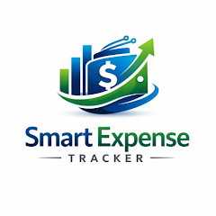
Smart Expense Analyzer
A beginner-friendly personal finance tracker built with Python
Submitted to
International School of Technology and Sciences for Women
Under the guidance of: Presented By:
Mr. G.Suresh , M. tech Kaja Navya
Assistant Professor, Kannuru Hykulu
Department of Artificial Intelligence and Machine Learning Kopiri Aswitha
Ravada Niharika

Slide 2
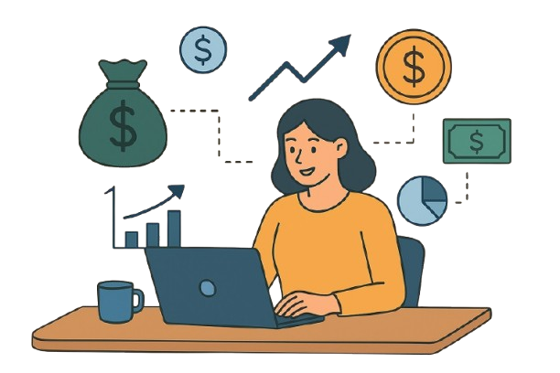
Abstract
The Personal Expense Analyzer is a Python desktop application built with Tkinter and SQLite3 for secure, persistent financial tracking. It provides an intuitive interface for users to register, log in, and manage their daily transactions within a centralized, local database.
The system features a Data Visualization module that utilizes Matplotlib to generate real-time pie and bar charts. These insights help users identify spending patterns and optimize their budgets through automated categorization and searchable history views.
For enhanced security, the project includes a "Code Red" privacy feature that allows users to permanently delete their records. This combination of a relational backend and event-driven frontend creates a practical tool for organized asset management and financial literacy
.
.

Slide 3

Introduction
Financial management is a crucial aspect of everyday life, yet many individuals struggle to monitor and control their expenses effectively. With the increasing use of digital transactions, credit cards, and online payments, keeping track of spending habits has become more complex.
To address these challenges, the Smart Expense Analyzer is designed as a Python‑based application that simplifies expense tracking and provides intelligent insights into financial behavior. By leveraging Python’s powerful libraries for data handling and visualization, the system can automatically categorize expenses, generate clear reports, and highlight spending patterns.
.

Slide 4
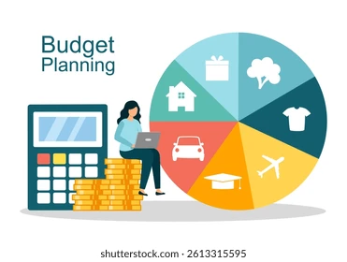
Problem Statement
Common Financial Challenges
In the modern digital era, individuals often engage in multiple financial transactions daily through cash, cards, UPI, and online wallets. While these methods make payments convenient, they also make expense tracking more complicated.
Many people struggle to track their daily expenses consistently. Without proper tools, it's difficult to understand spending patterns, identify unnecessary costs, or plan budgets effectively.

Slide 5
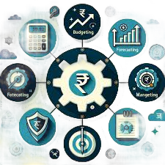
Objectives
To develop a Python‑based application that records and manages daily expenses in a structured format.
Organize Finances: To replace messy manual notes with a clean digital system
that records exactly when, where, and how much money you spend.
Visualize Spending: To turn boring lists of numbers into easy-to-read charts
(like pie and bar graphs) so users can instantly see their biggest spending habits.
Ensure Privacy: To create a secure space where different users can manage their
own private data and even wipe it clean with one click if they want to start over.

Slide 6
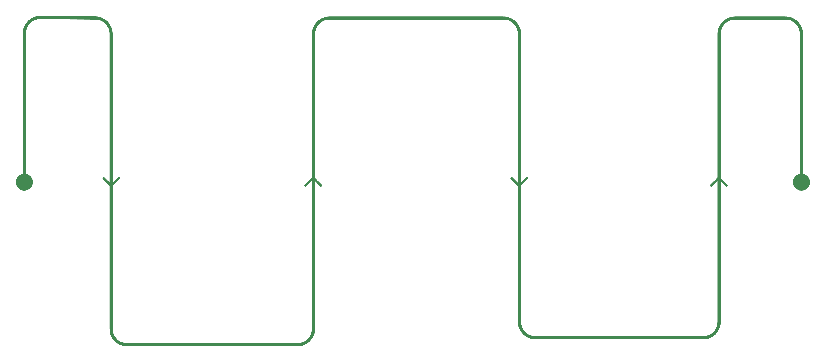



How It Works
Data Processing
Store and analyze patterns
User Input
Output
Add expenses via the interface
Show charts and forecasts

Slide 7

Key Features
User Authentication
Secure login and signup system with salary input.
Expense Management
Add, view, and delete expenses with details (date, category, amount,
description).
Data Storage
Local SQLite database with separate tables for users and expenses
Visualization Tools
Code Red Button
Pie chart for category distribution and bar chart for totals using Matplotlib.
Permanently delete all expense records for the active user.
Generate Charts
Expense Prediction
Tkinter-based interface with multiple pages (Login, Signup, Home, Add Expense, View Expenses, Statistics).
Analyze trends to estimate future monthly spending

Slide 8
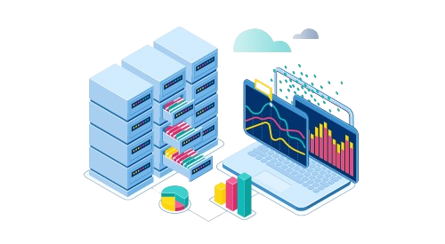
Methodology
Data Collection – Gather expense records through manual entry or CSV/Excel files.
Preprocessing – Clean and organize data using Python libraries like pandas.
Categorization – Classify expenses into categories (Food, Travel, Bills, etc.) using
rules or ML models.
Visualization – Generate charts and reports with matplotlib and seaborn to show
spending patterns.
Budget Monitoring – Set limits and trigger alerts when expenses exceed
thresholds.
Prediction – Apply regression models to forecast future expenses.
Testing – Validate accuracy of categorization, reporting, and predictions with
sample datasets.

Slide 9
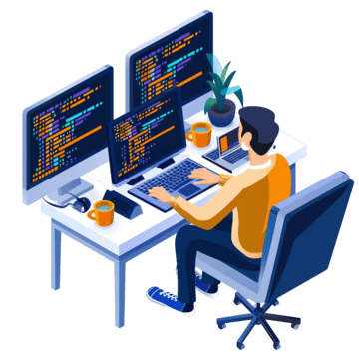
Tools and Technology Used
Programming Language: Python → Core language for application logic.
GUI Framework
  Tkinter → For building the graphical user interface.
  ttk (Themed Tkinter Widgets) → For styled dropdowns and tables.
  Tkcalendar → For date selection in expense entry.
Database
  SQLite → Lightweight local database for storing user and expense records
  .
Data Visualization:
  Matplotlib → For generating pie charts and bar charts.
Utilities
  Datetime Module → For handling date and time filters in statistics.

Slide 10
Advantages
Automation – Reduces manual effort by automatically categorizing and analyzing expenses.
Accuracy – Minimizes human errors compared to traditional bookkeeping or spreadsheets.
Visualization – Provides clear charts and reports for easy understanding of spending patterns.
Budget Control – Alerts users when expenses exceed predefined limits, promoting financial discipline
Prediction – Forecasts future expenses, helping in proactive financial planning.
User‑Friendly – Simple input methods and intuitive dashboards make it easy to use.
Scalability – Can be extended to integrate APIs, databases, or mobile apps for broader usage.

Slide 11
Future Scope
Bank/API Integration – Directly connect with banking systems, UPI apps, or digital wallets for automatic
expense tracking.
Mobile Application – Develop Android/iOS apps for real‑time expense monitoring on the go.
AI‑Driven Insights – Use advanced machine learning models to suggest savings strategies and detect unusual
spending behavior.
Voice & Chat Interfaces – Enable expense entry and queries through voice assistants or chatbots.
Multi‑User Support – Extend functionality for families or small businesses to manage shared expenses.
Data Security Enhancements – Implement encryption and authentication to protect sensitive financial information

Slide 12
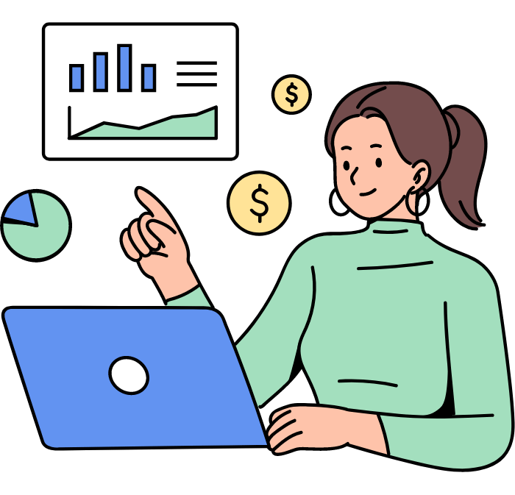
Conclusion
The Smart Expense Analyzer using Python provides an efficient and intelligent solution for managing personal finances. By automating expense categorization, generating clear visualizations, and offering budget alerts, the system helps users gain better control over their spending habits. With predictive analysis, it goes beyond simple tracking to provide valuable insights into future expenses, encouraging financial discipline and savings.
This project demonstrates how Python’s data handling and visualization capabilities can be applied to real‑life problems, transforming raw financial data into meaningful information. While the current version has limitations, it lays a strong foundation for future enhancements such as mobile integration, cloud storage, and AI‑driven insights. Ultimately, the Smart Expense Analyzer empowers individuals to make informed financial decisions and achieve long‑term financial stability

