Slide 1

Some Advance Queries are used to Generate more insights

Slide 2
MySql commands
Changing Data type of column TT_Spending
Create new column named as Total spending

Slide 3
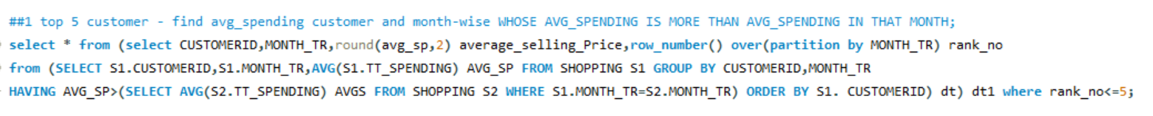
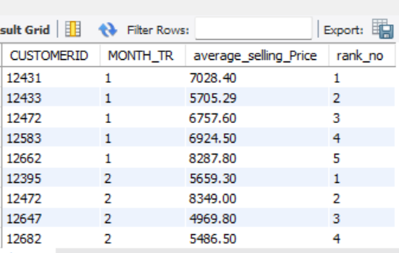
Some Advance Queries for extracting Insights from Data
Query1

Slide 4
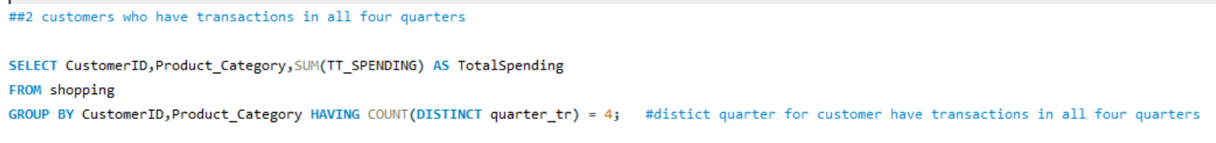
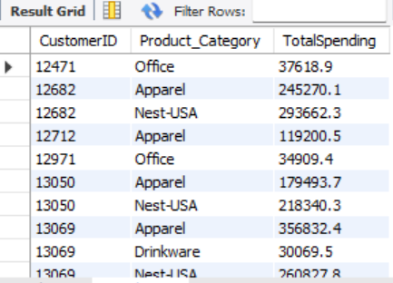
Query2

Slide 5
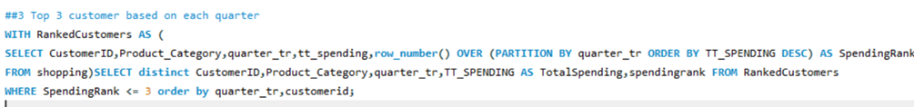
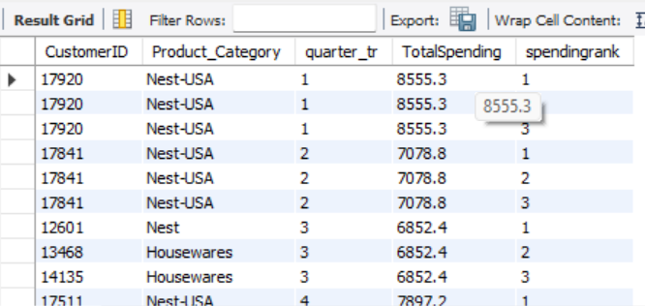
Query3

Slide 6
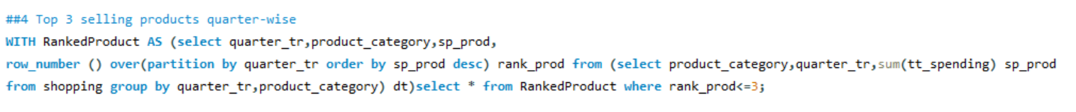
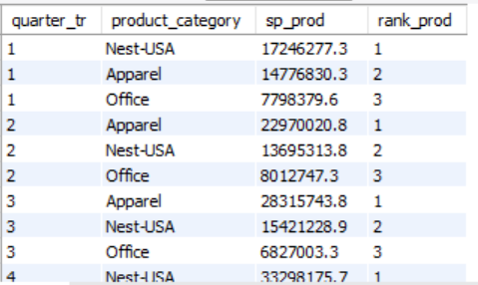
Query4

Slide 7
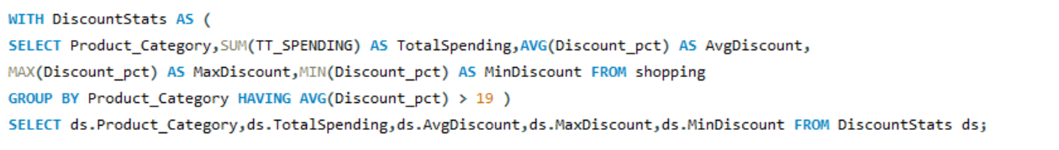
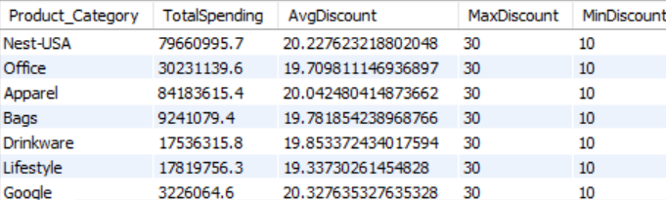
Query5

Slide 8
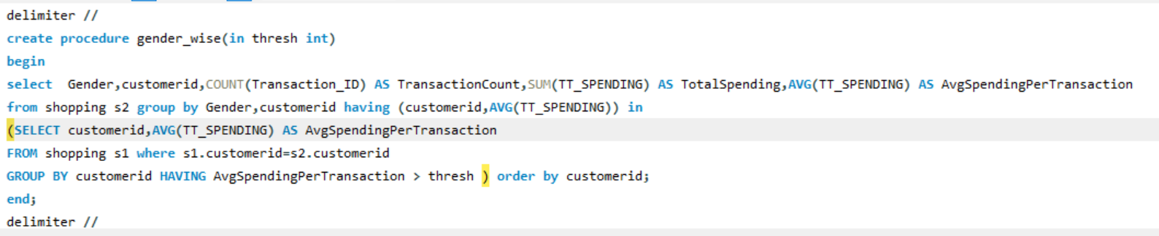

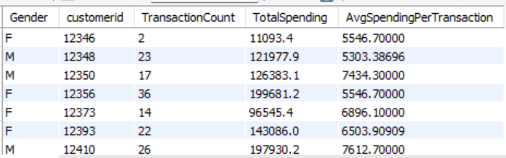
Query6

Slide 9

A Dashboard is designed to show Mysql Queries Visually so, It will easy to understand them.

Slide 10

PowerBI Dashboard

Slide 11

A Dashboard is designed to Generate Insights from data, containing Business level insights so that can be used for making strategies and advertisement.

Slide 12
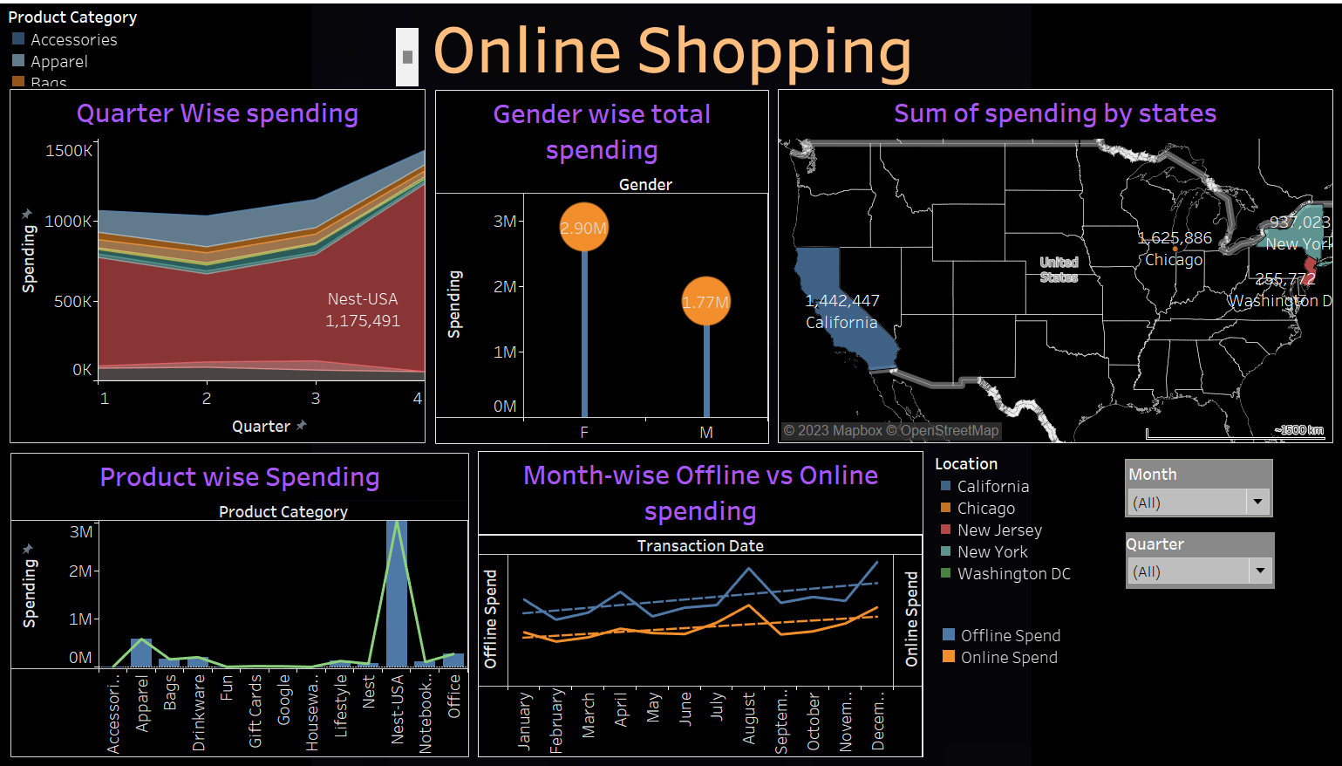
Tableau Dashboard

Slide 13
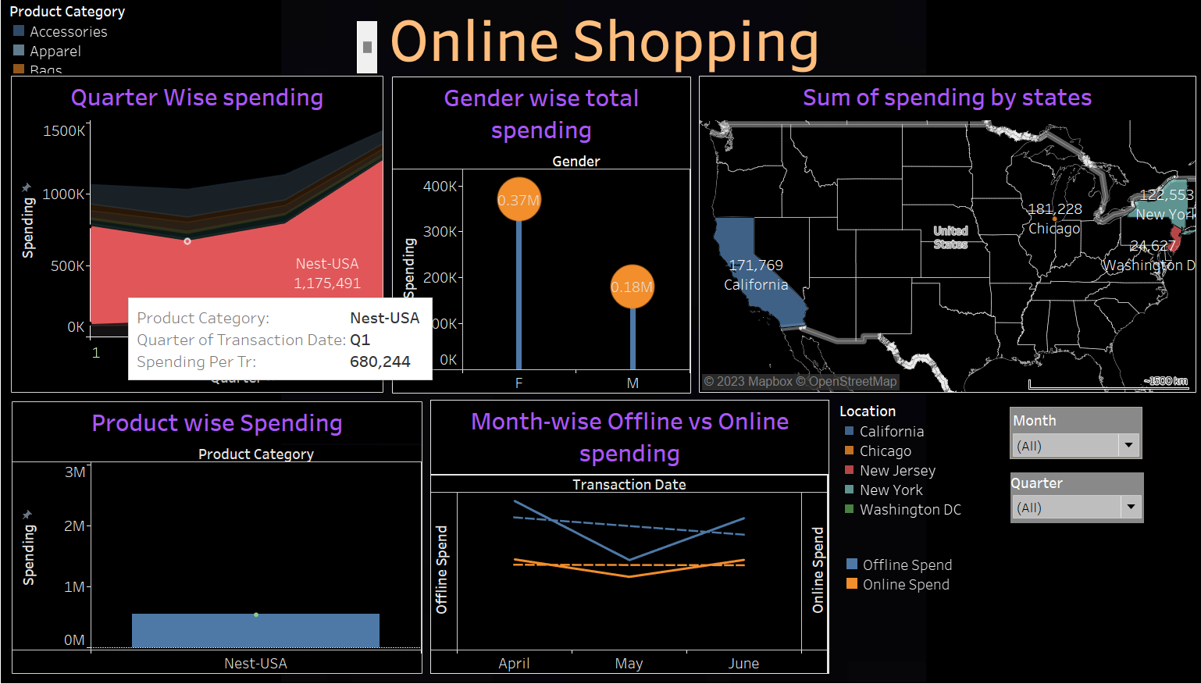
Here we can see majour drop in may Offline spending while spending with Nest-USA while cheking quarter-wise Nest-USA

Slide 14
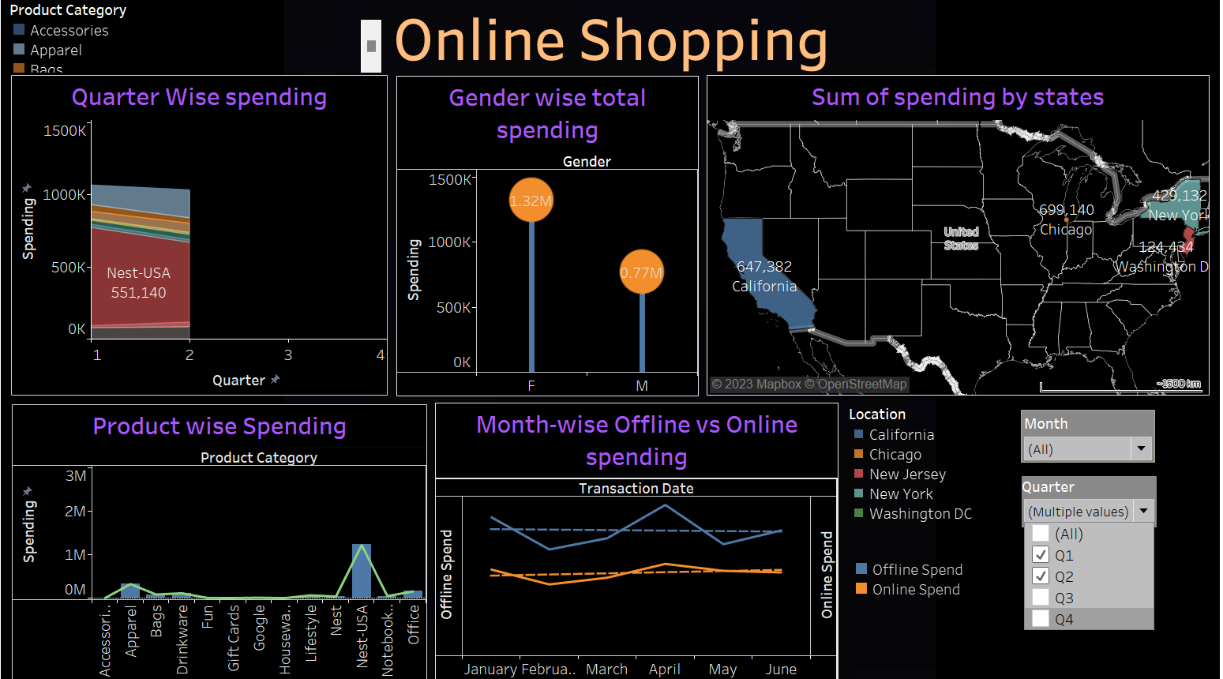
Here we can see some Boom in Offline spending in April Month

Slide 15


