Slide 1
Robotic Process Automation
Using UIPath

Slide 2
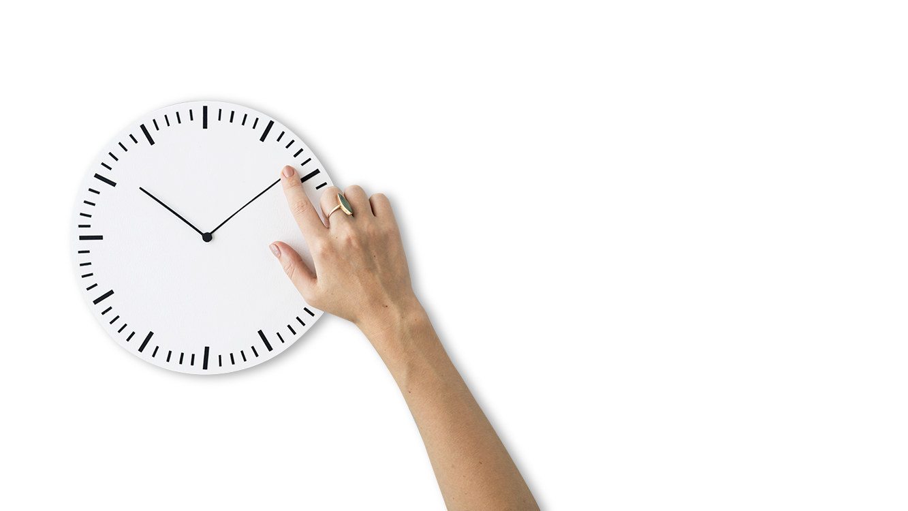
Contents
Overview about UIPath
Variables, Data Types, Control Flows & Data Manipulation
Recording & Selectors
Excel & Data Tables and E-mail automation
PDF & Image Processing
Debugging & Exception Handling
Citrix Automation

Slide 3

Overview about UIPath
Notes:
Esta imagem nao funciona; Espada em cor, nunca branco? Usar a forma de duas cores como os exemplos aqui em anexo.

Slide 4
What is Automation
Automation can be defined as the technology by which a process or procedure is performed without human assistance
Company
Jobs
Cost
Speed
Automation
Machine
Money
Solution
Lasers
Modern
Robots
Tasks
Precise

Slide 5
What is RPA ?

Slide 6
What is RPA ?
R
P
A
Robotic
An entity which is capable of being programmed by a computer for doing complex tasks as known as Robots, this task would be to mimic the human actions.
Process
Automaton

Slide 7
What is RPA ?
R
P
A
Robotic
A sequence of steps, that lead to a meaningful activity or task is known as Process
Process
Automation

Slide 8
What is RPA ?
R
P
A
Robotic
When a task happens automatically, i.e. without human intervention.
Process
Automation

Slide 9
Traditional Automation Vs RPA
Traditional Automation
Traditional automation is primarily based on programming and relies on APIs.
Requires complex integration.
Rolls out slower.
Cost is more.
Automation can not be personalized.
RPA
RPA on the other hand mimics the actions of a user at the User Interface level.
Requires no complex integration
Rolls out faster.
Cost is less.
One of the key benefit of an RPA automation can be that it can be personalized for a particular user. For e.g. the robot can read an email, extract information , do something and reply back to the email.

Slide 10
Introduction to UIPath

Slide 11
UiPath Studio - an advanced tool that enables you to design automation processes in a visual manner, through diagrams.
UiPath Robot - executes the processes built in Studio, as a human would. Robots can work unattended (run without human supervision in any environment, be it virtual or not) or as assistants (a human triggers the process).
UiPath Orchestrator - a web application that enables you to deploy, schedule, monitor and manage Robots and processes, while business exception handling is available through centralized work queues.

Slide 12
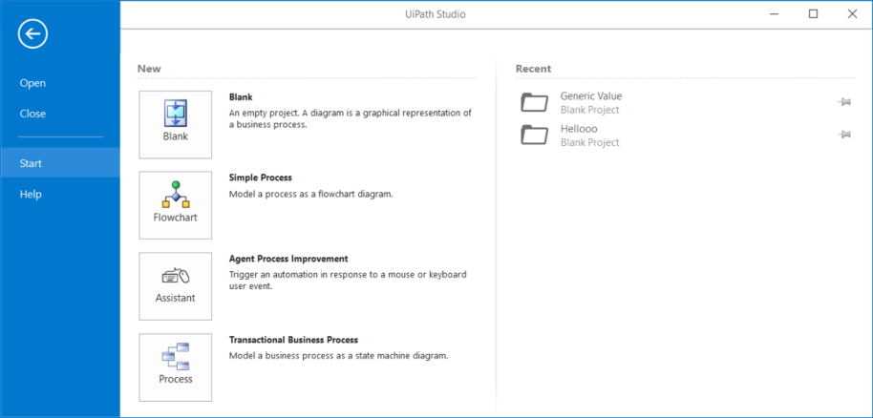
The User Interface Of UIPath
The Ribbon - The ribbon is straightforward and can be minimized or expanded by clicking the Minimize / Expand button . It consists of the following four tabs:
Start

Slide 13
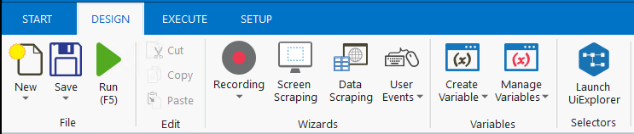
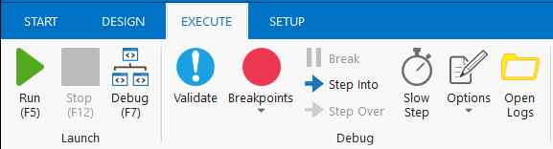
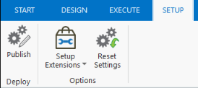
Design
Execute
Setup

Slide 14
Capgemini Automation Framework
This area uses technology to take action. We are used to the concept of Robots working on an assembly line and now they are moving into the office. Examples include resetting a password and placing a customer order.
Act
The ability to listen, read, talk, write and respond to users of the IA solution. The aim here is for technology to ensure that the interaction feels intuitive and the customer is happy. Examples in this space include chatbots and voicebots.
Listen/Talk
Service
Service
This the ability to detect patterns and recognise trends. It applies algorithms to knowledge to determine appropriate action or predict future consequences.
Interact
Think
Interaction
Analyze
Analyze
Here technology is used to watch and record key business data. It is used to create knowledge. This would include CCTV and IoT sensors.
This is about being able to store and find information effectively using components like databases and search engines. This is probably the least developed area within corporations, but examples include Wikipedia and employee’s hard drives.
Watch
Remember
Monitor
Monitor
Knowledge
Knowledge

Slide 15
Variables, Data Types, Control Flows & Data Manipulation

Slide 16
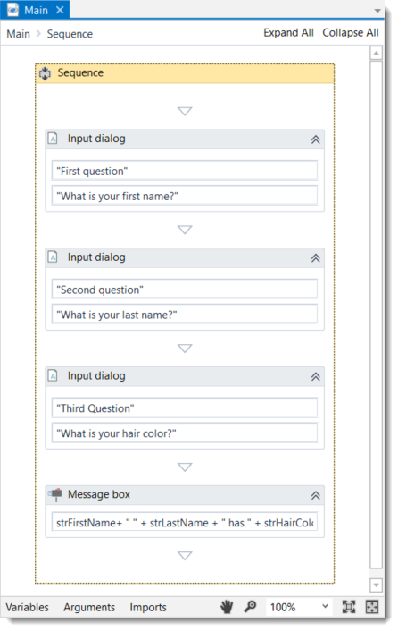
Sequences
Sequences are the smallest type of project. They are suitable to linear processes as they enable you to go from one activity to another seamlessly, and act as a single block activity
One of the key features of sequences is that they can be reused time and again, as a standalone automation
For example, you can create a sequence to take information from a .pdf file and add it to a spreadsheet, and reuse it in a different setting, while changing just a few properties.

Slide 17
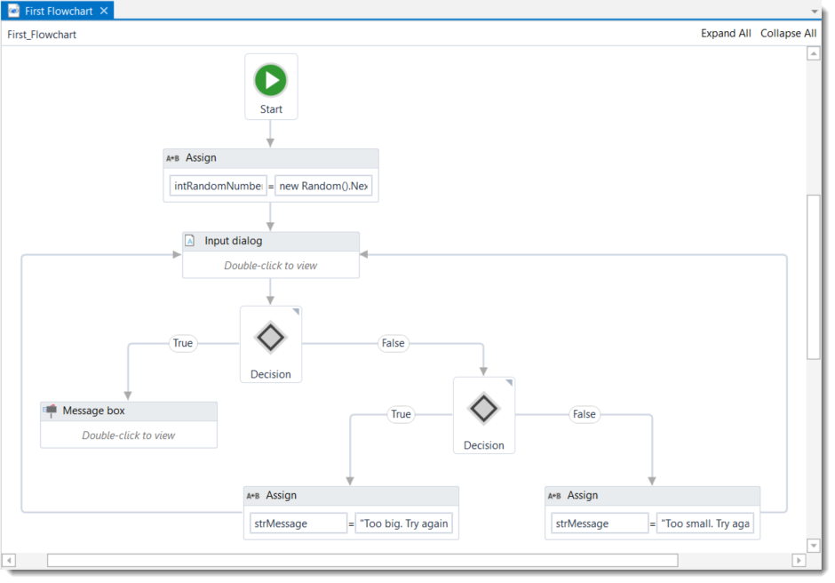
Flowcharts
Flowcharts can be used in a variety of settings, from large jobs to small projects that you can reuse in other projects
The most important aspect of flowcharts is that, unlike sequences, they present multiple branching logical operators, that enable you to create complex business processes and connect activities in multiple ways.

Slide 18
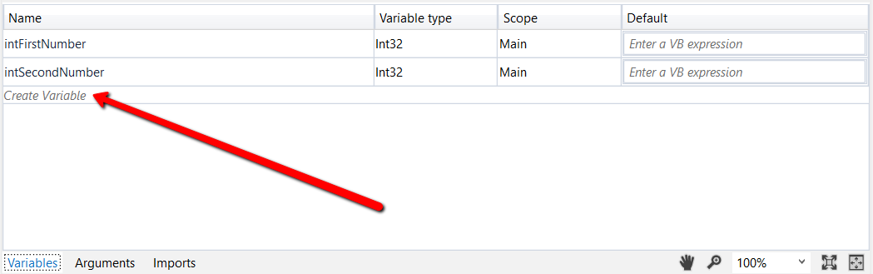
Variables
variables are used to store multiples type of data. Another key aspect of variables is that their value can change
In UiPath, we support a large amount of types, ranging from generic value, text, number, data table, time and date, UiElements to any .Net variable type.
Trim(), Replace(), Substr and many more String Operations.

Slide 19
Build Robot using the learnings
Open NotePad and type Hello World

