Slide 1
Assignment-Discussion POS Tagging Using HMM
200050033-Desai Divyeswar Reddy
200050056-Kajal Malik
200050117-Reddy Bhavana
September 4th , 2022
Notes:
<number>

Slide 2
Problem Statement
Given a sequence of words, produce the POS tag sequence
Technique to be used: HMM-Viterbi
Use Universal Tag Set (12 in number)
5-fold cross validation
Tags : 'NOUN', 'VERB', 'X', 'CONJ', '.', 'PRON', 'DET', 'ADJ', 'ADV', 'NUM', 'ADP', 'PRT'

Slide 3
Overall performance
Precision : 0.930173842295186
Recall : 0.9276729483750239
F-score (3 values) :-
F1 - score 0.928921712077252
F0.5-score 0.9296725853553282
F2 -score 0.9281720507434242

Slide 4
Per POS performance
Tag: P , R , F1 , F0.5 , F2 :
DET : 0.90977484 , 0.97893393 , 0.9430881639396256 , 0.9228136917776267 , 0.9642735200001054
NOUN : 0.9471996 , 0.8979869 , 0.9219369829698474 , 0.936930218945621 , 0.9074160478368843
ADJ : 0.9199674 , 0.8841014 , 0.9016778926610186 , 0.9125632918655618 , 0.8910491225837633
VERB : 0.9499367 , 0.92295635 , 0.9362521991407848 , 0.944415177774315 , 0.92822912340073
ADP : 0.9048836 , 0.94504046 , 0.9245262106232337 , 0.9126396497189257 , 0.9367264875322633
. : 0.92716396 , 0.9980464 , 0.9613002857304734 , 0.9405233592046042 , 0.9830159072281821
ADV : 0.93487364 , 0.8654071 , 0.8988001105427518 , 0.9201022246628353 , 0.8784620456569678
CONJ : 0.97213745 , 0.96020263 , 0.9661332156996544 , 0.9697268415805108 , 0.9625661260879986
PRT : 0.796546 , 0.82202935 , 0.8090870886255694 , 0.8015154981928893 , 0.8168030947559328
PRON : 0.959507 , 0.9176062 , 0.9380889235621437 , 0.9508234599721999 , 0.9256909904872016
NUM : 0.95827353 , 0.8970687 , 0.9266615472882688 , 0.9453733848872752 , 0.9086760622111456
X : 0.71896553 , 0.30086583 , 0.424211617218094 , 0.5626011998758317 , 0.3404637704158935

Slide 5
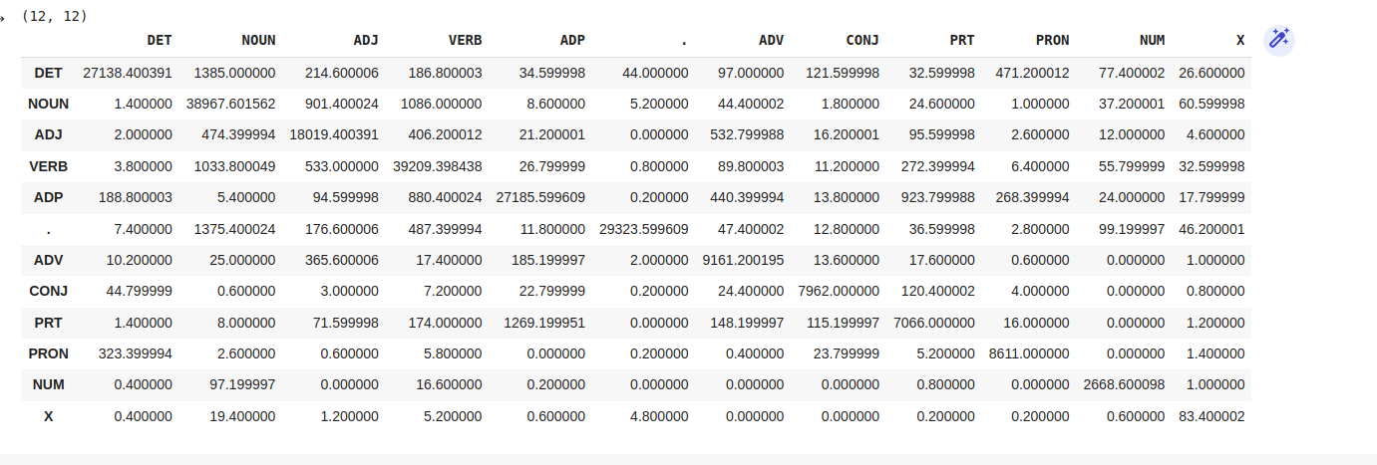
Confusion Matrix (12 X 12) (can give heat map)

Slide 6
Interpretation of confusion (error analysis)
Maximal Confusions :
1) Noun Verb confusions
2) Verb Noun Confusions
3)Tag-PRT confusions
Reasons :
1)As there are many words in english language which are used as both, noun and verb , like people, dance , bank etc . Which is cause of high values of noun verb and verb noun confusion in confusion matrix.

Slide 7
Data Processing Info (Pre-processing)
The given data contains list of sentences with tags , these sentences further contains list of tagged words
We broke down all the sentences in the data into a single list of tagged words.
We implemented frequency distribution of the words and tags.

Slide 8
Inferencing/Decoding Info
Viterbi :
First we’ll find transition and emmission probability for a given word for all possible tags
From those POSs , we’ll take the one with maximum value of transision*emmission probability and that woulde be considered as the predicted tag for that word in the sentence
And we’ll store the tags in a list names states and this list will be used for calculating the transition probability of the next word
Along with the list of states in the sentences, we’re maintaing mapping of the words with most probable tags in another list
And that list will be returned as output of the algorithms.

Slide 9
Marking Scheme
1. Demo working- 10/10 (if not, 0)
2. Implemented Viterbi and Clarity on Viterbi- 5/5
3. Transition and Lexical tables clearly described- 5/5
4. Confusion matrix drawn and error analysed- 5/5
5. Overall F-score > 90- 10/10, >80 & <=90- 8/10, else 6/10
6. Unknown word handling- done (5/5; else 0)

