Slide 1

EDA Project - AMCAT Data Analysis

Slide 2
About me
I am currently working as a Quality Team Lead at Tech Mahindra, where I manage various projects in content moderation, data labeling, quality management, and data analysis across different domains. My role focuses on enhancing processes to drive improvement and growth.
I have a strong passion for data analysis, as it empowers organizations to solve complex problems. This interest has motivated me to look deeper into data science, allowing me to leverage my problem-solving skills to analyze real-time data effectively.
LINKEDIN URL - https://www.linkedin.com/in/kajaldaga
Github URL - https://github.com/KajalDaga

Slide 3
Objective of the project
To improve the recruitment process by accurately forecasting a candidate’s job performance and fit based on their test scores, educational background, and demographic information.
Recruiters and employers need an efficient way to match candidates to roles, all while reducing hiring costs and enhancing retention rates. By utilizing this data, companies can more effectively identify high-potential candidates and optimize their recruitment strategies.

Slide 4
Exploratory Data Analysis:
Imported Libraries: Pandas, NumPy, Matplotlib, and Seaborn for data manipulation and visualization.
Load Dataset: Read the dataset into a Pandas DataFrame for exploration.
Initial Exploration: Use functions like .shape, .describe(), and .info() to understand the dataset size, data
types, and summary statistics.
Data Cleaning Steps:
Handling Missing Data: Identify and address any missing values.
Remove Duplicates: Eliminate any duplicate entries in the dataset.
Correct Inconsistent Values: Fix any inconsistencies in the data. Data cleaning involves rectifying or removing
incorrect, corrupted, improperly formatted, duplicate, or incomplete data.
Data Manipulation Steps:
Map Categorical Values:: Mapped Categorical values to proper streams
Removed Unnecessary Columns: Dropped unnecessary columns i.e Unnamed
Filterting :filtered the data as per the requirement for analysis

Slide 5
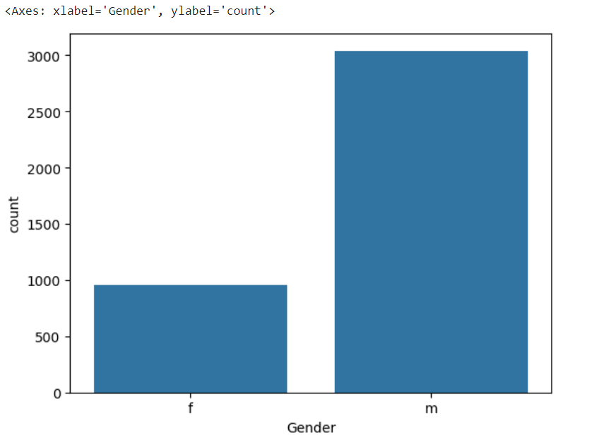
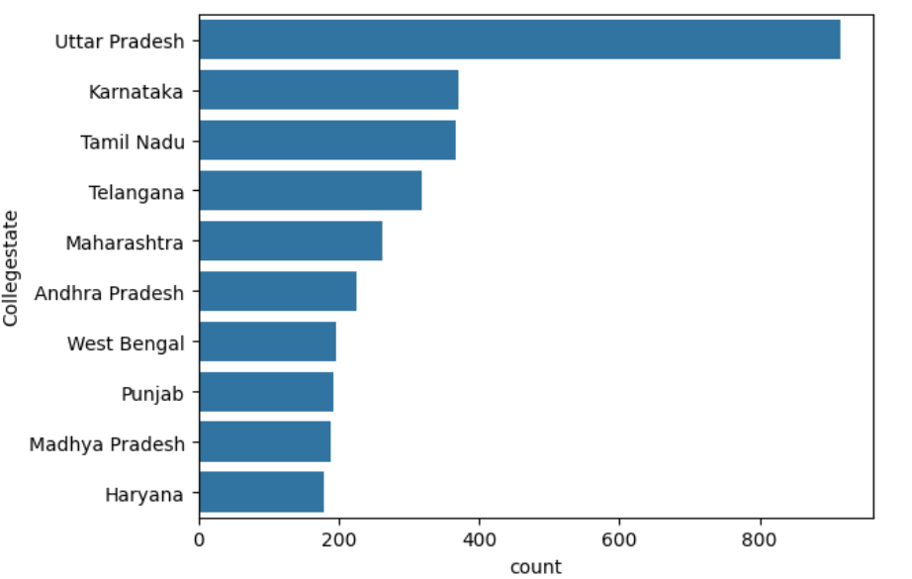
Univariate Data Analysis:
We have observed the females graduates are pursuing less jobs compare to the male
Observed the highest number of graduates completed their studies from Uttar pradesh are attempted the amcat test

Slide 6
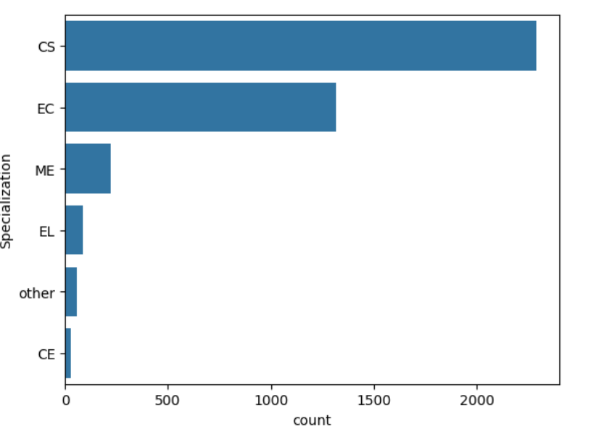
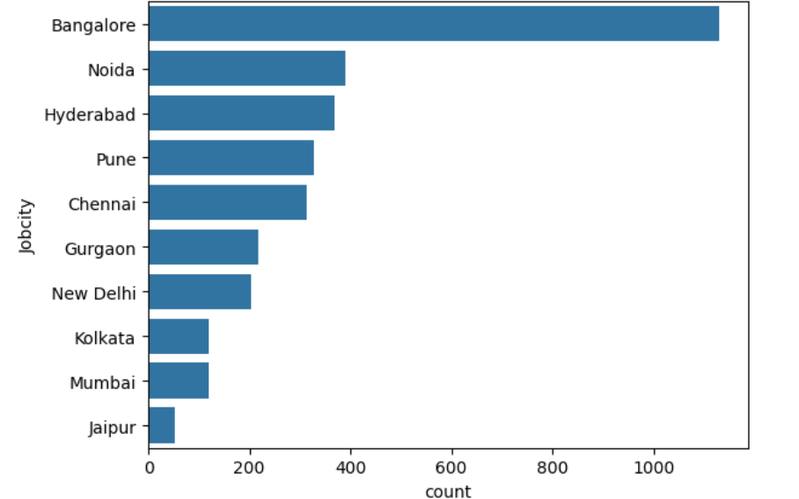
Univariate Data Analysis:
We have observed the people are preferring CS and EC compared to other streams
Observed the highest number of jobs are available at Bangalore and followed by Noida

Slide 7
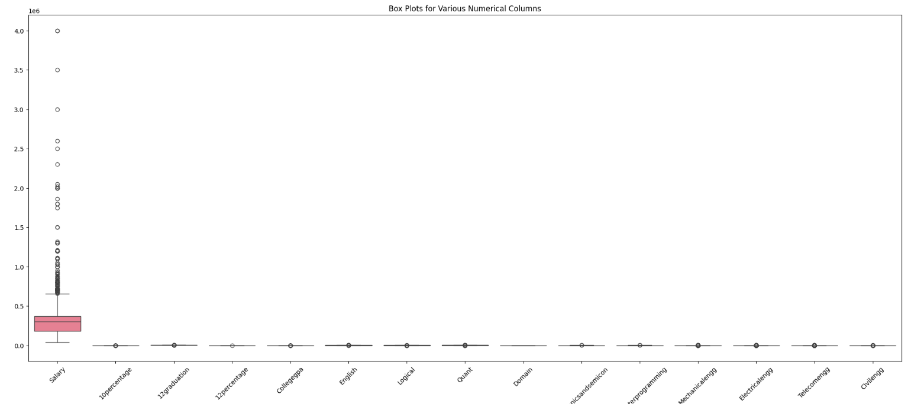
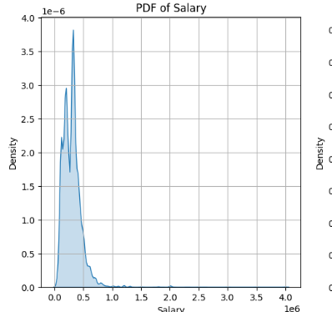
Univariate Data Analysis:
We have observed the major outliers in salary
Maximum salary stands at 40 Lakhs and Minimum salary stands at 35k
Average salary stands at 3.5 Lakhs

Slide 8
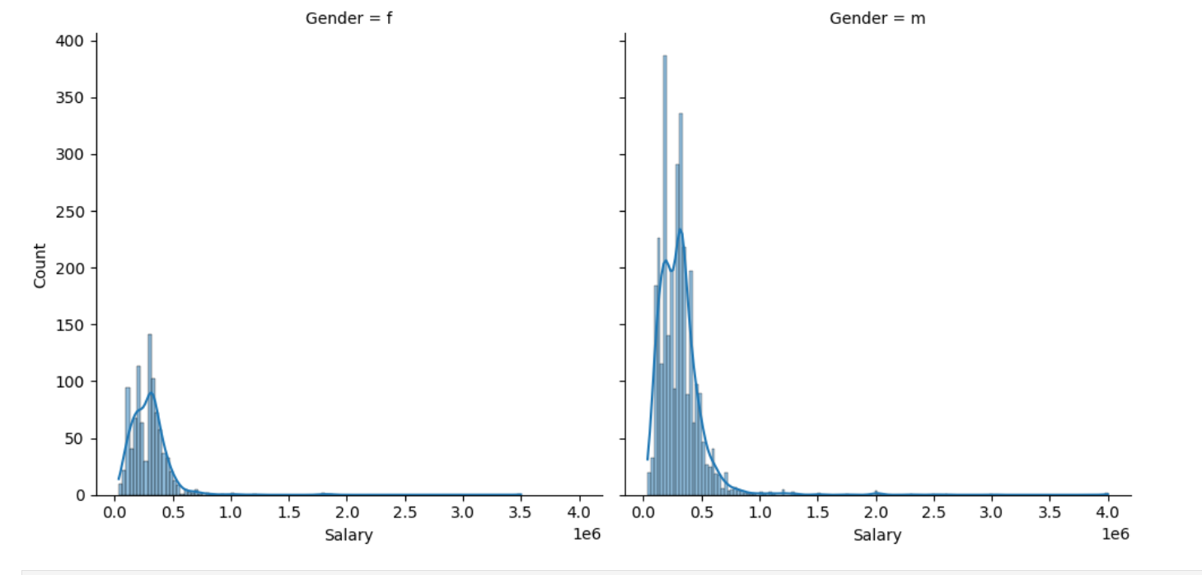
Bivariate Data Analysis:
Observed highest salaries are offered to the male compare to female employees

Slide 9
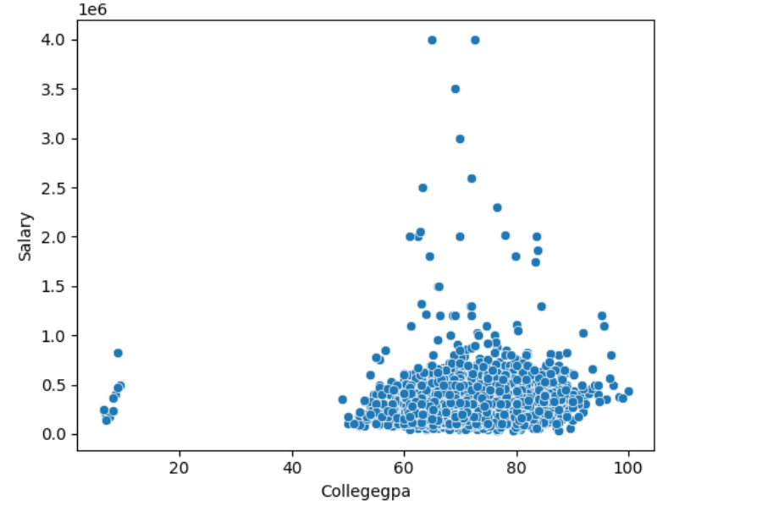
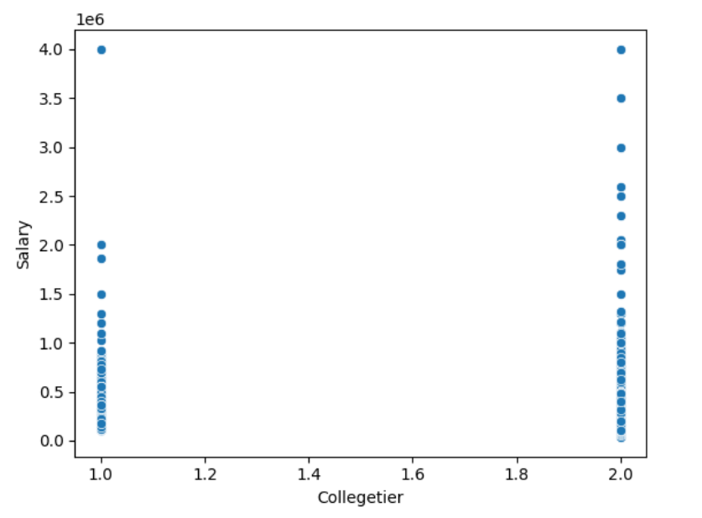
Bivariate Data Analysis:
No strong correlation between salary and GPA and majority of employees hold 60 - 90 GPA score
Also, no strong correlation between college tier and salaries as both tier 1 and 2 are getting highest salaries

Slide 10
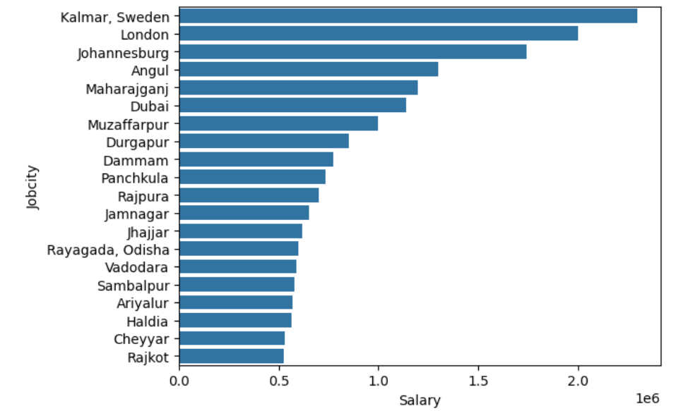
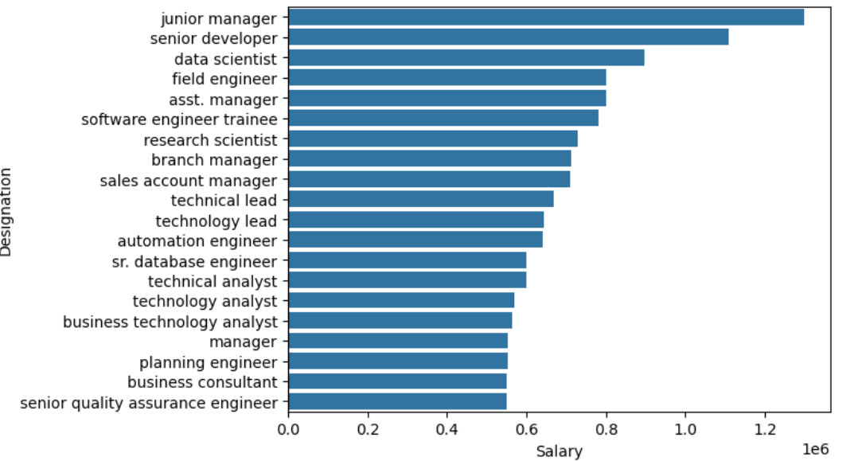
Bivariate Data Analysis:
Highest average salaries are offered in Sweden and followed by London
Highest salary is offered for Junior Managers and followed by Senior developer

Slide 11
Challenges:
While working on the AMCAT dataset project, one of the primary challenges was managing the complexity and diversity of data features, Ensuring data quality through effective cleaning was crucial, as missing and inconsistent values in variables such as job location, and education presented significant obstacles during the analysis.

Slide 12

Conclusion (Key finding overall)
Based on the analysis, the claim of a salary range between ₹2.5-3 lakhs for Computer Science graduates in specific job roles is not supported by the data.
There is significant relationship between gender and specialization ,p-value is less than 0.05.
No strong correlation between salary and GPA and also there is no correlation between tier colleges and salary
Observed highest salaries are offered to the male compare to female employees

Slide 13

THANK YOU

