Slide 1
PROJECT
SQL

Slide 2
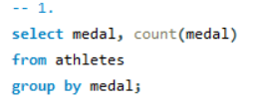
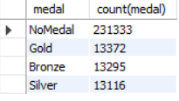
Q 1. Show how many medal count present for entire data

Slide 3
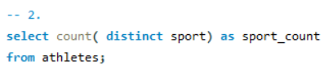

Q 2. Show count of unique sport are present in olympics

Slide 4
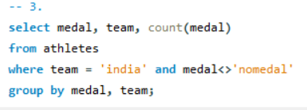
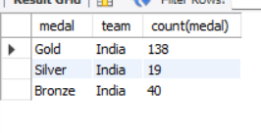
Q 3. Show how many different medal won by team india in data

Slide 5
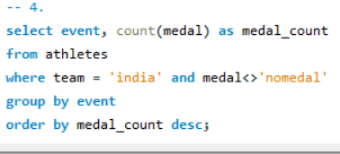
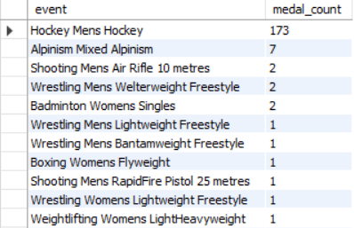
Q 4. Show event wise medal won by india show from highest to lowest medal won in order

Slide 6
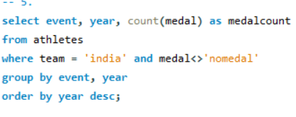
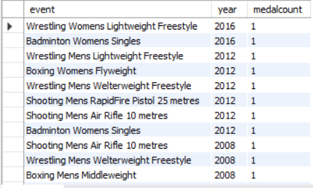
Q 5. Show event and yearwise medal won by india in order of year

Slide 7
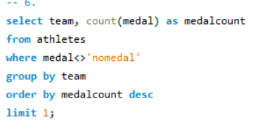

Q 6. Show the country with maximum medal won gold , silver, bronze

Slide 8
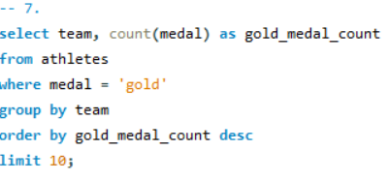
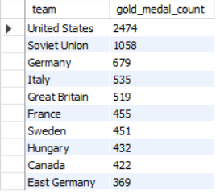
Q 7. Show the top 10 countries with respect to gold medal

Slide 9
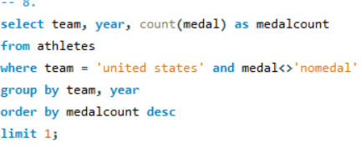

Q 8. Show in which year did united states won most medal

Slide 10
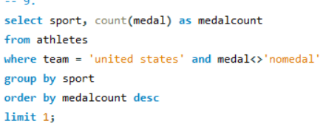

Q 9. In which sport united states has most medal

Slide 11
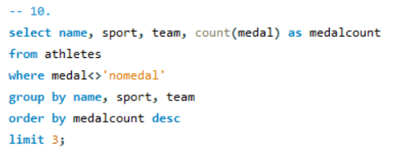

Q 10. Find top 3 players who have won most medal along with their sports and country

Slide 12
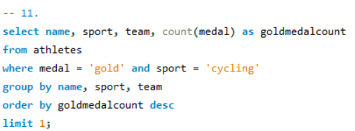

Q 11. Find player with most gold medal in cycling along with his country

Slide 13
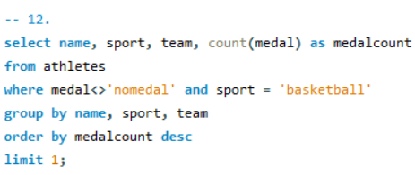

Q 12. Find player with most medal (gold + silver + bronze) in basketball along show his country

Slide 14
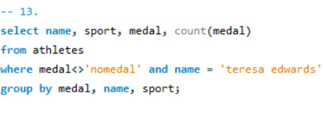

Q 13. Find out the count of different medal of the top basketball player

Slide 15
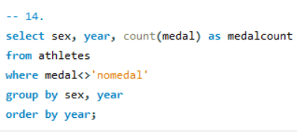
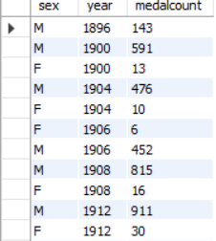
Q 14. Find out medal won by male , female each year

