Slide 1

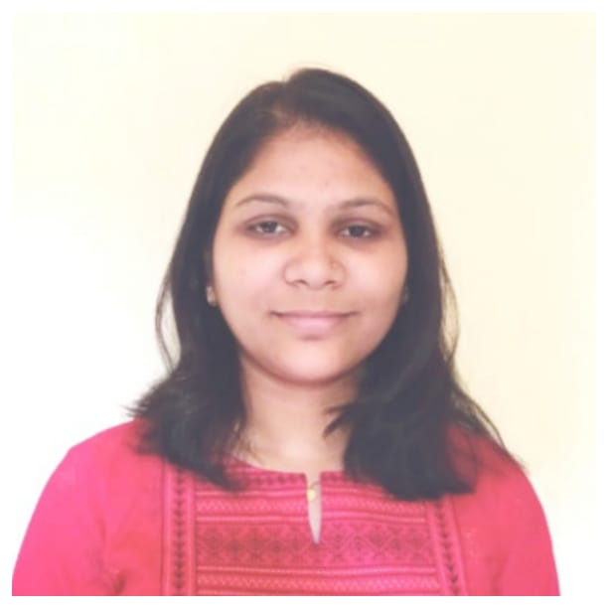



Kajal Khandekar
Education
Bachelor of Engineering Electronics & Telecommunication Engineering : 2016 - 2020
Skills
Analyst/Software Engineer
Base Location: Mumbai
Email ID: KAJAL.NARENDRA-KHANDEKAR@CAPGEMIN.COM
Mobile No: +91 9370067612
Grade: A4
java | java, OOPS, Collections, Array, Loops, Exceptions.
Database | PostgreSQL
UI Technology | HTML 5 & CSS3, JavaScript,Typescript, Bootsrap
Tools | Git & GitHub, Eclipse, Swagger, Visual Studio Code, SQL shell.
Strengths
Full Stack Java Developer
Hands on experience on Core java, PostgreSQL.
Proficient in creating Single page Web Application in Angular with Authentication with routing.
Hands on experience in developing web pages using HTML5, CSS3, Object TypeScript.
Ready to learn new technologies and implement them for the Future Knowledge improvement.
Achievement
Tour Management System
Case study of Tour Management System along with Swagger, responsive UI with HTML5, CSS3, Bootstrap and ANGULAR used as User Interface.
Presentation Title | Author | Date © Capgemini 2017. All rights reserved | 1

