Slide 1
IMPLEMENTATION AND ANALYSIS OF FEEDBACK DIVERSITY USING MATLAB SIMULINK
EC6100 – WIRELESS AND MOBILE COMMUNICATION
GROUP MEMBERS :
2020/E/034 – DILUSHANTH P.
2020/E/050 – HEMAKANTH N.
2020/E/063 – JEYASINGAM K.
2020/E/197 – MITHULAVAN V.
DEPARTMENT OF ELECTRICAL AND ELECTRONIC ENGINEERING

Slide 2
CONTENTS
Introduction
Theory behind the Feedback diversity
Design and implementation
Explanation of simulation
Results
Discussion
Significance
DEPARTMENT OF ELECTRICAL AND ELECTRONIC ENGINEERING

Slide 3
INTRODUCTION
Challenges in wireless communication system
1. Multipath fading
2. Noise
3. Interference
It will improve signal quality and reliability and enhance spectral efficiency and system capacity.
Objective – Design, implement, and simulate the feedback diversity technique using MATLAB Simulink
Notes:
Wireless communication systems face numerous challenges, including multipath fading, noise, and interference which can degrade signal quality and reliability. This feedback diversity is one of the technique to address this issues.

Slide 4
THEORY BEHIND THE FEEDBACK DIVERSITY
Basic components to transmit information – Transmitter, Channel, Receiver
Signals are subjected to various impairments that can affect their quality and reliability.
Channel impairments – Multipath fading, AWGN
Diversity techniques aim to improve signal quality and reliability by using two or more communication channels.
Diversity techniques:
1. Spatial Diversity
2. Time Diversity
3. Frequency Diversity
4. Polarization Diversity
Notes:
Wireless communications systems transmit information through the space using electromagnetic waves. This system includes basic components to transmit information. Such as,
Transmitter – generates and modulates the signal
Channel – the medium through which the signal propagates
Receiver – detects and demodulates the received signal
During the transmission process, signals are subjected to various impairments such as multipath fading, AWGN that can affect their quality and reliability.
Multipath fading occurs when a signal takes multiple paths from the transmitter to the receiver due to reflection, refraction, and scattering. It will result in multiple copies of the signal arriving at the receiver with different delays, amplitudes, and phases. In our implementation The Rayleigh fading model is used to describe multipath fading in environments where there is no line-of-sight path between the transmitter and receiver. 2.Additive White Gaussian Noise (AWGN) It’s a noise model. It adds white noise with a constant spectral density and a Gaussian distribution of amplitude to the signal passing through the signal.

Slide 5
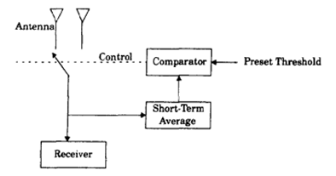
THEORY BEHIND THE FEEDBACK DIVERSITY
Feedback diversity is a reception method of spatial diversity.
It’s an adaptive technique where information about the channel conditions is send back to the transmitter. The transmitter then uses this feedback to adjust its transmission parameter.
similar to selection diversity.
N-signals are scanned on the receiver side until one is found to be above a predetermined threshold.
If the SNR value falls then the scanning process is initiated again.
Notes:
Which is similar to spatial diversity. In spatial diversity signals are scanned and selected simultaneously. But in feedback diversity signals are scanned in fixed set sequencer.
In this block diagram, there is a comparator. This comparator has a preset threshold SNR. So this comparator will compare threshold CNR with the received signal . When the received signal SNR vaue is greater than threshold then that signal will be chosen

Slide 6
THEORY BEHIND THE FEEDBACK DIVERSITY
Advantages of Feedback diversity:
1. Improved signal quality
2. Enhanced spectral efficiency
3. Reduced power consumption
4. Increased system capacity
5. Simple to implement

Slide 7
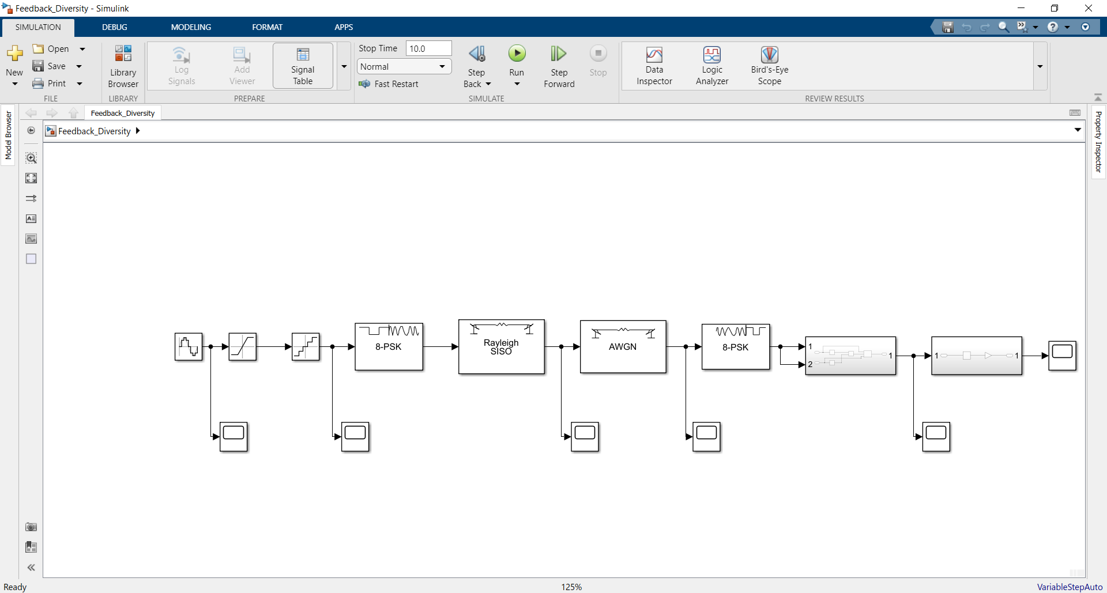
DESIGN AND IMPLEMENTATION
IMPLEMENTATION USING MATLAB SIMULINK
Figure 02: Simulink model for Feedback Diversity
Notes:
SISO systems use one transmit antenna and one receive antenna. While simpler to implement, SISO systems are more susceptible to fading and interference compared to multiple antenna systems.
2.6 QUANTIZATION It involves converting a continuous amplitude signal to a discrete amplitude signal. This process is essential for digital communication but here it introduces quantization noise.
2.7 MOVING AVERAGE FILTER It’s a simple low pass filter used for smoothing time series data. It operates by creating a series of averages of different subsets of the full data set, helping to reduce the impact of random variations in the signal.
Signal generation A sine wave generator was used as the input signal source. This simple waveform allows for easy visualization and analysis of the system’s effects on the signal.
2. Quantization The continuous sine wave was passed through a quantizer to convert it into discrete levels. This step simulates analog to digital conversion process in digital communication systems.
3. Channel modeling Two channel models were implemented to simulate here. I. Rayleigh SISO Channel This block simulates the effects of multipath fading in a SISO system. It applies Rayleigh fading to the signal, causing variations in amplitude and phase over time. II. AWGN Channel This block adds white Gaussian noise to the signal, simulating random noise present in wireless channels. 4. Feedback Diversity Logic A custom Simulink block was created to implement the feedback diversity logic. This block analysis the channel conditions based on the received signal generates appropriate feedback to the transmitter. 5. Moving Average Filter A moving average filter was applied to the output signal to smooth out rapid fluctuations of the overall signal.

Slide 8
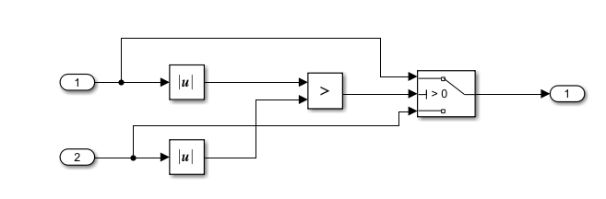
DESIGN AND IMPLEMENTATION
Figure 03: Subsystem for feedback diversity logic

Slide 9

DESIGN AND IMPLEMENTATION
Figure 03: Subsystem for moving average filter

Slide 10
EXPLANATION OF SIMULATION
COMPONENTS:
Signal generation – sine wave generator as input signal source
Quantization – convert the signal into discrete levels
Rayleigh SISO channel – It applies Rayleigh fading to the signal, causing variations in amplitude and phase over time
AWGN – Adds white Gaussian noise to the signal
Feedback diversity logic – Custom Simulink block
Analysis the channel conditions based on the received signal
Moving average filter – Applied to the output signal to smooth out rapid fluctuations of the overall signal.

Slide 11
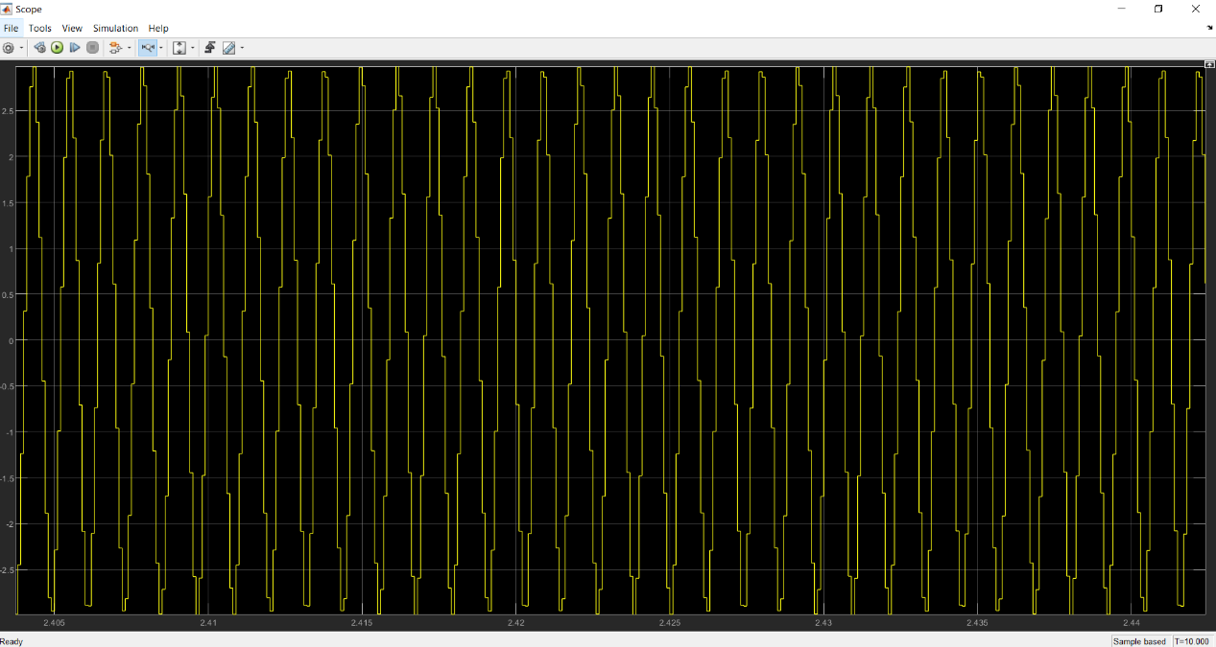
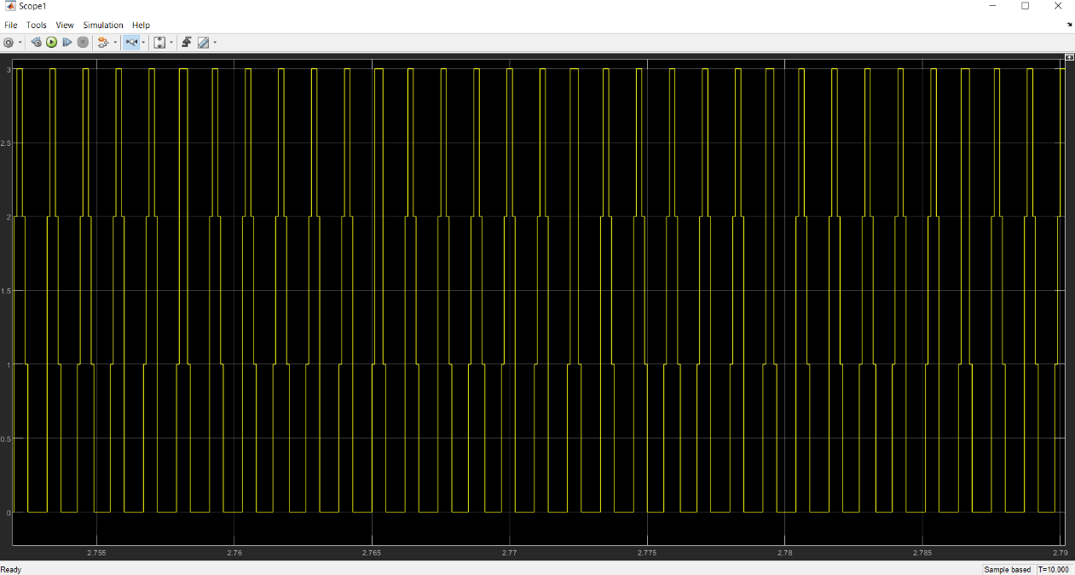
RESULTS AND ANALYSIS
RESULTS FROM MATLAB SIMULINK
A stepped waveform, representing the quantized version of the input sine wave.
The discretization of the continuous input signal into distinct levels.
Some distortion to the original sine wave, visible as the stepped nature of the waveform
Input signal of sine wave

Slide 12
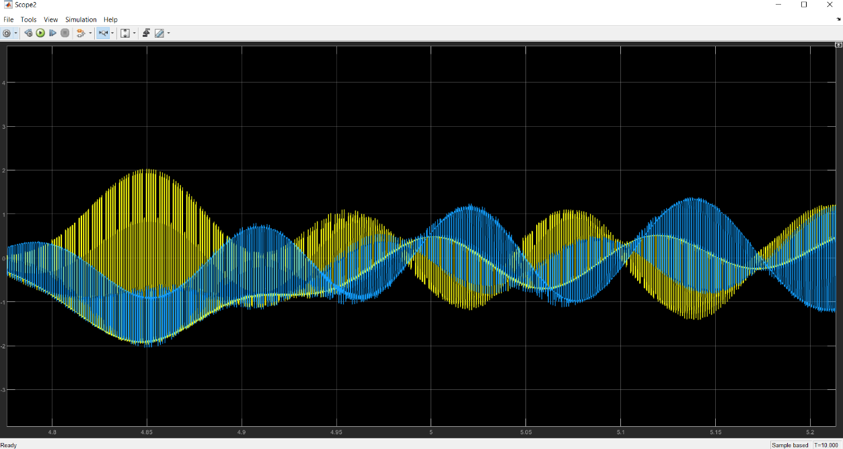
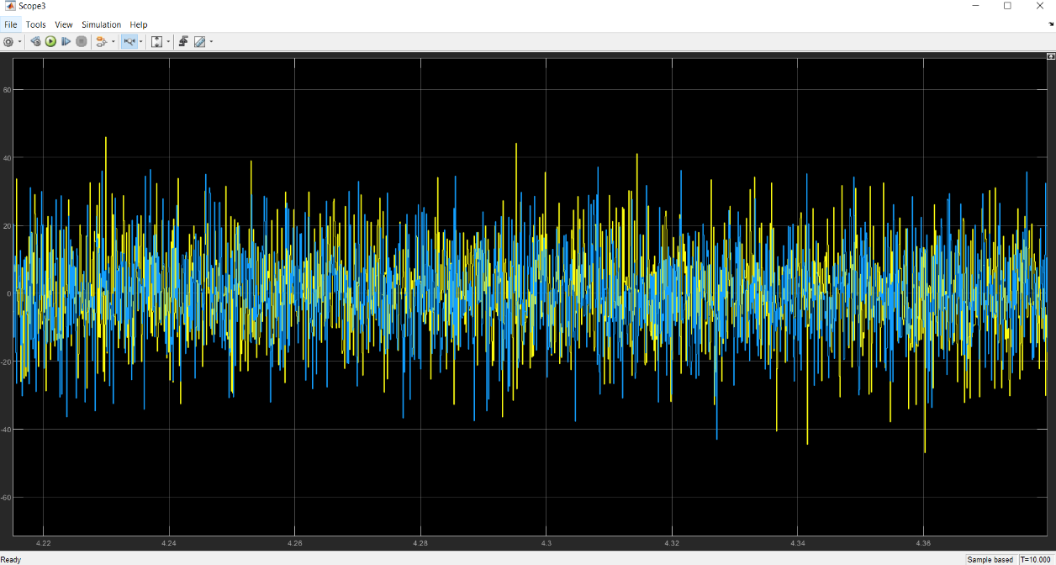
RESULTS AND ANALYSIS
RESULTS FROM MATLAB SIMULINK
Two overlapping sinusoidal waveforms with varying amplitudes.
The signal before and after passing through the Rayleigh SISO channel, demonstrates the effects of multipath fading.
Noisy, random signal with both positive and negative values.
Represents the signal after passing through the AWGN channel, demonstrating the added noise to the system.

Slide 13
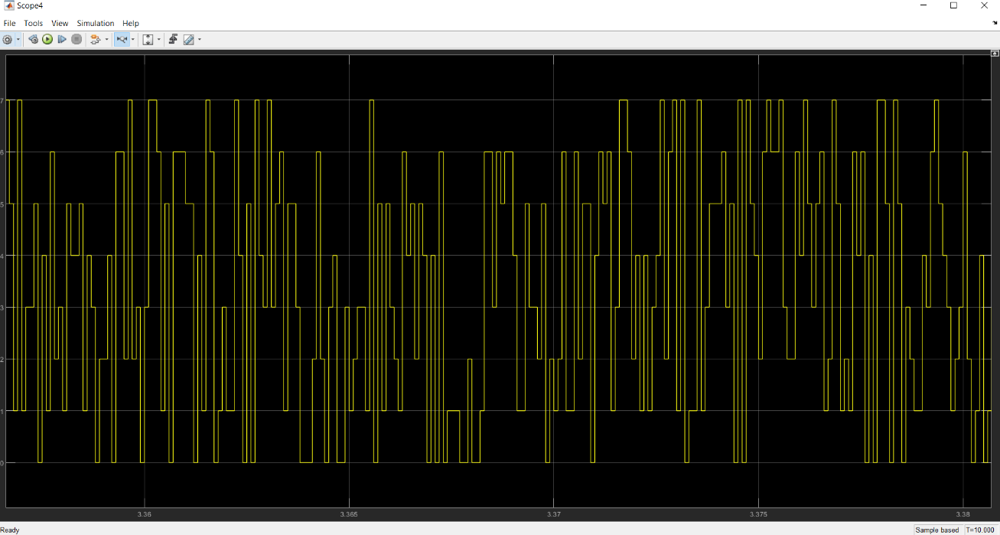
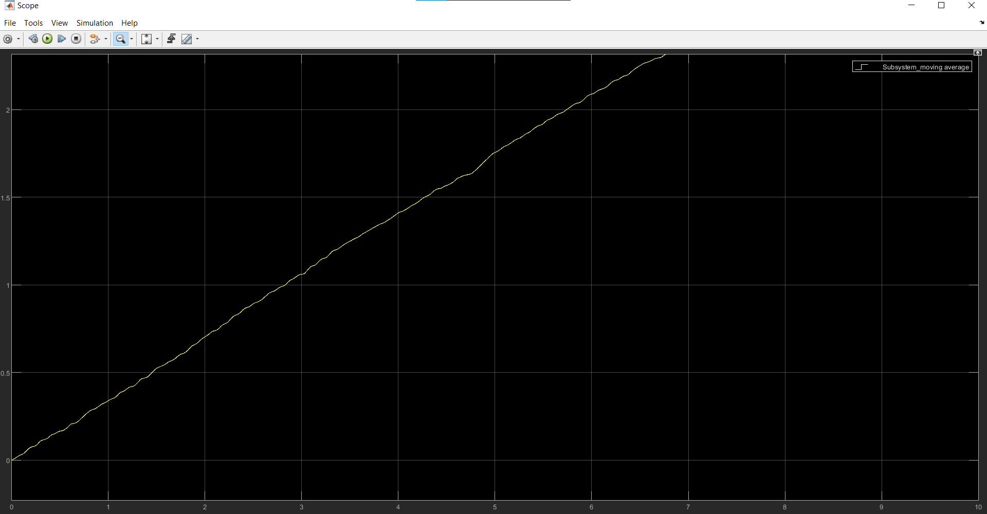
RESULTS AND ANALYSIS
RESULTS FROM MATLAB SIMULINK
Stepped waveform similar to the quantizer output, but with different characteristics.
It shows how then signal has been adjusted based on channel feedback.
Increasing trend over time.
Line is not perfectly smooth but exhibits small fluctuations, indicating some residual high frequency components.

Slide 14
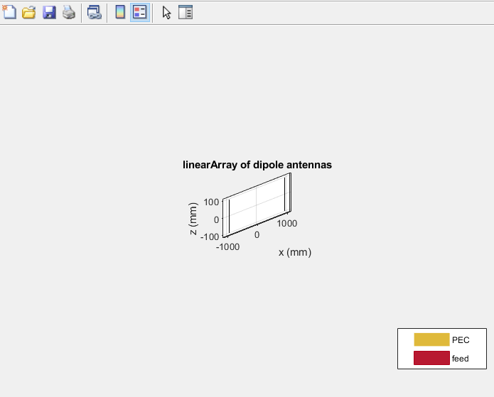
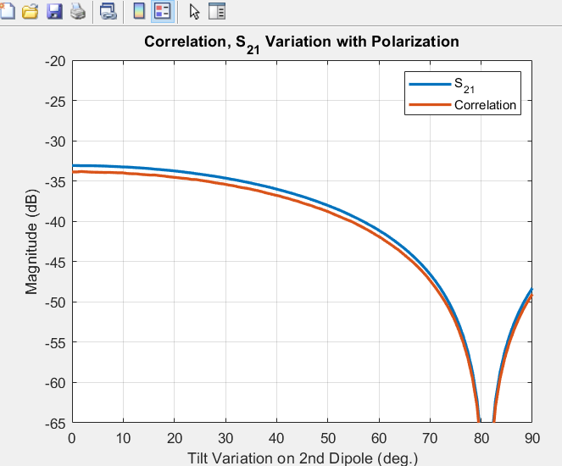
RESULTS AND ANALYSIS
RESULTS FROM MATLAB CODE
3D representation of linear array dipole antennas.
Array is positioned in the x-z plane, spanning from -1000 to 1000 mm along the x-axis and -100 to 100 along z-axis.
It forms the basis set of our diversity system
Both S21 and correlation decrease as the tilt angle increases, indicating reduced coupling between antennas.
Optimal diversity is achieved at around 80 degrees tilt.

Slide 15
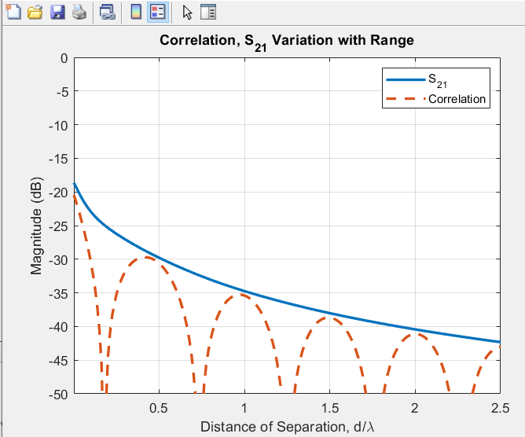
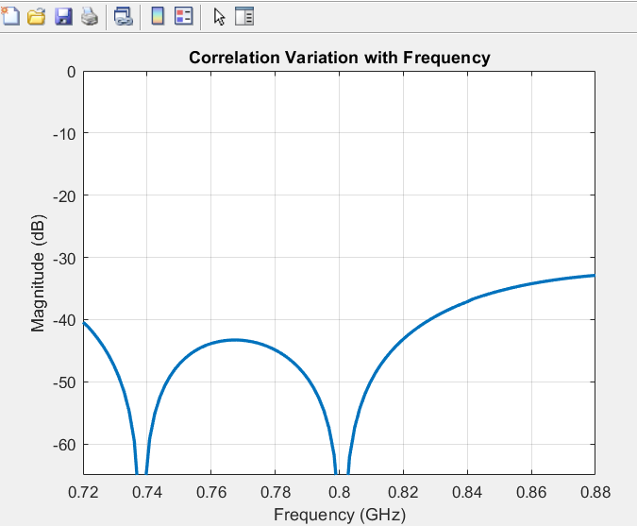
RESULTS AND ANALYSIS
RESULTS FROM MATLAB CODE
S21 steadily decreases with increased antenna separation.
Correlation oscillates but generally decreases with distance.
Periodic nulls in correlation indicate optimal separation distances.
Two distinct nulls at approximately 0.74 GHz and 0.8 GHz, indicating frequencies of minimal correlation.

Slide 16
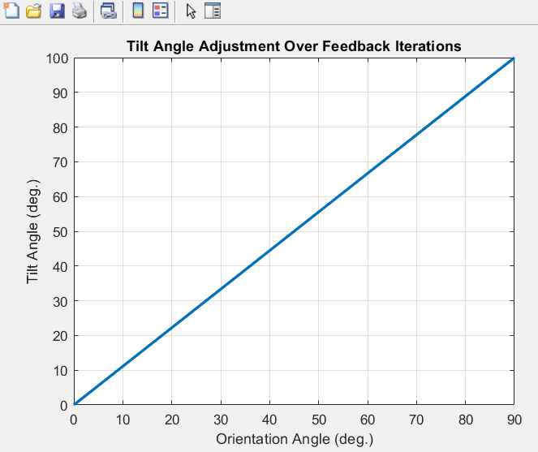
RESULTS AND ANALYSIS
RESULTS FROM MATLAB CODE
The tilt angle increases linearly from 0-100 degrees as the orientation angle increases from 0-90 degrees.
This suggest that our dieback system is adjusting the tilt angle proportionally to changes in orientation to maintain optimal diversity.

Slide 17
DISCUSSION
By continuously monitoring channel conditions and adaptively selecting the optimal diversity branch, the system can maintain a more reliable and efficient.
Implemented Simulink model successfully demonstrates the concept and potential benefits of feedback diversity in wireless communication system.
Model provides challenges faced in wireless communication and how feedback diversity can help mitigate theses issues.
The analysis of scope outputs present the effects of quantization, channel impairments, and the feedback diversity mechanism of the signal.
From the MATLAB Simulink, results show that feedback diversity is capable for improving signal quality and reliability.
From the MTLAB code, results show that feedback diversity is effectively optimizing antenna parameters to minimize correlation and improve diversity performance

Slide 18
SIGNIFICANCE
Practical applications
Mobile Networks – improves quality and reliability
helps maintain signal integrity in urban environment with high interference
Satellite communications – reduces the impact of atmospheric disturbances on signal quality.
Enhanced signal quality and reliability
Increased system capacity
Reduced power consumption
Improved spectral efficiency

Slide 19
THANK YOU !
DEPARTMENT OF ELECTRICAL AND ELECTRONIC ENGINEERING

