Slide 1



M A D E F O R R A Z O R P A Y A I B U I L D A T H O N
REVIVAL OPERATING SYSTEM
REOS
Revival Operating System
Recover more revenue. Prove every rupee.
BY AJAY JOHN PAUL
Notes:
Good morning. This is REOS — the Revival Operating System — built for the Razorpay AI Buildathon, Track 03: AI Revenue Recovery. In one line: it helps a merchant recover more revenue, and prove every single rupee. Over the next five minutes I’ll show you the problem, how the system works, why it is safe, and the measured results.

Slide 2

T H E P R O B L E M
R E O S / 2 0 2 6
Merchants leak
revenue everywhere.
Every Razorpay merchant loses money in four different places at once, and almost none of it is worked systematically. A card fails and nobody retries it. A shopper fills a cart, then abandons it at the last step. A subscription auto-charge silently fails and the customer churns without ever knowing. An invoice sits unpaid for weeks. Each of these lives in a separate tool with a separate team, so the leak stays invisible until the revenue is already gone — fragmented, manual, and unmeasured.
01 / PAYMENTS
One-off payment failures that are never retried or recovered after the first decline.
02 / CHECKOUT
Abandoned carts where buying intent was high but a moment of friction won.
03 / SUBSCRIPTIONS
Failed recurring billing that quietly turns into involuntary customer churn.
GITHUB.COM/KAJAYJOHNPAULDEV
Notes:
Merchants leak revenue in four places at once: payment failures, abandoned checkouts, failed subscriptions, and overdue receivables. Today these live in separate tools and separate teams, so the leak is invisible until the money is gone. The recovery that does happen is manual, fragmented, and impossible to measure honestly.

Slide 3

W H Y I T M A T T E R S
R E O S / 2 0 2 6
The cost of
doing nothing.
Failed payments are not edge cases — for many businesses they are one of the single largest sources of lost revenue and involuntary churn. A large share of failed recurring charges are recoverable with the right retry at the right time, yet most are never touched. Worse, the naive fixes make things worse: aggressive retries double-charge real customers, and aggressive reminders erode the trust that made the customer valuable in the first place. The opportunity is not “send more messages.” It is to work the right case, at the right moment, with proof that it worked.
4
1
0
revenue-leak surfaces, unified into one case model
deterministic ledger that owns all money truth
rupees moved by AI — ever, by design
Notes:
Failed payments are one of the biggest and most under-worked sources of lost revenue. Much of it is recoverable, but the naive fixes backfire — retries double-charge, reminders erode trust. The real opportunity is to work the right case at the right moment, and prove it worked. Our design is built around three numbers: four surfaces unified, one ledger owning money truth, and zero rupees ever moved by AI.

Slide 4
T H E G A P
Why current tools
AT A GLANCE
fall short.
01 / Blind Retries
Double charges and customer friction caused by stale data.
Most recovery tools treat a webhook as the truth. But a webhook is only a snapshot of one moment — and by the time it is processed, the world may have moved on. A payment marked “failed” may already be captured on retry. Acting on that stale snapshot is how customers get charged twice. The second failure is measurement: a later payment is claimed as “recovered” even when it would have happened anyway, and refunds quietly inflate the totals. Recovery without reconciliation is dangerous; recovery without measurement is just noise.
02 / Dark Patterns
Aggressive dunning that damages long-term brand trust.
03 / No Proof
“Recovery without proof is just noise.”
No way to separate incremental from organic recovery.
Notes:
Most tools treat a webhook as truth, but a webhook is just a snapshot — the payment marked failed may already be captured, and acting on that stale data double-charges people. The second failure is measurement: later payments get claimed as recovered even when they’d have happened anyway. Recovery without reconciliation is dangerous; recovery without measurement is just noise.

Slide 5
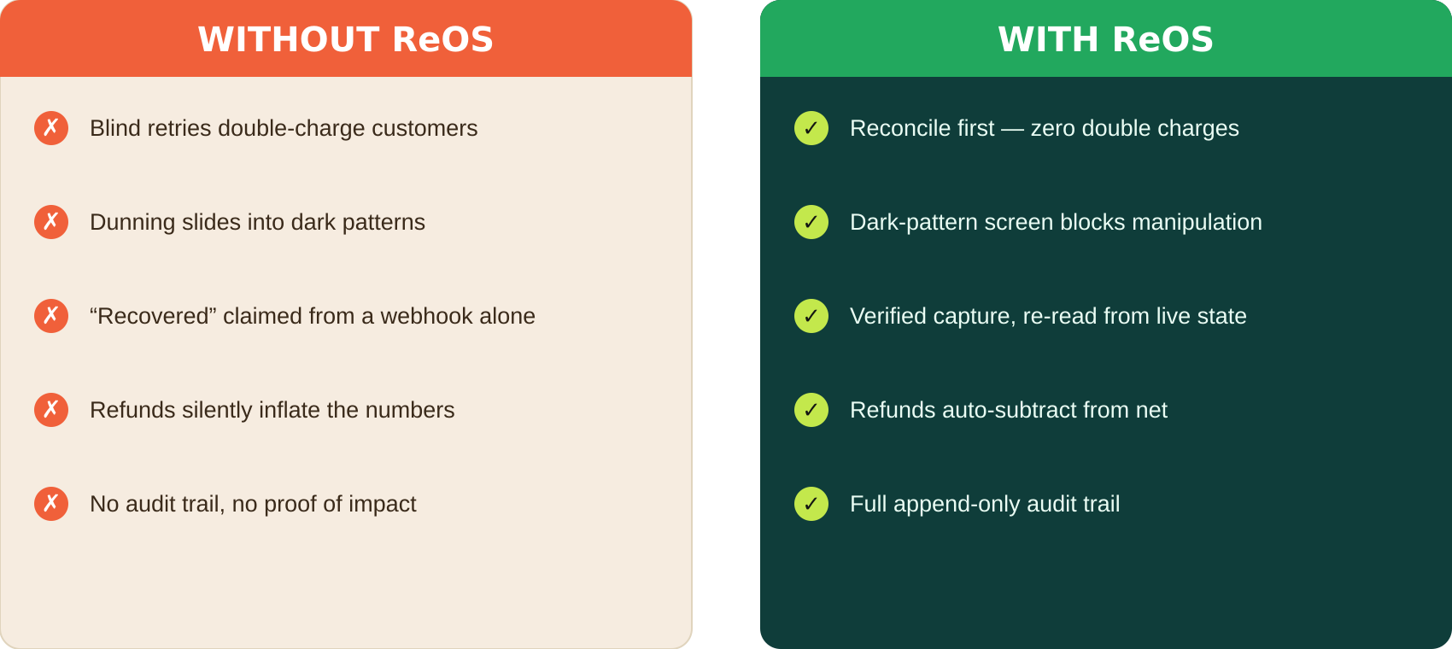
T H E S H I F T
R E O S / 2 0 2 6
From guesswork to proof.
The difference is not a nicer dashboard — it is a fundamentally safer operating model. On the left is how recovery works today: fast, blind, and impossible to trust. On the right is ReOS: every action is checked against live state first, every message is screened for manipulation, and every recovered rupee is a verified capture that survives refunds and disputes.
Notes:
This is the core shift — not a prettier dashboard, but a safer operating model. Today recovery is fast, blind, and untrustworthy. With ReOS every action is checked against live state, every message is screened, and every recovered rupee is a verified capture that survives refunds and disputes.

Slide 6
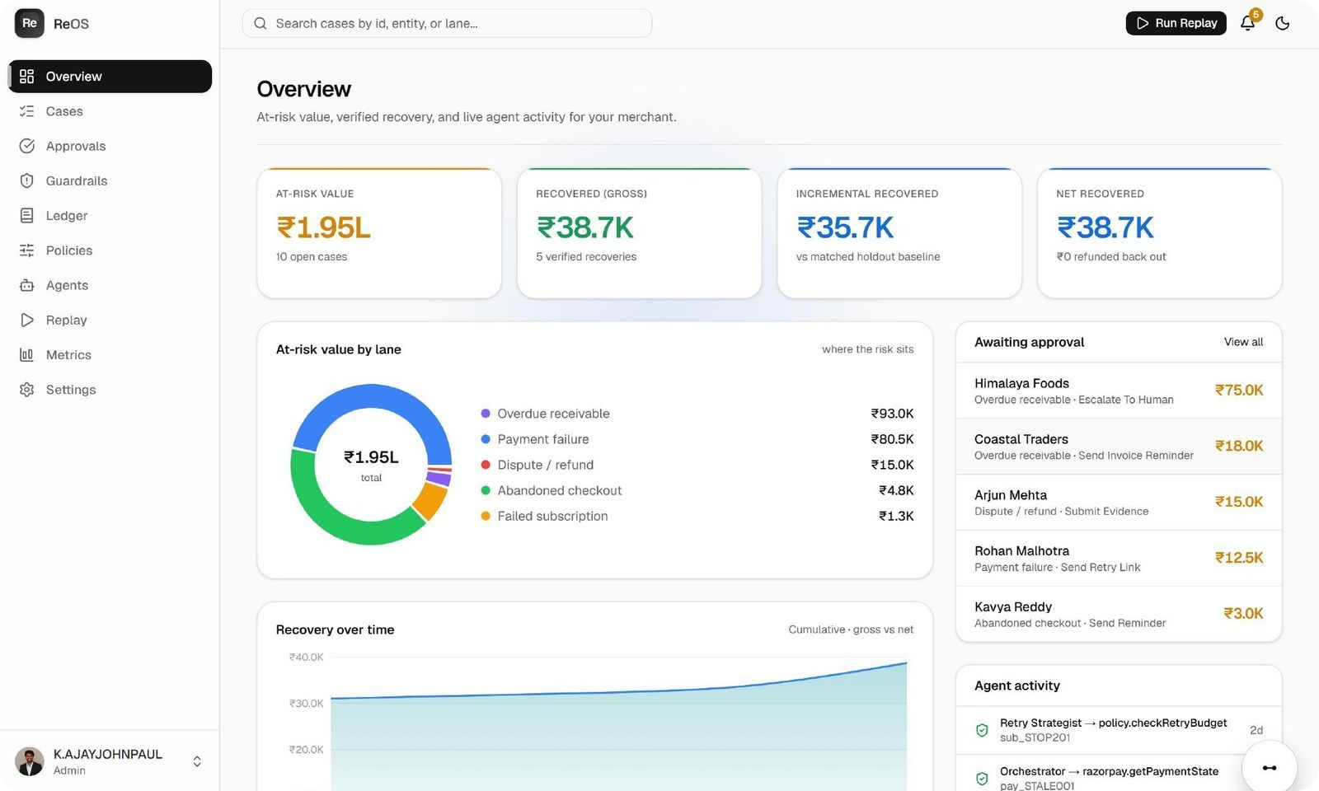
T H E S O L U T I O N
R E O S / 2 0 2 6
A control plane
for recovery.
ReOS is a desktop operations console — not a chatbot. It sits above all four leakage surfaces as a single control plane. Every at-risk event becomes one normalized “case.” The system detects the risk, reconciles it against Razorpay’s live state, chooses exactly one bounded action, and records the outcome in an append-only ledger. The operator sees the whole story on one screen: what happened, why the system chose what it did, and whether real money actually came back.
01 / DETECT
02 / RECONCILE
03 / PROVE
Real-time monitoring of payment and subscription risk.
Verify live state before any action is taken.
Transparent ledger of every recovery and its value.
DETECT → RECONCILE → ACT → PROVE
Notes:
ReOS is a desktop operations console that sits above all four surfaces as one control plane. Every at-risk event becomes one normalized case: detect, reconcile against live state, act once, prove. The operator sees the entire story on a single screen — what happened, why, and whether real money came back.

Slide 7

T H E E N G I N E
R E O S / 2 0 2 6
01
How the engine works.
Notes:
Let me show you what happens under the hood — the six-layer engine that turns a raw, messy event into a safe, proven recovery.

Slide 8
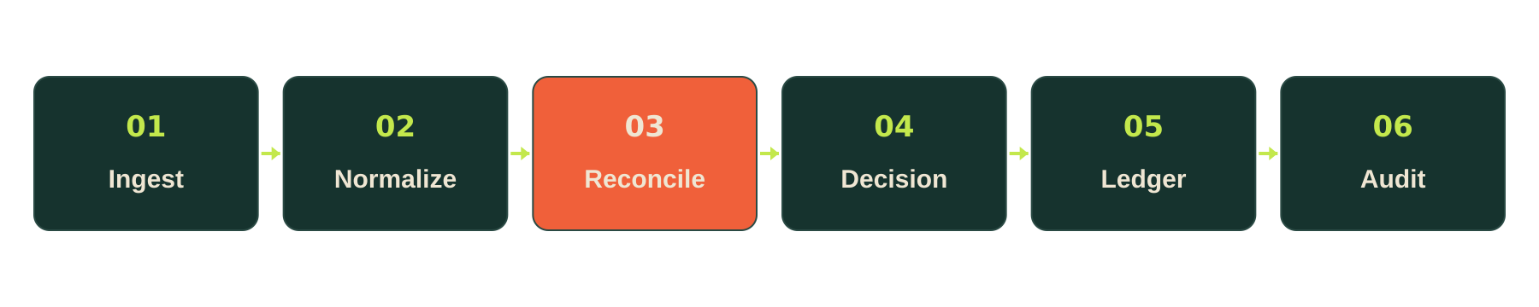
T H E E N G I N E
R E O S / 2 0 2 6
Six layers, One flow.
01 / INGESTION
02 / NORMALIZE
03 / RECONCILE
Signed webhooks are received and de-duplicated so the same event can never be processed twice.
Payments, orders, subscriptions and invoices are mapped into one common case model.
Live state is re-read from Razorpay before any action — the single most important step.
04 / DECISION
05 / LEDGER
06 / AUDIT
A rule-based score picks the best bounded action, with a reason code and a confidence.
Every money event is appended, never edited — refunds subtract back out automatically.
The full case timeline is exportable, giving finance teams complete transparency.
Notes:
Every event flows through six layers, once. Ingestion de-dupes. Normalize unifies. Reconcile re-reads live state — the most important step. Decision scores the best bounded action. Ledger appends money truth and subtracts refunds. Audit makes the whole case exportable. AI is only ever used after the state is trustworthy.

Slide 9
R E L I A B I L I T Y
R E O S / 2 0 2 6
The double-
charge firewall.
This is our most important reliability idea, and it is grounded in Razorpay’s own documentation: a payment can move from failed to captured almost instantly, and you can even receive a “failed” webhook after the money is already in. So, before ReOS acts on any failure, it re-reads the live state. If the order is already paid, the system logs an intelligent no-op instead of retrying — turning a would-be double charge into a proven non-event.
1
Webhook says “failed”
2
Live check says “captured”
3
NO-OP — no second charge
Notes:
This is the reliability centerpiece and it’s straight from Razorpay’s docs: a payment can go from failed to captured instantly, and a failed webhook can even arrive after the money is in. So before acting, ReOS re-reads live state. If the order is already paid, it logs an intelligent no-op instead of retrying — turning a would-be double charge into a proven non-event. This one demo is worth more than any feature.

Slide 10
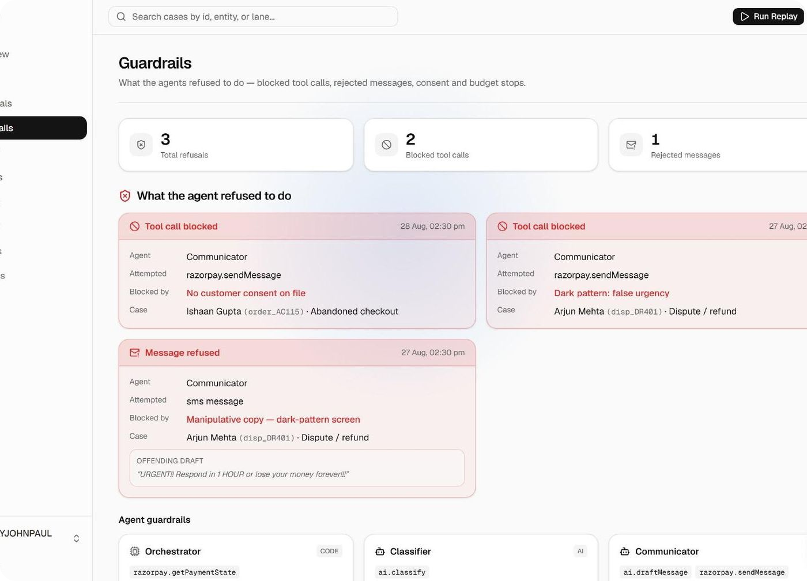
S A F E T Y F I R S T
R E O S / 2 0 2 6
Safety is a feature.
In a payments system, safety is not plumbing you hide — it is the product. ReOS makes a hard architectural split: deterministic code owns all money truth, and AI is only ever allowed to classify, draft, and explain. No AI path can move a rupee. Every outbound message passes a dark-pattern screen that rejects false urgency, confirm-shaming, and fake scarcity. Consent is checked before contact. And every refusal the system makes is surfaced on a Guardrails cockpit, so you can literally watch the safety working.
01 / NO DARK PATTERNS
The agent refuses manipulative copy or forced consent, every time.
02 / APPEND-ONLY LEDGER
Every state change is logged permanently — there are no hidden actions.
03 / GUARDRAILS COCKPIT
A dedicated screen shows every refusal the agent made, with the rule that blocked it.
Notes:
In payments, safety is the product, not hidden plumbing. ReOS makes a hard split: deterministic code owns money truth, AI only classifies, drafts, and explains — no AI path can move a rupee. Every message passes a dark-pattern screen, consent is enforced, and every refusal shows up on the Guardrails cockpit so you can watch the safety working.

Slide 11
T H E A G E N T S
R E O S / 2 0 2 6
02
Seven bounded roles.
Notes:
Now the intelligence layer — seven bounded agents, and crucially, an honest split between where we use AI and where we do not.

Slide 12
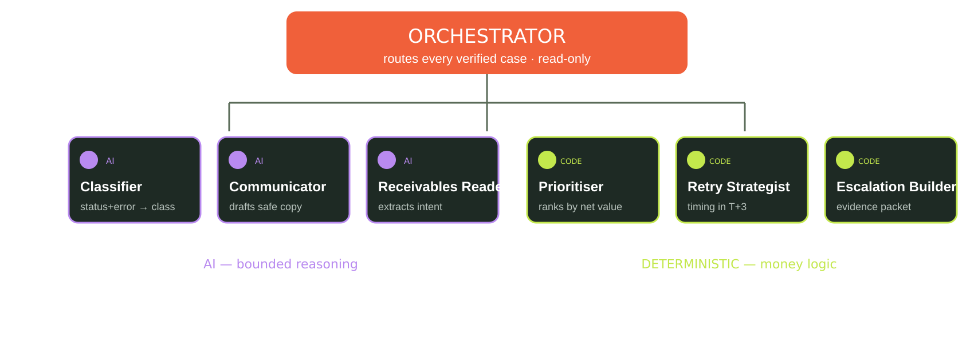
T H E A G E N T S
R E O S / 2 0 2 6
AI where it helps. code where it counts.
A common mistake is to let a language model do everything. ReOS does the opposite: three AI agents handle judgment — classifying failures, drafting consented copy, and reading customer replies — while three deterministic agents handle anything touching money or budgets. One orchestrator routes every verified case and enforces a fixed tool allowlist per agent. If an agent cannot identify the entity, the state, the allowed action, or consent, it abstains and escalates to a human.
Notes:
The common mistake is letting an LLM do everything. We do the opposite: three AI agents handle judgment — classify, draft, read replies — and three deterministic agents handle anything touching money. One orchestrator routes every case and enforces a fixed tool allowlist. If an agent can’t identify the entity, state, action, or consent, it abstains and escalates. That honesty is itself a scored strength.

Slide 13
T H E P R O O F
R E O S / 2 0 2 6
03
Watch it work,
then measure it.
Notes:
Talk is cheap in a hackathon — so everything I’ve described, you can watch run, and then measure.

Slide 14
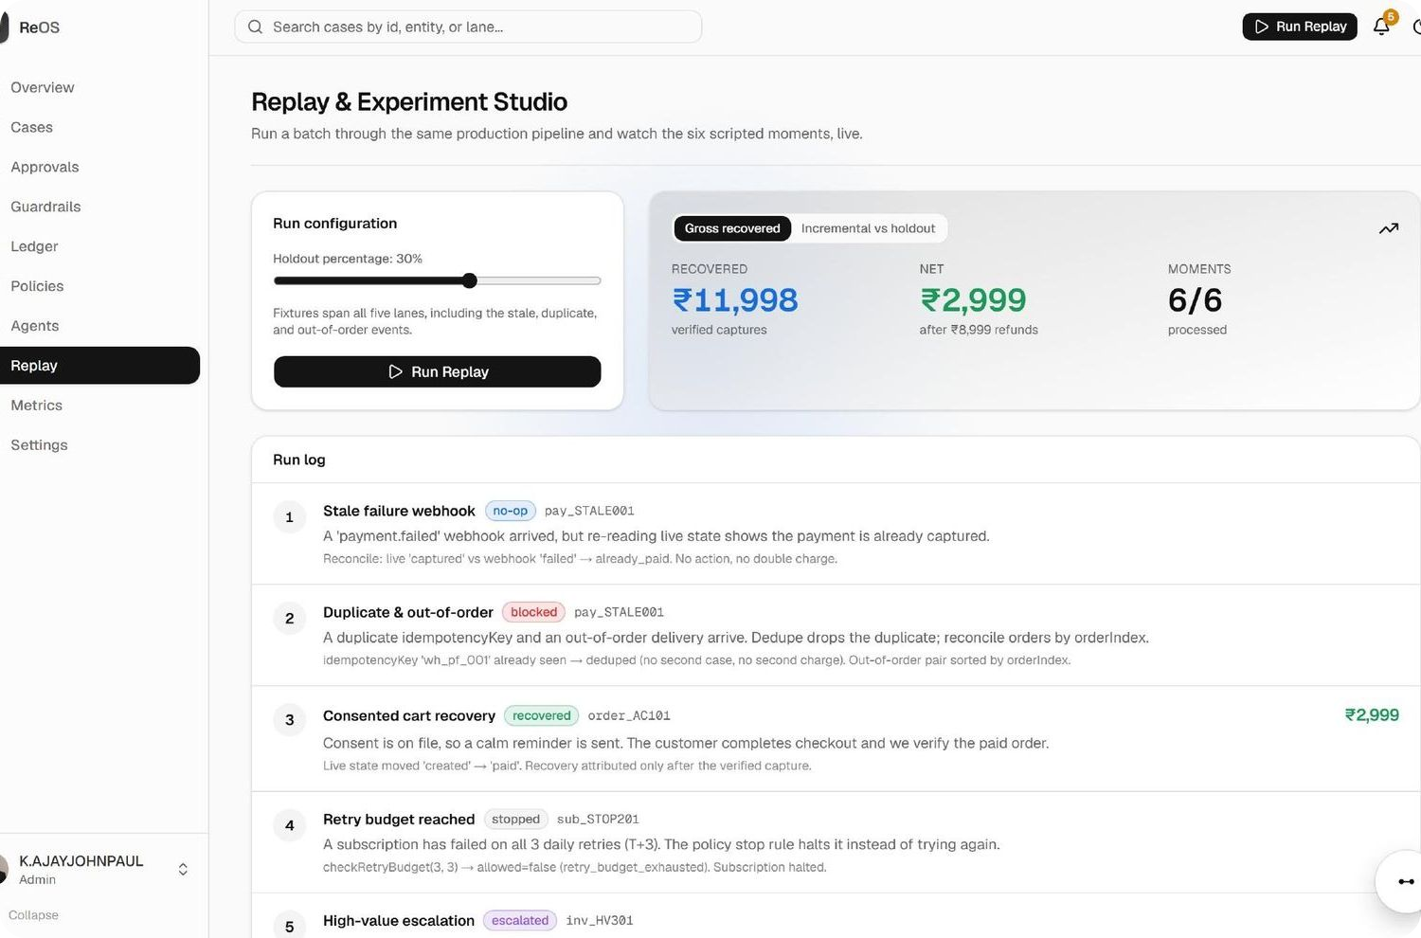
R E P L A Y S T U D I O
R E O S / 2 0 2 6
Watch it work, then measure it.
SIX SCRIPTED MOMENTS
The Replay & Experiment Studio runs a whole batch of cases through the exact same production pipeline, and streams the results live. It walks six scripted moments on purpose: a stale no-op, a blocked duplicate, a consented cart recovery, a subscription stopped at it retry budget, a high-value escalation, and a refund that auto-subtracts. Then the key move: a treatment-vs-holdout toggle. The holdout sends nothing, so it shows what would have recovered anyway — letting us report only the money the agent caused.
1
Stale failure
no-op
2
Duplicate event
blocked
3
Cart recovery
recovered
4
Retry budget (T+3)
stopped
5
High-value case
escalated
6
Refund lands
subtracted
+ ₹35.7K incremental — vs matched holdout
Notes:
Replay & Experiment Studio runs a batch through the same production pipeline and streams it live, walking six scripted moments: stale no-op, blocked duplicate, consented cart recovery, retry-budget stop, high-value escalation, and a refund that auto-subtracts. Then the key move — a treatment-vs-holdout toggle. The holdout sends nothing, so we only ever claim the incremental money the agent actually caused: here, ₹35.7K.

Slide 15
T H E N U M B E R S
R E O S / 2 0 2 6
Prove every rupee.
AT-RISK vs RECOVERED, BY LANE
Every figure here comes from the demo dataset and is labelled as such in-app. Gross is what we captured. Incremental is gross minus the holdout baseline. Net subtracts refunds, fees, and discounts back out. We never present a model’s confidence as if it were revenue.
AT-RISK REVENUE
₹1.95L
NET RECOVERED
₹38.7K
Notes:
Every figure is from the demo dataset and labelled in-app. Gross is what we captured; incremental is gross minus the holdout; net subtracts refunds, fees and discounts. At-risk ₹1.95L, net recovered ₹38.7K, incremental ₹35.7K. We never dress a model’s confidence up as revenue — that honesty is what survives judging.

Slide 16
M E A S U R E D , N O T C L A I M E D
R E O S / 2 0 2 6
Ten measures. one export.
We do not stop at a headline number. ReOS tracks ten separate measures across opportunity, effectiveness, economics, and safety — and every case can be exported to JSON or CSV in one click, so a finance or compliance team can verify the numbers themselves. Audit completeness is a first-class metric: a case only counts as complete when it has its source event, its decision reason, its tool result, its outcome, and its stop reason.
At-risk value
Eligible rate
Recovery rate
Gross recovered
opportunity, not success
policy discipline
operational effectiveness
the direct outcome
Incremental
Net recovered
False-action rate
Customer-harm rate
vs matched holdout
economics after costs
financial risk
trust cost
Automation vs escalation
Audit completeness
where AI helps
proof of traceability
ONE-CLICK AUDIT EXPORT · JSON + CSV
Notes:
We don’t stop at a headline. ReOS tracks ten measures across opportunity, effectiveness, economics and safety, and every case exports to JSON or CSV in one click so finance can verify it. Audit completeness is first-class: a case only counts when it has its source event, decision reason, tool result, outcome, and stop reason.

Slide 17
T H E P R O D U C T
Role-based and
AT A GLANCE
genuinely usable.
10+ Screens
A full dashboard for every role.
ReOS is not a demo shell — it is a real, role-based console with more than ten working screens. Four logins each get a tailored view: an Admin who owns policy, an Operator who works the case queue, an Analyst who reads the ledger, and an Auditor who traces every decision. And built in is Baymax, an in-app assistant powered by Google Gemini with an offline fallback, so anyone on the team can ask what a screen does or why a case was decided the way it was.
Offline First
Runs with zero external keys.
Next.js Core
ADMIN & OPERATOR
ANALYST & AUDITOR
A modern, fast, typed stack.
Full control over recovery policies and the manual intervention queue.
Deep insight into recovery metrics and immutable audit logs.
BAYMAX AI ASSISTANT
In-app assistant — Google Gemini with offline fallback.
Notes:
ReOS is a real, role-based console with 10+ working screens. Four logins get tailored views — Admin owns policy, Operator works cases, Analyst reads the ledger, Auditor traces decisions. Built in is Baymax, an in-app assistant on Google Gemini with an offline fallback, so anyone can ask what a screen does or why a case was decided.

Slide 18
H O N E S T V A L U E · C L O S I N G
R E O S / 2 0 2 6
Thank you.
One last, honest point. The recovered money belongs to the merchant — we never claim it as Razorpay’s revenue. Razorpay’s benefit is indirect but real: merchants who capture more and churn less make the platform stickier through conversion, retention, and differentiation. We measure those two things separately and never conflate them. ReOS runs fully offline with zero keys, has a tested credibility core, and is built on Next.js — ready to run the moment you clone it.
K. Ajay John Paul
github.com/Kajayjohnpauldev/REOS
RECOVER MORE REVENUE · PROVE EVERY RUPEE
Notes:
One honest closing point: the recovered money is the merchant’s — we never claim it as Razorpay’s revenue. Razorpay’s benefit is indirect but real: stickier platform via conversion and retention, measured separately. ReOS runs fully offline with zero keys, has a tested core, and is built on Next.js. Thank you — recover more revenue, and prove every rupee.

