Slide 2
Project Name
Snake Game
.
1
Snake Game

Slide 3
Apparatus for project
Windows XP, 7 or 10.
Eclipse, NetBeans.
Java language.
2
Snake Game

Slide 4
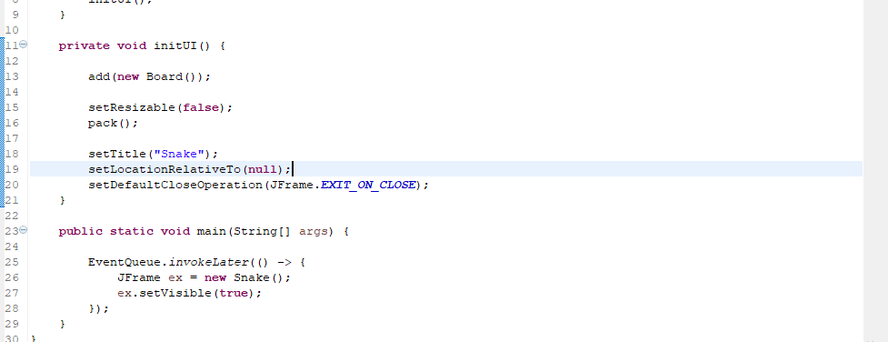
Working section
Main function in the project
Snake Game
3

Slide 5
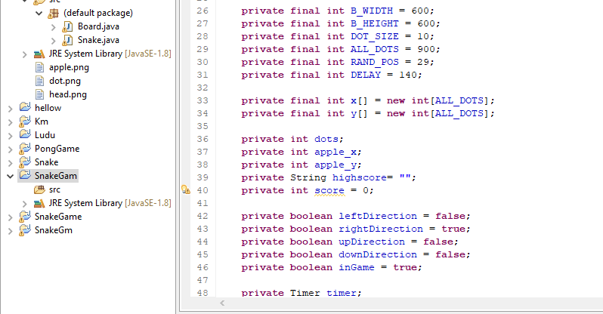
Board
This code make the snake applet . Make the size of height width of the applet.
Apple size, snake speed.
Snake Game
4

Slide 6
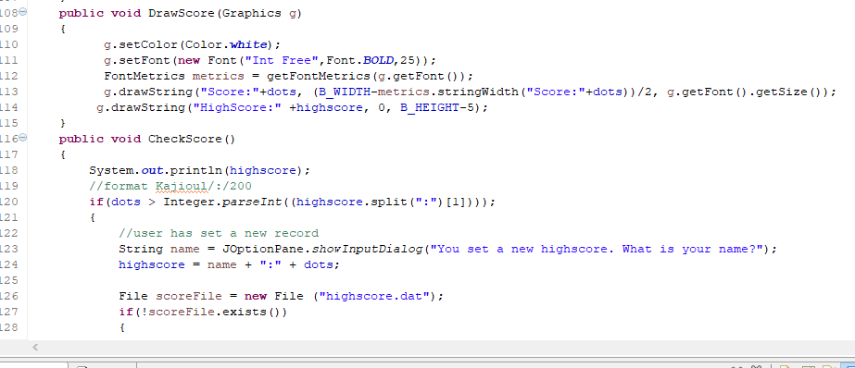
Draw Score Function
This code show score on the screen when you run the game.
The score shown in the top and middle in the screen when game run.
The high score shown the bottom of the screen.
Check score Function
The code check the score is grater then high score and the score is high score.
Snake Game
5

Slide 7
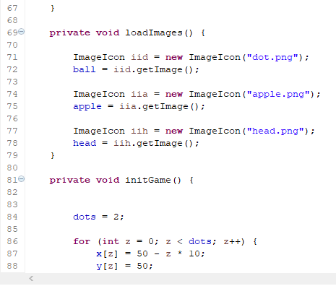
Load Image Function
Load image function input the snake image .
Snake Game
6

Slide 8
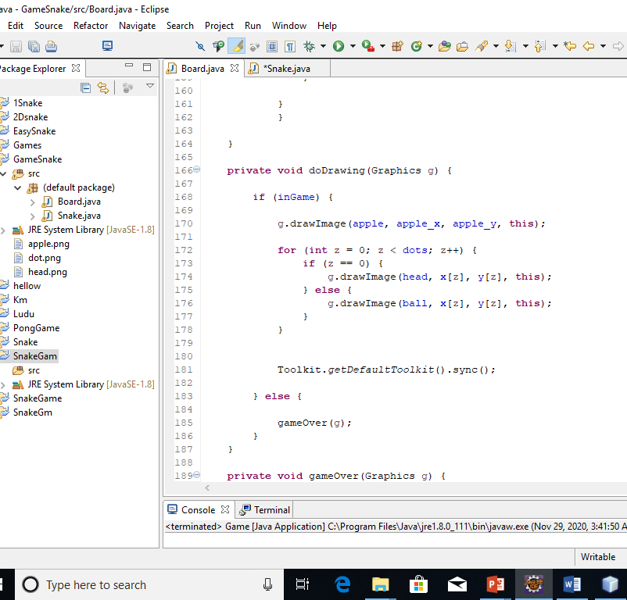
Draw function
This function draw the snake and apple.
Snake Game
7

Slide 9
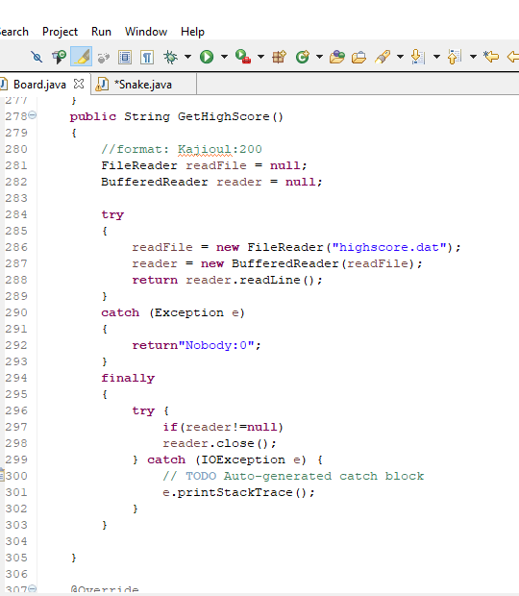
High Score
This function code make high score to show in the
Screen when the game run.
Snake Game
8

Slide 10
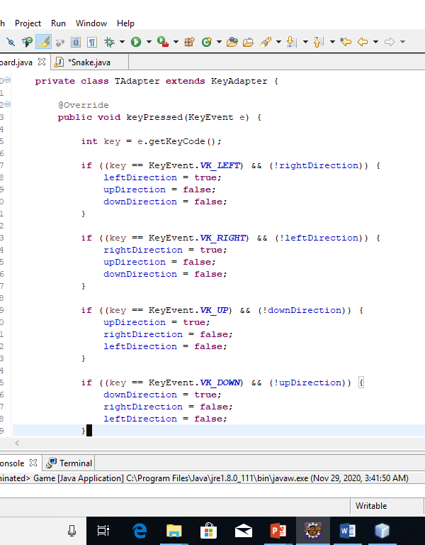
Key Pressed Function
In this function we set the key to control the snake . Up arrow key move the snake up down arrow key move the snake down right arrow key move the snake right and left arrow key move the snake left.
Snake Game
9

Slide 11
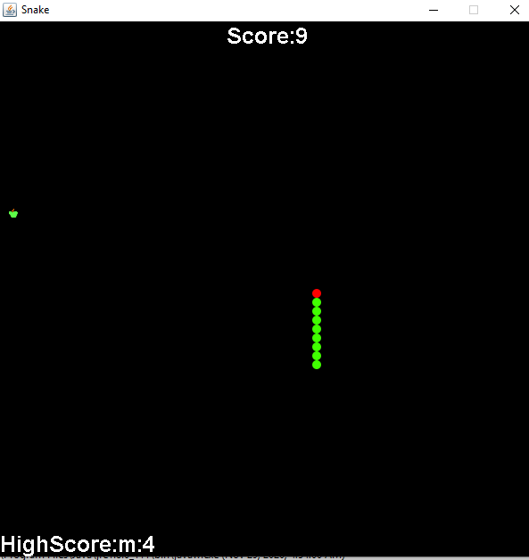
Output
When you run the snake game the snake is running in the applet and you control the snake and eat apple the snake is increase score increase also.
Snake Game
10

Slide 12
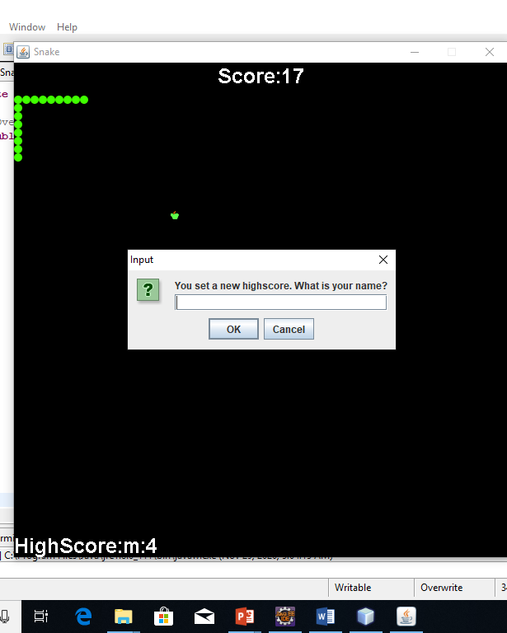
Output
If your score is high score , ask your name input and the score make high score and save it.
Snake Game
11

Slide 13
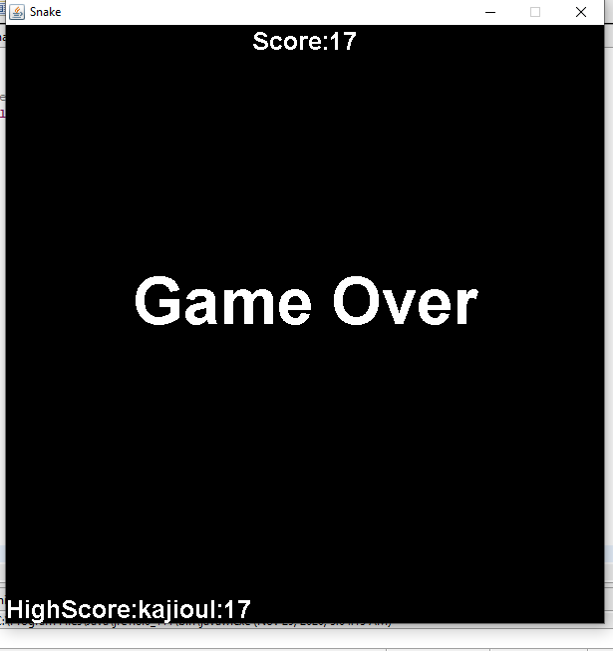
Output
If snake hit the border of the board or the snake body part the game is over.
Take your name as input ,if your score is high save your name and score as a high score .
Show in the screen your score and the game is over.
Snake Game
12

Slide 14
Snake Game
13

Slide 15


