Slide 1


Music Store Analysis
SQL Project on
-Kajol Gupta

Slide 2
Welcome
Hello, I’m Kajol Gupta. Today, I’ll be presenting my analysis of customer spending patterns in a music store. Using SQL, we’ll uncover trends in popular genres, artists, albums, and top spenders, offering insights to improve marketing and inventory strategies.

Slide 3
Goal
The goal of this project is to identify key trends in customer behavior, helping the music store enhance marketing efforts, customer experience, and inventory management.

Slide 4
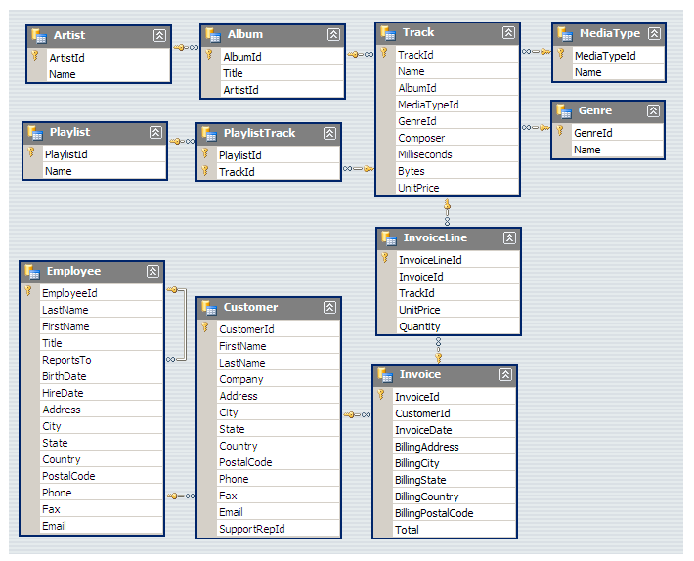
Schemas

Slide 5


Q1. Who is the senior most employee based on job title?

Slide 6

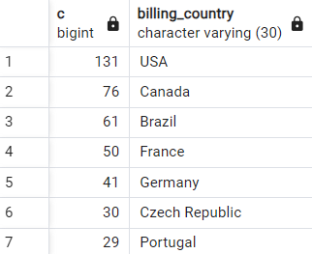
Q2. Which countries have the most Invoices?

Slide 7

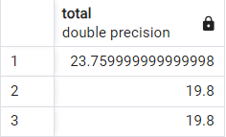
Q3. What are top 3 values of total invoice?

Slide 8
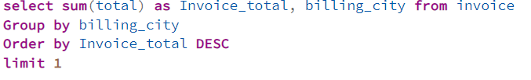

Q4. Which city has the best customers? We would like to throw a promotional Music Festival in the city we made the most money. Write a query that returns one city that has the highest sum of invoice totals. Return both the city name & sum of all invoice totals.

Slide 9
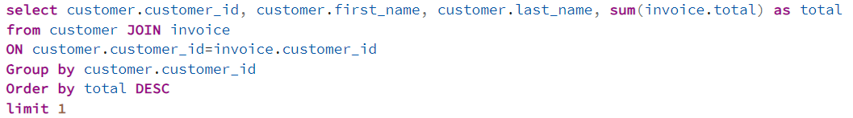
Q5. Who is the best customer? The customer who has spent the most money will be declared the best customer. Write a query that returns the person who has spent the most money.

Slide 10
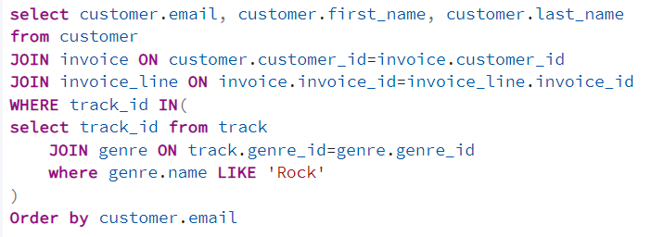
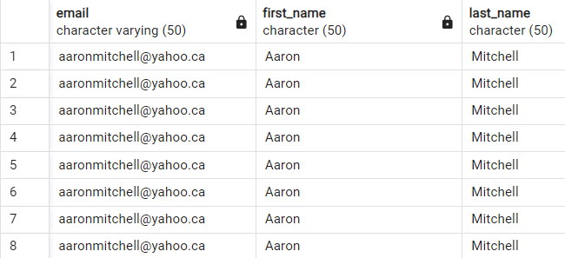
Q6. Write query to return the email, first name, last name, & Genre of all Rock Music listeners. Return your list ordered alphabetically by email starting with A.

Slide 11
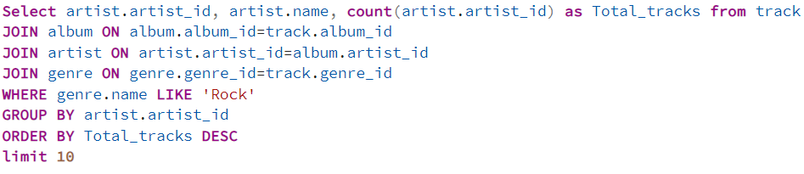
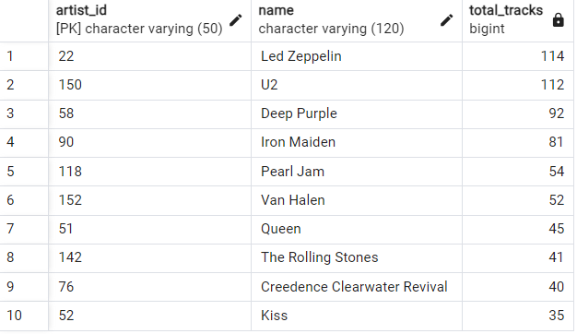
Q7. Let's invite the artists who have written the most rock music in our dataset. Write a query that returns the Artist name and total track count of the top 10 rock bands.

Slide 12
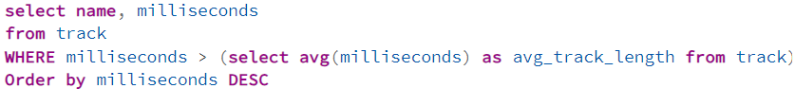
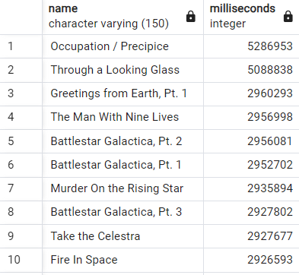
Q8. Return all the track names that have a song length longer than the average song length. Return the Name and Milliseconds for each track. Order by the song length with the longest songs listed first.

Slide 13
Thank you!

