Slide 1

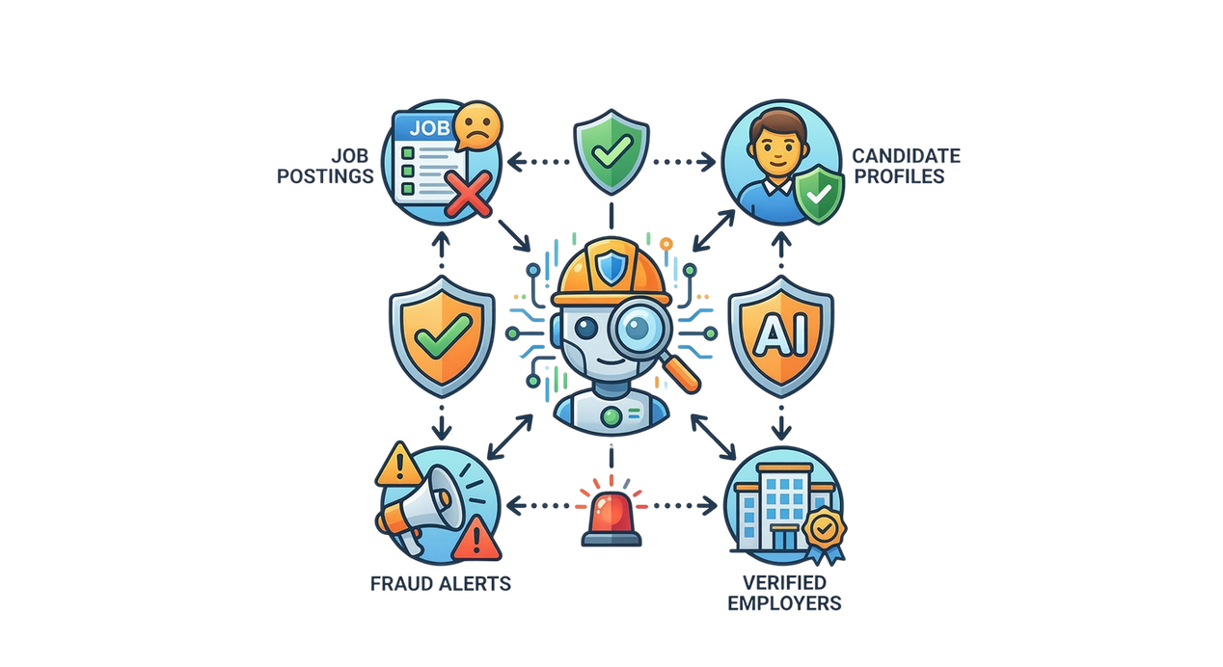



AI-POWERED JOB SCAM
DETECTION ECOSYSTEM
A Multi-Model Framework for Fake Job Detection, Employer Verification, Communication Analysis & Explainable Risk Scoring
Protecting Sri Lankan Job Seekers Through Intelligent AI
R26-SE-002
Final Presentation

Slide 2

AI-POWERED JOB SCAM DETECTION ECOSYSTEM
Panel Comments on PP2 and How We Addressed
Student ID
Panel comments
Action and evidence
Kajanthan U
IT22224002
“Explained well”
No action needed.
Santhosh S
“Overall fine. Considerable explanation was there.”
IT22113740
No action needed.
“Need to focus more on how weightages can be taken. When comes to final evaluation, please bring some evidence.”
ACTION
Weights: compared 5 weight profiles and a grid search of 1,771 combinations. Chosen: model 40%, registry 30%, reputation 20%, website 10%.
Thresholds: Low 70+, Medium 45 to 69, High below 45. Set first as a safety policy (a scam must never be labelled safe), then tested. R1: no scams in Low. R2: High flags at most about 10% of real employers.
Nipuni Bandara
IT22251664
EVIDENCE
Validation: R1 first met at 70; R2 holds up to 45. A plain 90% target gives 55/60 and puts 5 scams in Low (fails R1). Cost is lowest near 65.
Test: 0 of 107 Low-band scams; 16 of 195 real employers (8.2%) in High.
Files: weight_sensitivity_report.md, weight_profile_comparison_clear.csv, risk_band_distribution_test.csv. Method backed by Provost, F. and Fawcett, T. (2001), Scott, C. and Nowak, R. (2005), Elkan, C. (2001), Daryousse, M. (2025, April 12)
Methmi N P C S
IT22188618
“Good explanation and overall fine.”
No action needed.
R26-SE-002

Slide 3



AI-POWERED JOB SCAM DETECTION ECOSYSTEM
Research Supervision
Supervisor
Co-Supervisor
External Validator
Ms. Karthiga Rajendran,
Year 04 Coordinator / Software Engineering Lecturer
Department of Software Engineering
Faculty of Computing
SLIIT
Ms. Thilini Jayalath,
Senior Lecturer | 3rd Year Coordinator (SE Program)
Department of Software Engineering
Faculty of Computing
SLIIT
Mr. Saman Gunawardena,
Consultant - Industrial Liaison and Placement
Faculty of Computing
SLIIT

Slide 4



Four components, one app: scan, verify and report.
AI-POWERED JOB SCAM DETECTION ECOSYSTEM
Design excellence: four components
Problem in brief
Problem: Employment fraud in Sri Lanka’s online job market. Fake offers look real.
A
B
Fake job post detection
Employer legitimacy verification
Classifies the job post as Legitimate, Suspicious or Fake.
Checks the company against official registries, website and reputation.
Who: Job seekers applying online, from fresh graduates to migrant workers.
Why it matters: Lost money, stolen data and wasted time. Tools that read only the job text miss the rest.
C
D
Scam communication detection
Fraud-aware job ranking
Puts safe, relevant jobs first, using the fraud signals.
Spots scam tactics in recruiter chats and messages.
Inventive step: detect, verify, analyse and rank in one integrated system, from spotting the scam to recommending safer jobs.
In the work we reviewed, text-only detection misses company verification (JobScamShield).
R26-SE-002

Slide 5
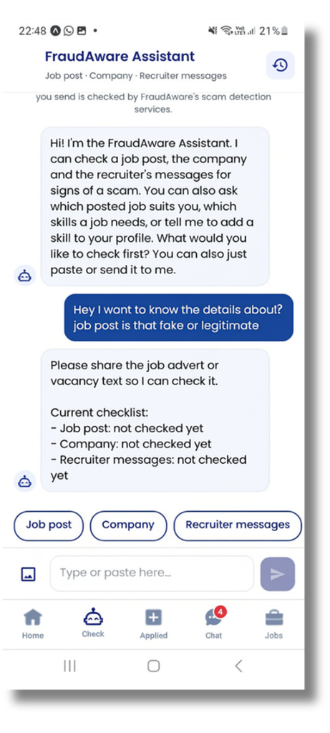
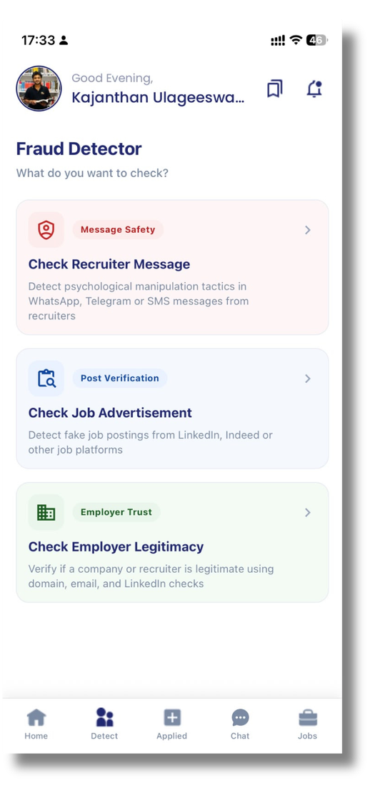

One Chat for Everything: CareerNet Assistant
AI-POWERED JOB SCAM DETECTION ECOSYSTEM
Based on feedback from our external validator and real users: “The four components should work as one system.”
After
  One chat for all checks
  Guided buttons: Job post / Company / Recruiter messages
  One combined result card
  “Which job matches me?” gives top 5 posted jobs with missing skills
Before
  3 separate check screens
  The user had to know which
tool to use
  Results shown separately
  No link to the profile or jobs
“Is this job safe? Is it right for me? One conversation.”
R26-SE-002

Slide 6
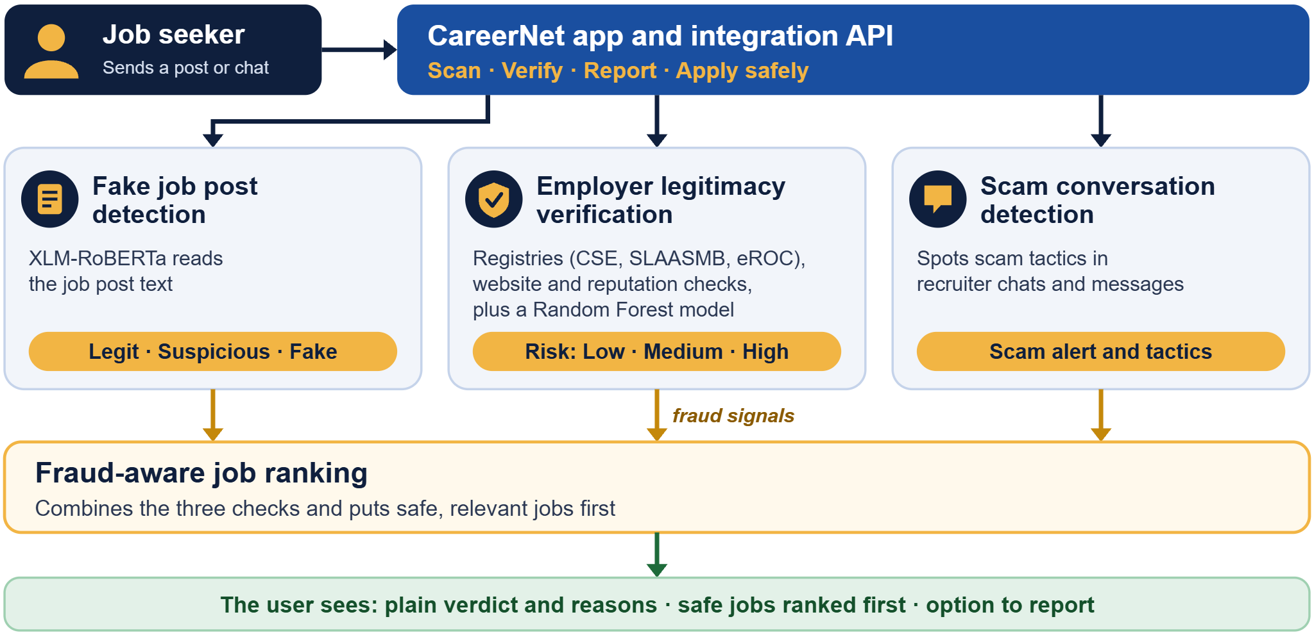
System Architecture Diagram
AI-POWERED JOB SCAM DETECTION ECOSYSTEM
R26-SE-002

Slide 7





AI-POWERED JOB SCAM DETECTION ECOSYSTEM
Business Case
Validation & Traction
Business
Framework
Target Market
  Job seekers requiring safe listings
  Verified recruiters & hiring teams
  University career portals & partners
Revenue Model
SLIIT Validated
  Free access for job seekers
  Subscription tiers for employers
  Paid verification API for job portals
Reviewed and validated by
SLIIT Placement Coordinator
and industry experts.
Value Delivered
  100% scam-free job discovery
  Trusted, pre-vetted employers
  Protection for user data & credentials
User Tested
Differentiators
4 comprehensive user tests completed across job seekers and university recruiters.
  End-to-end employer & message checks
  4-layer AI verification engine
  Tailored Sri Lankan job market focus
R26-SE-002

Slide 8











Milestones to Market
PHASE 1
PHASE 2
PHASE 3
Build and validate
Integrate and pilot
Partnerships
Develop core features
& validate
Connect systems
& run SLIIT pilot
Engage universities
& job portals
PHASE 4
PHASE 5
Public launch
Scale
Deploy web app
& reach seekers
Expand & enhance
recommendation
R26-SE-002

Slide 9
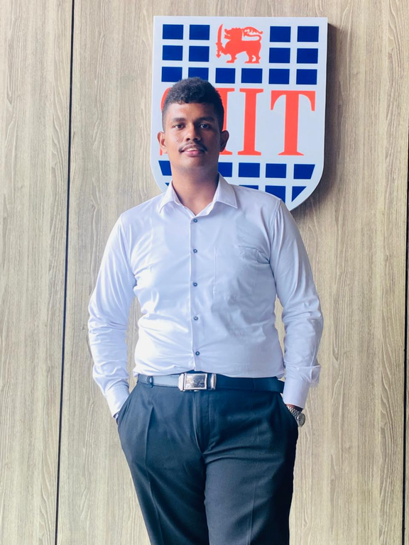
AI-POWERED JOB SCAM DETECTION ECOSYSTEM
IT22113740 | Santhosh S
COMPONENT 01
FAKE JOB POST DETECTION
Purpose:
Detects fraudulent job postings on Sri Lankan online employment platforms to protect job seekers. It is the first layer of defense in the CareerNet platform.
Technical Approach:
  Combined dataset: 4,590 job postings from EMSCAD, ikman.lk and topjobs.lk, which covers the Sri Lankan job market.
  XLM-RoBERTa (fine-tuned): Reads the text of each job post and classifies it as legitimate or fake.
  CareerNet app: Shows the result to the job seeker and passes it to job ranking.
IT22113740 | Santhosh S | R26-SE-002

Slide 10

AI-POWERED JOB SCAM DETECTION ECOSYSTEM
IT22251664 | Nipuni Bandara
COMPONENT 02
EMPLOYER LEGITIMACY VERIFICATION
Purpose:
Checks whether a company is real before a job seeker applies and gives a clear Low, Medium, or High risk verdict with reasons.
Technical Approach:
  Registry check (CSE, SLAASMB, eROC): Is the company officially registered?
  Website and reputation check: Does the company have a real website and good reviews online?
  Random Forest model: Learns from past real and fake companies to score each company. Weighted score: Combines all checks into one score: Low (70+), Medium (45–69), or High (below 45).
IT22251664 | Nipuni Bandara | R26-SE-002

Slide 11

AI-POWERED JOB SCAM DETECTION ECOSYSTEM
IT22224002 | Kajanthan U
COMPONENT 03
SCAM COMMUNICATION DETECTION
Purpose:
Detects scam messages from recruiters in chats and screenshots, names the pressure tactic being used, and warns the job seeker in real time. It protects job seekers after they apply, inside the CareerNet chat.
Technical approach:
  Two-phase DistilBERT: Phase 1 decides scam or legitimate. Phase 2 detects 4 pressure tactics: urgency, FOMO, sunk cost and social proof.
  Real-time chat (Socket.IO): every recruiter message is checked as it arrives, with a red warning and a notification.
  OCR for screenshots: EasyOCR, with Tesseract as fallback, reads WhatsApp and Telegram screenshots.
IT22224002 | Kajanthan U | R26-SE-002

Slide 12

AI-POWERED JOB SCAM DETECTION ECOSYSTEM
IT22288618 | Methmi Chethya
COMPONENT 04
JOB RECOMMENDATION AND RANKING
Purpose :
Ranks relevant jobs while considering fraud risks to
recommend safer opportunities.
Technical approach :
  TF-IDF + cosine similarity: Match job descriptions with user skills.
  Entropy Weight Method (EWM): Calculate weights for the fraud-risk indicators.
  TOPSIS: Rank candidate jobs using the defined ranking criteria.
IT22288618 | Methmi Chethya | R26-SE-002

Slide 13
WHOLE SYSTEM: FOUR COMPONENTS, ONE APP
Results, user acceptance and limitations
FAKE JOB POST DETECTION
EMPLOYER VERIFICATION · 300 UNSEEN
SCAM CONVERSATIONS
FRAUD-AWARE RANKING
87%
Precision 84%
81%
Scam F1 0.86%
88.5%
Recall 78%
Recall 0.86%
10.52%
accuracy
F1 0.81
accuracy
Tactic F1 0.83
test accuracy
0 of 105 scams marked as safe on testing
90.8% of external scams caught
reduction in average risk
User evidence
Limitations
Next steps
  Tested with real recruiters and job seekers and got their feedback
  Tested and validated with industry connecting person at the university
  Develop the application into a professional social networking platform similar to LinkedIn
  Integrate AI agents to automate processes
  Run a larger user study.
  Publish to the Sri Lanka industry
Results are for Sri Lankan jobs only.
Value: one app tells a job seeker if the post, the employer and the chat look safe, and ranks safer jobs first.
R26-SE-002

Slide 14



WHOLE SYSTEM: FOUR COMPONENTS, ONE APP
Technologies, models and testings
Technologies
AI Models
  Mobile - React Native
  Web: Next.js
  Backend: Node.js/Express + Python/FastAPI
  Data: MongoDB, Cloudinary, JWT + bcrypt
  CI: GitHub Actions
  Recruiter messages: DistilBERT + OCR
  Job posts: XLM-RoBERTa
  Employer: Random Forest
  Job match: TF-IDF + cosine, Entropy weighting, TOPSIS
  Assistant: Gemini understands the question; the models decide
Testing
  Unit: Vitest (Node), Pytest (Python)
  Integration: Pytest API tests (mocked models)
  User Acceptance Testing
  CI: each service tested on every push
R26-SE-002

Slide 15

Thank you
An AI Ecosystem for Fake Job Scam Detection and Fraud-Aware Job Recommendation
Scan. Verify. Report. Apply safely.
OUR TEAM
Kajanthan U.
Santhosh S.
Bandara H.M.N.T.
Methmi N.P.C.S.
IT22224002
IT22113740
IT22251664
IT22188618
Supervisor: Ms. Karthiga Rajendran · Co-supervisor: Ms. Thilini Jayalath

