Slide 1
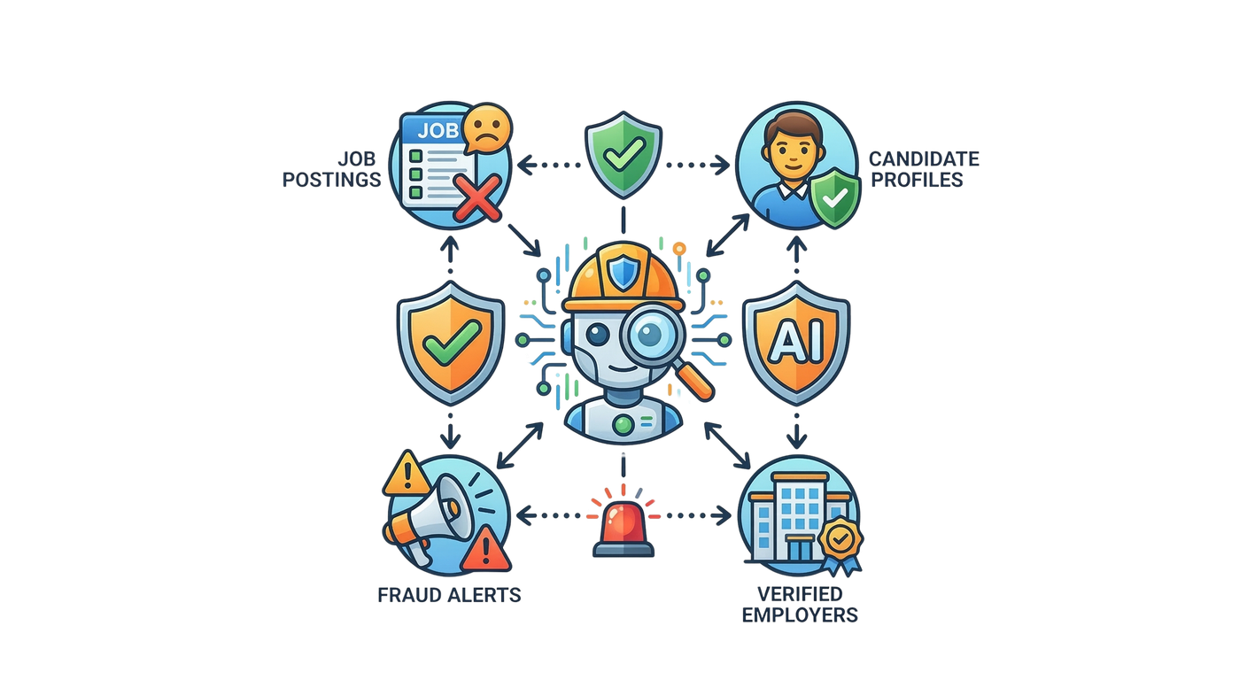


AI-POWERED JOB SCAM
DETECTION ECO SYSTEM
A Multi-Model Framework for Fake Job Detection, Employer Verification, Communication Analysis & Explainable Risk Scoring
Protecting Sri Lankan Job Seekers Through Intelligent AI
R26-SE-002

Slide 2
AI-POWERED JOB SCAM DETECTION ECOSYSTEM
PANEL COMMENTS AND HOW WE ADDRESSED
Student ID | Pannel Comments | How you/team addressed them
IT22224002 Kajanthan U | AS A GROUP, time management should be there. Further, with whole group, literature is missing. Try to do the survey much more. mainly focuses on the inchat statements. Going to analyze the scam messages behaviour. Currently he has trying to get a data set from phd candidate. | Literature review expanded — added Songailaitė et al. (DistilBERT justification), Anagha et al. (tactic taxonomy), Pitumpe & Rahmati (scam message behaviour), Shinde et al. (OCR validation) Did not use PhD candidate dataset — instead used transfer learning on publicly available datasets — EMSCAD (3,364) and UCI SMS (2,747) — combined with 2,000 synthetic messages and 522 real messages manually collected from participants System analyses full recruiter–candidate conversation behaviour across 3 input modes — built-in chat, text paste, and screenshot upload Scam message behaviour analysis implemented through BSTD framework detecting 4 psychological manipulation tactics — urgency, FOMO, sunk-cost, social proof
IT22113740 Santhosh S | Student need to figure out what is the actual novelty path you take after discussing with the supervisor. At least for sinhala language, do it perfectly. Need to include the related literature | Discussed with supervisor and finalize the novelty part Gathered Sinhala post data as well by extracting post contents
R26-SE-002

Slide 3
AI-POWERED JOB SCAM DETECTION ECOSYSTEM
PANEL COMMENTS AND HOW WE ADDRESSED
Student ID | Pannel Comments | How you/team addressed them
IT22251664 Nipuni Bandara | AS A GROUP, time management should be there. Further, with whole group, literature is missing. Try to do the survey much more. mainly focuses on the inchat statements. Going to analyze the scam messages behaviour. Currently he has trying to get a data set from phd candidate.
IT22113740 Santhosh S | Student need to figure out what is the actual novelty path you take after discussing with the supervisor. At least for sinhala language, do it perfectly. Need to include the related literature
Student ID | Pannel Comments | How you/team addressed them
IT22251664 Nipuni Bandara | Why student need to have model, is not clearly explained. Better to think about it again before go to the next level. just because of mismatch in email address, cannot say it is a fraud employer. Need to include the literature | Re-evaluated the need for ML and redesigned the system as a multi-factor fraud detection model Reduced dependence on single indicators such as email mismatch Added company registration and reputation verification methods Improved the system using literature and real-world scam detection concepts Enhanced transparency with explainable risk scoring and evidence tracing
IT22188618 Methmi N P C S | Componenet is fine. No major issues. Need to manage time properly. Literature and the background is missing. | Strengthened the literature review by analyzing existing recommendation techniques, their limitations, and research gaps. Improved the research background by justifying the selection of TF-IDF, EWM, and TOPSIS based on limitations of existing approaches.
R26-SE-002

Slide 4

AI-POWERED JOB SCAM DETECTION ECOSYSTEM
BENEFICIARIES
PROBLEM AND IMPACT
  Job seekers and undergraduates
  Online job platforms, recruitment agencies, and educational institutions
  Government authorities and law enforcement agencies
  Increasing fake job scams and online recruitment fraud in Sri Lanka
  Causes financial loss, personal data theft, psychological stress, and career setbacks
  Reduces trust in digital recruitment platforms and creates social and economic impact
  AI ecosystem integrating fake job detection, employer legitimacy verification, communication analysis, and fraud-aware job recommendation
  Detects recruitment fraud from multiple stages instead of relying only on job post analysis
  Provides overall fraud risk analysis and recommends safer job opportunities for users
DESIGN EXCELLENCE OF THE OVERALL SOLUTION
R26-SE-002

Slide 5

AI-POWERED JOB SCAM DETECTION ECOSYSTEM
IT22113740 | Santhosh S
FAKE JOB DETECTION SYSTEM
Specialization: Software Engineering (SE)
IT22113740 | Santhosh S | R26-SE-002

Slide 6


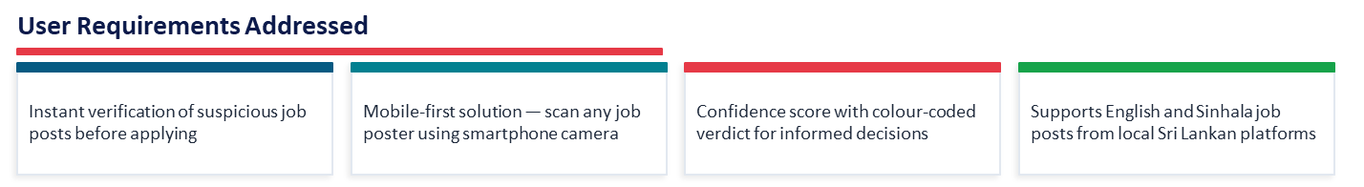
AI-POWERED JOB SCAM DETECTION ECOSYSTEM - COMPONENT 01
SUB PROBLEM AND HOW ADDRESSED
Fraudulent job advertisements on topjobs.lk and ikman.lk are targeting Sri Lankan job seekers causing financial loss. The system enables users to photograph any job post and receive an instant verdict — FAKE, SUSPICIOUS, or LEGITIMATE — using a fine-tuned XLM-RoBERTa multilingual model trained on 4,230 English and Sinhala job posts.
React Native App
User input & image upload
👁 Claude Vision
Text Extraction
XLM-RoBERTa Model
Fake job classification
Instant result
IT22113740 | Santhosh S | R26-SE-002

Slide 7
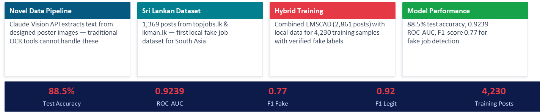
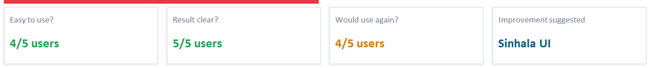
AI-POWERED JOB SCAM DETECTION ECOSYSTEM - COMPONENT 02
DESIGN EXCELLENCE / CONTRIBUTION
USER FEEDBACK ON PROTOTYPE
IT22113740 | Santhosh S | R26-SE-002

Slide 8

AI-POWERED JOB SCAM DETECTION ECOSYSTEM
IT22251664 | Nipuni Bandara
EMPLOYER LEGITIMACY VERIFICATION SYSTEM
Specialization: Software Engineering (SE)
IT22113740 | Nipuni Bandara | R26-SE-002

Slide 9
EMPLOYER LEGITIMACY VERIFICATION SYSTEM
SOLUTION
SUB PROBLEM
The Employer Verification System helps users identify potentially fake employers by combining:
  machine learning prediction,
  website analysis,
  registry verification,
  and reputation checks.
The system analyzes multiple trust indicators and generates an explainable fraud risk assessment instead of relying on a single feature or manual verification process.
Job seekers and students often struggle to identify whether a company behind a job advertisement is genuine or potentially fraudulent. Many scam employers create realistic websites and social media pages, making manual verification difficult.
  Verify whether an employer/company is legitimate
  Detect suspicious or potentially fake job providers
  Provide easy-to-understand verification results
  Reduce the risk of job and financial scams
  Improve trust through explainable evidence and verification methods
USER REQUIREMENTS ADDRESSED
IT22251664 | Nipuni Bandara | R26-SE-002

Slide 10
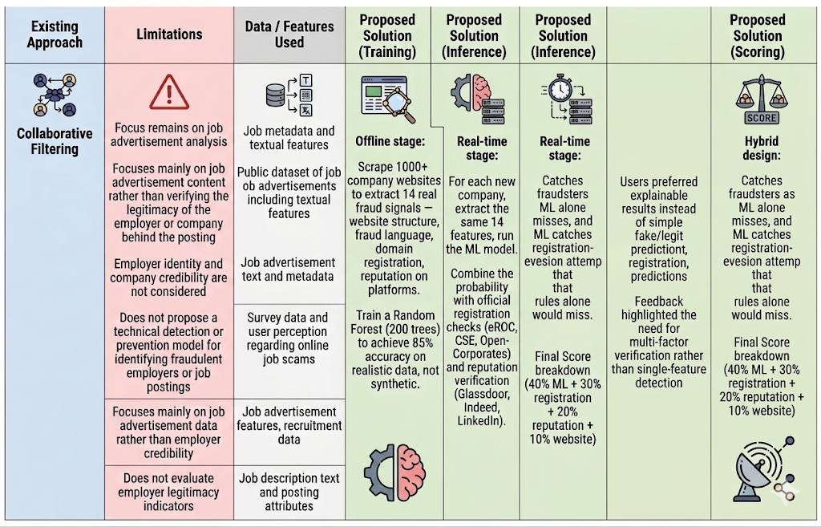
EMPLOYER LEGITIMACY VERIFICATION SYSTEM
LITERATURE REVIEW
IT22251664 | Nipuni Bandara | R26-SE-002

Slide 11
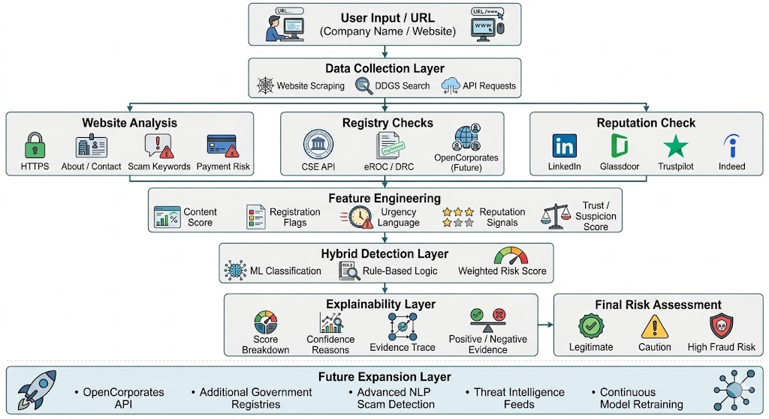
EMPLOYER LEGITIMACY VERIFICATION SYSTEM
DESIGN EXCELLENCE / CONTRIBUTION
IT22251664 | Nipuni Bandara | R26-SE-002

Slide 12
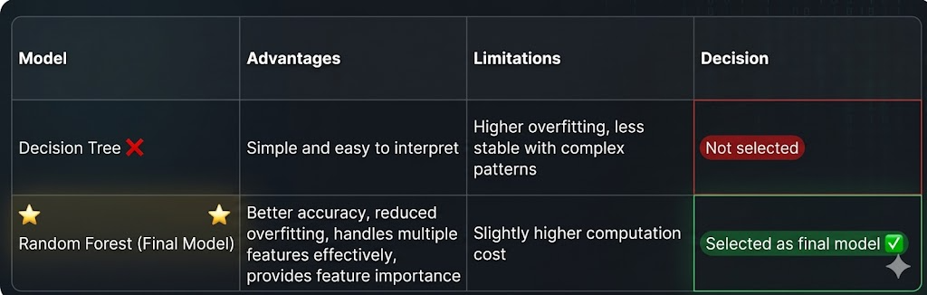
EMPLOYER LEGITIMACY VERIFICATION SYSTEM
  Users preferred explainable results instead of simple fake/legit predictions
  Feedback highlighted the need for multi-factor verification rather than single-feature detection
  Registry verification and evidence tracing improved user trust in the system
  Clear risk summaries and score breakdowns made the prototype easier to understand
USER FEEDBACK ON PROTOTYPE
MODEL COMPARISON
IT22251664 | Nipuni Bandara | R26-SE-002

Slide 13

AI-POWERED JOB SCAM DETECTION ECOSYSTEM
COMPONENT 03
SCAM COMMUNICATION DETECTION MODEL
IT22224002 | Kajanthan U | R26-SE-002

Slide 14
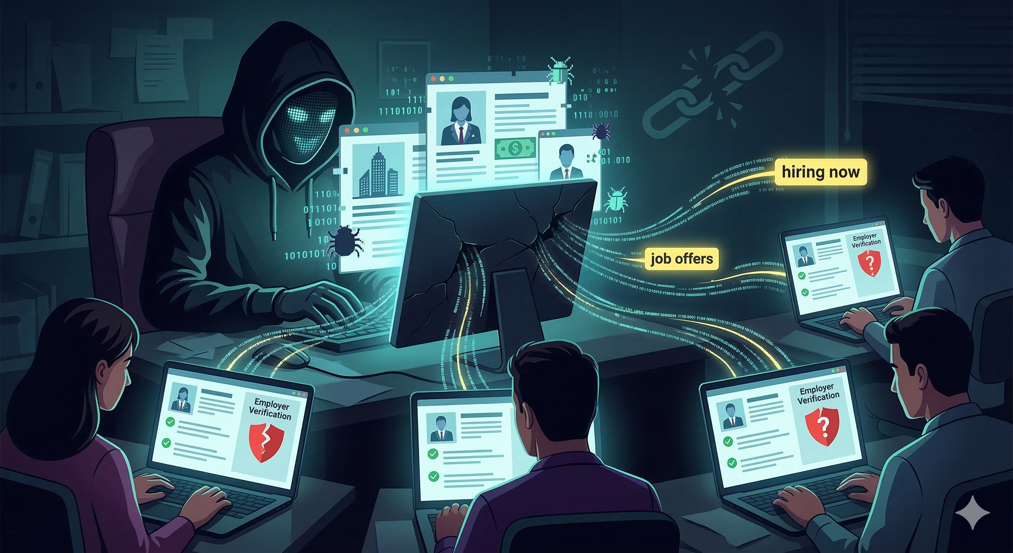

AI-POWERED JOB SCAM DETECTION ECOSYSTEM - COMPONENT 03
THE PROBLEM
  Existing systems detect fake job posts only — no protection once communication moves to WhatsApp, Telegram, or SMS
  No system identifies which psychological manipulation tactic is being used
NOVELTY
  First system to operationalise Anagha et al. 4 tactics — urgency, FOMO, sunk-cost, social proof
  Works across WhatsApp, Telegram, SMS, LinkedIn, email
  Plain-language explainable warnings for non-technical job seekers
IT22224002 | Kajanthan U | R26-SE-002

Slide 15
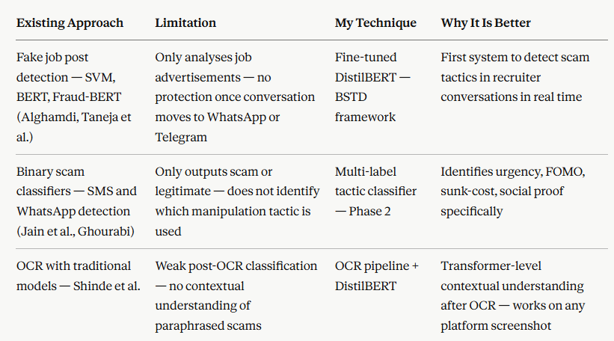
AI-POWERED JOB SCAM DETECTION ECOSYSTEM - COMPONENT 03
LITERATURE REVIEW
IT22224002 | Kajanthan U | R26-SE-002

Slide 16
AI-POWERED JOB SCAM DETECTION ECOSYSTEM - COMPONENT 03
DOMAIN KNOWLEDGE & METHODOLOGY
Baseline
Phase 1
Phase 2
TF-IDF + Logistic Regression
  Fine-tuned DistilBERT on
- 7,433 samples
  Transfer learning from Phase 1
  3,890 samples across 6 datasets
Test Accuracy 84%
  Binary scam classification
  Multi-label tactic classification
Establishes performance
benchmark
  Detects urgency, FOMO, sunk-cost, social proof
  4 datasets — EMSCAD, UCI SMS, synthetic, real collected
Not used in live app
  Stratified 80/10/10 split
Both models run simultaneously — ensemble decision — Phase2 tactic detection overrides Phase 1 if tactic found
IT22224002 | Kajanthan U | R26-SE-002

Slide 17
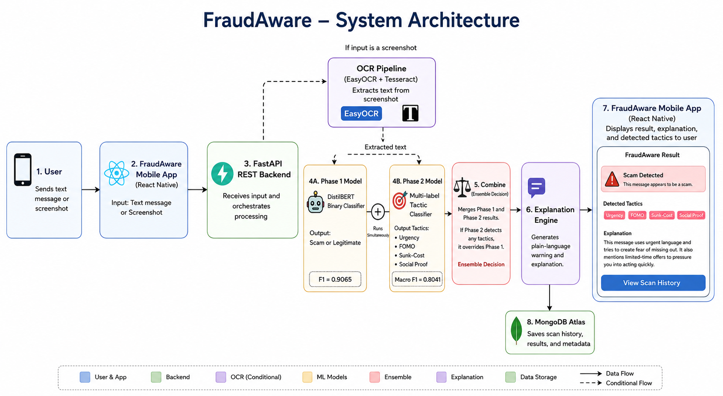
AI-POWERED JOB SCAM DETECTION ECOSYSTEM - COMPONENT 03
IMPLEMENTATION + DESIGN EXCELLENCE
IT22224002 | Kajanthan U | R26-SE-002

Slide 18

AI-POWERED JOB SCAM DETECTION ECOSYSTEM
COMPONENT 04
RISK-AWARE RANKING MODEL FOR JOB RECOMMENDATION SYSTEMS
IT22188618 | Methmi N P C S | R26-SE-002

Slide 19

RISK-AWARE RANKING AND RECOMMENDATION SYSTEM - COMPONENT 04
SUB PROBLEM
ADDRESSED USER REQUIREMENTS
Existing job recommendation systems do not effectively consider skill matching together with fraud awareness when ranking jobs.
Recommend jobs based on user skills.
Identify risky job postings.
Rank jobs using both skill match & risk awareness
Show skill gaps to help users.
SOLUTION
Develop a Risk Aware Ranking and Recommendation Module for
Job Seekers
IT22188618 | Methmi N P C S | R26-SE-002

Slide 20
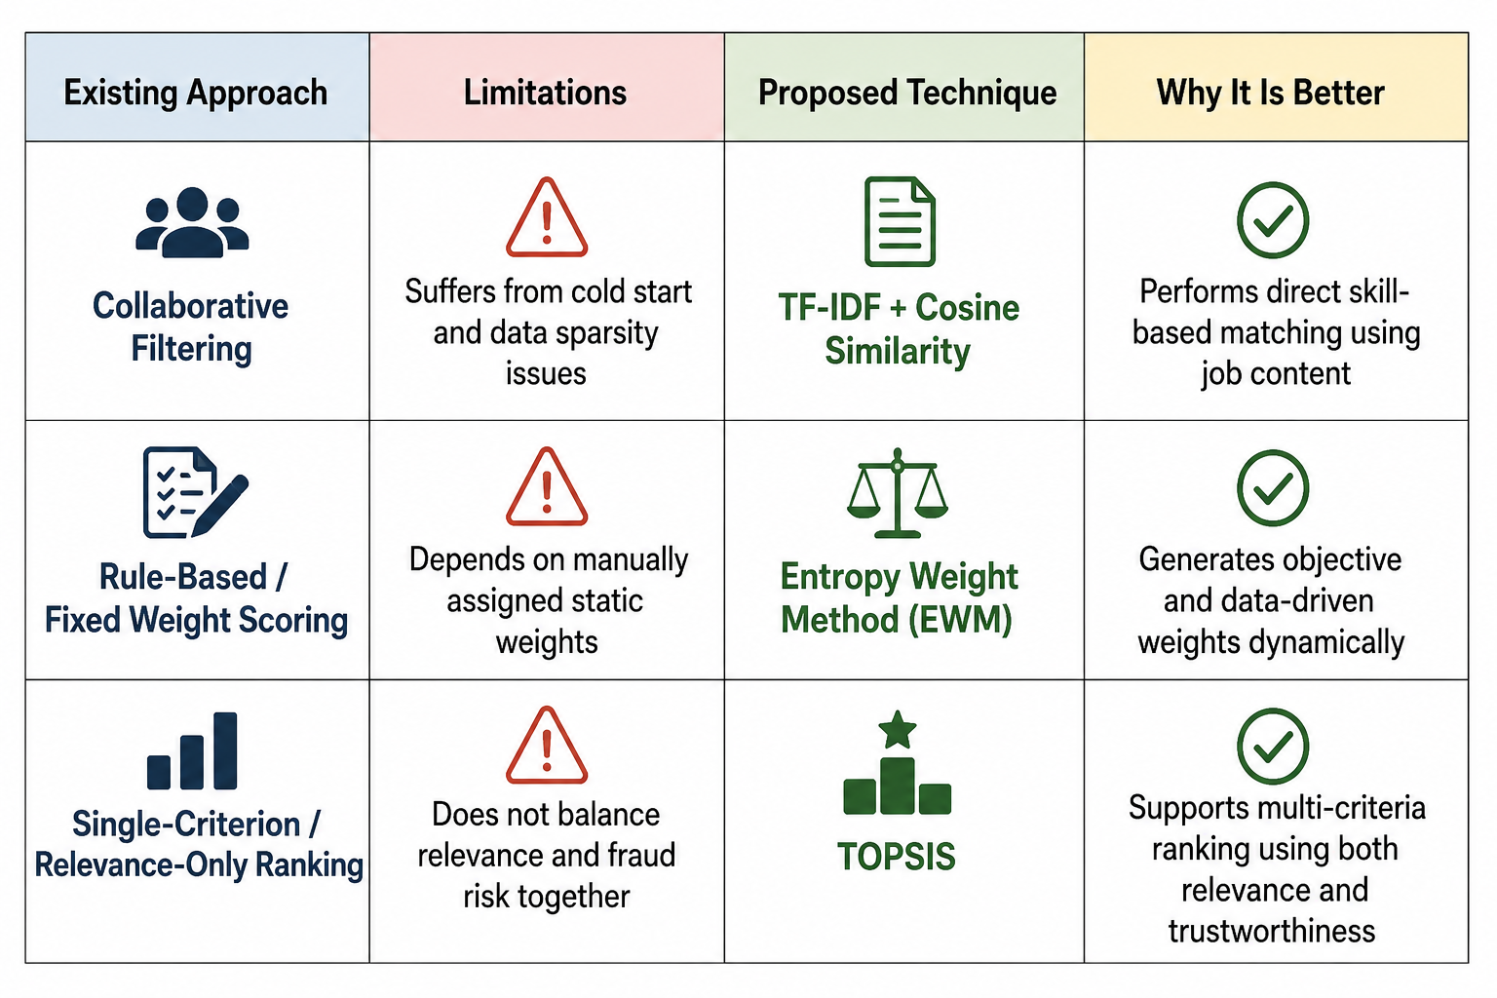
RISK-AWARE RANKING AND RECOMMENDATION SYSTEM - COMPONENT 04
LITERATURE REVIEW
IT22188618 | Methmi N P C S | R26-SE-002

Slide 21
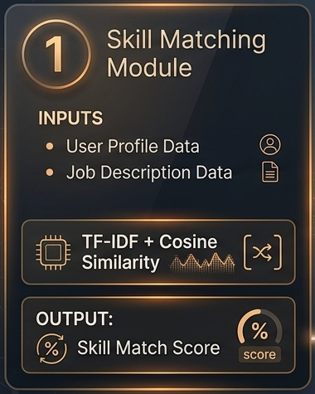
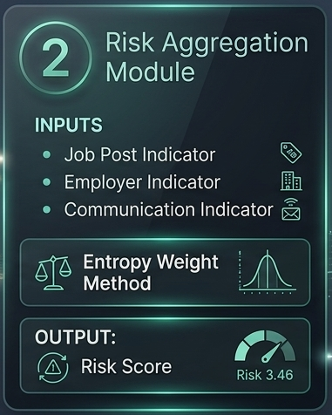
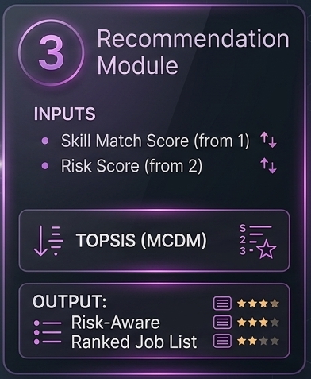
RISK-AWARE RANKING AND RECOMMENDATION SYSTEM - COMPONENT 04
DESIGN EXCELLENCE
IT22188618 | Methmi N P C S | R26-SE-002

Slide 22
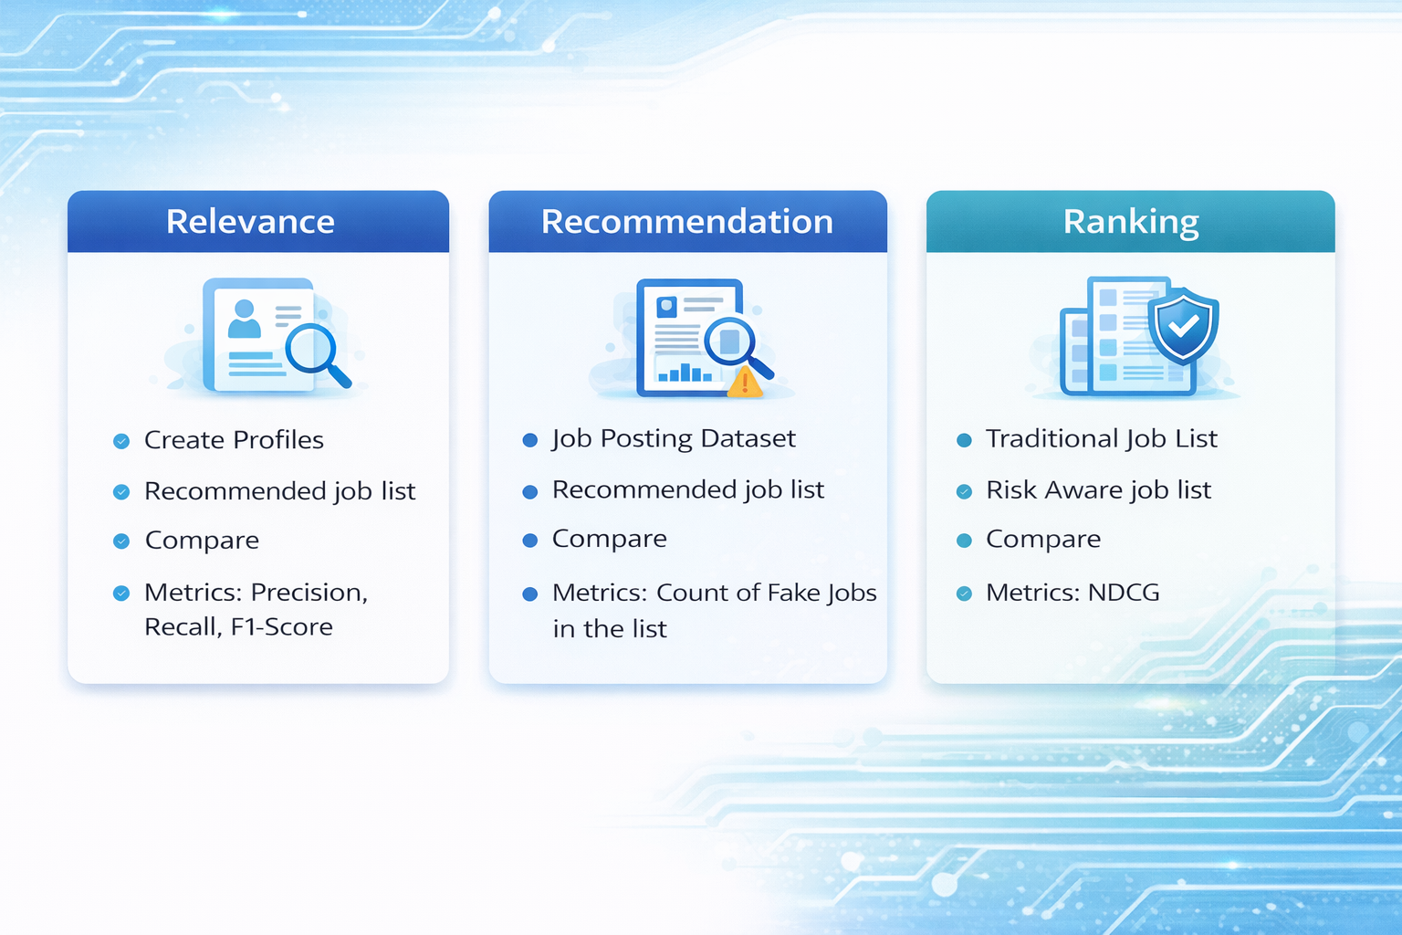
RISK-AWARE RANKING AND RECOMMENDATION SYSTEM - COMPONENT 04
FUTURE IMPROVEMENTS
IT22188618 | Methmi N P C S | R26-SE-002

Slide 23
AI-POWERED JOB SCAM DETECTION ECOSYSTEM
COMMERCIALIZATION
Cost Recovery
&
Sustainability
Target Market
  Job seekers, undergraduates, online job platforms, and recruitment agencies
  Growing demand for secure digital recruitment solutions due to increasing online job scams
  Potential use by universities, government authorities, and employment agencies
  Revenue through subscription plans, API integration, and enterprise licensing for job platforms
  Long-term sustainability through partnerships with recruitment platforms and institutions
  Scalable AI-based solution with future expansion opportunities for digital recruitment security
What is unique in our solution
  Combines fake job detection, employer legitimacy verification, communication analysis, and fraud-aware job recommendation in one ecosystem
  Detects scams from multiple stages instead of only analyzing job advertisements
  Provides overall fraud risk analysis with safer job recommendations

