Slide 1
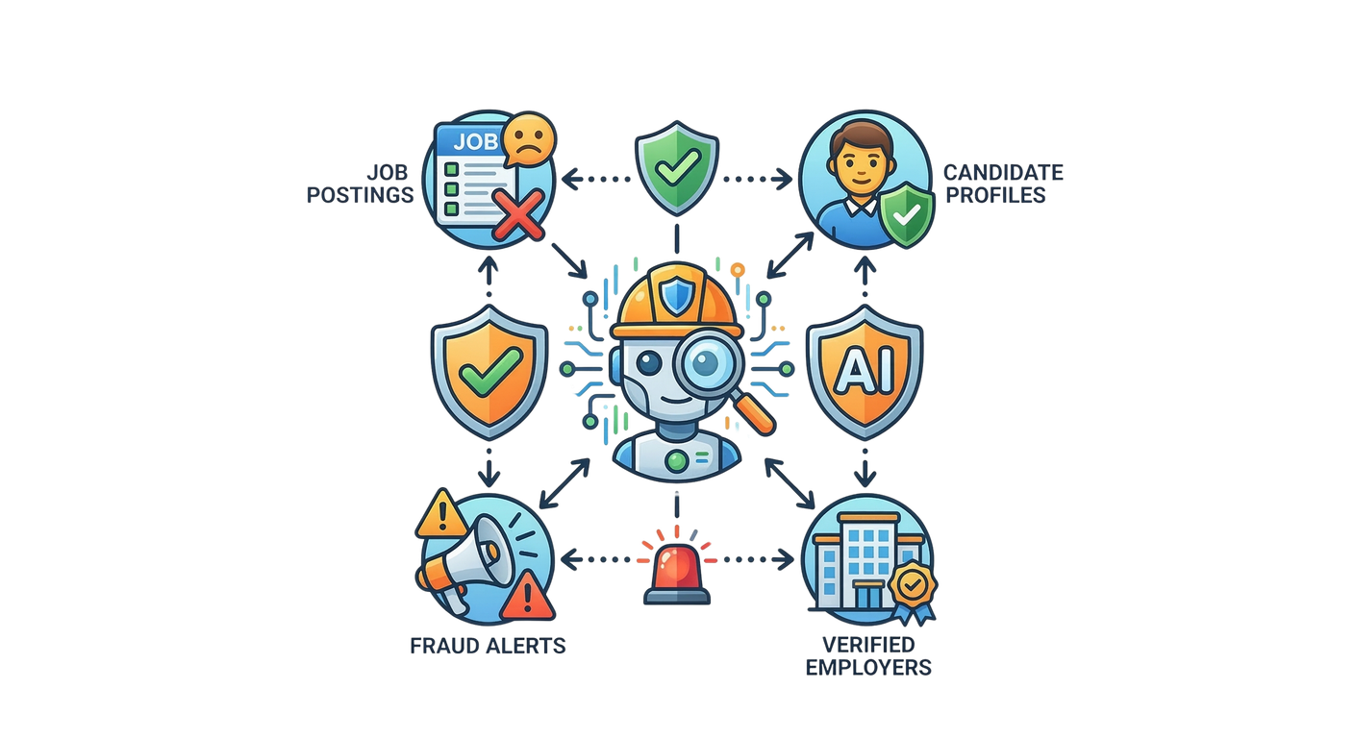



AI-POWERED JOB SCAM
DETECTION ECOSYSTEM
A Multi-Model Framework for Fake Job Detection, Employer Verification, Communication Analysis & Explainable Risk Scoring
Protecting Sri Lankan Job Seekers Through Intelligent AI
R26-SE-002

Slide 2

PANEL COMMENTS ON PP1 AND HOW WE ADDRESSED
AI-POWERED JOB SCAM DETECTION ECOSYSTEM
Student ID | Panel Comments | How you/team addressed them
IT22224002 Kajanthan U | Has a considerable progress from the proposal. Better to keep it up. No major issues at this level.
IT22113740 Santhosh S | AB. Rescheduled on 26th May. Student having a good progress since proposal. At pp2, need to provide an valid explanation for the fake post and give a try on Sinhala post as well. | Implemented SHAP & LIME to highlight words pushing toward Fake or Legitimate. Collected 308 Sinhala job posts from ikman.lk and attempted Sinhala fake job detection — limited training data affects accuracy,
IT22251664 Nipuni Bandara | Better to improve the data set. She is using APIs to check whether the company is registered one or not. For the final calculation, you have taken some weights. At the pp2, you have to bring some samples which represents the effect of weights changing and show to the panel as evidence. | The dataset was refined and the RandomForest model retrained. Employer legitimacy is verified at runtime using official registries and combined into a hybrid score of 40% ML, 30% registry, 20% reputation, and 10% website analysis. Different weight combinations were tested, but the 40/30/20/10 profile was selected to maintain reliable registry verification.
IT22188618 Methmi N P C S | Better to grow the data set. Other than HR, it is good to have more domains. No major issues at this level. | The job dataset contains 1,167 records across five domains—Information Technology, Business Development, Finance, Sales, and HR—addressing the panel's recommendation to broaden the dataset beyond HR.
R26-SE-002

Slide 3



AI-POWERED JOB SCAM DETECTION ECOSYSTEM
THE PROBLEM
With youth unemployment rising and online job hunting booming in Sri Lanka, scammers are exploiting the desperation of thousands — and no intelligent, localized system exists to stop them.
Rising Threat
Vulnerable Targets
No localized
Fake job scams surging on ikman.lk, Top Jobs & social media
Youth graduates, migrant workers & unemployed individuals
AI-powered system not exists for
Sri Lanka
R26-SE-002

Slide 4


USERS & STAKEHOLDERS
AI-POWERED JOB SCAM DETECTION ECOSYSTEM
Primary Users
Stakeholders
Job Seekers
Government
&
Regulatory
Banks
&
Financial Bodies
Young graduates, migrant workers & unemployed individuals on ikman.lk, TopJobs & social media.
Law Enforcement
Job
platforms
HR & Recruitment Professionals
Legitimate employers who need to protect their brand from impersonation by scammers.
Educational Institutes
R26-SE-002

Slide 5




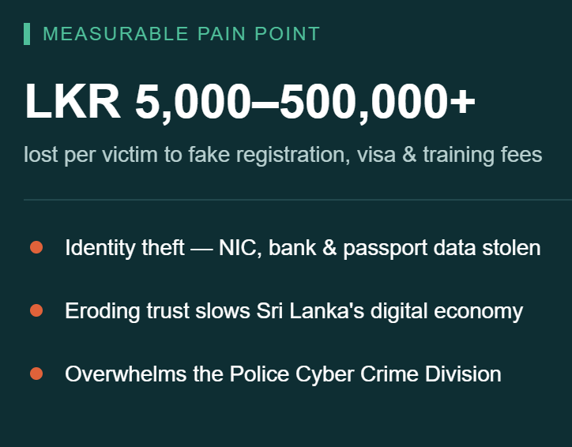




AI-POWERED JOB SCAM DETECTION ECOSYSTEM
IMPACT & MEASURABLE PAIN POINT
Impact on users
Financial Loss
Personal Data Theft
Career Setbacks
Impact on Society
Lost to Employment Fraud Annually
Eroding Digital Trust
Brain Drain Exploitation
Law Enforcement Burden
R26-SE-002

Slide 6
AI-POWERED JOB SCAM DETECTION ECOSYSTEM
RESEARCH GAP & OBJECTIVES
Solution | Local Context? | Real-time? | Domestic Jobs? | AI-Driven?
Manual Reporting | Yes | No | Yes | No
Google Safe Browsing | No | Yes | No | No
SLBFE Portal | Yes | Yes | No | No
Spam Filters | No | Yes | No | Yes
Glassdoor / ScamAdvisor | No | No | No | No
Our Objectives:
  Detect fake job posts
  Verify employer legitimacy
  Detect scam tactics in recruiter–candidate communication
  Rank jobs by fraud-aware relevance
No existing solution combines employer verification, multilingual scam analysis & explainable AI risk scoring — tailored for Sri Lanka
No existing solution combines employer verification, multilingual scam analysis & explainable AI risk scoring — tailored for Sri lanka
R26-SE-002

Slide 7
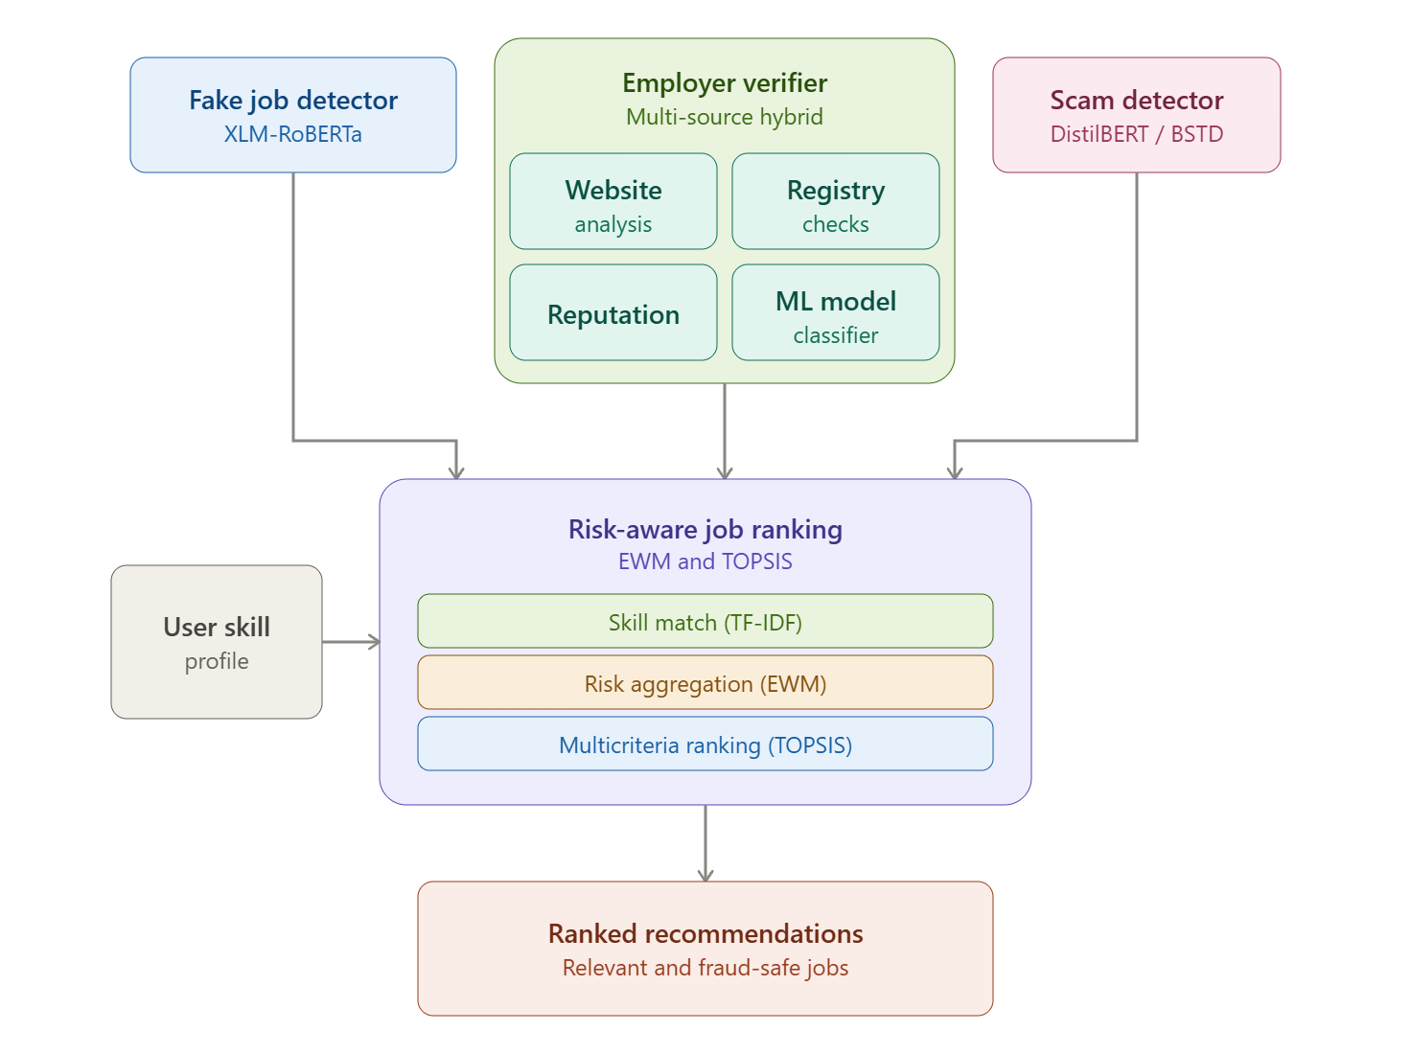
AI-POWERED JOB SCAM DETECTION ECOSYSTEM
SOLUTION OVERVIEW + ARCHITECTURE
System Design & Delivery Practices:
  Modular multi-model ecosystem independently trained & evaluated components
  Multi-source hybrid verification — website + registry + reputation fused
  Multi-criteria ranking (EWM + TOPSIS) — fraud risk engineered into relevance —
  API-first, three-tier architecture — app, dashboard & admin on one backend
  CI/CD pipeline — automated build, test & deployment
  Explainable-by-design — human-readable evidence behind every risk score
Architecture – Microservices Architecture
R26-SE-002

Slide 8
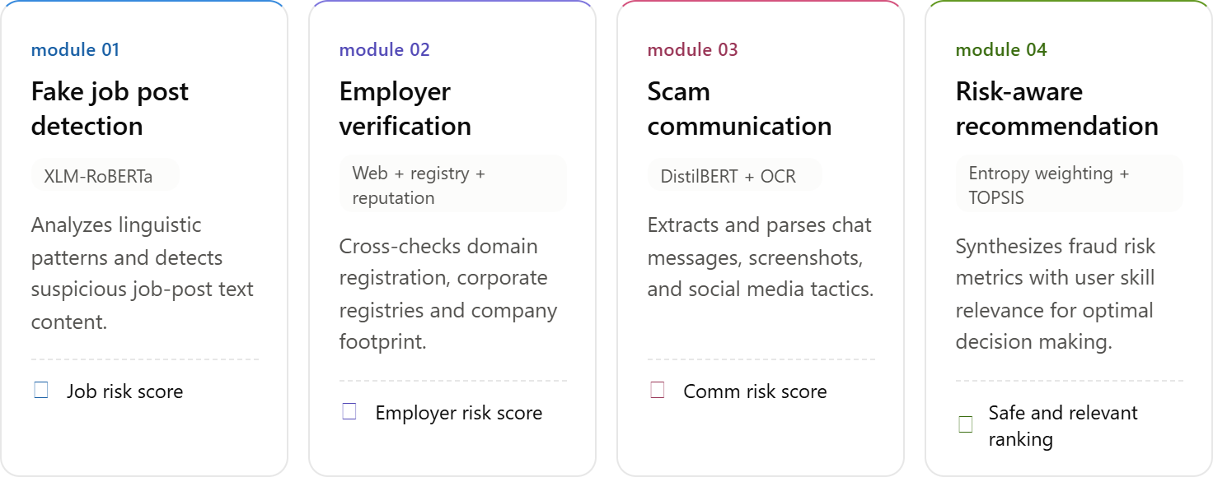


AI-POWERED JOB SCAM DETECTION ECOSYSTEM
INTEGRATION & COMPLETION STATUS
IMPLEMENTED
Fake job post detection
Employer verification
Scam message detector
Recruiter–candidate chat monitoring
Risk-aware ranking
Future Work
Team collaboration
Billing and Subscription Management
R26-SE-002

Slide 9
AI-POWERED JOB SCAM DETECTION ECOSYSTEM
EVALUATION EVIDENCE
Model | Accuracy | F1 | ROC-AUC
Fake Job Post Detector (XLM-RoBERTa) | 88.50% | – | 0.9239
Scam Message Detector (Phase 1) | 85.34% | 0.8399 / 0.8549 | –
Scam Tactic Detector (Phase 2) | – | Macro 0.8345 Micro 0.8722 | –
Employer Verification (ML classifier alone) | 78.3% | 0.77 | 0.87
Employer Verification – Full hybrid score (ML + registry + reputation + website) | 76.5% | 0.83 | –
Risk Aware Job Recommendation
R26-SE-002

Slide 10




AI-POWERED JOB SCAM DETECTION ECOSYSTEM
NON-FUNCTIONAL REQUIREMENTS
Performance
Real-time response for job, message & employer classification
Scalability
Handles growing post & chat volume across platforms
Security and Privacy
Protects chat and personal data throughout the pipeline
Maintainability
Supports a continuous model retraining pipeline
R26-SE-002

Slide 11
AI-POWERED JOB SCAM DETECTION ECOSYSTEM
COMMERCIALIZATION
Who Benefits:
Job seekers on ikman.lk & TopJobs — graduates, migrant workers, unemployed individuals
Platforms & recruiters as B2B adopters, protecting users and brand trust
Why They’ll Adopt:
Safety: flags fraud before financial/data harm occurs
Protection from monetary fraud and data theft
Can It Be Sustained:
Deploy as an API layer integrated into existing platforms — low adoption friction
Continuous retraining pipeline keeps pace with evolving scam tactics
Pilot strategy: start with one platform partner + highest-harm job category
Evidence:
User Feedbacks: Users found the system easy to use and practically valuable, while suggesting minor UI and usability improvements.
Measured Benefits: The system detects fake jobs, scam messages, and scam tactics with 78–89% accuracy and 0.83–0.87 F1/AUC across components. Employer verification currently favors caution — 54.9% fraud recall — to avoid wrongly flagging legitimate employers, a tradeoff targeted for refinement in future work.
R26-SE-002

Slide 12



AI-POWERED JOB SCAM DETECTION ECOSYSTEM
DEMO ROADMAP – WHAT TO WATCH FOR
One Connected Ecosystem
01.
02.
03.
Jobseeker App
Recruiter Dashboard
Admin & Safety Team
Empowers candidates to search, verify, and apply for jobs with built-in instant scam detection tools.
Gives legitimate employers a centralized workspace to post jobs, manage pipelines, and message candidates.
Monitors platform health, investigates candidate reports, and swiftly removes bad actors in real time.
R26-SE-002

Slide 13
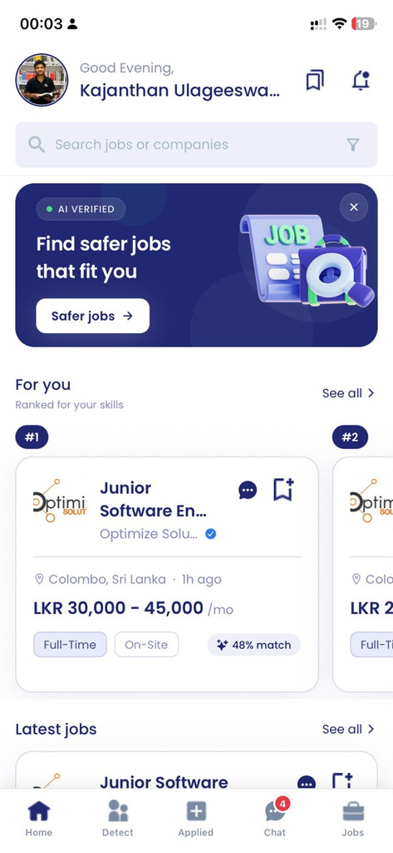
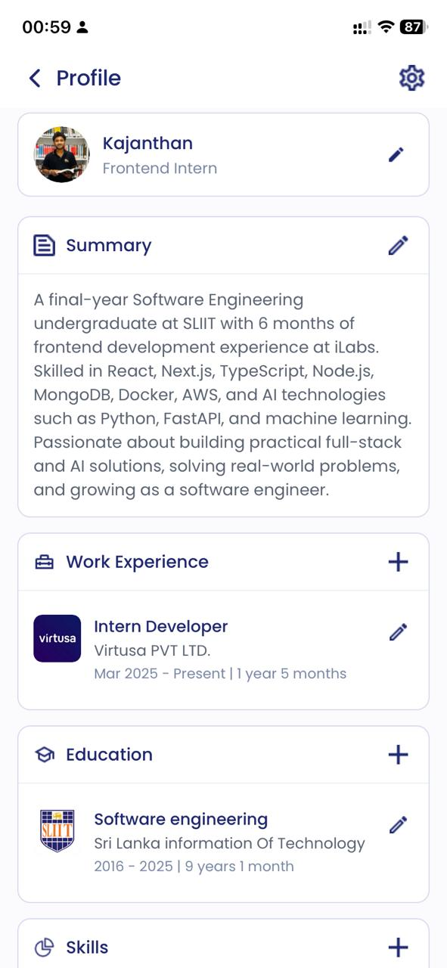
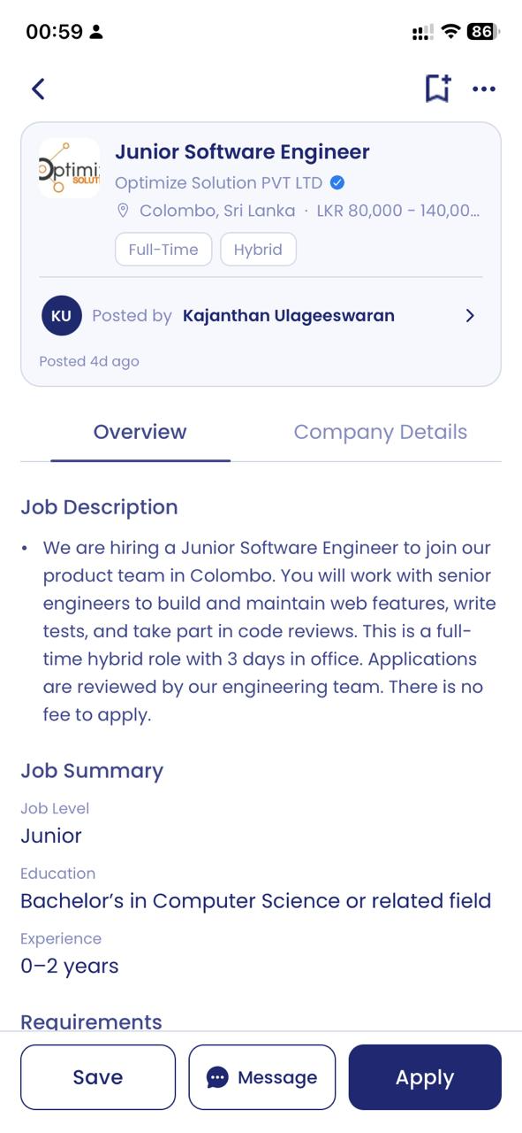
AI-POWERED JOB SCAM DETECTION ECOSYSTEM
01. Jobseeker App
R26-SE-002

Slide 14
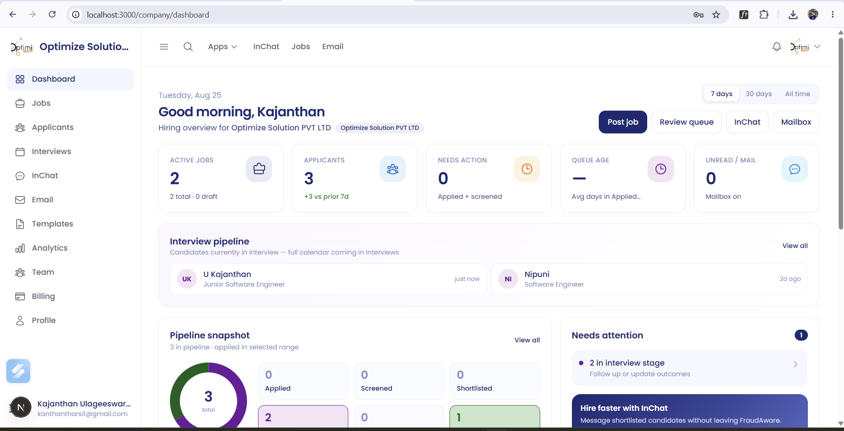
AI-POWERED JOB SCAM DETECTION ECOSYSTEM
02. Recruiter Dashboard: Modern Hiring Workspace
R26-SE-002

Slide 15
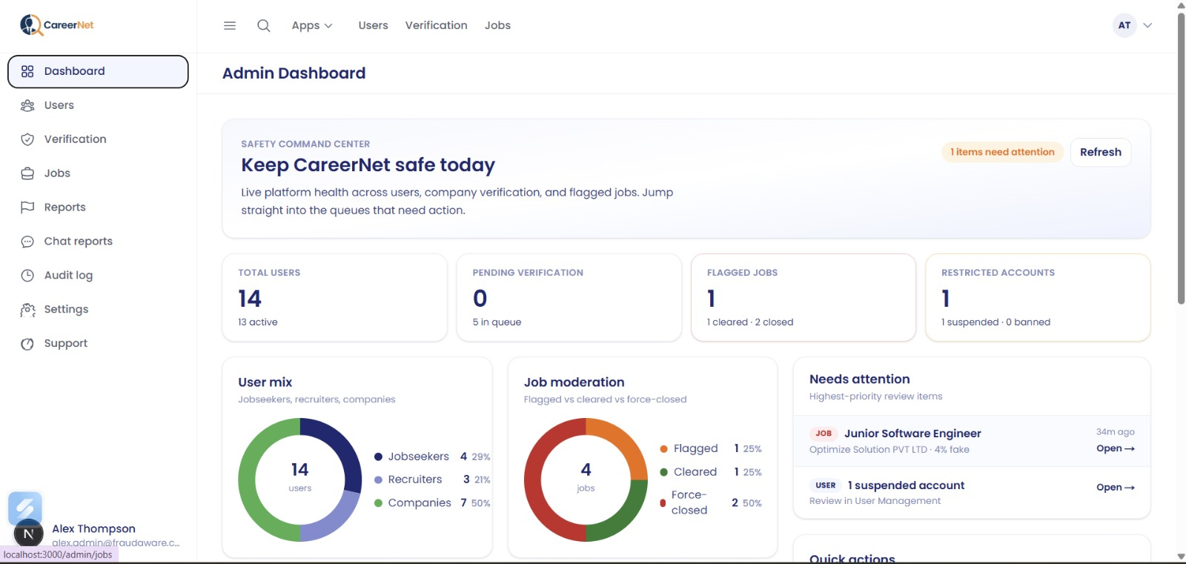
AI-POWERED JOB SCAM DETECTION ECOSYSTEM
02. Admin Dashboard
R26-SE-002

Slide 16

R26-SE-002
Kajanthan U
Santhosh S
Nipuni Bandara
Methmi Chethya

