Slide 1

Content-Provenance Watermarking for AI-Generated Media
Multimedia Systems Course Project
Team Members: Ashvin Mavila Kannoth, Sermin Singh, Kshitiz Khandelwal
• Registration Numbers: 23BIT0152, 23BIT0344, 23BIT0121
• Guide: BALASUBRAMANI M

Slide 2

Why Content Provenance Matters
Explosion of generative AI media
Rise of deepfakes and misinformation
Difficult to verify authenticity
Loss of public trust
Need for transparent attribution
Reliable provenance is becoming essential for digital trust.

Slide 3
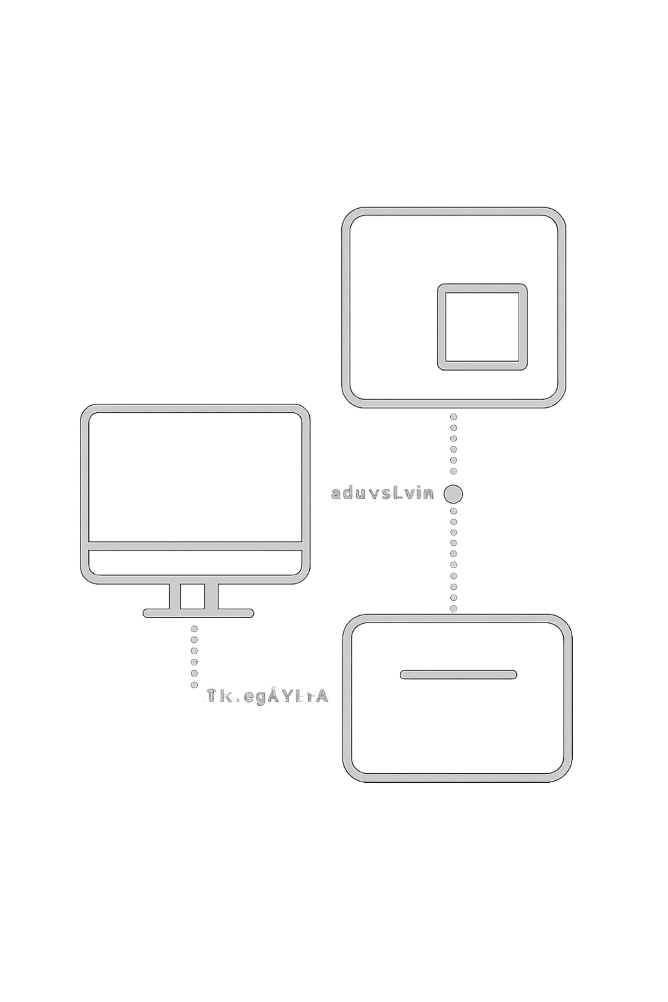
Problem Statement
AI images easily modified
Metadata frequently removed
Existing watermarks are fragile
Provenance chains incomplete
Authenticity not reliably verifiable
Current solutions fail under real-world transformations.

Slide 4
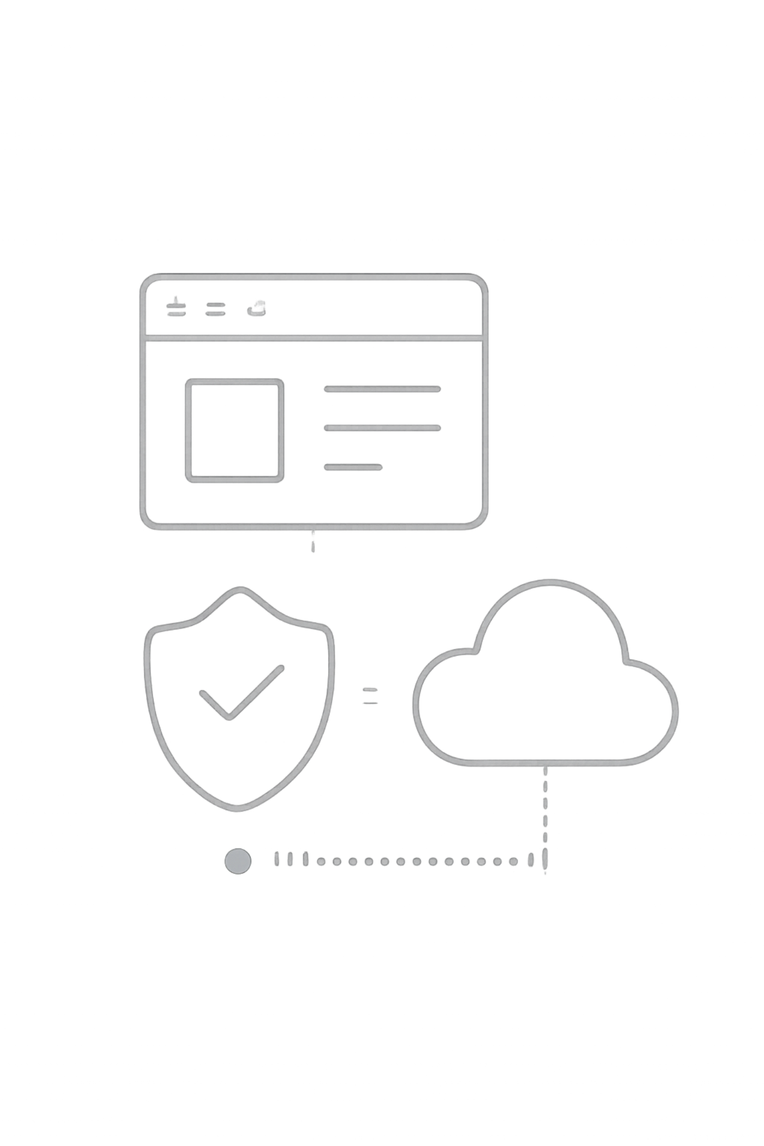
Project Objectives
Embed invisible provenance watermark
Preserve image quality
Survive editing and compression
Verify source authenticity
Support ownership tracking
Develop a robust and transparent provenance framework.

Slide 5
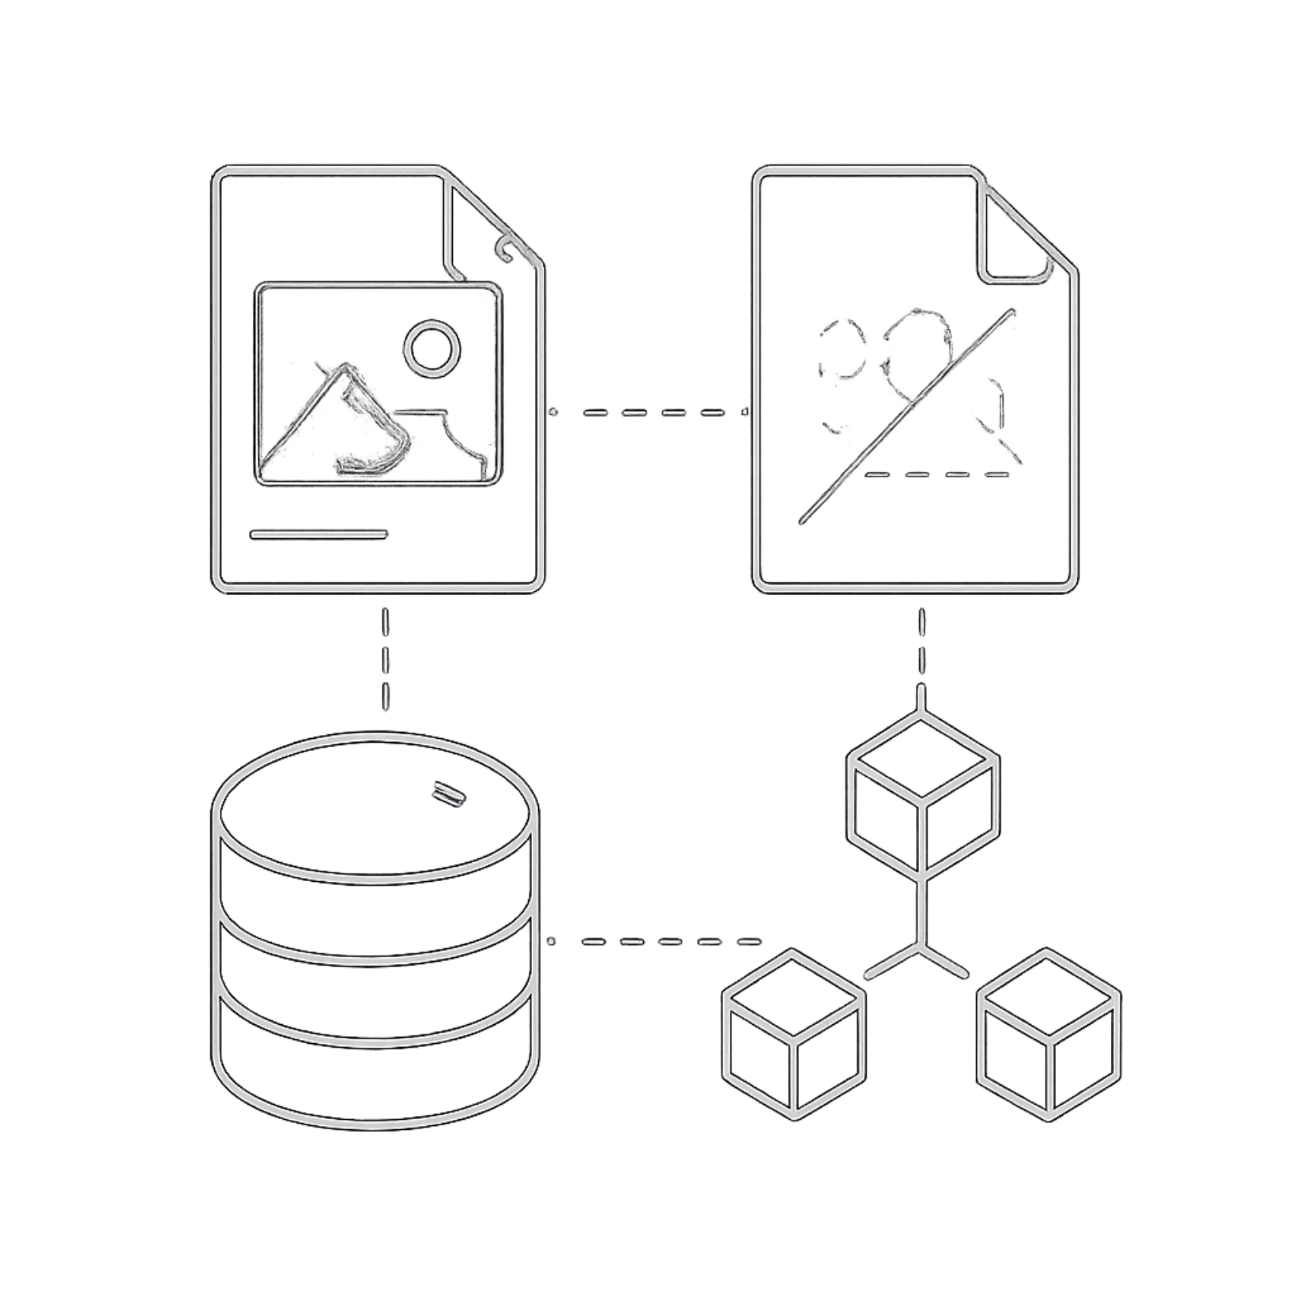
Existing Solutions & Limitations
Visible watermarks — easy removal
Invisible watermarks — limited robustness
Metadata standards — stripping risk
C2PA — partial adoption
Blockchain — high cost, latency
No single solution provides complete provenance protection.

Slide 6

Proposed System Architecture
AI Generator
Watermark Encoder
Generated Media
Distribution
Content carries verifiable provenance throughout its lifecycle.

Slide 7
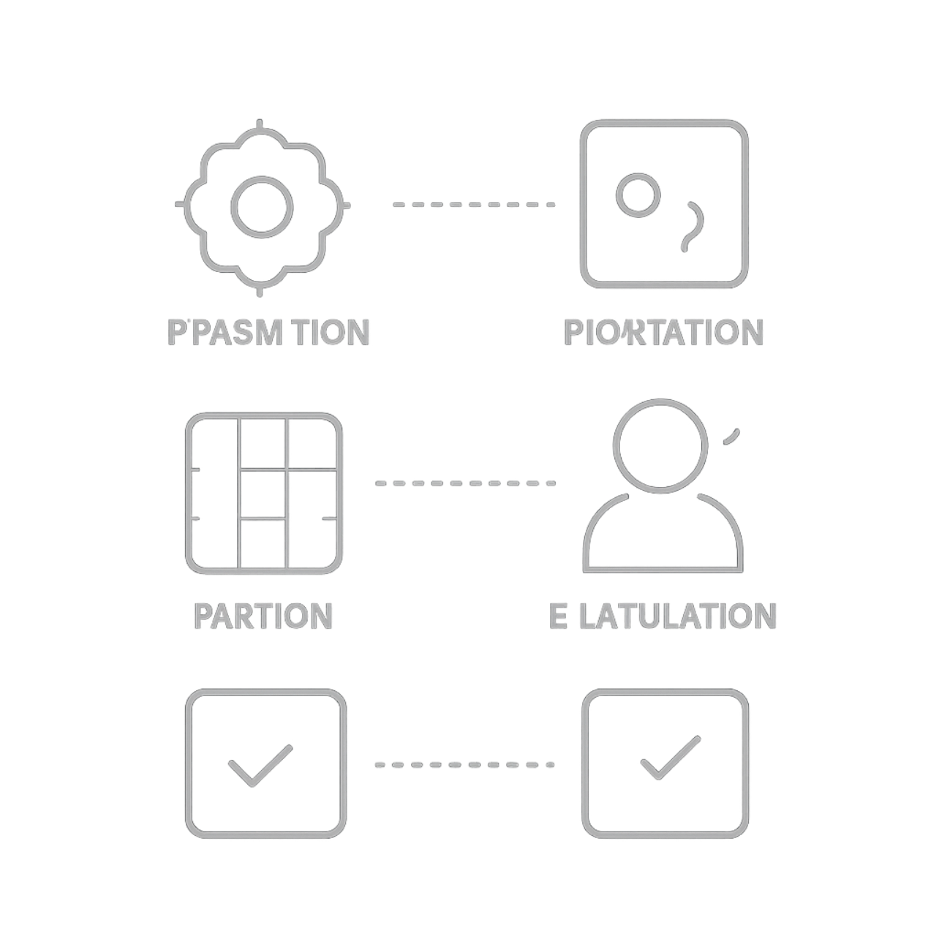
Technical Workflow
AI content generation
Feature extraction
Watermark embedding
Secure hashing
Provenance registration
Verification and authenticity check
Stepwise pipeline with verification at publication and retrieval.

Slide 8

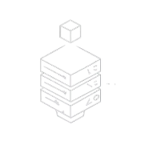



Technology Stack
Frontend
Backend
AI
Security & DB
React
Tailwind
CSS
FastAPI
Python
Stable Diffusion GPT APIs
SHA-256 Signatures PostgreSQL
Multimedia Technologies
OpenCV • FFmpeg • Pillow • Robust Neural Watermarking / DWT-DCT watermarking
A complete AI and security stack enables trustworthy provenance.

Slide 9
Research Gap
Novelty
Methods operate in isolation
Weak robustness under edits
Poor cross-platform verification
Limited provenance integration
End-to-end provenance
Robust watermark embedding
Tamper detection mechanisms
Automated verification APIs
Combines watermarking and provenance into one unified framework.

Slide 10
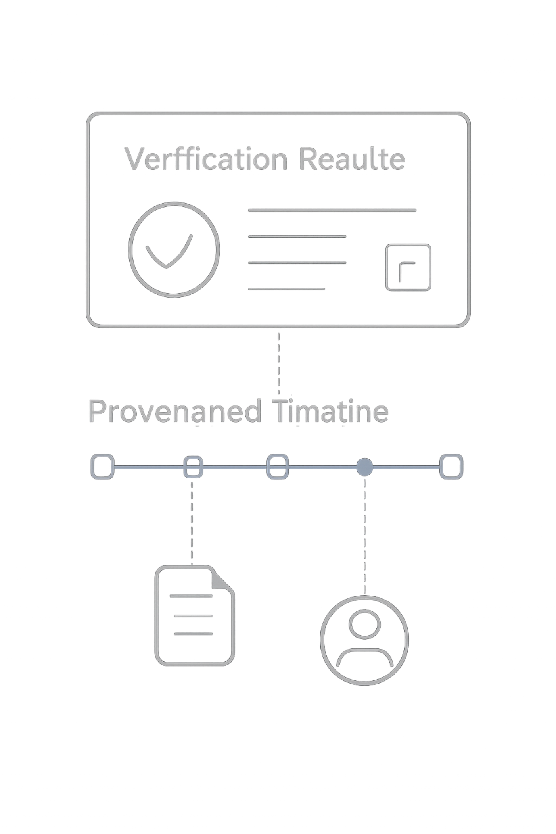
Expected Outcomes
Authentic AI-generated media
Robust watermark recovery
Provenance verification dashboard
Reduced misinformation
Stronger copyright protection
Enable trustworthy AI-generated content ecosystems.

Slide 11
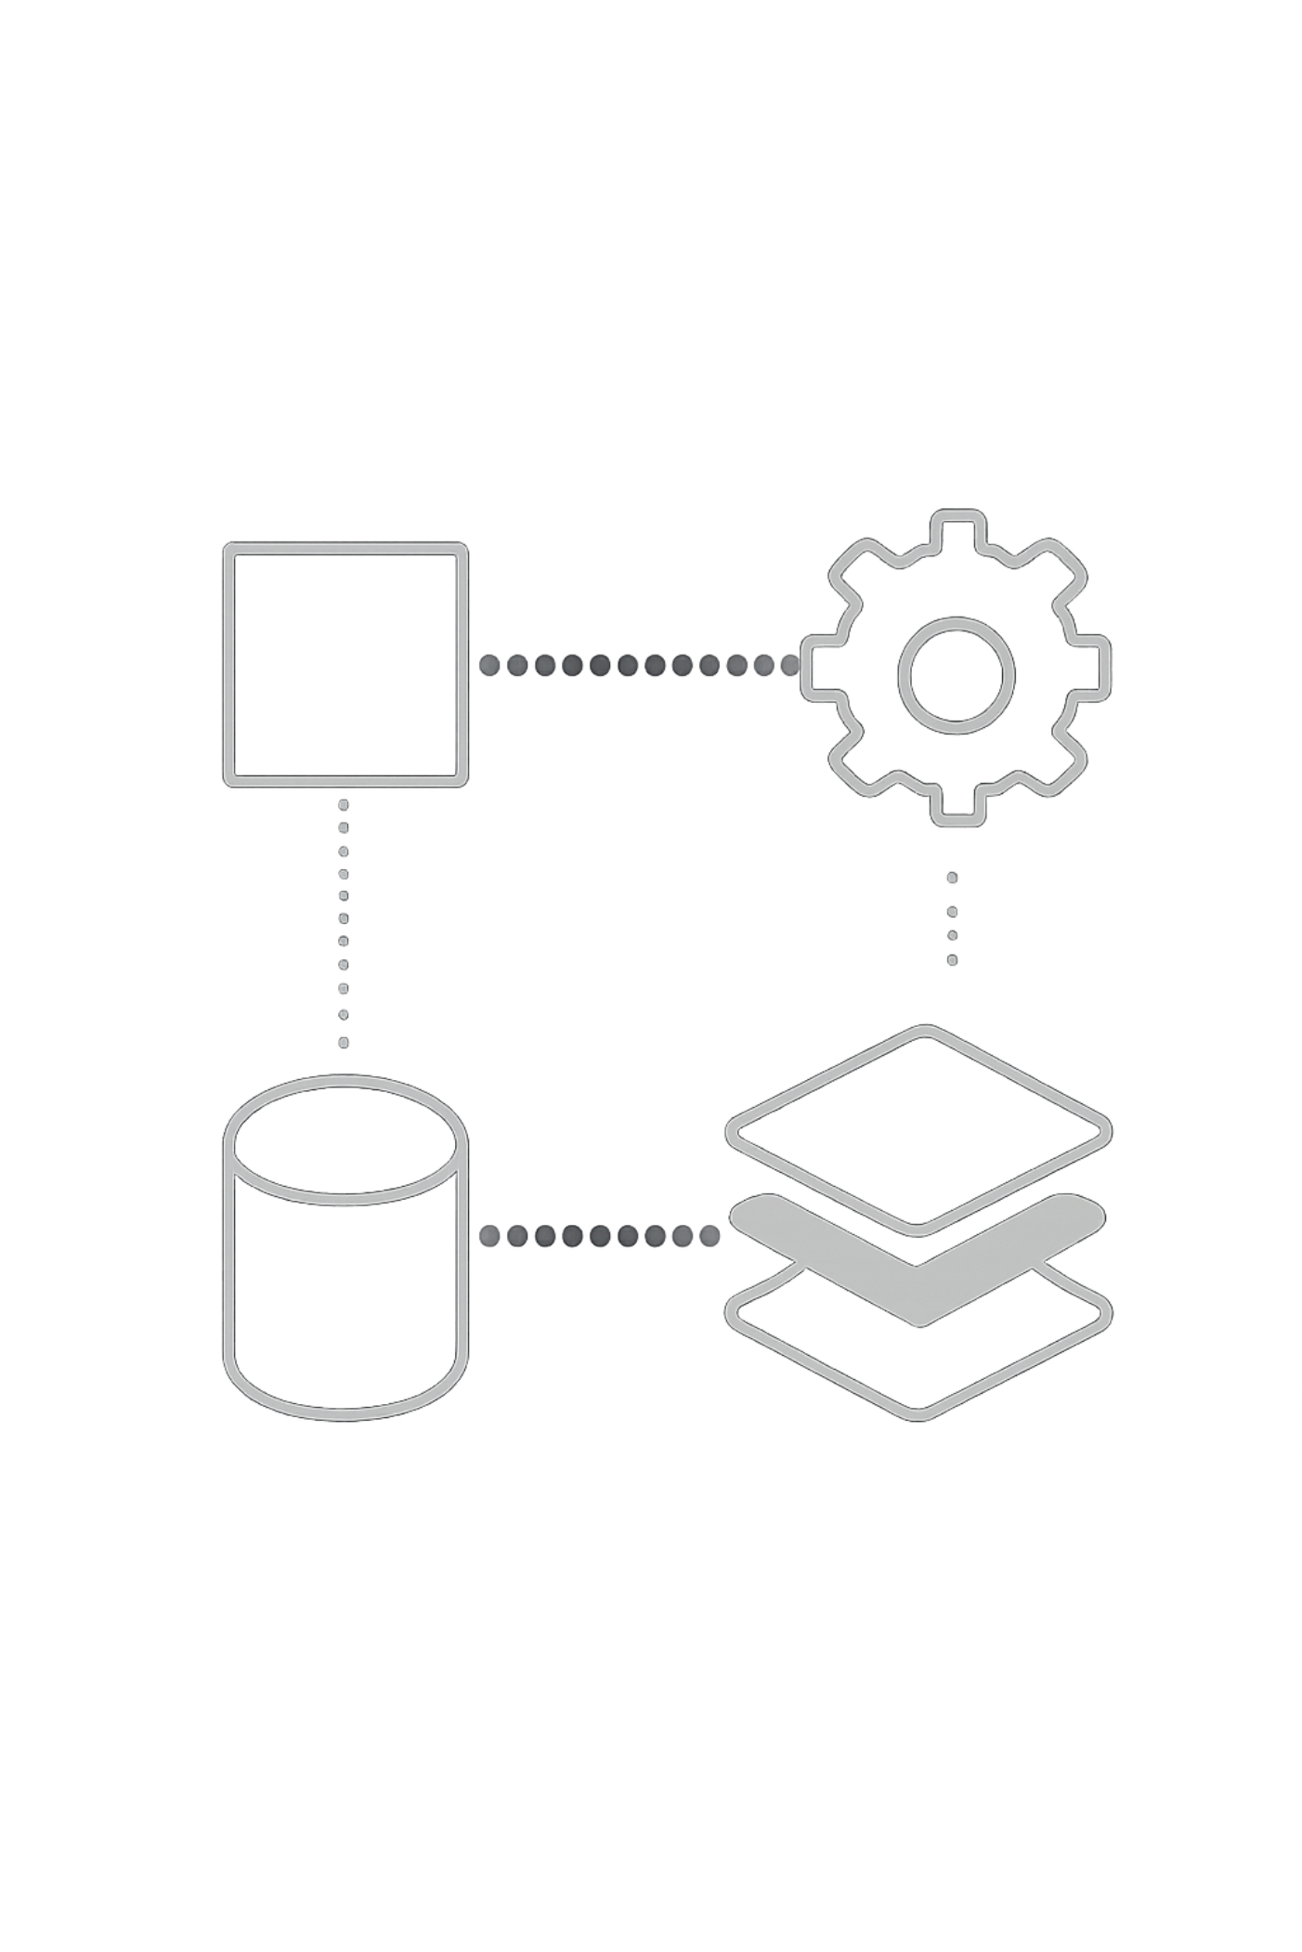
Real-World Applications
Social media platforms
Journalism
Legal evidence
Digital art & NFTs
Government communications
Educational content
Enterprise AI systems
Applicable wherever AI-generated media requires trust and accountability.

