Slide 1
Chapter 2
Uses and Limitations

Slide 2
Chapter 2 Contents
The Chinese Room
HAL – Fantasy or Reality?
AI in the 21st Century

Slide 3
The Chinese Room
A thought experiment used to argue against strong AI.
A non-Chinese speaker is in a room with a set of cards with Chinese characters, and a set of instructions in English.
Questions in Chinese are fed into the room, and by following the instructions, the human is able to produce answers.
The room appears to understand Chinese – it can answer questions in the language – but the human inside cannot.

Slide 4
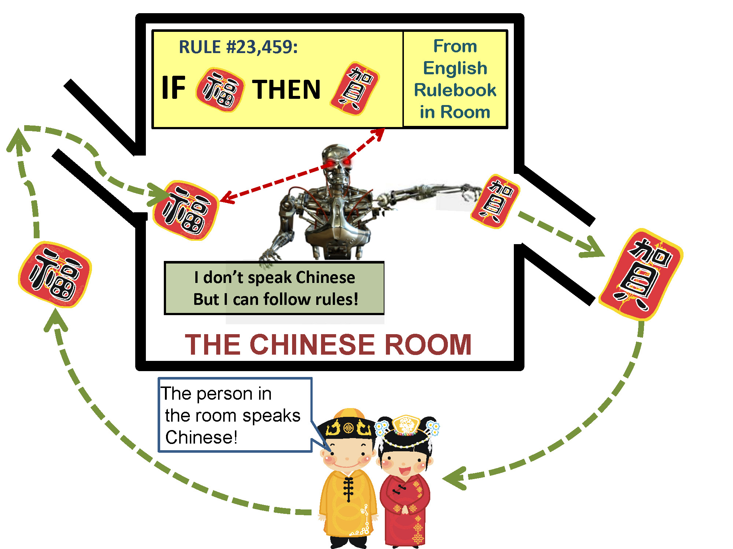

Slide 5
Searle’s Argument
The man in the room does not understand Chinese.
The pieces of card do not understand Chinese.
The room itself does not understand Chinese, and yet the system as a whole is able to exhibit properties that lead an observer to believe that the system (or some part of it) does understand Chinese.

Slide 6
Searle’s Argument (1)
In other words, running a computer program that behaves in an intelligent way does not necessarily produce understanding, consciousness, or real intelligence.

Slide 7
One response to Searle
The combination of the room, the human, the cards with Chinese characters, and the instructions form a system that in some sense is capable of understanding Chinese stories.
There have been a great number of other objections to Searle’s argument, and the debate continues.

Slide 8
Objections to Strong AI
The Halting Problem:
There are some functions that a computer cannot be programmed to compute, and as a result, it would seem to be impossible to program a computer to perform all the computations needed for real consciousness.

Slide 9
Halting Problem
One potential response to it is to claim that the human brain is in fact a computer, and that although it must also be limited by the Halting Problem, it is still capable of intelligence.

Slide 10
HAL – Fantasy or Reality
HAL – the computer in the film 2001: A Space Odyssey.
  Plays chess with humans (and wins).
  Reads people’s lips.
  Engages in conversation with humans.
Computers can play chess, and beat most players.
Reading lips is very hard to automate.
The conversational skills of the best systems today are very weak.

Slide 11
AI in the 21st Century
AI is everywhere.
Fuzzy logic is used in elevators, washing machines and cars.
Intelligent agents are used in many software applications.
Robots explore other worlds, and toy robots play with children (and some adults).
Expert systems diagnose diseases and recommend remedies.
Computer games use AI.

Slide 12
Strong Artificial Intelligence
While it may be the ultimate goal of some Artificial Intelligence research, even the most optimistic proponents of strong AI would agree that it is not likely to be achieved in the next century.

