Slide 1
Chapter 4
Search Methodologies

Slide 2
Chapter 4 Contents
Brute force search
Depth-first search
Breadth-first search
Properties of search methods
Implementations
Depth first iterative deepening
Heuristics

Slide 3
Chapter 4 Contents Continued
Hill climbing
Best first search
Beam search
Optimal paths
A* algorithms
Uniform cost search
Greedy search

Slide 4
Problem Solving as Search
blind search methods
Informed (heuristics) search methods
search space
search methods

Slide 5
Data-Driven or Goal-Driven Search
top-down v bottom-up
Data-driven search starts from an initial state and uses actions that are allowed to move forward until a goal is reached.
This approach is also known as forward chaining.

Slide 6
Data-Driven or Goal-Driven Search (1)
Search can start at the goal and work back toward a start state, by seeing what moves could have led to the goal state.
This is goal-driven search, also known as backward chaining.

Slide 7
Brute Force Search
Search methods that examine every node in the search tree – also called exhaustive.
Generate and test is the simplest brute force search method:
  Generate possible solutions to the problem.
  Test each one in turn to see if it is a valid solution.
  Stop when a valid solution is found.
The method used to generate possible solutions must be carefully chosen.

Slide 8
Brute Force Search(1)
Generate and Test needs to have a suitable Generator, which should satisfy three properties:
It must be complete:
It must be nonredundant:
It must be well informed:
blind search technique

Slide 9
Depth-First Search
An exhaustive search method.
Follows each path to its deepest node, before backtracking to try the next path.

Slide 10
Depth-First Search
Uninformed Search Technique
Stack(LIFO)
Deepest Node
Incomplete
Non Optimal
Time Complexity [ O(b^d)]

Slide 11
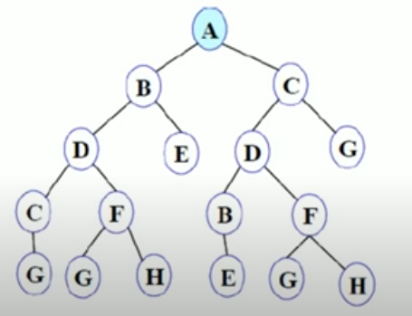
Depth-First Search

Slide 12
Breadth-First Search
An exhaustive search method.
Follows each path to a given depth before moving on to the next depth.

Slide 13
Breadth-First Search
Uninformed Search Technique
Queue(FIFO)
Shallowest Node
Complete
Optimal
Time Complexity [ O(b^d)]

Slide 14
Breadth-First Search
Uninformed Search Technique
Queue(FIFO)
Shallowest Node
Complete
Optimal
Time Complexity [ O(b^d)]

Slide 15
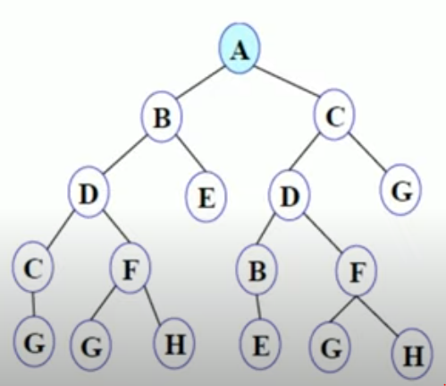
Breadth-First Search

Slide 16
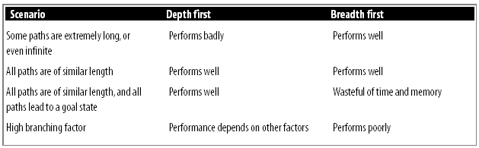
Comparison of Depth-First and Breadth-First Search
It is important to choose the correct search method for a given problem.
In some situations, for example, depth first search will never find a solution, even though one exists.

Slide 17
Properties of Search Methods
Complexity
  How much time and memory the method uses.
Completeness
  A complete method is one that is guaranteed to find a goal if one exists.
Optimality & Admissibility
  A method is optimal (or admissible) if it is guaranteed to find the best path to the goal.
Irrevocability
  A method is irrevocable if, like hill climbing, it does not ever back-track.

Slide 18
Why Humans Use Depth-First Search
More closely relates to the natural way in which humans search for things
Example 1: Traversing a Maze
Example 2: Searching for a Gift

Slide 19
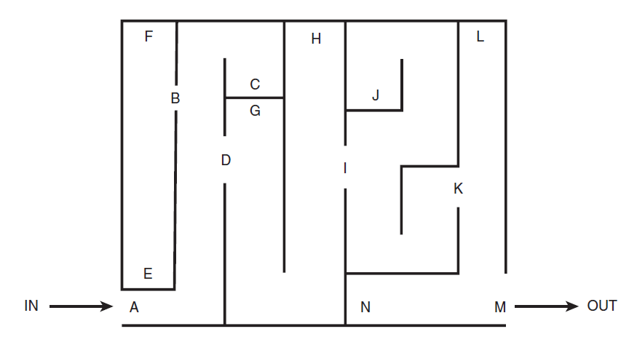
Traversing a Maze
A, B, E, F, C, D, G, H, I, J, K, L,M

Slide 20
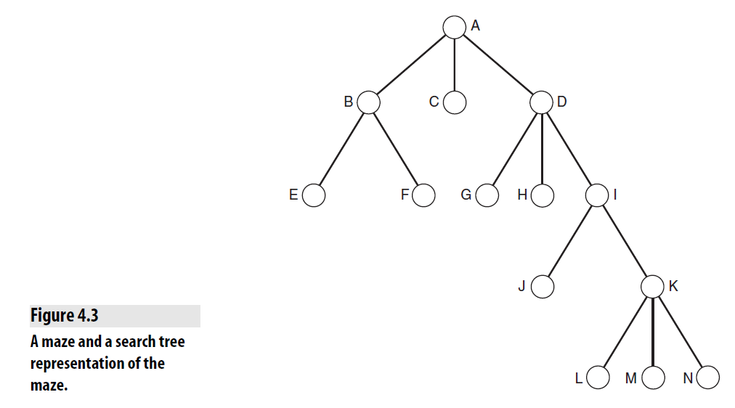
Search Tree For Maze

Slide 21
Implementations
Depth-first search can be implemented using a queue to store states
  But a stack makes more sense
  And enables us to create a recursive depth-first search function
Breadth-first search implementations are almost identical to depth-first
  Except that they place states on the back of the queue instead of on the front.

Slide 22
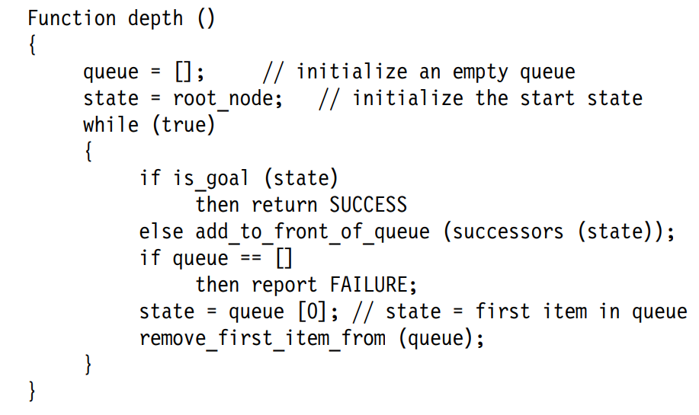
Pseudocode implementation of DFS

Slide 23
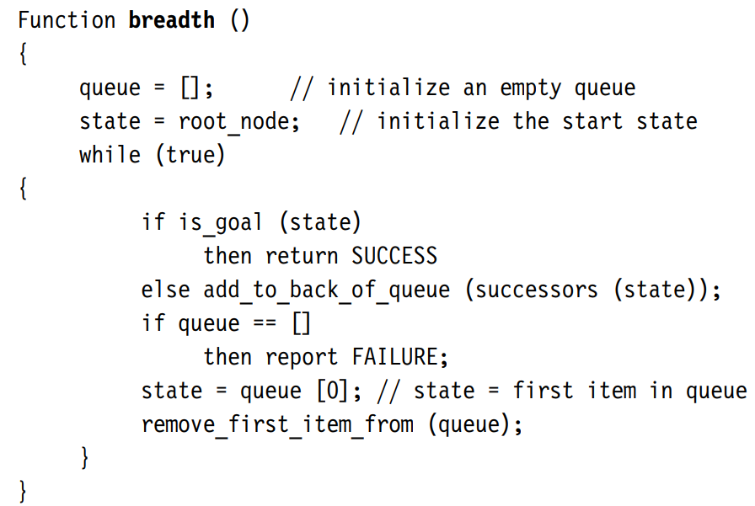
Pseudocode implementation of BFS

Slide 24
Example: Web Spidering
Some parts of the Internet have a very high branching factor.
On average though, the branching factor is reasonably low, breadth-first search might be a sensible approach.
Depth-first search would also not be practical because some paths might have almost infinite depth.

Slide 25
Depth-First Iterative Deepening
An exhaustive search method based on both depth-first and breadth-first search.
Carries out depth-first search to depth of 1, then to depth of 2, 3, and so on until a goal node is found.
Efficient in memory use, and can cope with infinitely long branches.
Not as inefficient in time as it might appear, particularly for very large trees, in which it only needs to examine the largest row (the last one) once.

Slide 26
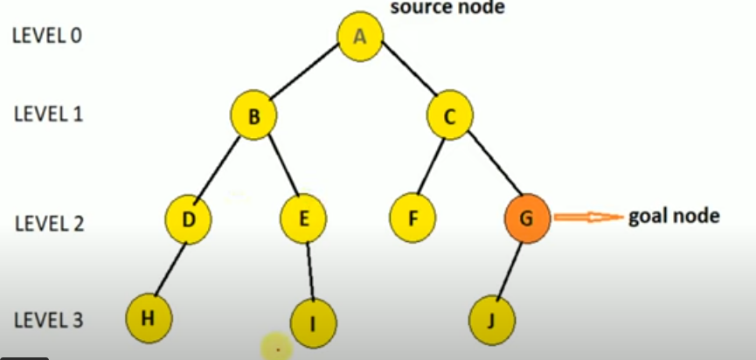
Depth-First Iterative Deepening

Slide 27
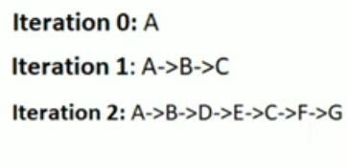
Depth-First Iterative Deepening

Slide 28


Depth-First Iterative Deepening (1)
For a tree of depth d and with a branching factor of b, the total number of nodes
Geometric Progression equal to
Using DFID, nodes must be
examined more than once,
resulting in the following progression:

Slide 29

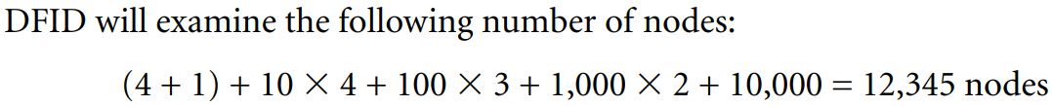
Depth-First Iterative Deepening (2)
A tree with depth of 4 and branching factor of 10
# of Nodes =
majority of the nodes to be examined (in this case, 10,000 out of 12,345) are in the last row

Slide 30
Heuristics
Heuristic: a rule or other piece of information that is used to make methods such as search more efficient or effective.
In search, often use a heuristic evaluation function, f(n):
  f(n) tells you the approximate distance of a node, n, from a goal node.
f(n) may not be 100% accurate, but it should give better results than pure guesswork.
Notes:
heuristics can reduce an otherwise impossible problem
to a relatively simple one.

Slide 31
Heuristics – how informed?
The more informed a heuristic is, the better it will perform.
Heuristic h is more informed than j, if:
  h(n) ≤ j(n) for all nodes n.
A search method using h will search more efficiently than one using j.
A heuristic should reduce the number of nodes that need to be examined.

Slide 32
Choosing a Good Heuristic
like choosing the right representation, choosing the right heuristic can make a significant difference in our ability to solve a problem.
Efficiency of running the heuristic
if it takes an hour to compute a heuristic value for a given state!

Slide 33
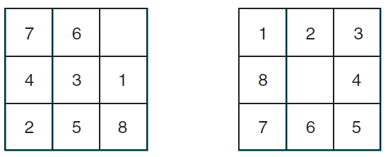
The 8-puzzle
Tiles can be slid about within the grid, but a tile can only be moved into the empty square if it is adjacent to the empty square.
start state goal state

Slide 34
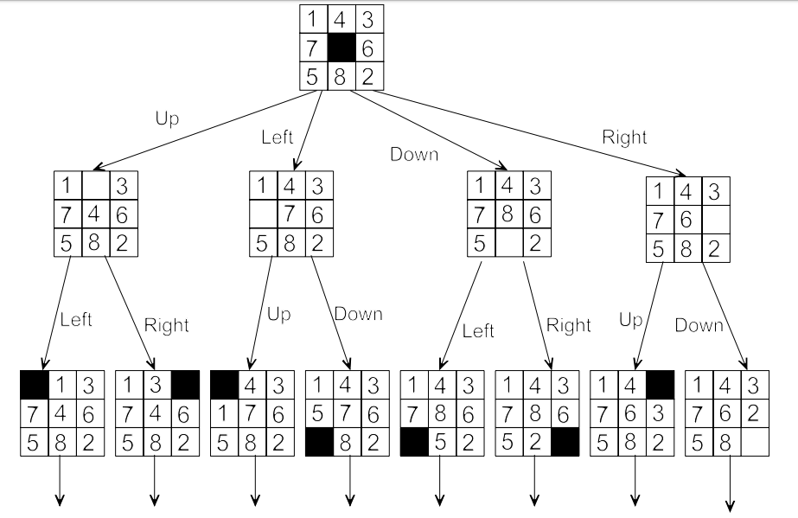
8-Puzzle State space representation

Slide 35
Exhaustive search for 8-puzzle
20 moves from a random start state to the goal state, depth of around 20
Branching factor in the middle is 4; if it is on an edge, 3, and if it is in a corner, 2.
3²⁰states, which is around 3.5 billion

Slide 36
Heuristic function for 8-puzzle
First heuristic- Count how many tiles are in the wrong place h1(node) = 8
Improved heuristic- How far each tile had to move to get to its correct state
(Manhattan distance is the sum of the horizontal and vertical moves that need to be made to get from one position to another)

Slide 37
Heuristic function for 8-puzzle(1)
h2 (node) ≥ h1 (node)
h2 is more informed than h1
The ideal heuristic gave exactly accurate costs every time.
Effective branching factor, b*
h2 has a lower effective branching factor than the h1
Notes:
This means that h2 dominates h1, which means that a search method using heuristic h2 will
always perform more efficiently than the same search method using h1.
This is because h2 is more informed than h1.

Slide 38
Heuristic function for 8-puzzle(2)
Third heuristic-uses a function k(node), which is equal to the number of direct swaps that need to be made between adjacent tiles to move them into the correct sequence,
h3 (node) must be greater than h2 (node), meaning that h3 is a more informed heuristic than h2.

Slide 39
Relaxed Problem
Problem that has fewer constraints
A tile can be moved to an adjacent square regardless of whether that square is empty or not
h2 (node) would be exactly equal to the number of moves needed to get from a node to the goal node

Slide 40
Relaxed Problem (1)
A tile could move to any square
h1 (node) exactly equals the number of moves needed to get from a node to the goal node
A number of heuristic functions may exist

Slide 41
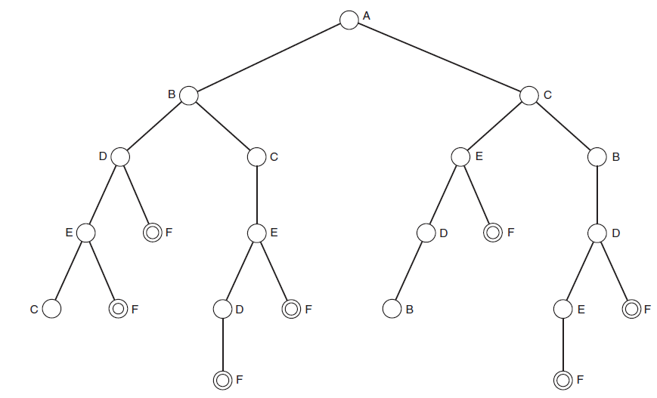
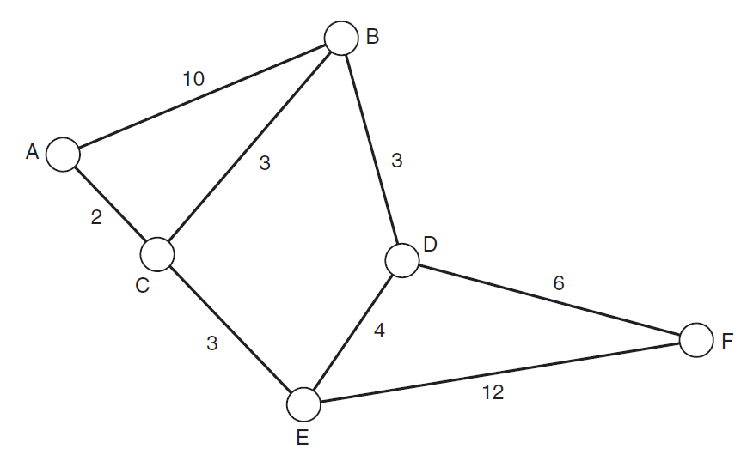
Monotonicity
A search method always reaches a given node by the shortest possible path
Notes:
A depth-first approach to this problem would provide path number 1,
A,B,D,E,F, which has a total distance of 29.
Breadth-first search always produces the path that has the least steps, but
not necessarily the shortest path. In this case, it would yield path 2, which is
A,B,D,F and which has a length of 19. This is much shorter than the path
produced by depth-first search but is not the shortest path (the shortest
path is path 5, A,C,E,F, which has a length of 17).

Slide 42
Hill Climbing
An informed, irrevocable search method.
Easiest to understand when considered as a method for finding the highest point in a three dimensional search space:
Check the height one foot away from your current location in each direction; North, South, East and West.
As soon as you find a position whose height is higher than your current position, move to that location, and restart the algorithm.
Notes:
Applications of Hill climbing
Solving optimization problems, such as the traveling salesman problem and the knapsack problem.
Finding the best move in a game, such as chess or Go.
Tuning the parameters of a machine learning model.
Finding the best way to schedule tasks.

Slide 43
Hill Climbing
Local Search Algorithm
Greedy Approach
No Backtrack

Slide 44
Hill Climbing
Evaluate initial state
Loop until solution is found.
  Evaluate the new state
  If goal state than quit.
  If better than current state than it is new current state.

Slide 45
Problems in Hill Climbing
Local Maximum /Foothills
Plateaus / Flat Maximum
Ridge

Slide 46
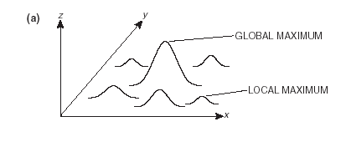
Foothills/Local Maximum
  Cause difficulties for hill-climbing methods.
  A foothill is a local maximum.

Slide 47
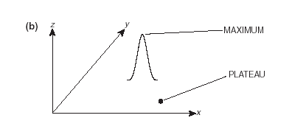
Plateaus/Flat Maximum
  Cause difficulties for hill-climbing methods.
  Flat areas that make it hard to find where to go next.

Slide 48
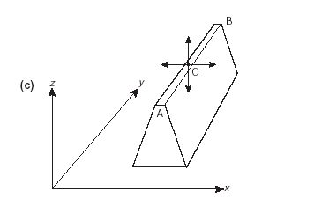
Ridges
  Cause difficulties for hill-climbing methods
  B is higher than A.
  At C, the hill-climber can’t find a higher point North, South, East or West, so it stops.

Slide 49
Best-First Search
Informed Search Technique
Use Heuristic value.
Tends to find a shorter path but does not guarantee to find the best path.
Notes:
The entire queue is sorted after new paths have been added to it, rather than adding a set of sorted paths.
In practical terms, this means that best-first search follows the best path
available from the current (partially developed) tree, rather than always following a depth-first style approach
The Best First Search algorithm finds applications in various domains, including gaming, puzzle-solving, route optimization, action planning, robotics, and more. It is widely used whenever finding the shortest path is crucial for problem-solving.

Slide 50
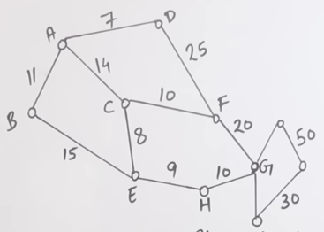
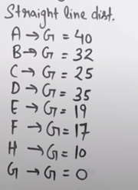
Best-First Search
Notes:
The entire queue is sorted after new paths have been added to it, rather than adding a set of sorted paths.
In practical terms, this means that best-first search follows the best path
available from the current (partially developed) tree, rather than always following a depth-first style approach
The Best First Search algorithm finds applications in various domains, including gaming, puzzle-solving, route optimization, action planning, robotics, and more. It is widely used whenever finding the shortest path is crucial for problem-solving.

Slide 51
Beam Search
Breadth-first method.
Only expands the best few paths at each level.
Thus has the memory advantages of depth-first search.
Not exhaustive, and so may not find the best solution.
May not find a solution at all.

Slide 52
Optimal Paths
An optimal path through a tree is one that is the shortest possible path from root to goal.
In other words, an optimal path has the lowest cost (not necessarily at the shallowest depth, if edges have costs associated with them).
The British Museum procedure finds an optimal path by examining every possible path, and selecting the one with the least cost.
There are more efficient ways.

Slide 53
A* Algorithms
Uses the cost function:
  f(node) = g(node) + h(node).
g(node) is the cost of the path so far leading to the node.
h(node) is an underestimate of how far node is from a goal state.
f is a path-based evaluation function.
An A* algorithm expands paths from nodes that have the lowest f value.

Slide 54
A* Algorithms (continued)
A* algorithms are optimal:
  They are guaranteed to find the shortest path to a goal node.
Provided h(node) is always an underestimate. (h is an admissible heuristic).
A* methods are also optimally efficient – they expand the fewest possible paths to find the right one.
If h is not admissible, the method is called A, rather than A*.

Slide 55
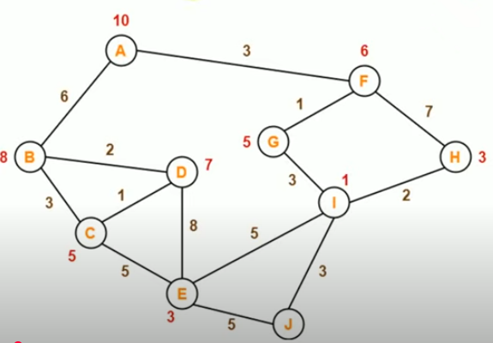
A* Algorithms (continued)

Slide 56
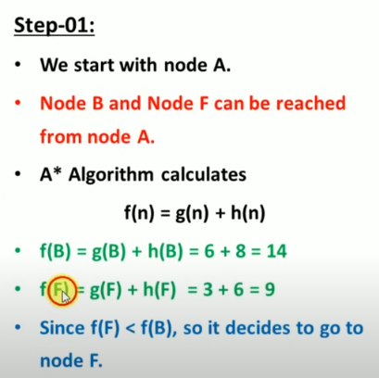
A* Algorithms (continued)

Slide 57
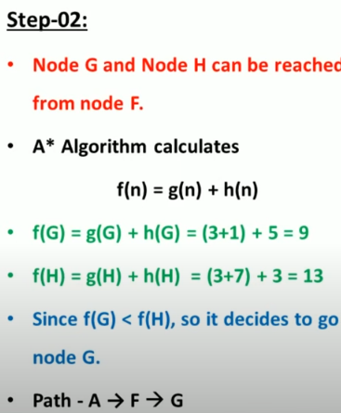
A* Algorithms (continued)

Slide 58
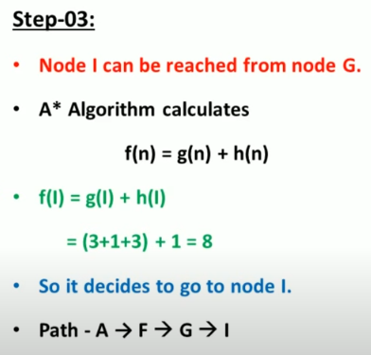
A* Algorithms (continued)

Slide 59
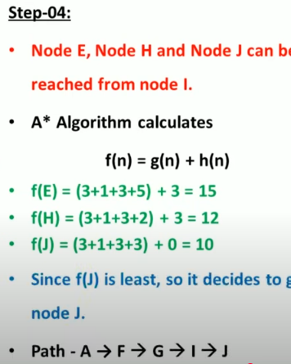
A* Algorithms (continued)

Slide 60
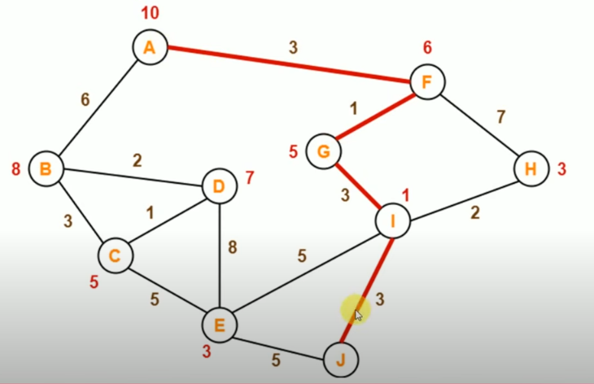
A* Algorithms (continued)

Slide 61
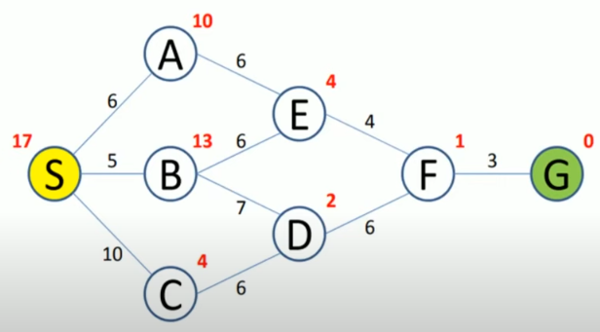
A* Algorithms (continued)
Example 2

Slide 62
Uniform Cost Search
Also known as branch and bound.
Like A*, but uses:
  f(node) = g(node).
  g(node) is the cost of the path leading up to node.
Once a goal node is found, the method needs to continue to run in case a preferable solution is found.

Slide 63
Greedy Search
Like A*, but uses:
  f(node) = h(node).
Hence, always expands the node that appears to be closest to a goal, regardless of what has gone before.
Not optimal, and not guaranteed to find a solution at all.
Can easily be fooled into taking poor paths.

Slide 64
Example: The Knapsack Problem
A man is packing items into his knapsack. He wants to take the most valuable items he can, but there is a limit on how much weight he can fit in his knapsack. Each item has a weight wi and is worth vi. He can only fit a total weight of Win his knapsack. The items that he wants to take are things that can be broken up and still retain their value (like flour or milk), and he is able to take fractions of items. Hence, the problem is called the fractional knapsack p
The problem is solved by calculating the value per unit weight of each item: vi/wi, and then taking as much as he can carry of the item with the greatest value per unit weight.

Slide 65
knapsack problem
Our man has knapsack that lets him carry total 20 pounds. The item are:
Objects | Object1 | Object2 | Object3
Profit | 25 | 24 | 15
Weight | 18 | 15 | 10

Slide 66
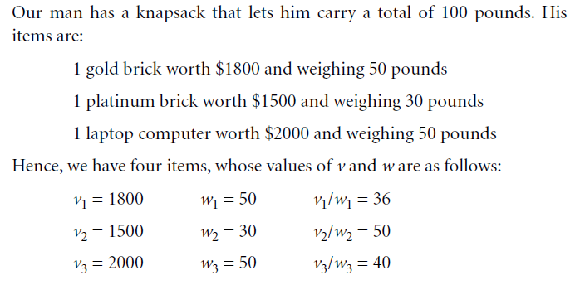
0-1 knapsack problem
The 0-1 knapsack problem is the same as the fractional knapsack problem, except that he cannot take parts of items. Each item is thus something like a television set or a laptop computer, which must be taken whole.

Slide 67
Greedy Search Strategy
In this case, a greedy-search strategy would pick item 2 first, and then would take item 3, giving a total weight of 80 pounds, and a total value of $3500.
In fact, the best solution is to take items 1 and 3 and to leave item 2 behind giving a total weight of 100 pounds and a total value of $3800.

