Slide 1

Artificial Intelligence
Instructor : Dr. Iram Noreen

Slide 2
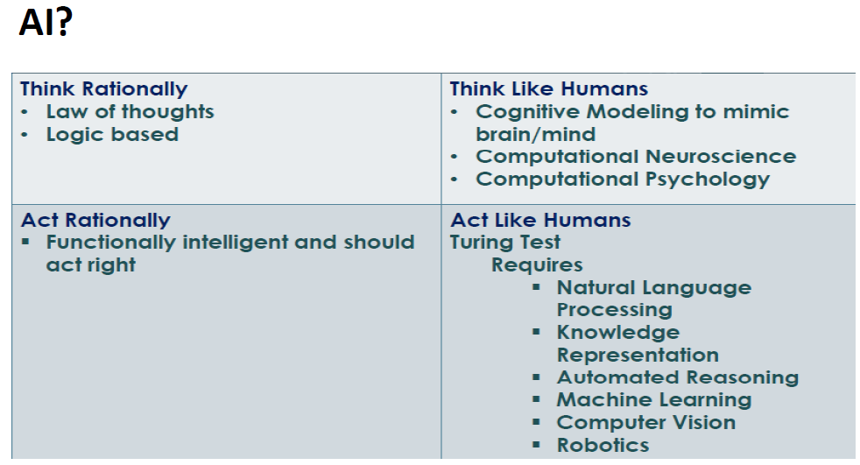

Slide 3

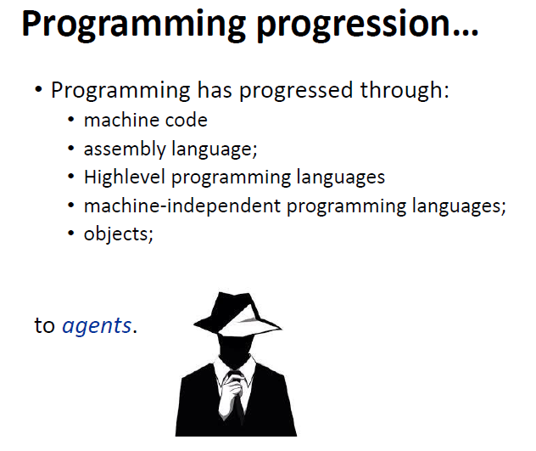
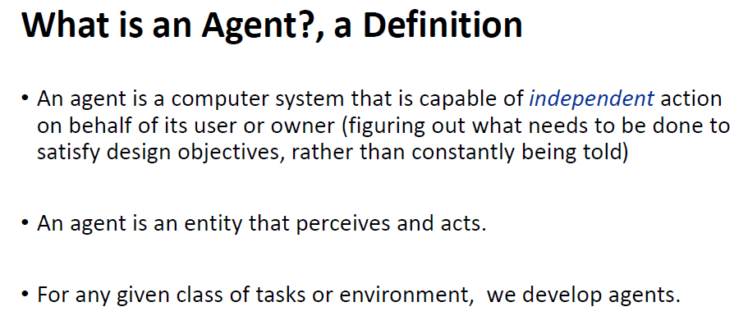

Slide 4
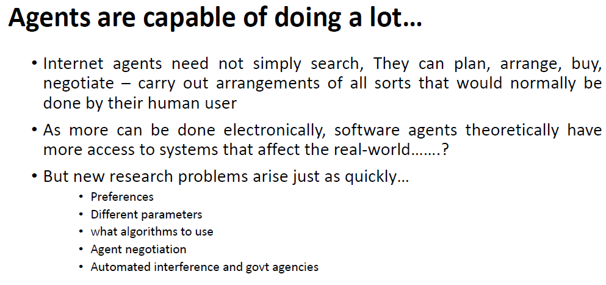

Slide 5


Slide 6
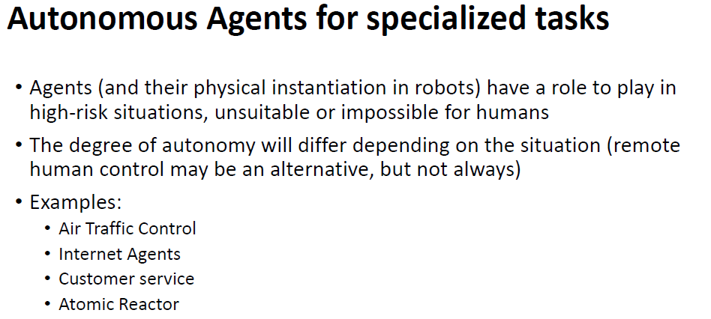

Slide 7
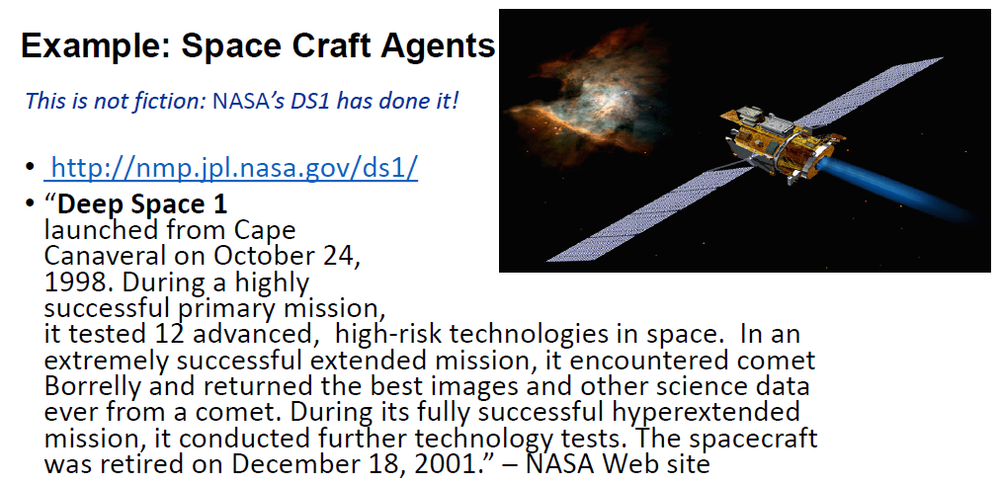

Slide 8
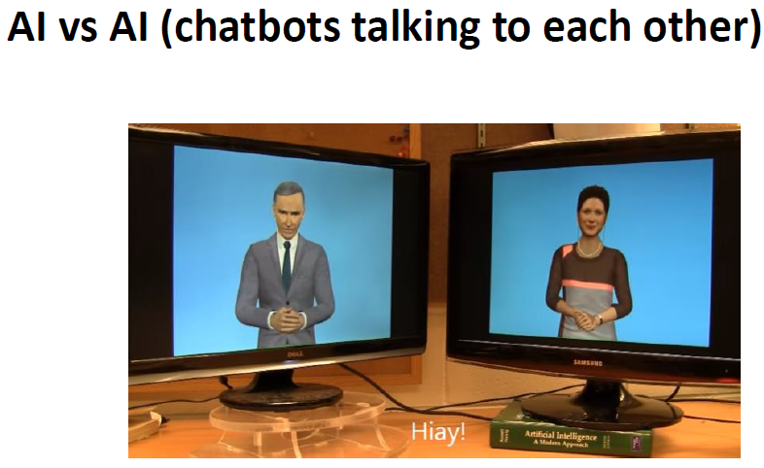
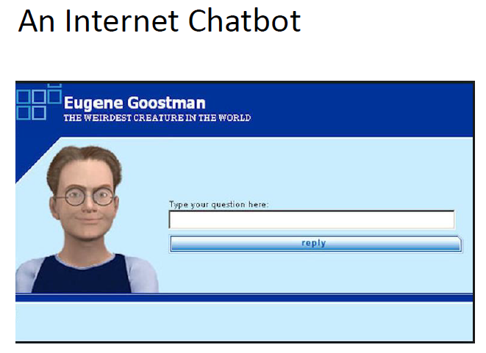

Slide 9
The Structure of Intelligent Agents
Agent = Architecture + Agent Program
Architecture = the machinery that an agent executes on.
Agent Program = an implementation of an agent function.

Slide 10

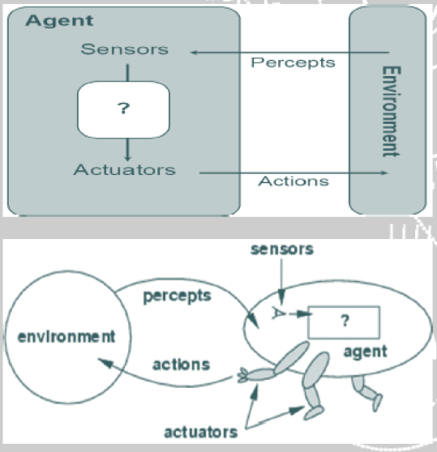
Agent
Human Agent
Hardware/ Robotic Agent
Software Agent
The problem the agent solves is
characterized by (PEAS)
Performance Measure,
Environment, Actuators, and
Sensors.

Slide 11
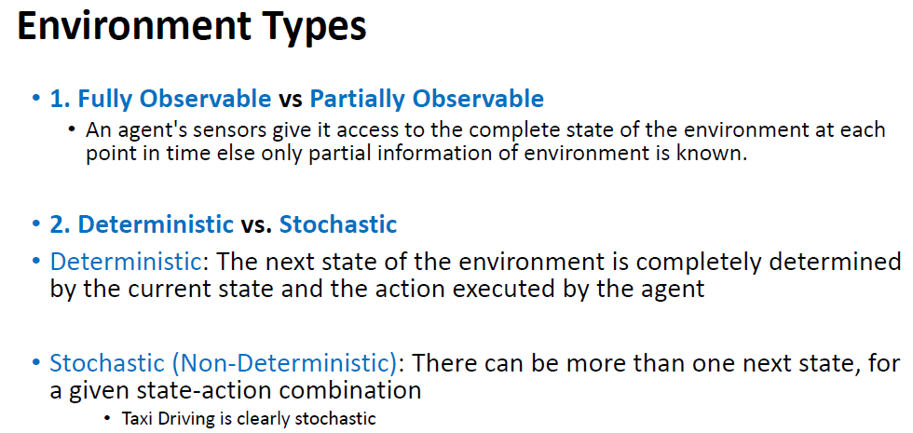

Slide 12
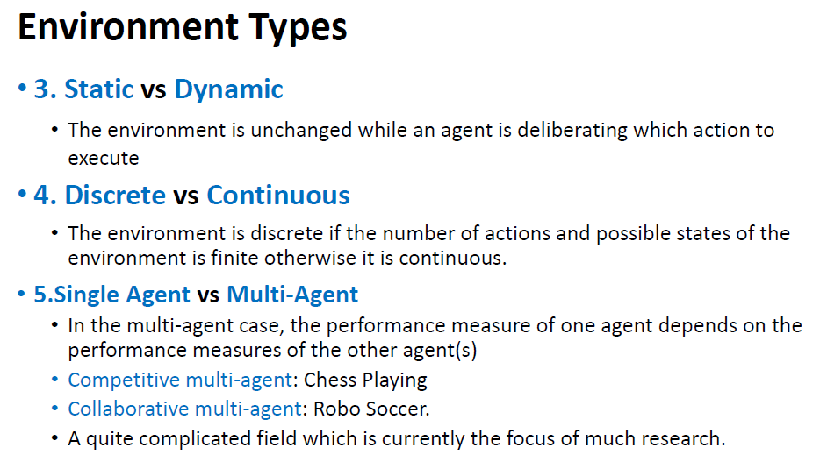

Slide 13
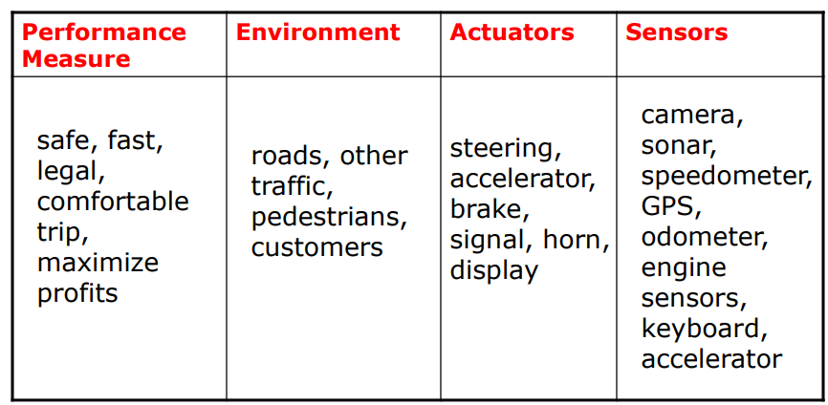
Driver Example
DARPA urban challenge 07: http://www.youtube.com/watch?v=SQFEmR50HAk

Slide 14
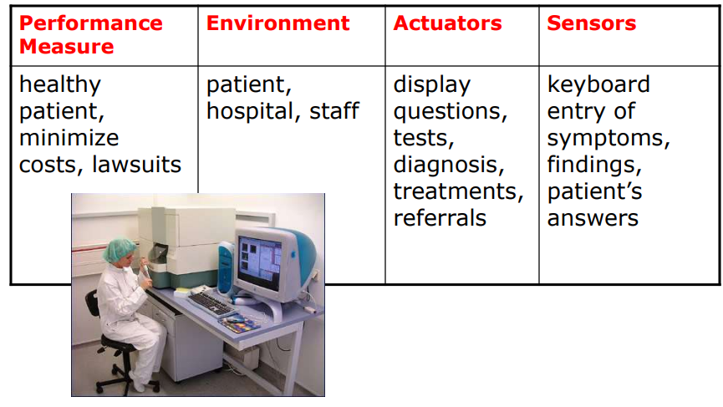
Medical Diagnosis System

Slide 15
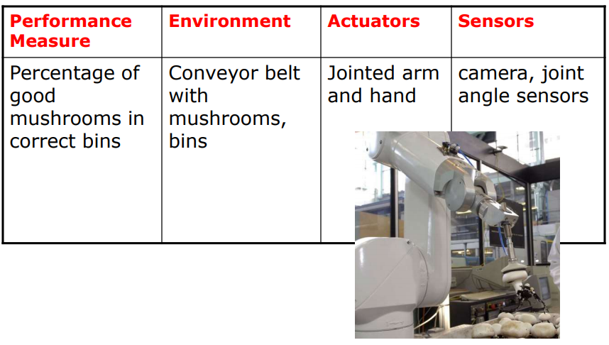
Mushroom-Picking Robot

Slide 16
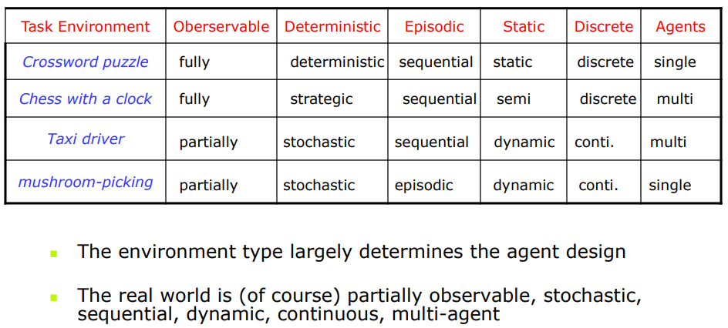

Slide 17
Agent Terminology
Performance Measure of Agent − It is the criteria, which determines how successful an agent is.
Percept − It is agent’s perceptual inputs at a given instance.
Percept Sequence − It is the history of all that an agent has perceived till date.
Behavior of Agent − It is the action that agent performs after any given sequence of percepts.
Agent Function − It is a map from the precept sequence to an action
i.e., input to output.

Slide 18
Rational agent
Rationality?
status of being reasonable, sensible, and having good sense of judgment.
A rational agent is an agent that
has clear preferences
has percept sequence, and built-in knowledge base
models uncertainty via expected values of variables or functions
has clear performance measures, which determine the degree of success.
chooses to perform the action with the optimal expected outcome among all feasible actions.

Slide 19
Types of Agents
Simple Reflex Agents
Model-Based Reflex Agents
Goal-Based Agents
Utility-Based Agents

Slide 20
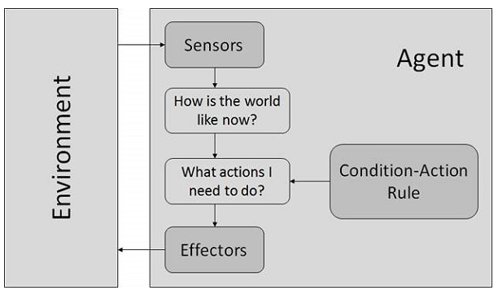
Simple Reflex Agents
Simple reflex agents ignore the percept history and act only on the basis of the current percept.
The agent function is based on the condition-action rule. A condition-action rule is a rule that maps a state i.e, condition to an action.
function only succeeds when the environment is fully observable.
Very limited intelligence and knowledge.
If there occurs any change in the environment then the collection of rules need to be updated.

Slide 21
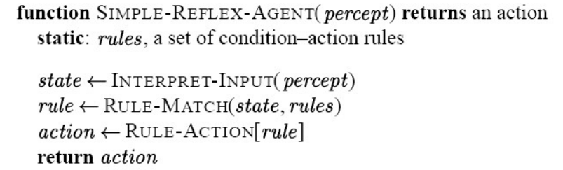
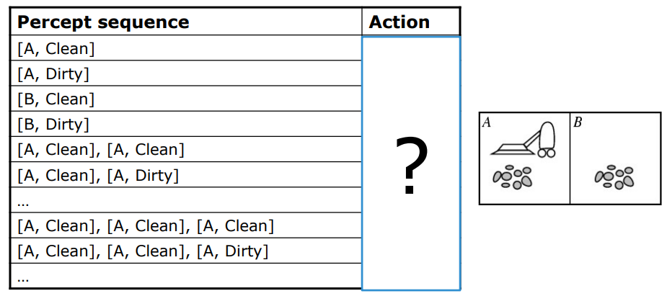
A simple agent function

Slide 22
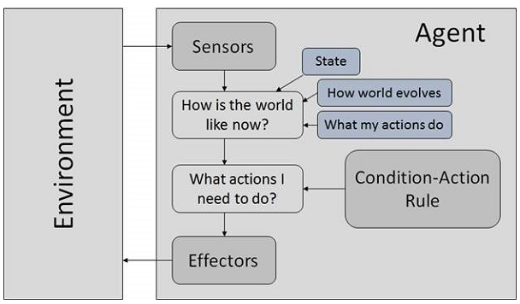
Model-based reflex agents
They use a model of the world to choose their actions.
They maintain an internal state.
Updating the state requires the information about −
How the world evolves?
How the agent’s actions affect the world?

Slide 23
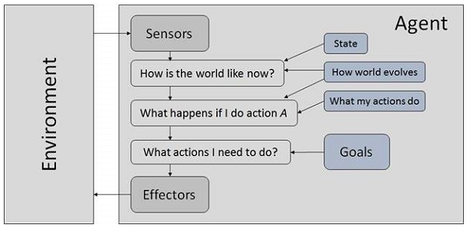
Goal Based Agents
They choose their actions in order to achieve goals, i.e. based on how far they are currently from their goal. They action to reduce distance from goal.
It is more flexible than reflex agent since the knowledge supporting a decision is explicitly modeled, and allows modifications/updates.
They usually require search and planning techniques.

Slide 24
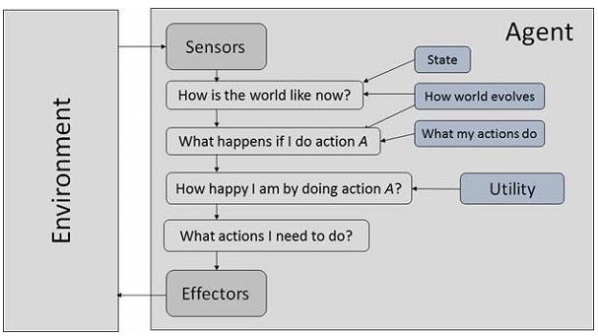
Utility-based agents
They choose actions based on a preference (utility) for each state.
Sometimes achieving the desired goal is not enough. We may look for quicker, safer, cheaper trip to reach a destination. Agent happiness should be taken into consideration. Utility describes how “happy” the agent is. Because of the uncertainty in the world, a utility agent chooses the action that maximizes the expected utility.
A utility function maps a state onto a real number which describes the associated degree of happiness.

Slide 25
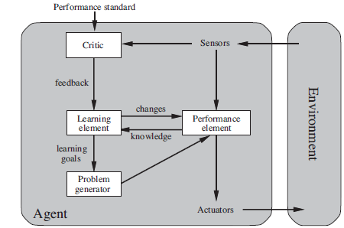
Learning in agents
All agents can improve their performance through learning.
Learning: A process of modification of each component of the agent using available feedback
information.

Slide 26
Quiz1
Develop PEAS description for the following task environment:
Robot soccer player
Shopping for used AI books on the Internet

