Slide 1
Bayes' Theorem and Probabilistic Reasoning in AI

Slide 2
Why Probability in AI?
- Real-world environments are uncertain and partially observable.
- Agents must make decisions under uncertainty.
- Logic alone is insufficient,we need degrees of belief.
- Probability theory provides a formal framework for uncertainty.

Slide 3
Why Probability in AI?
1. "Real-world environments are uncertain and partially observable.“
In the real world, agents (like robots or software) don’t have access to complete or perfect information
Example: A robot navigating a room might not know where all the obstacles are due to limited sensors.

Slide 4
Why Probability in AI?
2. “Agents must make decisions under uncertainty”
Even when they aren't 100% sure of what's going on, AI agents still need to:
Take actions
Make predictions
Choose between options
Example: A self-driving car sees a blurry object ahead. Is it a plastic bag or a child? The car must decide how to react, even if it isn't completely sure.

Slide 5
Why Probability in AI?
3. “Logic alone is insufficient, we need degrees of belief.”
Classical logic (e.g., "True or False") isn't enough when:
You don’t know something for sure.
You need to express how likely something is.
That’s where degrees of belief (probabilities) come in:

Slide 6
Why Probability in AI?
Rather than saying “It will rain” (True/False), we say:
“There’s a 70% chance of rain.”
This allows agents to reason with uncertainty,something logic by itself can't do.

Slide 7
Why Probability in AI?
"Probability theory provides a formal framework for uncertainty.“
To handle uncertainty mathematically and systematically, AI uses probability theory, which includes:
Bayes’ Theorem
Probabilistic models (like Naive Bayes, Bayesian Networks)
Joint/marginal/conditional probabilities

Slide 8
Bayes' Theorem
Bayes' Theorem is a fundamental rule in probability theory used to update the probability of a hypothesis based on new evidence.

Slide 9
Bayes' Theorem - Core Concept
P(A|B) = P(B|A) * P(A) / P(B)
- P(A|B): Posterior probability
- P(B|A): Likelihood
- P(A): Prior probability
- P(B): Evidence probability
Used to update belief in hypothesis A after observing evidence B.

Slide 10
Bayes' Theorem - Core Concept
P(H∣E)=P(E∣H)xP(H)​/ P(E)
Where:
P(H∣E): Posterior — the probability of the hypothesis H given the evidence E.
P(E∣H):Likelihood — the probability of observing evidence E given that hypothesis H is true.
P(H): Prior — the initial probability of the hypothesis before seeing the evidence.
P(E): Marginal likelihood — the total probability of the evidence under all possible hypotheses.

Slide 11
Example: Email Spam Detection
20% of emails are spam. 70% of spam emails contain the word “free”, and 10% of non-spam emails also contain “free”.
Q:If an email contains “free”, what’s the probability it’s spam?
Given:
P(S)=0.2, 𝑃(¬𝑆)=0.8
P(“free”∣S)=0.7
𝑃(“𝑓𝑟𝑒𝑒”∣¬𝑆)=0.1

Slide 12
Example: Email Spam Detection
Solution:
Compute total probability of "free":
P("free") = P("free"∣S).P(S)+P("free"∣¬S).P(¬S)
P("free") = 0.7×0.2+0.1×0.8
P("free") = 0.14+0.08=0.22

Slide 13
Example: Email Spam Detection
Apply Bayes’
Theorem:P(A|B) = P(B|A) * P(A) / P(B)
𝑃(𝑆∣"𝑓𝑟𝑒𝑒") = P(“𝑓𝑟𝑒𝑒”∣ 𝑆) .P(𝑆)/ P(“𝑓𝑟𝑒𝑒”)​
= 0.7x0.20/.22
= 0.140/.22≈0.636
Answer: There's a 63.6% chance the email is spam if it contains “free”.

Slide 14
Example: Weather Prediction
It rains only 10% of the time. If it rains, there's an 80% chance you see dark clouds. If it doesn’t rain, there's still a 30% chance of dark clouds.
Q:If you see dark clouds, what’s the chance it will rain?
Given:
P(R)=0.1, 𝑃(¬R)=0.9
P(C∣R)=0.8, 𝑃(𝐶∣¬𝑅)=0.3

Slide 15
Example: Weather Prediction
Solution:
Total probability of clouds:
P(C) = P(C∣R).P(R)+P(C∣¬R).P(¬R)
P(C) = 0.8x0.1+0.3x0.9
P(C) = 0.08+0.27
= 0.35

Slide 16
Example: Weather Prediction
Apply Bayes’
Theorem:P(A|B) = P(B|A) * P(A) / P(B)
𝑃(R∣C) = P(C∣ R) .P(R)/ P(C)​
= 0.8x0.1/ 0.35
= 0.08/.35≈0.2286
Answer: There's about a 22.86% chance of rain if you see dark clouds.

Slide 17
Example - Disease Diagnosis
Let:
D: Patient has a disease
T: Test is positive
Given:
P(D) = 0.01, P(T|D) = 0.99, P(T|¬D) = 0.05
P(T) = 0.0594
P(D|T) ≈ 0.167
Even with a positive result, probability of disease is 16.7%.

Slide 18
Example - Disease Testing
A disease affects 1% of a population. A test detects it correctly 99% of the time, but also gives false positives 5% of the time.
Q: What is the probability a person has the disease if they test positive?

Slide 19
Bayesian Networks (Bayes Nets)
A Bayesian network is a directed acyclic graph (DAG) that represents a set of variables and their conditional dependencies via probability.
They provide a compact and structured representation of the joint probability distribution.
Also known as Belief Networks or Bayes Nets.

Slide 20
Components of a Bayesian Network
Nodes: Random variables (e.g., Burglary, Earthquake, Alarm)
Edges: Directed links showing conditional dependencies.
CPT (Conditional Probability Table): Gives the probability of each variable given its parents.

Slide 21
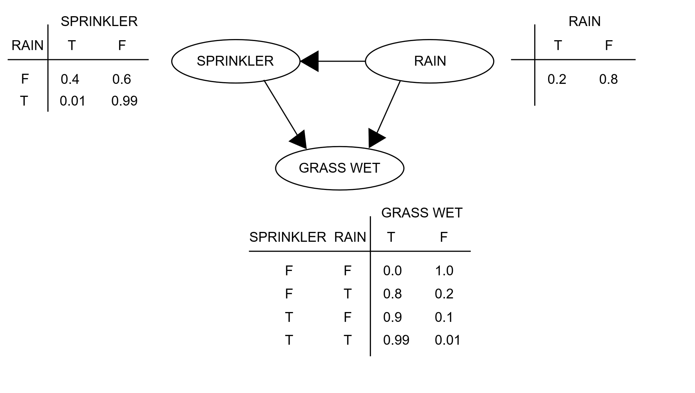
Bayesian Networks

Slide 22
Inference in Bayesian Networks
- Compute posterior probabilities given evidence.
Methods:
- Enumeration
- Variable Elimination
Applications: Diagnosis, decision making, fault detection.

Slide 23
Naive Bayes Classifier
The Naive Bayes Classifier is a simple probabilistic classification algorithm based on Bayes’ Theorem, with a strong (naive) assumption that all features are independent of each other given the class.

Slide 24
Based on Bayes’ Theorem:
P(A|B) = P(B|A) * P(A) / P(B)
- P(A|B): Posterior probability
- P(B|A): Likelihood
- P(A): Prior probability
- P(B): Evidence probability

Slide 25

Naive Assumption
Naive Bayes assumes:
This means that all features x1,x2,...,xn​ are conditionally independent given the class C.

Slide 26
Naive Bayes Example
A mobile company wants to predict whether a customer will buy a Premium Phone (Yes/No) based on past purchase data. They use three features:
Income (High / Low)
Age Group (Young / Adult)
Previous Purchase (Yes / No)

Slide 27
Naive Bayes Example
The company has the following training data:
ID | Income | Age Group | Previous Purchase | Bought Premium Phone
1 | High | Adult | Yes | Yes
2 | Low | Young | No | No
3 | High | Young | No | Yes
4 | Low | Adult | Yes | No
5 | High | Adult | No | Yes

Slide 28
Naive Bayes Example
Task
Compute the prior probabilities for each class (Yes/No).
Compute the conditional probabilities for each feature value given each class.
Use the Naive Bayes classifier to predict whether a new customer with:
Income = High
Age Group = Young
Previous Purchase = No
is likely to buy a Premium Phone or not.

Slide 29
Naive Bayes Example:Solution
Task1:Prior Probabilities
𝑃(Yes)=3/5,𝑃(No)=2/5​
Step (ii): Conditional Probabilities
For Class = Yes (3 instances)
Feature | Value | Count | Probability
Income | High | 3 | 3/3 = 1.0
Age Group | Young | 1 | 1/3 ≈ 0.33
Age Group | Adult | 2 | 2/3 ≈ 0.67
Previous Purchase | No | 2 | 2/3 ≈ 0.67
Previous Purchase | Yes | 1 | 1/3 ≈ 0.33

Slide 30
Naive Bayes Example:Solution
For Class = No (2 instances)
Feature | Value | Count | Probability
Income | Low | 2 | 2/2 = 1.0
Age Group | Young | 1 | 1/2 = 0.5
Age Group | Adult | 1 | 1/2 = 0.5
Previous Purchase | No | 1 | 1/2 = 0.5
Previous Purchase | Yes | 1 | 1/2 = 0.5

Slide 31
Naive Bayes Example:Solution
Task3: Predict for
Income = High
Age Group = Young
Previous Purchase = No
Compute Posterior for Yes
P(Yes)⋅P(High∣Yes)⋅P(Young∣Yes)⋅P(No∣Yes)
=3/5x​1.0x0.33x0.67 =0.132
Compute Posterior for No
P(No)⋅P(High∣No)⋅P(Young∣No)⋅P(No∣No)
=2/5x0x0.5x0.5=0
Prediction: Yes(The customer is likely to buy a Premium Phone.)

Slide 32
Learning Probabilities from Data
- Estimate probabilities from data:
- MLE (Maximum Likelihood Estimation)
- Bayesian Parameter Learning
- Structure learning: Learn the graph structure using scoring + search.

Slide 33
Hidden Markov Models (HMMs)
- Temporal Bayesian network with hidden states.
- Observations visible, states hidden.
Problems:
- Evaluation
- Decoding (Viterbi)
- Learning (Baum-Welch)
Applications: Speech recognition, POS tagging.

Slide 34
Markov Decision Processes (MDPs)
- Model decision-making under uncertainty.
Defined by (S, A, T, R, γ)
Goal: Find optimal policy π*(s)
Solved using:
- Value Iteration
- Policy Iteration
- Q-Learning

