Slide 1
Database Architectures and the Web
Chapter 3

Slide 2
Multi-user Database System Architectures
3.1.1 Teleprocessing
3.1.2 File-Server Architecture
3.1.3 Traditional Two-Tier Client–Server Architecture
3.1.4 Three-Tier Client–Server Architecture
3.1.5 N-Tier Architectures
3.1.6 Middleware
3.1.7 Transaction Processing Monitors

Slide 3
1. Teleprocessing
The traditional architecture for multi-user systems was teleprocessing
One computer with a single central processing unit (CPU)
And a number of terminals
All processing is performed within the boundaries of the same physical computer
User terminals are typically incapable of functioning on their own, and cabled to the central computer
The terminals send messages via the communications control subsystem of the operating system to the user’s application program
Which in turn uses the services of the DBMS

Slide 4
In the same way, messages are routed back to the user’s terminal.
Tremendous burden on the central computer,
Which had to not only run the application programs and the DBMS, but also carry out a significant amount of work on behalf of the terminals (such as formatting data for display on the screen).
In recent years, there have been significant advances in the development of high-performance personal computers and networks.
Replacing expensive mainframe computers with more cost-effective networks of personal computers that achieve the same, or even better, results.
This trend has given rise to the next two architectures: file-server and client-server.

Slide 5
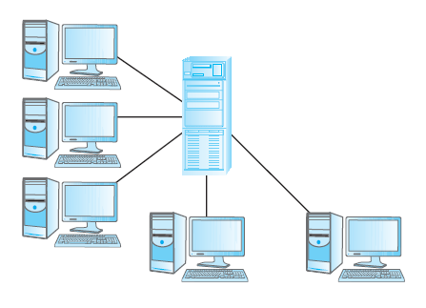

Slide 6
2. File-Server Architecture
File server
A computer attached to a network with the primary purpose of providing shared storage for computer files such as documents, spreadsheets, images, and databases.
In a file-server environment, the processing is distributed about the network, typically a local area network (LAN).
The file-server holds the files required by the applications and the DBMS.
However, the applications and the DBMS run on each workstation, requesting files from the file-server when necessary.
In this way, the file-server acts simply as a shared hard disk drive

Slide 7
The DBMS on each workstation sends requests to the file-server for all data that the DBMS requires that is stored on disk
Significant amount of network traffic, which can lead to performance problems
SELECT fName, Iname FROM Branch b, Staff s
WHERE b.branchNo = s.branchNo AND b.street = ‘163 Main St’;
As the file-server has no knowledge of SQL, the DBMS must request the files corresponding to the Branch and Staff relations from the file-server, rather than just the staff names that satisfy the query.

Slide 8
Disadvantage
Three main disadvantages:
(1) There is a large amount of network traffic.
(2) A full copy of the DBMS is required on each workstation.
(3) Concurrency, recovery, and integrity control are more complex, because there can be multiple DBMSs accessing the same files.

Slide 9
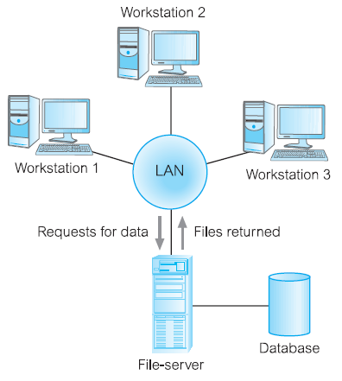

Slide 10
3. Traditional Two-Tier Client–Server Architecture
The client–server architecture was developed
To overcome the disadvantages of the first two approaches
Accommodate an increasingly decentralized business environment,
There is no requirement that the client and server must reside on the same machine
In practice, it is quite common to place a server at one site in a LAN and the clients at the other sites

Slide 11
Data-intensive business applications consist of four major components:
The database,
The transaction logic,
The business and data application logic,
The user interface

Slide 12
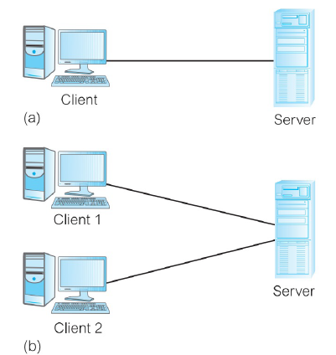

Slide 13
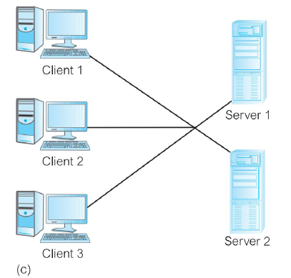

Slide 14
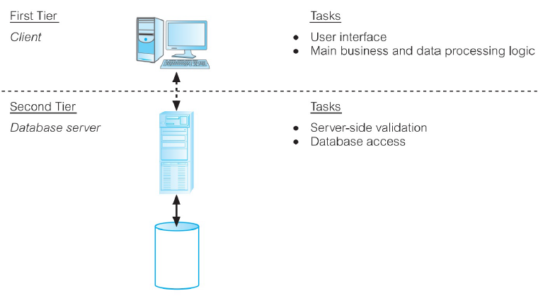
Traditional two tier client-server architecture

Slide 15
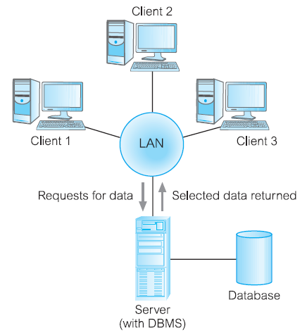

Slide 16
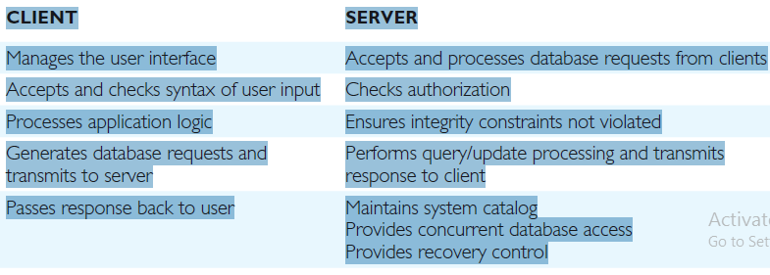

Slide 17
Three-Tier Client–Server Architecture
Problems with previous architecture
A “fat” client, requiring considerable resources on the client’s computer to run effectively. This includes disk space, RAM, and CPU power.
A significant client-side administration overhead.
New Architecture proposed three layers:
The user interface layer, which runs on the end-user’s computer (the client).
(2) The business logic and data processing layer. This middle tier runs on a server and is often called the application server.
(3) A DBMS, which stores the data required by the middle tier. This tier may run on a separate server called the database server.

Slide 18
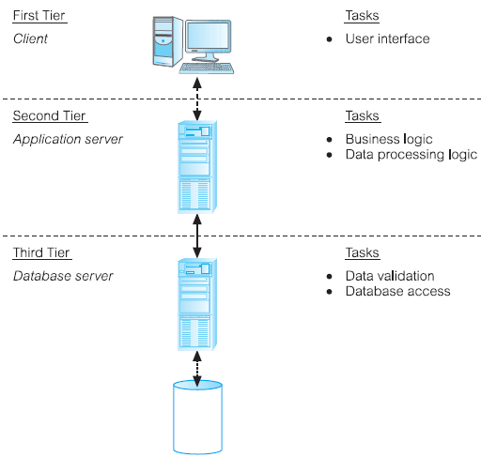

Slide 19
N-Tier Architectures
The three-tier architecture can be expanded to n tiers

Slide 20
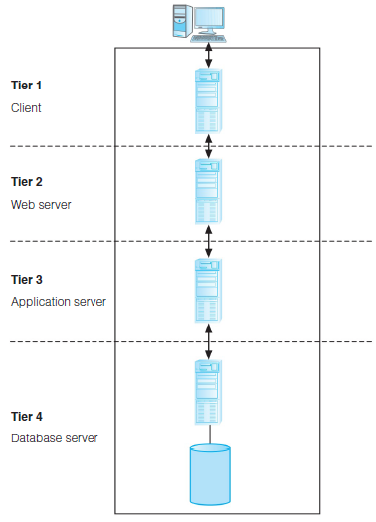

Slide 21
Application servers
Hosts an application programming interface (API) to expose business
logic and business processes for use by other applications.

Slide 22
Distributed Database Systems
Distributed database
A logically interrelated collection of shared data (and a description
of this data), physically distributed over a computer network.
Distributed DBMS
The software system that permits the management of the distributed database and makes the distribution transparent to users.

Slide 23
Distributed DBMSs
Decentralized approach
Single logical database
Split into a number of fragments
Each fragment is stored on one or more computers (replicas)
Use computer network to access data
Local Autonomy
Local applications for local data access
Global Application for Global data access

Slide 24
A collection of logically related shared data;
Data split into a number of fragments;
Fragments may be replicated;
Fragments/replicas are allocated to sites;
Sites are linked by a communications network;
Data at each site is under the control of a DBMS;
DBMS at each site can handle local applications, autonomously;
Each DBMS participates in at least one global application.

Slide 25
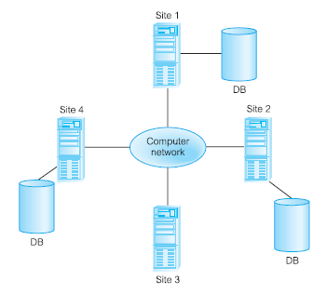

Slide 26
IT Systems
We can divide IT systems into further two systems
1. Online Transaction Processing System
(OLTP)
2. Online Analytical Processing System
(OLAP).
- In general we can assume that OLTP systems provide source data to data warehouses, whereas OLAP systems help to analyze it.

Slide 27
OLTP Systems (Online Transaction Processing System)
To automate business process
Efficient and cost-effective services to the customer
Use operational data to support decision making
For gaining competitive advantages
Operational systems were never primarily designed to support business decision making

Slide 28
OLTP (On-line Transaction Processing) System
Large number of short on-line transactions (INSERT, UPDATE, DELETE).
Fast query processing,
Maintaining data integrity in multi-access environments and an effectiveness measured by Number of transactions per second.
In OLTP database, there is detailed and current data.
Schema used to store transactional databases is the entity model (usually 3NF).

Slide 29
OLAP (On-line Analytical Processing) System
Relatively low volume of transactions.
Queries are often very complex and involve aggregations.
For OLAP systems a response time is an effectiveness measure.
OLAP applications are widely used by Data Mining techniques.
In OLAP database there is aggregated, historical data, stored in multi-dimensional schemas (usually star schema).

Slide 30
Data Warehousing
The data held in a data warehouse is described as being subject-oriented, integrated, time-variant, and nonvolatile (Inmon, 1993)

Slide 31
Subject-oriented
In operational sources data is organized by applications, or business processes.
In DW subject is the organization method
Subjects vary with enterprise
These are critical factors, that affect performance
Example of Manufacturing Company
Sales
Shipment
Inventory etc

Slide 32
Integrated Data
Data comes from several applications
Problems of integration comes into play
File layout, encoding, field names, systems, schema, data heterogeneity are the issues
Bank example, variance: naming convention, attributes for data item, account no, account type, size, currency
In addition to internal, external data sources
External companies data sharing
Websites
Others
Removal of inconsistency
So process of extraction, transformation & loading

Slide 33
Time variant
Operational data has current values
Comparative analysis is one of the best techniques for business performance evaluation
Time is critical factor for comparative analysis
Every data structure in DW contains time element
In order to promote product in certain, analyst has to know about current and historical values
The advantages are
Allows for analysis of the past
Relates information to the present
Enables forecasts for the future

Slide 34
Non-volatile
Data from operational systems are moved into DW after specific intervals
Data is persistent/ not removed i.e. non volatile
Every business transaction don’t update in DW
Data from DW is not deleted
Data is neither changed by individual transactions
Properties summary
Subject Oriented
Time-Variant
Non-Volatile
Organized along the lines of the subjects of the corporation. Typical subjects are customer, product, vendor and transaction.
Every record in the data warehouse has some form of time variancy attached to it.
Refers to the inability of data to be updated. Every record in the data warehouse is time stamped in one form or another.

Slide 35
 | OLTP System Online Transaction Processing (Operational System) | OLAP System Online Analytical Processing (Data Warehouse)
Source of data | Operational data; OLTPs are the original source of the data. | Consolidation data; OLAP data comes from the various OLTP Databases
Purpose of data | To control and run fundamental business tasks | To help with planning, problem solving, and decision support
What the data | Reveals a snapshot of ongoing business processes | Multi-dimensional views of various kinds of business activities
Inserts and Updates | Short and fast inserts and updates initiated by end users | Periodic long-running batch jobs refresh the data
Queries | Relatively standardized and simple queries Returning relatively few records | Often complex queries involving aggregations

Slide 36
 | OLTP System Online Transaction Processing (Operational System) | OLAP System Online Analytical Processing (Data Warehouse)
Processing Speed | Typically very fast | Depends on the amount of data involved; batch data refreshes and complex queries may take many hours; query speed can be improved by creating indexes
Space Requirements | Can be relatively small if historical data is archived | Larger due to the existence of aggregation structures and history data; requires more indexes than OLTP
Database Design | Highly normalized with many tables | Typically de-normalized with fewer tables; use of star and/or snowflake schemas
Backup and Recovery | Backup religiously; operational data is critical to run the business, data loss is likely to entail significant monetary loss and legal liability | Instead of regular backups, some environments may consider simply reloading the OLTP data as a recovery method

Slide 37
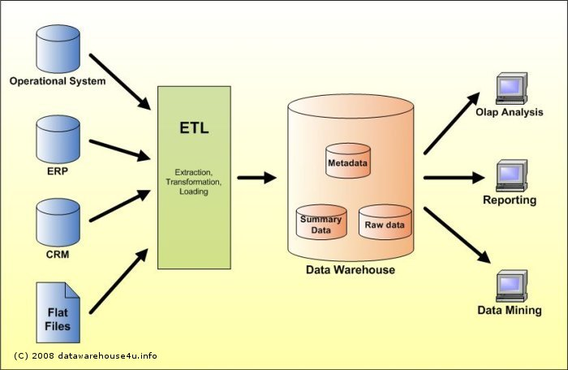

Slide 38
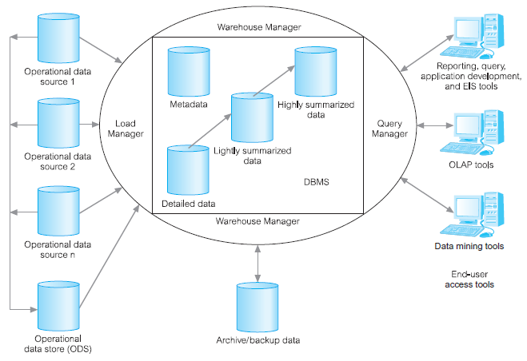
The typical architecture of a data warehouse.

