Slide 1
Relational Algebra
Chapter 5

Slide 2
Both the algebra and the calculus are formal, non-user-friendly languages.
Basis for other, higher-level Data Manipulation Languages (DMLs) for relational databases
The relational algebra is a theoretical language
There are several variations of syntax for relational algebra commands
The five fundamental operations in relational algebra
Selection, Projection, Cartesian product, Union, and Set difference
In addition, there are also the Join, Intersection, and Division operations

Slide 3
Unary and Binary Operations
The Selection and Projection operations are Unary operations
They operate on one relation
Other operations work on pairs of relations and are therefore called Binary operations

Slide 4
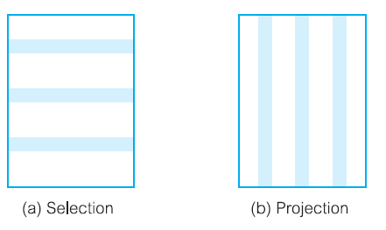
Unary Operations
Notes:
Dllas

Slide 5

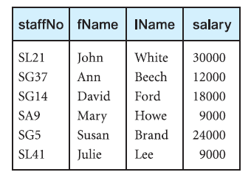
Projection

Slide 6
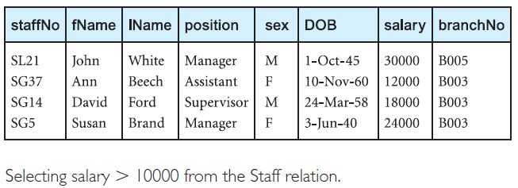
List all staff with a salary greater than £10000.

Slide 7
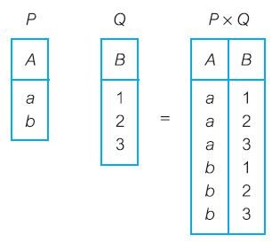
Cartesian Product

Slide 8
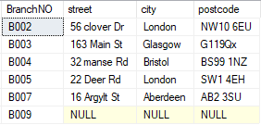

Slide 9
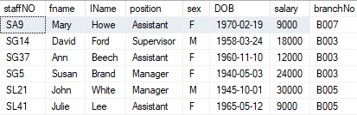

Slide 10
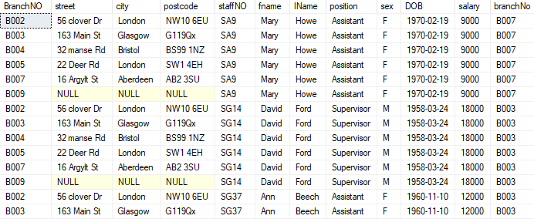

Slide 11
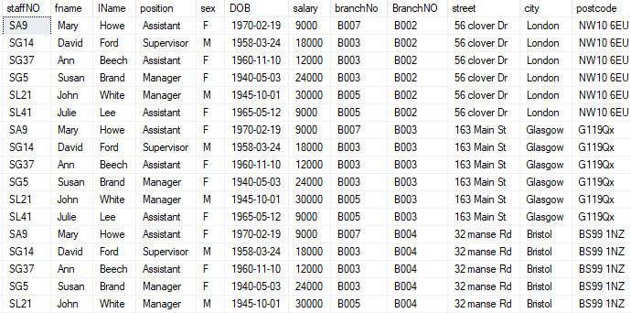

Slide 12
Cartesian product

Slide 13
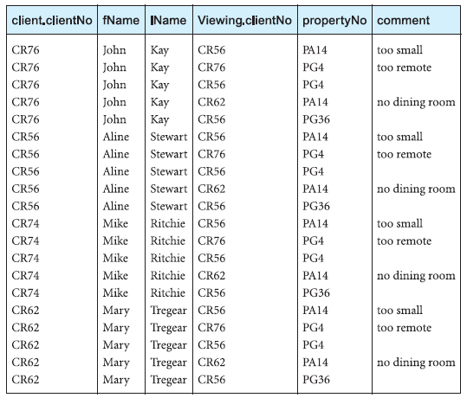

Slide 14
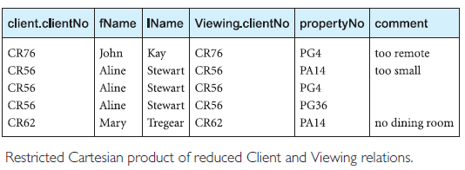

Slide 15
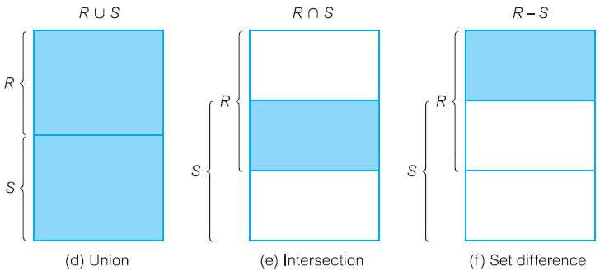

Slide 16
Union Operation
Example 5.3 Union operation
List all cities where there is either a branch office or a property for rent.
πcity(Branch) U πcity(PropertyForRent)

Slide 17
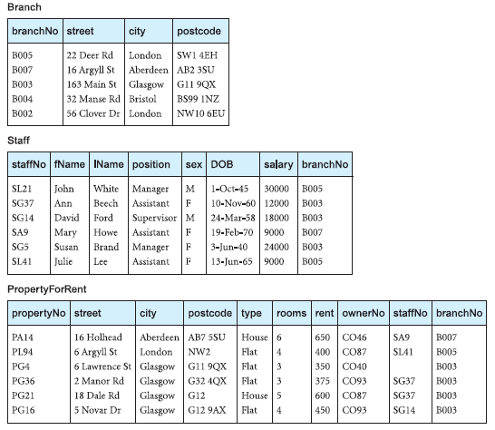

Slide 18
Set difference
Example 5.4 Set difference operation
List all cities where there is a branch office but no properties for rent.
πcity(Branch) - πcity(PropertyForRent)

Slide 20
Intersection
Example 5.5 Intersection operation
List all cities where there is both a branch office and at least one property for rent.
πcity(Branch) ∩ πcity(PropertyForRent)

Slide 22
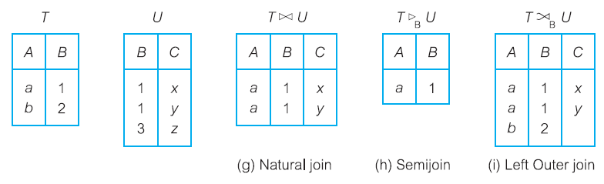
Joins

Slide 23
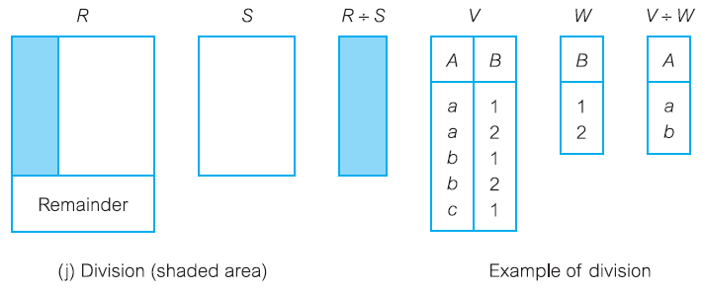
Division

Slide 24
Join Operations
we want only combinations of the Cartesian product that satisfy certain conditions
use a Join operation instead of the Cartesian product operation
The Join operation, which combines two relations to form a new relation
One of the essential operations in the relational algebra
Join is a derivative of Cartesian product
Equivalent to performing a Selection operation,
Using the join predicate as the selection formula, over the Cartesian product of the two operand relations
Difficult to implement in RDBMS

Slide 26
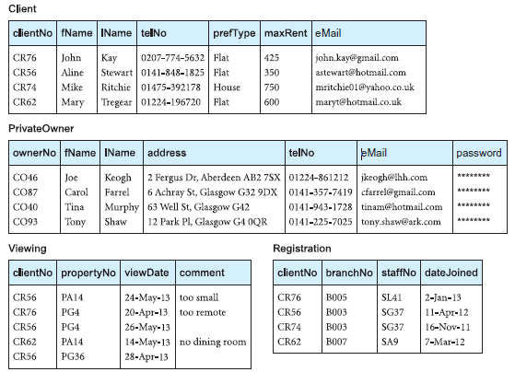

Slide 27
Join Operations
Theta join
Equijoin (a particular type of Theta join)
Natural join
Outer join
Semijoin

Slide 28

Theta join

Slide 29
Equijoin
When equal sign is used as predicate its called equijoin.

Slide 31
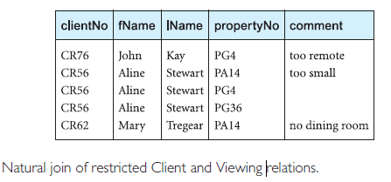
Natural join One occurrence of each common attribute is eliminated from the result

Slide 32
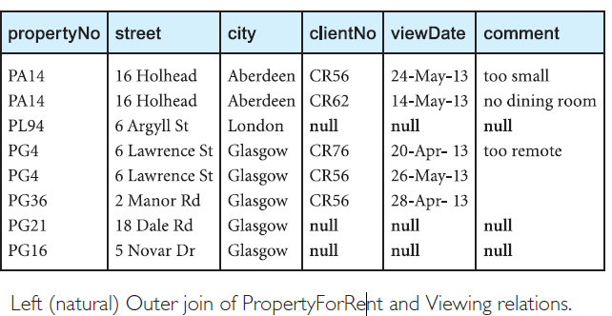
Outerjoin Produce a status report on property viewings.

Slide 33
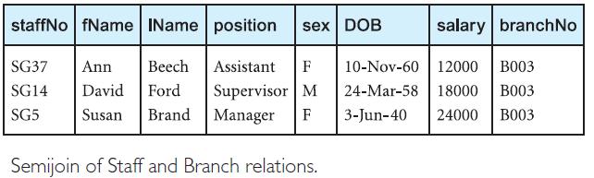
Semijoin List complete details of all staff who work at the branch in Glasgow.

