Slide 1
Database Environment
Chapter 2

Slide 2
Chapter Objectives
In this chapter you will learn:
• The purpose and origin of the three-level database architecture.
• The contents of the external, conceptual, and internal levels.
• The purpose of the external/conceptual and the conceptual/internal mappings.
• The meaning of logical and physical data independence.
• The distinction between a Data Definition Language (DDL) and a Data Manipulation Language (DML).
• A classification of data models.
• The purpose and importance of conceptual modeling.
• The typical functions and services that a DBMS should provide.
• The function and importance of the system catalog.

Slide 3
Functions of a DBMS
Data storage, retrieval, and update
A user-accessible catalog
Transaction support
Concurrency control services
Recovery services
Authorization services
Support for data communication
Integrity services
Services to promote data independence

Slide 4
Database Environment
A major aim of a database system is to provide users with an abstract view of data,
Hiding certain details of how data is stored and manipulated.
A database is a shared resource
Each user may require a different view of the data held in the database
Most commercial DBMSs based on the so-called ANSI-SPARC architecture.

Slide 5
DreamHome case study
We may be interested in modeling:
• The “real-world” entities Staff, PropertyforRent, PrivateOwner, and Client;
• Attributes describing properties or qualities of each entity (for example, each Staff entry has a name, position, and salary);
• Relationships between these entities (for example, Staff Manages PropertyforRent).

Slide 6
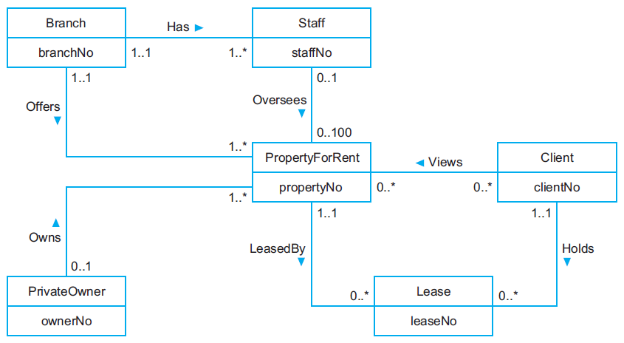
Entity Relationship Model for DreamHome

Slide 7
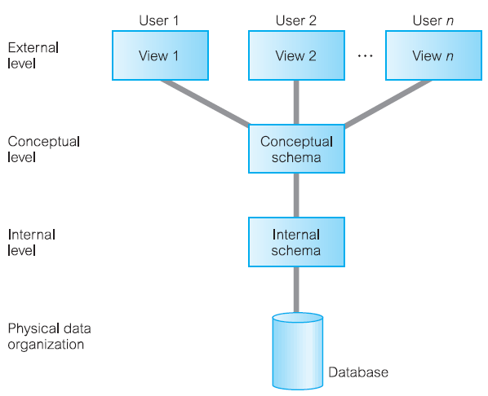
The Three-Level ANSI-SPARC Architecture

Slide 8
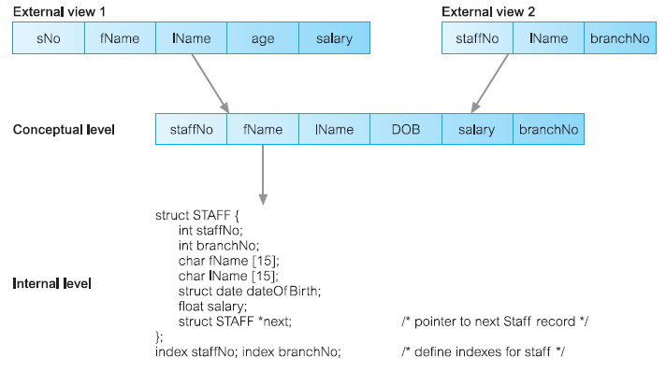

Slide 9
External Level
The users’ view of the database. This level describes that part of the
database that is relevant to each user.
Each user can have a different view

Slide 10
Conceptual Level
The community view of the database. This level describes what data
is stored in the database and the relationships among the data.
All entities, their attributes, and their relationships;
The constraints on the data;
Semantic information about the data;
Security and integrity information.

Slide 11
Internal Level
The physical representation of the database on the computer. This
level describes how the data is stored in the database.
• Storage space allocation for data and indexes;
• Record descriptions for storage (with stored sizes for data items);
• Record placement;
• Data compression and data encryption techniques.

Slide 12
Schemas, Mappings, and Instances
Database Schema
The overall description of the database is called the database schema
Three different type of schemas in the database according to their abstraction level.
External schemas (subschemas)
At the highest level, we have multiple external schemas (also called subschemas) that correspond to different views of the data.
2. Conceptual schema
Which describes all the entities, attributes, and relationships together with integrity constraints.
3. Internal schema
Which is a complete description of the internal model, containing the definitions of stored records, the methods of representation, the data fields, and the indexes and storage structures used.

Slide 13
Conceptual schema
At the conceptual level, we have the conceptual schema,
which describes all the entities, attributes, and relationships together with integrity constraints.
Internal schema
At the lowest level of abstraction we have the internal schema,
which is a complete description of the internal model, containing the definitions of stored records, the methods of representation, the data fields, and the indexes and storage structures used.
There is only one conceptual schema and one internal schema per database.

Slide 14
The schema is specified during the database design process and is not expected to change frequently.
However, the actual data in the database may change frequently.
for example, it changes every time we insert details of a new member of staff or a new property.
The data in the database at any particular point in time is called a database instance.
Many database instances can correspond to the same database schema.
The schema is sometimes called the intension of the database.
An instance is called an extension (or state) of the database.

Slide 15
Data Independence
A major objective for the three-level architecture is to provide data independence,
Which means that upper levels are unaffected by changes to lower levels.
There are two kinds of data independence: logical and physical.
Logical data independence
The immunity of the external schemas to changes in the conceptual schema
Adding attributes, entities

Slide 16
Physical Data Independence
The immunity of the conceptual schema to changes in the internal schema.
Changes to the internal schema, such as using different file organizations or storage structures.
using different storage devices, modifying indexes or hashing algorithms.
Should be possible without having to change the conceptual or external
schemas.
From the users’ point of view, the only effect that may be noticed is a
change in performance.
In fact, deterioration in performance is the most common reason for internal schema changes
Figure 2.3 illustrates where each type of data independence occurs in relation to the three-level architecture.

Slide 17
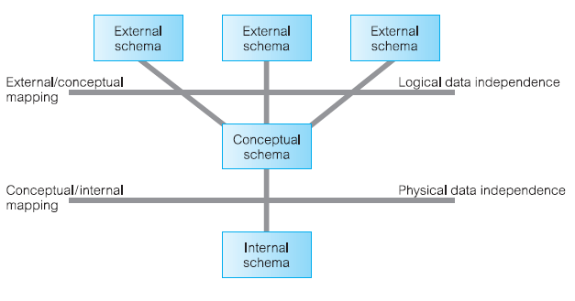

Slide 18
Database Languages
DDL
Describe and name the entities, attributes, and relationships required for the application, together with any associated integrity and security constraints.
system catalog

Slide 19
DML
A language that provides a set of operations to support the basic data
manipulation operations on the data held in the database.
Insertion of new data into the database;
Modification of data stored in the database;
Retrieval of data contained in the database;
Deletion of data from the database.
The part of a DML that involves data retrieval is called a query language.
a. Procedural DMLs
b. Nonprocedural DMLs

Slide 20
Fourth-Generation Languages (4GLs)
Forms generators
Report generators
Graphics generators
Application generators

Slide 21
Data Models and Conceptual Modeling
Data Model
An integrated collection of concepts for describing and manipulating
data, relationships between data, and constraints on the data in an organization.
Structural part, consisting of a set of rules according to which databases can
be constructed;
Manipulative part, defining the types of operation that are allowed on the
data (this includes the operations that are used for updating or retrieving
data from the database and for changing the structure of the database).
Set of integrity constraints, which ensures that the data is accurate.

Slide 22
Object-Based Data Models
Entity-Relationship (ER)
Semantic
Functional
Object-oriented

Slide 23
Record-Based Data Models
Relational data model
Network data model
Hierarchical data model

