Slide 1
Database Joins

Slide 2
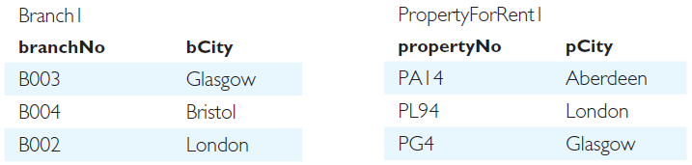
DreamHome

Slide 3
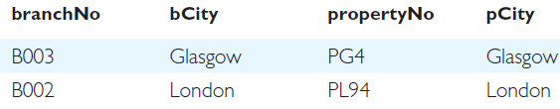
Inner join
List branch numbers and property numbers with same city.
SELECT b.*, p.*
FROM Branch1 b, PropertyForRent1 p
WHERE b.bCity = p.pCity;

Slide 4
List all branch offices and any properties that are in the same city.
Join??

Slide 5
Outer join
There are three types of Outer join:
Left,
Right
Full

Slide 6
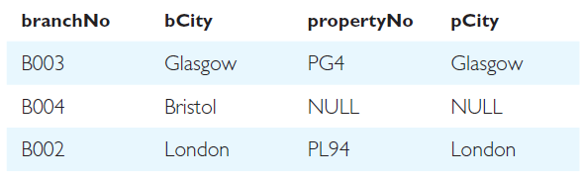
Left Outer join
List all branch offices and any properties that are in the same city.
The Left Outer join of these two tables:
SELECT b.*, p.*
FROM Branch1 b LEFT JOIN PropertyForRent1 p ON b.bCity = p.pCity;

Slide 7
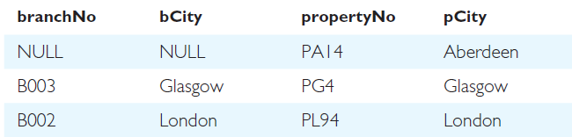
Right Outer join
List all properties and any branch offices that are in the same city.
The Right Outer join of these two tables:
SELECT b.*, p.*
FROM Branch1 b RIGHT JOIN PropertyForRent1 p ON b.bCity = p.pCity;

Slide 8
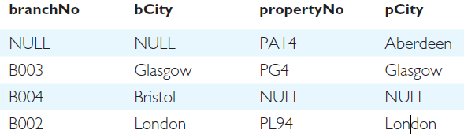
Full Outer join
List the branch offices and properties that are in the same city along with any unmatched branches or properties.
The Full Outer join of these two tables:
SELECT b.*, p.*
FROM Branch1 b FULL JOIN PropertyForRent1 p ON b.bCity = p.pCity;

Slide 9
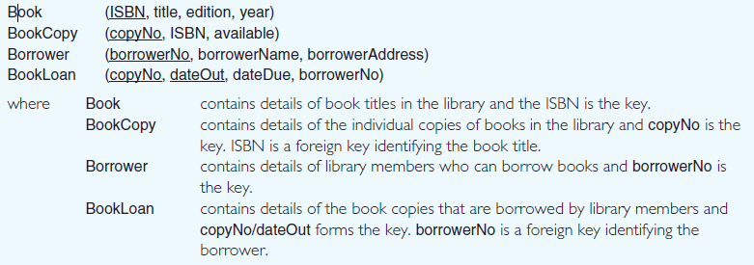
Library Database

Slide 10
List all managers and supervisors.
Query?

Slide 11
List all managers and supervisors.
SELECT staffNo, fName, IName, position
FROM Staff
WHERE position IN (‘Manager’, ‘Supervisor’);
Table 6.8 Result table for Example 6.8.
staffNo fName IName position
SL21 John White Manager
SG14 David Ford Supervisor
SG5 Susan Brand Manager

Slide 12
Escape Character
LIKE ‘15#%’ ESCAPE ‘#’

Slide 13
ORDER BY Clause (Sorting Result)
Ascending
Descending
More than one attribute
Attribute may or may not in result
Major sort key
Minor sort key

Slide 14
Sorting by type
propertyNo type rooms rent
PL94 Flat 4 400
PG4 Flat 3 350
PG36 Flat 3 375
PG16 Flat 4 450
PA14 House 6 650
PG21 House 5 600

Slide 15
SELECT propertyNo, type, rooms, rent FROM PropertyForRent ORDER BY type, rent DESC;
propertyNo type rooms rent
PL94 Flat 4 400
PG4 Flat 4 450
PG36 Flat 4 375
PG16 Flat 4 350
PA14 House 6 650
PG21 House 5 600

Slide 16
Subqueries
A scalar subquery returns a single column and a single row, that is, a single value.
A row subquery returns multiple columns, but only a single row.
A table subquery returns one or more columns and multiple rows.

Slide 17
List the staff who work in the branch B003.
Query?

Slide 18
List the staff who work in the branch at ‘163 Main St’.
SELECT staffNo, fName, IName, position
FROM Staff
WHERE branchNo = (SELECT branchNo
FROM Branch
WHERE street = ‘163 Main St’);

Slide 19
SELECT staffNo, fName, IName, position
FROM Staff
WHERE branchNo = ‘B003’;

Slide 20
Using a subquery with an aggregate function
List all staff whose salary is greater than the average salary, and show by how much their salary is greater than the average.
SELECT staffNo, fName, IName, position,
salary – (SELECT AVG(salary) FROM Staff) AS salDiff
FROM Staff
WHERE salary > (SELECT AVG(salary) FROM Staff);

