Slide 1
The Relational Model
Chapter 4

Slide 2
Brief History of the Relational Model
A relational model of data for large shared data banks” (Codd, 1970)
To allow a high degree of data independence
To provide substantial grounds for dealing with data semantics, consistency, and redundancy problems
To enable the expansion of set-oriented data manipulation languages.
DBMS System R (IBM)
DB2 and SQL/DS from IBM
Oracle from Oracle Corporation.
INGRES (Interactive Graphics Retrieval System) project at the University of California at Berkeley
MS SQL Server, MySQL, ORACLE, PostgreSQL, IBM DB2, SQLite etc.

Slide 3
Terminology
Relational Data Structure
Relation: A relation is a table with columns and rows.
Attribute: An attribute is a named column of a relation.
Domain: A domain is the set of allowable values for one or more attributes.
Tuple: A tuple is a row of a relation.
Degree: The degree of a relation is the number of attributes it contains.
Cardinality: The cardinality of a relation is the number of tuples it contains.
Relational database: A collection of normalized relations with distinct relation names.

Slide 4
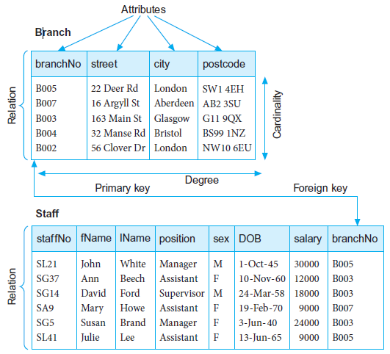

Slide 5
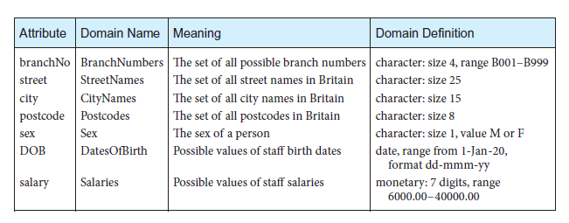
Domain Definition

Slide 6
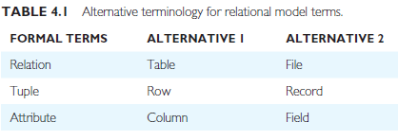
Alternative terminology

Slide 7
Properties of Relations
Distinct name of relation from all other relation names in the relational schema;
Each cell of the relation contains exactly one atomic (single) value;
Each attribute has a distinct name;
The values of an attribute are all from the same domain;
Each tuple is distinct; there are no duplicate tuples;
The order of attributes has no significance;
The order of tuples has no significance, theoretically. (However, in practice, the Order may affect the efficiency of accessing tuples.)

Slide 8
Relational Keys
Primary key
The attribute that is selected to identify tuples uniquely within
the relation.
Foreign key
An attribute, or set of attributes, within one relation that matches
the candidate key of some (possibly the same) relation.

Slide 9
Representing Relational Database Schemas
A relational database consists of any number of normalized relations.
The relational schema for part of the DreamHome case study is:

Slide 10
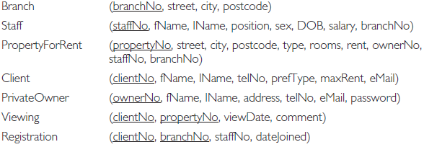

Slide 11
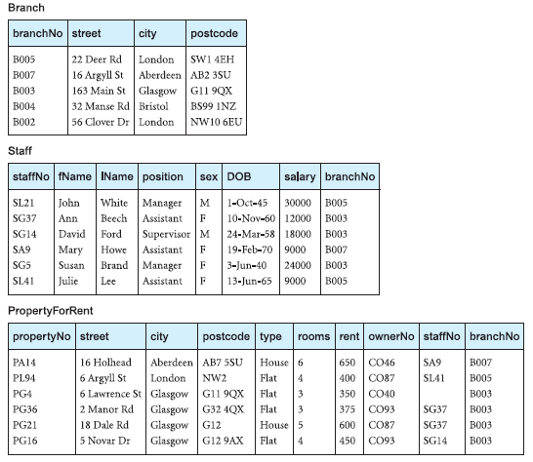

Slide 12
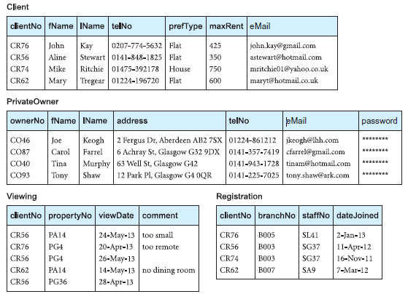

Slide 13
Integrity Constraints
Domain constraints
Null
Entity Integrity
Referential Integrity
General Constraints

Slide 14
Domain constraints: Every attribute has an associated domain, there are constraints (called that form restrictions on the set of values allowed for the attributes of relations.
Null: Represents a value for an attribute that is currently unknown or is not applicable for this tuple.
Entity integrity: In a base relation, no attribute of a primary key can be null.
Referential integrity:
If a foreign key exists in a relation, either the foreign key value must match a candidate key value of some tuple in its home relation or the foreign key value must be wholly null.
General constraints:
Additional rules specified by the users or database administrators of a database that define or constrain some aspect of the enterprise.

Slide 15
Mathematical Relations
Cartesian Product
D1: {2, 4} D2: {1, 3, 5}
D1 X D2 = {(2, 1), (2, 3), (2, 5), (4, 1), (4, 3), (4, 5)}
R = {(2, 1), (4, 1)}
D1 = {1, 3} D2 = {2, 4} D3 = {5, 6}
D1 X D2 X D3 = {(1, 2, 5), (1, 2, 6), (1, 4, 5), (1, 4, 6), (3, 2, 5), (3, 2, 6), (3, 4, 5), (3, 4,6)}

Slide 16
Database Relations
Relation schema
A named relation defined by a set of attribute and domain name
pairs.
{(B005, 22 Deer Rd, London, SW1 4EH)}
or more correctly:
{(branchNo: B005, street: 22 Deer Rd, city: London, postcode: SW1 4EH)}
Relation instance

Slide 17
Relational database schema
A set of relation schemas, each with a distinct name.
relational schema, R, as: R = {R1, R2, . . . , Rn}

Slide 18
Views
Base relation : A named relation corresponding to an entity in the conceptual schema, whose tuples are physically stored in the database.
View: The dynamic result of one or more relational operations operating on the base relations to produce another relation.
A view is a virtual relation that does not necessarily exist in the database but can be produced upon request by a particular user, at the time of request.

Slide 19
Example
CREATE VIEW [Brazil Customers] AS SELECT CustomerName, ContactName FROM Customers WHERE Country = 'Brazil’;
SELECT * FROM [Brazil Customers];

Slide 20
Purpose of Views
It provides a powerful and flexible security mechanism
It permits users to access data in a way that is customized to their needs
It can simplify complex operations on the base relations

Slide 21
Updating Views
Using a simple query involving a single base relation and containing either the primary key or a candidate key of the base relation.
Updates are not allowed through views involving multiple base relations.
Updates are not allowed through views involving aggregation or grouping operations.

