Slide 1
Transaction Management
Chapter 22

Slide 2
Transaction
An action, or series of actions, carried out by a single user or application program, that reads or updates the contents of the database.

Slide 3
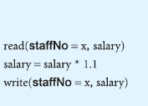

Slide 4
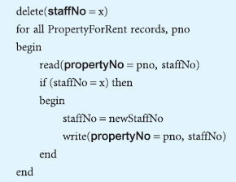

Slide 5
Consistent state
inconsistent state
Committed
Abort
Rollback/undone
Compensating transaction

Slide 6
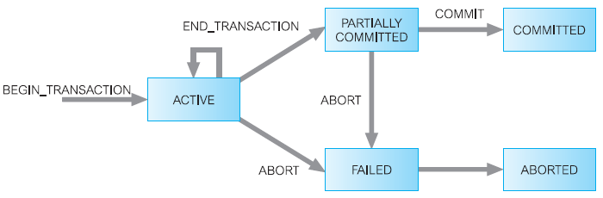

Slide 7
Properties of Transactions
ACID:
Atomicity
Consistency
Isolation
Durability

Slide 8
Concurrency control
The process of managing simultaneous operations on the database without having them interfere with one another.
lost update problem
uncommitted dependency problem
inconsistent analysis problem

Slide 9
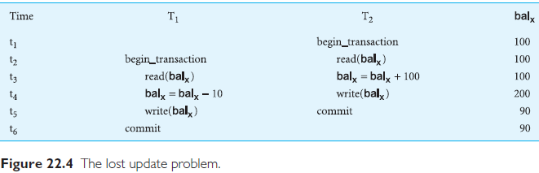

Slide 10
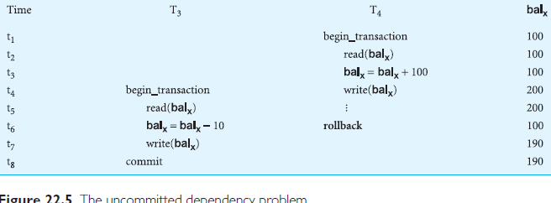

Slide 11
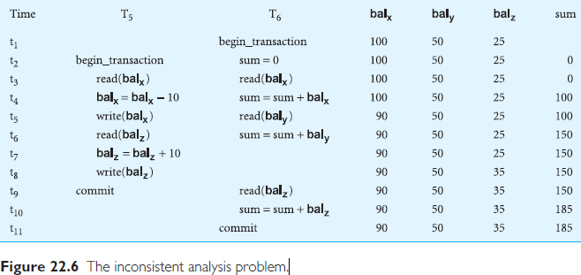

Slide 12
