Slide 1
Database Security
Chapter 20

Slide 2
Database security
The mechanisms that protect the database against intentional or
accidental threats.
Risks:
theft and fraud;
loss of confidentiality (secrecy);
loss of privacy;
loss of integrity;
loss of availability.

Slide 3
Threat
Any situation or event, whether intentional or accidental, that may
adversely affect a system and consequently the organization.

Slide 4
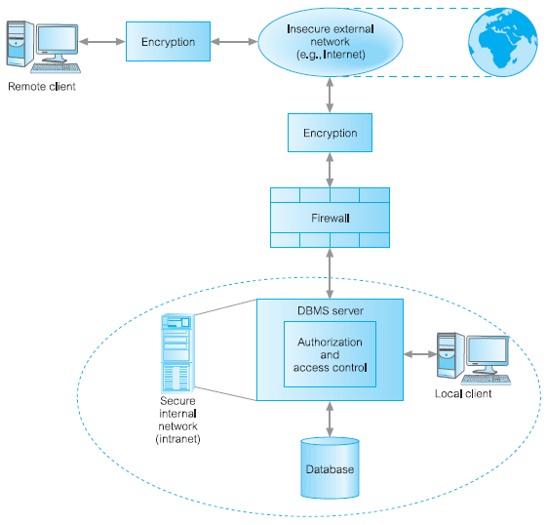

Slide 5
Computer-based security controls for a multi-user environment
authorization,
access controls,
views,
backup and recovery,
integrity,
encryption,
RAID technology.

Slide 6
Authorization
Authorization
The granting of a right or privilege that enables a subject to have
legitimate access to a system or a system’s object.
Authentication
A mechanism that determines whether a user is who he or she
claims to be.
. OS login
. DBMS login

Slide 7
Access Controls
Access Controls
- Granting and revoking of privileges
- A privilege allows a user to create or access
(that is read, write, or modify) some database object (such as a
relation, view, index)

Slide 8
Views
A view is the dynamic result of one or more relational operations operating on the base relations to produce another relation.
A view is a virtual relation that does not actually exist in the database, but is produced upon request by a particular user, at the time of request.

Slide 9
Backup and Recovery
The process of periodically copying of the database and log file (and
possibly programs) to offline storage media.

Slide 10
Journaling
The process of keeping and maintaining a log file (or journal) of all
changes made to the database to enable recovery to be undertaken
effectively in the event of a failure.

Slide 11
Integrity
Integrity constraints also contribute to maintaining a secure database system by preventing data from becoming invalid, and hence giving misleading or incorrect results.

Slide 12
Encryption
The encoding of the data by a special algorithm that renders the
data unreadable by any program without the decryption key.

Slide 13
RAID (Redundant Array of Independent Disks)
The hardware that the DBMS is running on must be fault-tolerant, meaning that the DBMS should continue to operate even if one of the hardware components fails.

Slide 14
Data Replication
The process of generating and reproducing multiple copies of data at one or more sites.

