Slide 1
Normalization Exercises

Slide 2
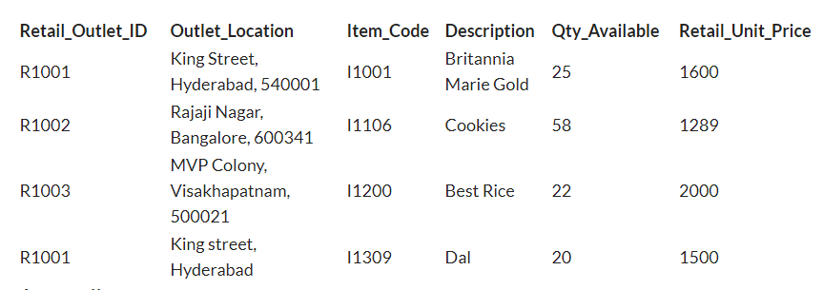

Slide 3
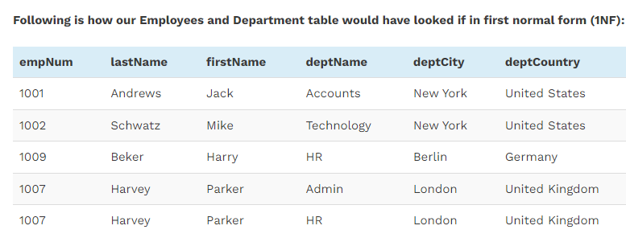

Slide 4
