Slide 1
Database System Development Lifecycle
Chapter 10

Slide 2
Success/Failure of Database Projects
80–90% do not meet their performance goals;
about 80% are delivered late and over budget;
around 40% fail or are abandoned;
under 40% fully address training and skills requirements;
less than 25% properly integrate enterprise and technology objectives;
just 10–20% meet all their success criteria.

Slide 3
Reasons of Failure
Lack of a complete requirements specification
Lack of an appropriate development methodology
Poor decomposition of design into manageable components.

Slide 4
Solution------Structured approach
Information Systems Lifecycle (ISLC)
Software Development Lifecycle (SDLC).
Database System Development Lifecycle (DSDLC).

Slide 5
Information system
The resources that enable the collection, management, control and dissemination of information throughout an organization.
A computer-based information system includes:
a database,
database software,
application software,
computer hardware,

Slide 6
Continue….
personnel using and developing the system.
System analyst
Business analyst
Database designer
Application developer
Database administrator
End user

Slide 7
The Database System Development Lifecycle

Slide 8
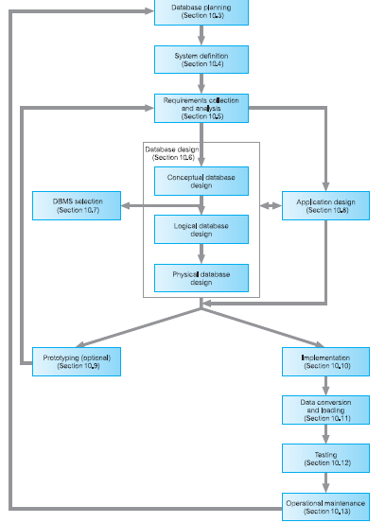

Slide 9
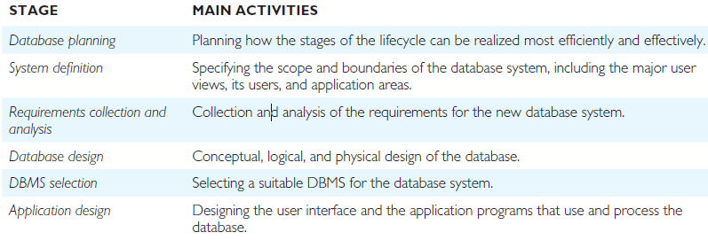

Slide 10
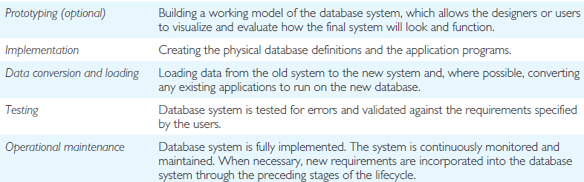

Slide 11
Database Planning
The management activities that allow the stages of the database system development lifecycle to be realized as efficiently and effectively as possible.
Mission statement
Mission Objective
Team
Standards
Legal requirement (confidential data)

Slide 12
System Definition
Describes the scope and boundaries of the database system and the major user views.
current users and application areas
Future users and application areas

Slide 13
Requirements Collection and Analysis
The process of collecting and analyzing information about the part of the organization that is to be supported by the database system and using this information to identify the requirements for the new system.
fact-finding techniques
a description of the data used or generated;
the details of how data is to be used or generated;
any additional requirements for the new database system.
Requirements specifications

Slide 14
Continue…..
Too much study too soon leads to paralysis by analysis
Too little thought can result in an unnecessary waste of both time and money
Data Flow Diagrams (DFD)
Computer-Aided Software Engineering (CASE) tools
Unified Modeling Language (UML)

Slide 15
Database Design
The process of creating a design that will support the enterprise’s mission statement and mission objectives for the required database system.
Approaches to database design
Data modeling
Three phases of database design

Slide 16
Approaches to database design
Bottom-up
Top-down.

Slide 17
Bottom-up Approach
Attributes, Relations, Entities, Relationship between entities
Normalization technique
For less complex system and less attributes
Top-down
Entities, Relationship between entities, Attributes, Relations
ER Model (Entity Relationship model)
For complex system having hundreds and thousands of attributes

Slide 18
Data Modeling
ER Model
Understanding of both the designer and the users

Slide 19
Phases of Database Design
Conceptual, Logical, and Physical design
Conceptual Database Design:
To build the conceptual representation of the database, which includes identification of the important entities, relationships, and attributes.

Slide 20
Logical database design
To translate the conceptual representation to the logical structure of the database, which includes designing the relations.
Physical database design
The process of producing a description of the implementation of the database on secondary storage; it describes the base relations, file organizations, and indexes used to achieve efficient access to the data, and any associated integrity constraints and security measures.

Slide 21
Database design is an iterative process that has a starting point and an almost endless procession of refinements

Slide 22
DBMS Selection

Slide 23
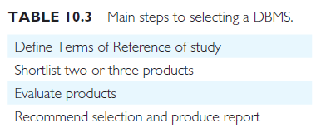
Main steps to select a DBMS

Slide 24
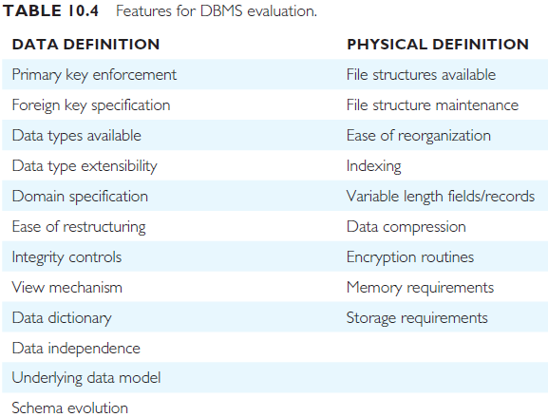

Slide 25
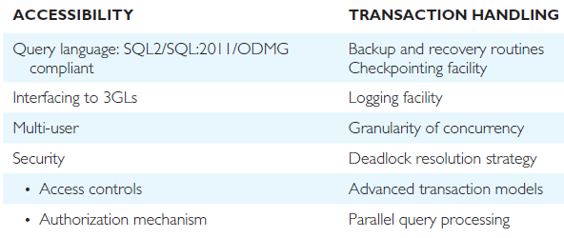

Slide 26
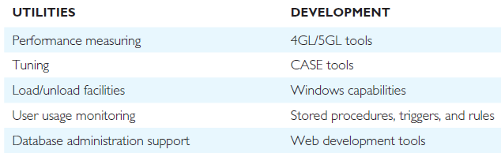

Slide 27
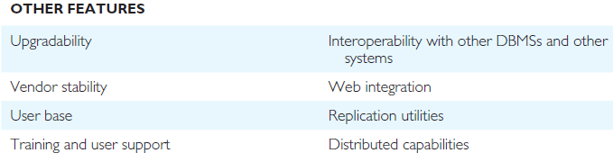

Slide 28
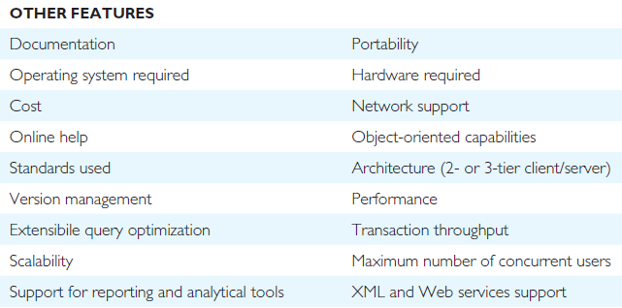

Slide 29
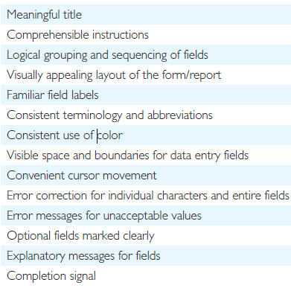
Form/Report
Design Format

Slide 30
Prototyping
Building a working model of a database system.

Slide 31
Implementation
The physical realization of the database and application
designs.

Slide 32
Data Conversion and Loading
Transferring any existing data into the new database and converting
any existing applications to run on the new database

Slide 33
Testing
The process of running the database system with the intent of finding errors.

Slide 34
Operational Maintenance
The process of monitoring and maintaining the database system
following installation

