Slide 1
Normalization
Chapter 14

Slide 2
Database Design
When we design a database for an enterprise
The main objectives are:
to create an accurate representation of the data,
relationships between the data,
and constraints on the data that is pertinent to the enterprise.
Database design Techniques:
ER Modeling
Normalization

Slide 3
Normalization
A technique for producing a set of relations with desirable properties,
given the data requirements of an enterprise.
The characteristics of a suitable set of relations include the following:
The minimal number of attributes necessary to support the data requirements of the enterprise;
Attributes with a close logical relationship (described as functional dependency) are found in the same relation;
Minimal redundancy, with each attribute represented only once, with the important exception of attributes that form all or part of foreign keys, which are essential for the joining of related relations.

Slide 4
Benefits of suitable set of relations
Will be easier for the user to access and maintain the data.
and take up minimal storage space on the computer.
Controlled Redundancy.

Slide 5
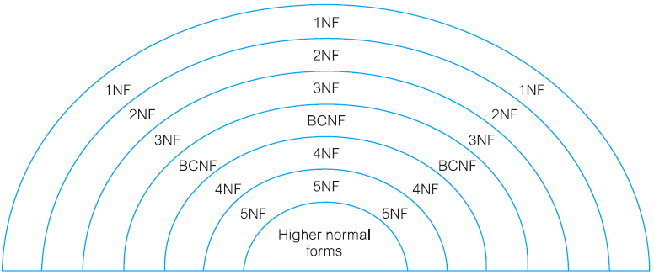
Normalization is a Series of test

Slide 6
How Normalization Supports Database Design
Approach 1
Bottom-up standalone database design technique
Approach 2
A validation technique to check the structure of relations, which may have been created using a top-down approach such as ER modeling

Slide 7
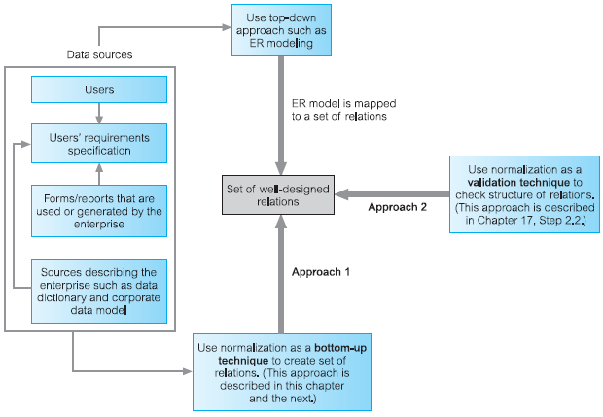

Slide 8
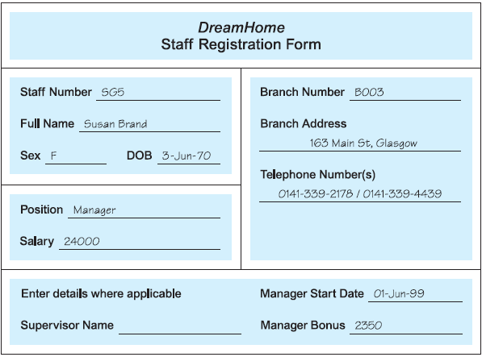

Slide 9
Data Redundancy and Update Anomalies
Staff (staffNo, sName, position, salary, branchNo)
Branch (branchNo, bAddress)
StaffBranch (staffNo, sName, position, salary, branchNo, bAddress)

Slide 10
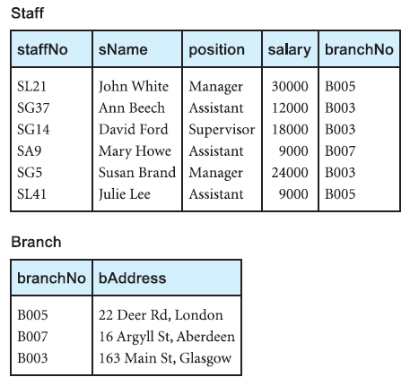

Slide 11
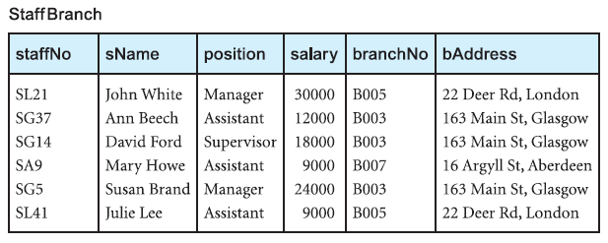

Slide 12
Update anomalies
Insertion (Why we separate staff and branch tables)
Deletion, (if we delete staff SA9 from staffbranch)
Modification (change the address of branch)

Slide 13
Decomposition
Lossless join
Dependency Preservation

Slide 14
Functional Dependencies (Important concept)
Relationship between attributes
How functional dependencies can be identified
and used to identify the primary key for a relation.

Slide 15
Characteristics of functional dependencies
There is a one-to-one relationship between the attribute(s)
They hold for all time.
The determinant has the minimal number of attributes

Slide 16
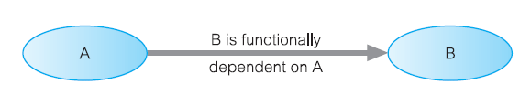

Slide 17
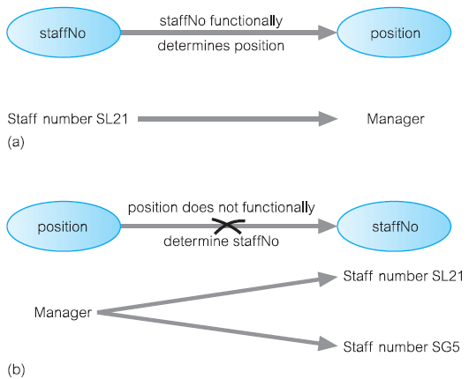

Slide 18
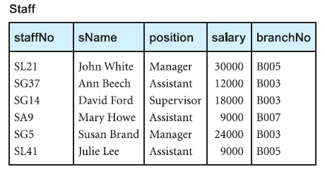
Functional dependency that holds for all time
staffNo ® sName
sName ® staffNo

Slide 19
Identifying Functional Dependencies
Relationships between the attributes are well understood
Understanding through documentation and discussion
Depending on the database application
Experience of designer for missing information

Slide 20
position held and the branch determine a member of staff’s salary
staffNo ® sName, position, salary, branchNo, bAddress
branchNo ® bAddress
bAddress ® branchNo
branchNo, position ® salary
bAddress, position ® salary

Slide 21
Full functional dependency
staffNo, sName ® branchNo
staffNo ® branchNo

Slide 22
Transitive dependency
staffNo ® sName, position, salary, branchNo, bAddress
branchNo ® bAddress

Slide 23
Normalization Process
Unnormalized Form (UNF)
A table that contains one or more repeating groups.
First Normal Form (1NF)
A relation in which the intersection of each row and column contains
one and only one value.

Slide 24
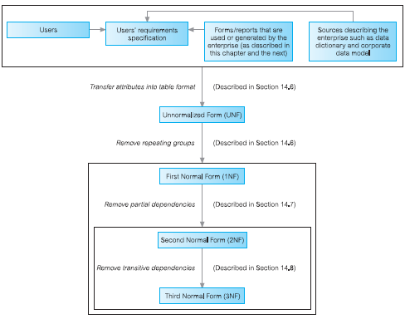

Slide 25
Common approaches to removing repeating groups
By entering appropriate data in the empty columns of rows containing the repeating data. (“flattening”)
2. By placing the repeating data, along with a copy of the original key
attribute(s), in a separate relation.

Slide 26
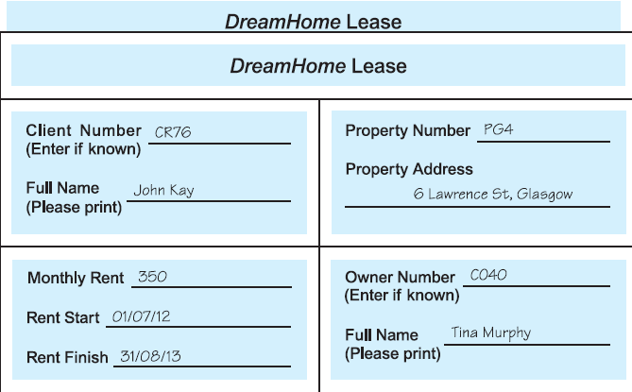

Slide 27
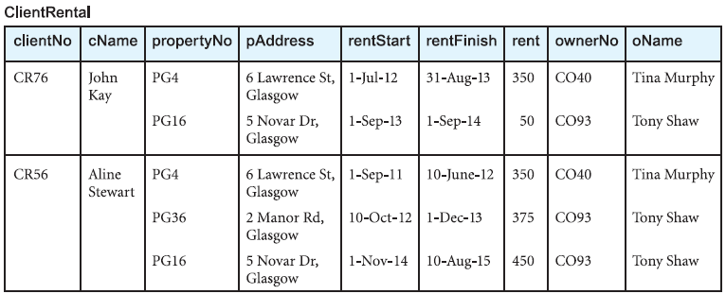
Repeating Group

Slide 28
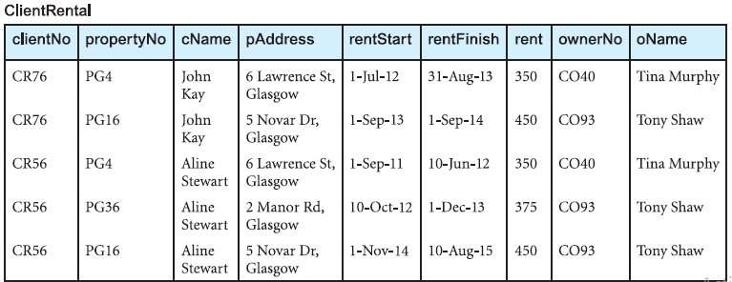
Flattening

Slide 29
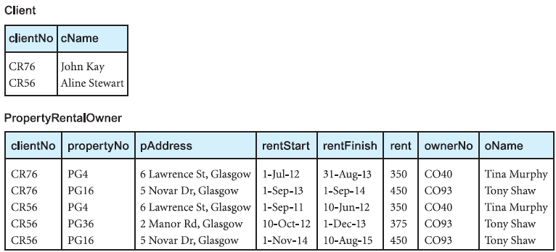

Slide 30
Second Normal Form (2NF)
A relation that is in first normal form and every non-primary-key
attribute is fully functionally dependent on the primary key.

Slide 31
Functional Dependency
fd1 clientNo, propertyNo ® rentStart, rentFinish (Primary key)
fd2 clientNo ® cName (Partial dependency)
fd3 propertyNo ® pAddress, rent, ownerNo, oName (Partial dependency)
fd4 ownerNo ® oName (Transitive dependency)
fd5 clientNo, rentStart ® propertyNo, pAddress, rentFinish,
rent, ownerNo, oName (Candidate key)
fd6 propertyNo, rentStart ® clientNo, cName, rentFinish (Candidate key)

Slide 32
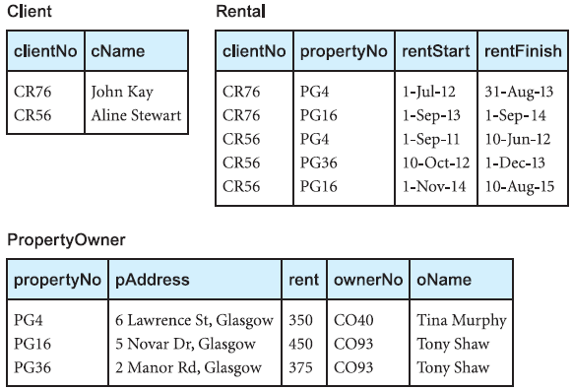

Slide 33
Third Normal Form (3NF)
A relation that is in first and second normal form and in which no non-primary-key attribute is transitively dependent on the primary key.

Slide 34
Transitive Dependency
PropertyOwner
fd3 propertyNo ® pAddress, rent, ownerNo, oName (Primary key)
fd4 ownerNo ® oName (Transitive dependency)

Slide 35
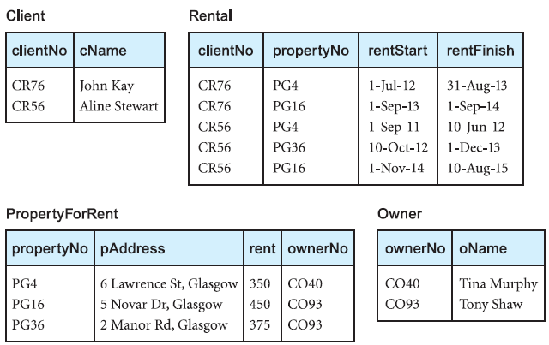

Slide 36
