Slide 1
Serializability

Slide 2
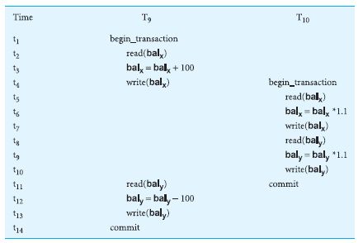

Slide 3
Concurrency control techniques
Locking
Timestamping

Slide 4
Locking
A procedure used to control concurrent access to data. When one transaction is accessing the database, a lock may deny access to other transactions to prevent incorrect results

Slide 5
Types of Locks
Shared lock
If a transaction has a shared lock on a data item, it can read the item but not update it.
Exclusive lock
If a transaction has an exclusive lock on a data item, it can both read and update the item.

Slide 6
Two-phase locking (2PL)
A transaction follows the two-phase locking protocol if all locking operations precede the first unlock operation in the transaction.
Growing phase
Shrinking phase

Slide 7
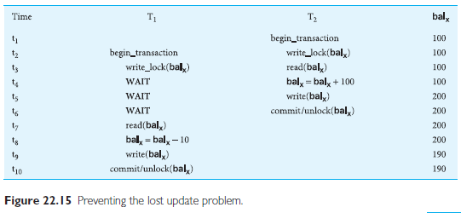

Slide 8
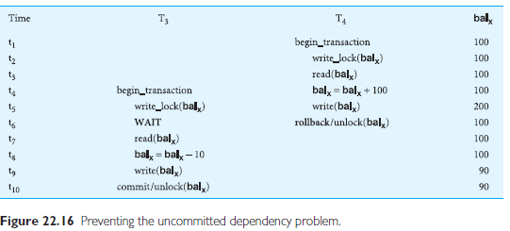

Slide 9
Preventing the inconsistent analysis problem.
Consult your text book for reading.

Slide 10
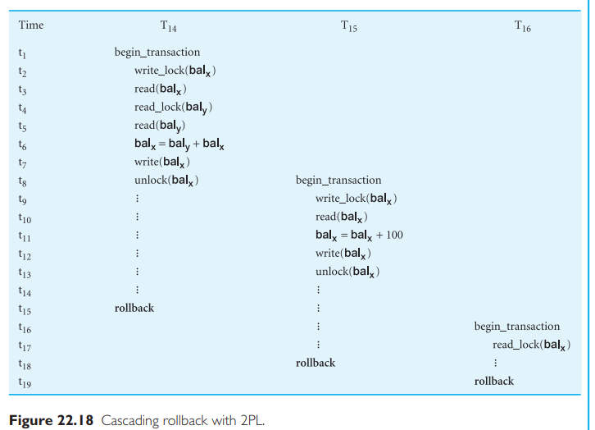
Cascading Rollback

Slide 11
Deadlock
Chapter 22

Slide 12
Deadlock
An impasse that may result when two (or more) transactions are
each waiting for locks to be released that are held by the other.

Slide 13
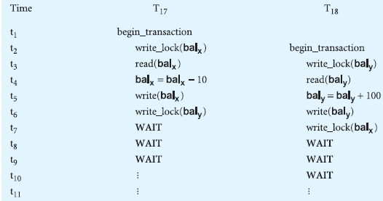

Slide 14
Database Recovery
Chapter 22

Slide 15
Database Recovery
The process of restoring the database to a correct state in the event
of a failure.

Slide 16
The Storage Medium
The storage of data generally includes four different types of media
1. Main memory
2. Magnetic disk
3. Magnetic tape
4. Optical Disk
5. SSD
Primary storage
Secondary Storage
RAID (Redundant Array of Independent Disks)

Slide 17
Causes of failure
• System crashes due to hardware or software errors, resulting in loss of main
memory;
• Media failures, such as head crashes or unreadable media, resulting in the loss
of parts of secondary storage;
• Application software errors, such as logical errors in the program that is accessing
the database, that cause one or more transactions to fail;
• Natural physical disasters, such as fires, floods, earthquakes, or power failures;
• Carelessness or unintentional destruction of data or facilities by operators or
users;
• Sabotage, or intentional corruption or destruction of data, hardware, or software
facilities.

Slide 18
Transactions and Recovery
Transactions represent the basic unit of recovery in a database system
In failure, the recovery manager guarantee the Atomicity and Durability properties of transaction.

Slide 19
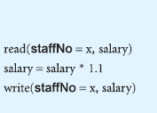
Transaction

Slide 20
Transaction steps
find the address of the disk block that contains the record with primary key
value x;
Transfer the disk block into a database buffer in main memory;
Copy the salary data from the database buffer into the variable salary.
For the write operation, the DBMS carries out the following steps:
Find the address of the disk block that contains the record with primary key
value x;
Transfer the disk block into a database buffer in main memory;
Copy the salary data from the variable salary into the database buffer;
Write the database buffer back to disk.

Slide 21
Database buffer
Database buffers: Occupy an area in main memory from which data is transferred to and from secondary storage.
When database buffers flushed, the updates are stored permanently on secondary storage.
Buffers are flushed when its full or when a command is issued.
What? If a failure occurs between writing to the buffers and flushing the buffers to secondary storage .
The Recovery Manager resolve the issue.

Slide 22
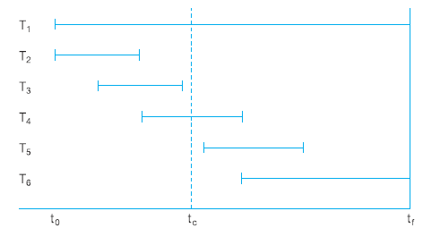

Slide 23
Buffer Management
Transfer pages to and from secondary storage
Replacement strategy
First in First out
Least recently used
Data already in buffer should not read from disk

Slide 24
Recovery Facilities
A DBMS should provide the following facilities to assist with recovery:
Backup mechanism
Log file (journal)
Checkpoint
Recovery Manager

Slide 25
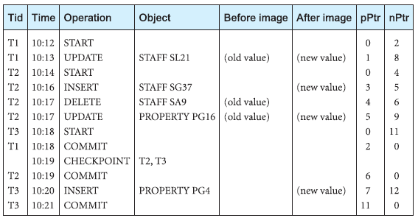
Segment of a log file

Slide 27
Recovery Techniques
Consider two cases:
If the database has been extensively damaged
If the database has not been physically damaged but has become inconsistent

Slide 28
Recovery techniques using deferred update
Using the deferred update recovery protocol, updates are not written to the database until after a transaction has reached its commit point.
Use log file for recovery
Recovery techniques using immediate update
Using the immediate update recovery protocol, updates are applied to the database as they occur without waiting to reach the commit point

