Slide 1

APEX Institutional
Autonomous High-Frequency Crypto Trading Engine Triple-Agent AI Consensus | Unified Step-Trailing System

Slide 2
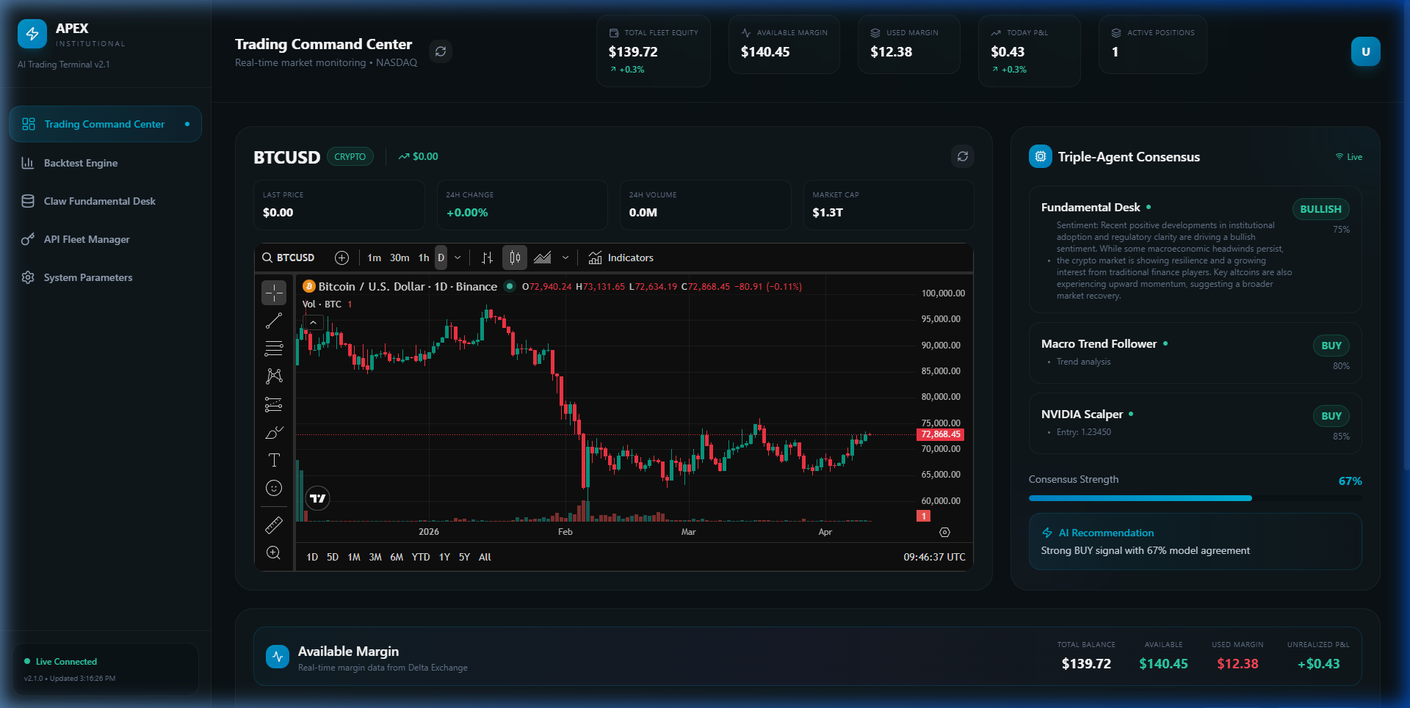
What is APEX Institutional?
A highly-advanced, emotionless cryptocurrency trading terminal.
Employs a Triple-Agent AI System to evaluate market conditions.
Trades execution requires a strict 60%+ consensus between all agents.
Dynamically scales leverage (1x to 100x) based purely on AI confidence scores.
Executes directly on Delta Exchange with fallbacks to live Binance feeds.

Slide 3
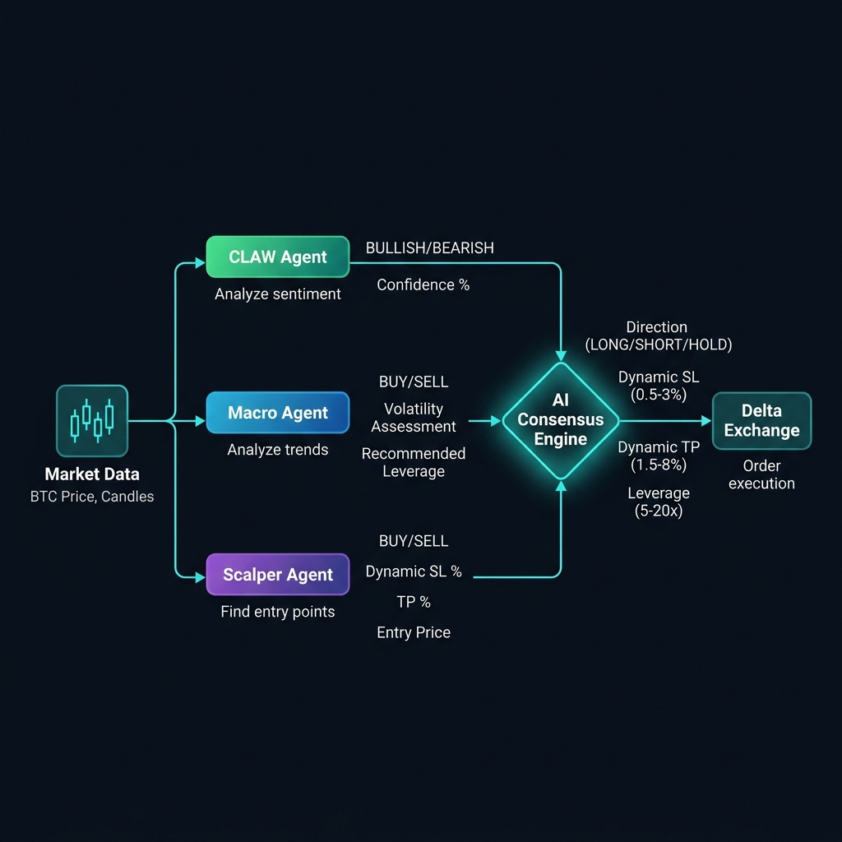
The 3-Agent AI Pipeline
Agent 1: CLAW (News Sentiment) - Scans breaking news and global funding rates.
Agent 2: Macro Trend - Evaluates higher timeframe volatility and bias.
Agent 3: Scalper - Identifies precise entry points on the 5M charts.
Execution Safeguards:
• Staggered 2-second delays prevent API rate limit crashes.
• If agents disagree, the bot safely holds capital. Zero forced trades.

Slide 4
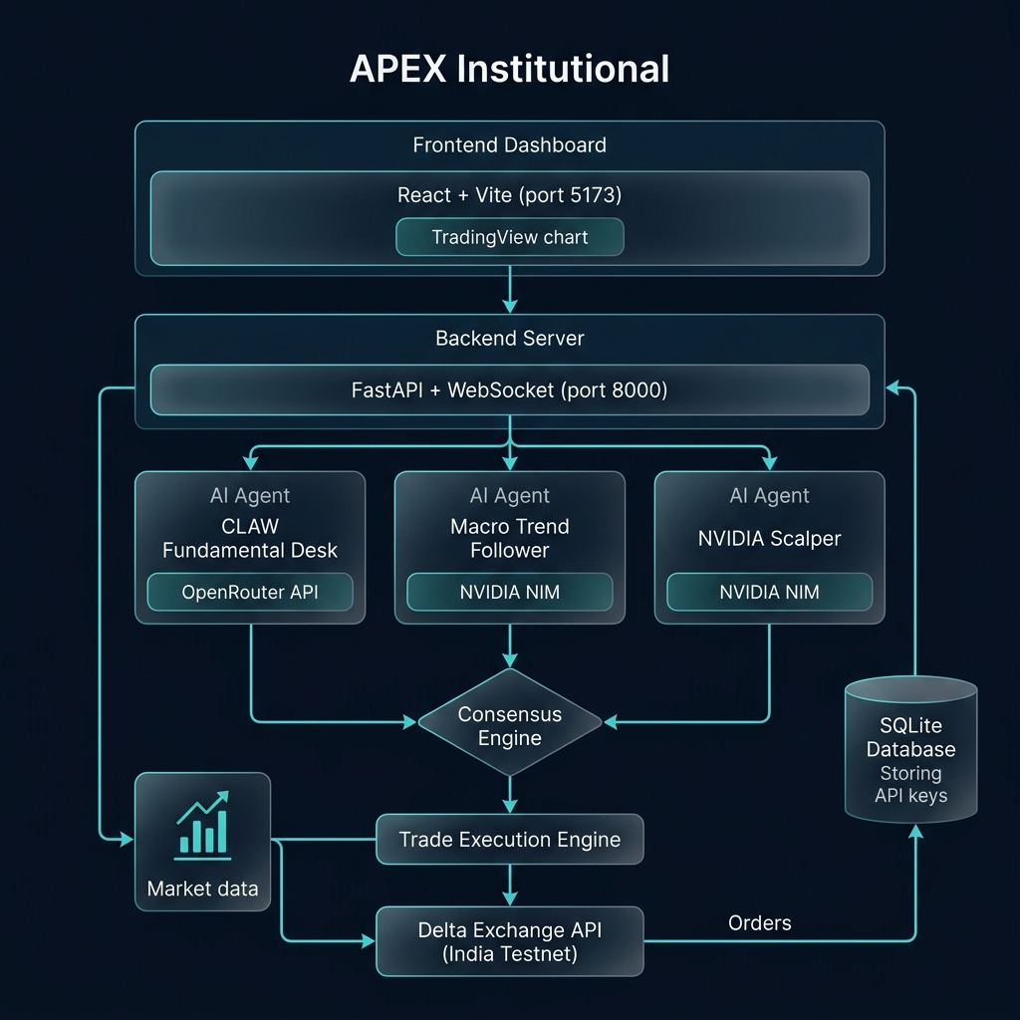
Unified Fused Trailing Engine
Simultaneously runs a Math-Tier system and an AI Predictive Trap system.
Picks the most protective stop-loss before execution.
Tight Scalping Tiers:
• Tier 1 (+0.5% profit): Stop-Loss snaps to entry. Zero Risk.
• Tier 2 (+1.0% profit): Locks in 0.7% guaranteed profit.
• Tier 3 (+1.5% profit): Shadows peak price aggressively by 0.15%.
Fast-Recovery: Recovers missing DB trades and SLs directly from Delta Exchange.

Slide 5
Recent Trade Performance Validation
The recent volatility drop activated the Tier 3 Step-Trail system.
APEX autonomously locked in maximum profit before the market reversed.
• INDIA_TESTNET2: +$155.69 (119 Contracts)
• DeltaIndia: +$20.28 (16 Contracts)

