Slide 1

APEX Institutional
The Next Generation Autonomous Crypto Trading Terminal

Slide 2
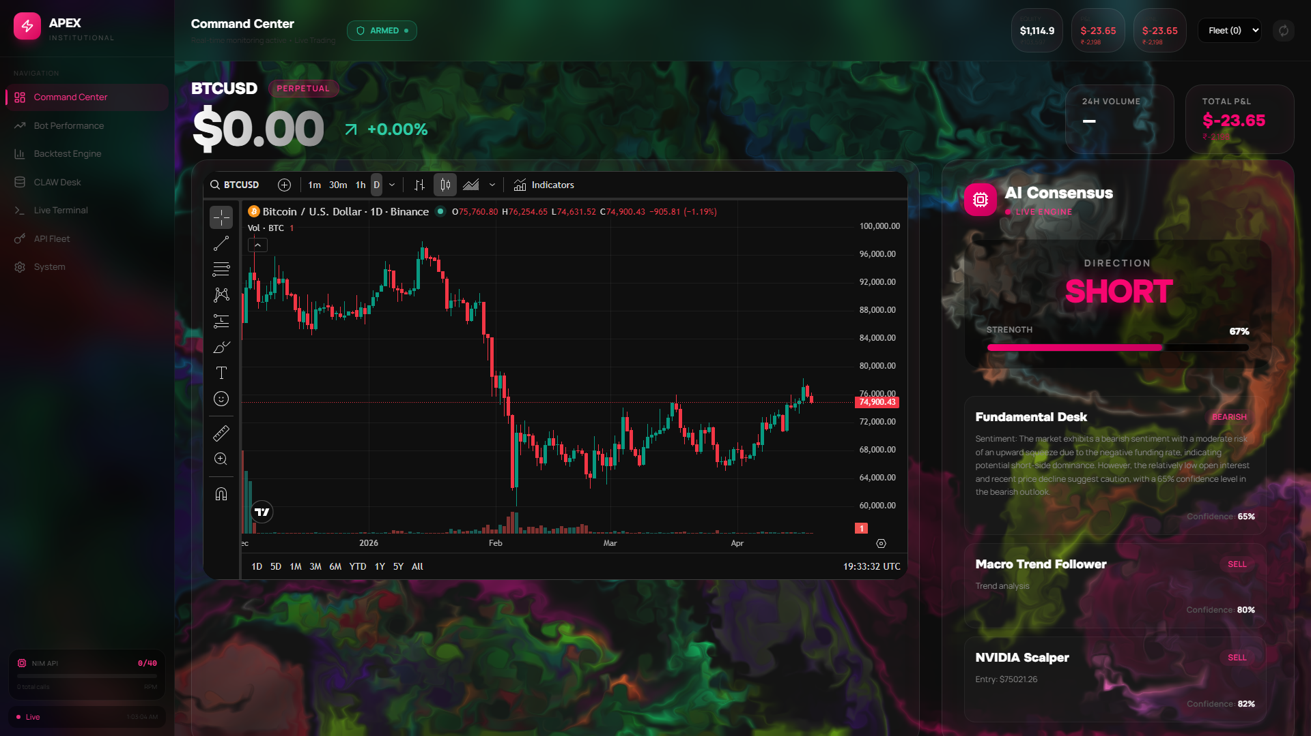
The Command Center
Live High-Frequency Order Execution and AI Monitoring Dashboard.
Displays real-time market action, live positions, and execution latency.
Beautiful glassmorphism interface built for Institutional clarity.

Slide 3

Triple-Agent Consensus Logic
1. CLAW (News Sentiment Agent): Analyzes fundamental data and liquidity.
2. Macro (Trend Following Agent): Sets the baseline bias (Bullish/Bearish).
3. Scalper (Sniper Agent): Determines exact dynamic risk entry pricing.
If they don't reach a 60%+ agreement, the bot holds capital. Emotionless logic.

Slide 4
DOM X-Ray (Order Book Intelligence)
Real-time visibility into the Delta Exchange L2 Order Book.
Detects massive physical buy/sell walls to gauge market imbalance.
Macro Agent scales leverage dynamically based on wall support/resistance.
Scalper & Trap Agents front-run reversals by positioning ahead of massive walls.

Slide 5
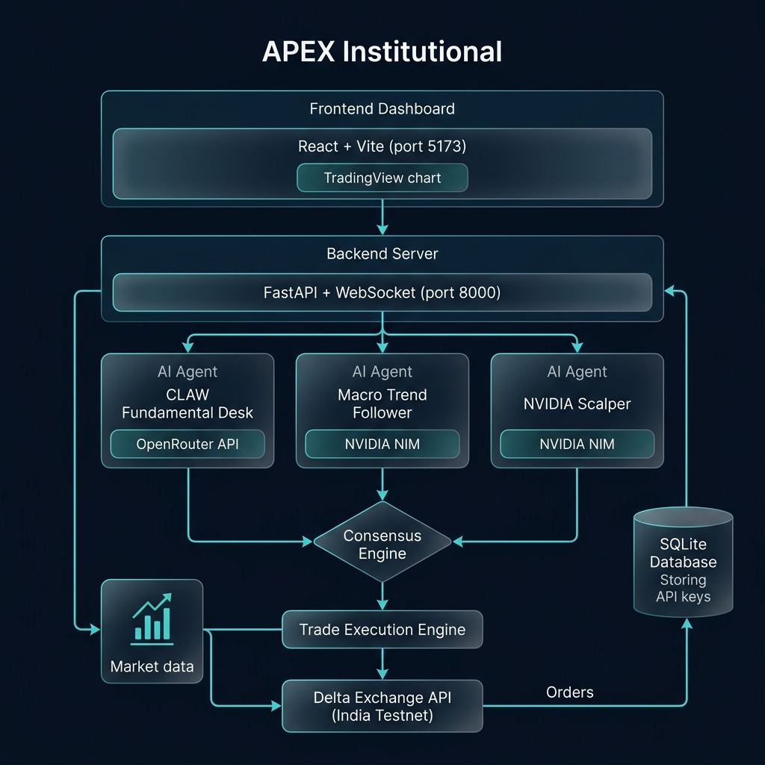
Predictive Traps & Step-Trailing
The Fused Engine selects the tightest stop-loss before execution:
• Tier 1 (+0.5%): SL snaps to Breakeven.
• Tier 2 (+1.0%): SL locks in +0.7% guaranteed.
• Tier 3 (+1.5%): SL tightly shadows the market peak by 0.15%.
The Predictive AI Trap loop constantly evaluates Binance tick data to snap Take-Profits before reversals occur.

Slide 6
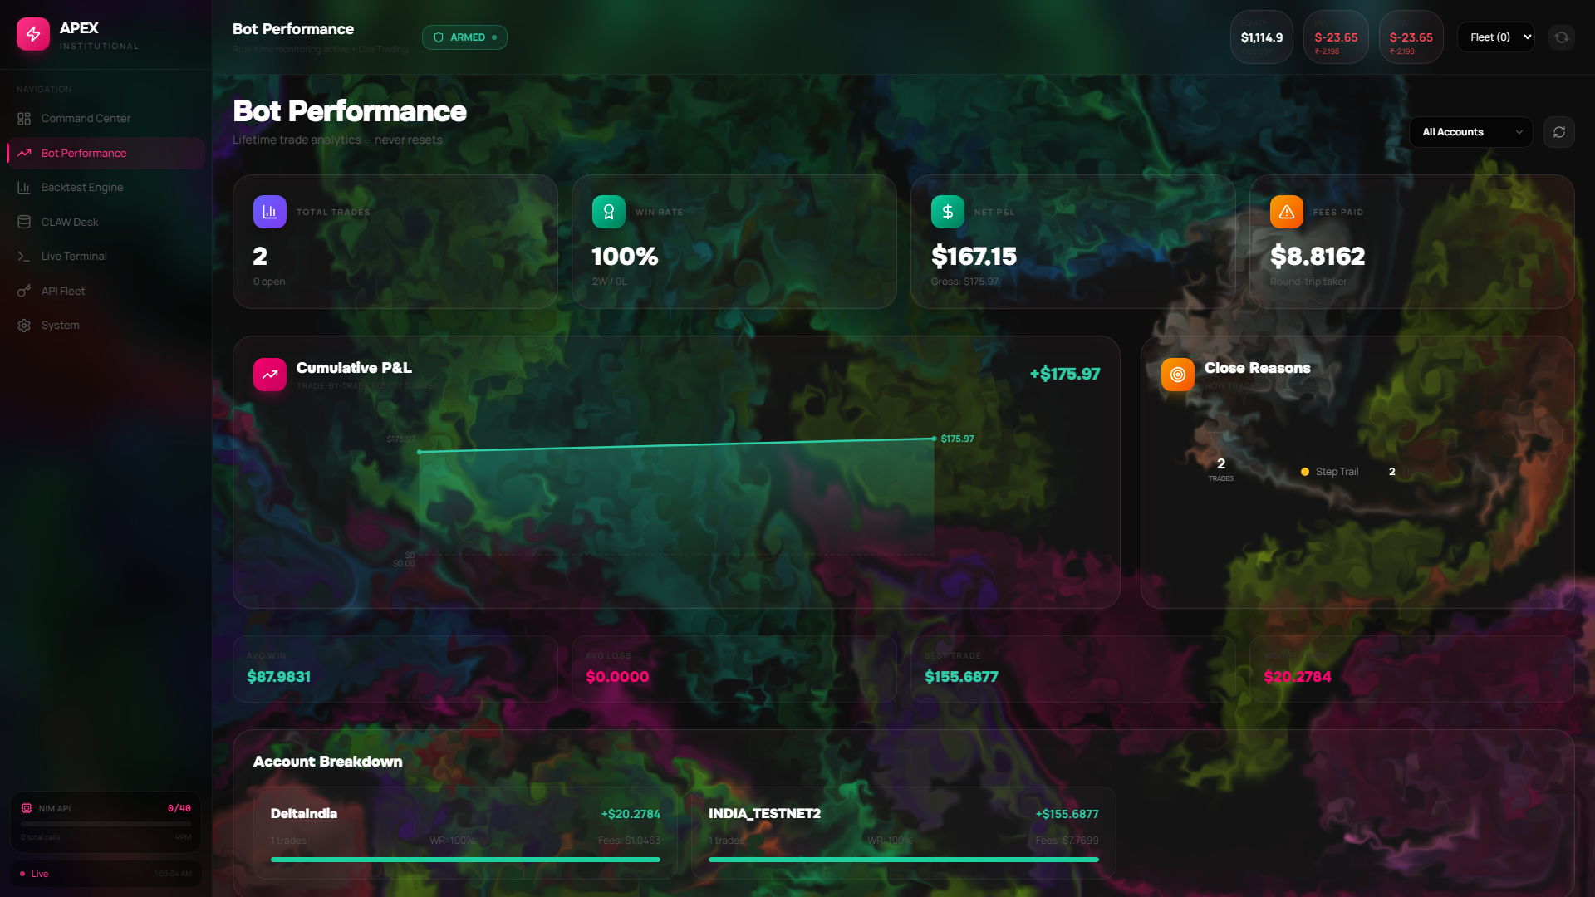
Immutable Performance Analytics
Live Database tracking system logs every closed position automatically.
Backfill logic recovers trades even after server restarts to ensure perfect PnL tracking.
Shows recent Step-Trail lock wins (e.g. +$155.69, +$20.28) dynamically.

