Slide 1

(DR. BABASAHEB AMBEDKAR TECHNOLOGICAL UNIVERSITY, LONERE) RAJIV GANDHI COLLEGE OF ENGINEERING, RESEARCH TECHNOLOGY, CHANDRAPUR Department of Computer Science and Engineering (2023-24)
A Seminar Presentation
On
“Insert Seminar TITILE”
SEMISTER- III SECOND YEAR
Seminar –I
Guided By
Prof Dr. Dhanajay Dumbere
Submitted By
Ayush kakde (CSEA530)
Vikram Ade (CSEA529)
Ayush Nagpure (CSEA569)
Priyanshu Gedam (CSEA555)

Slide 2
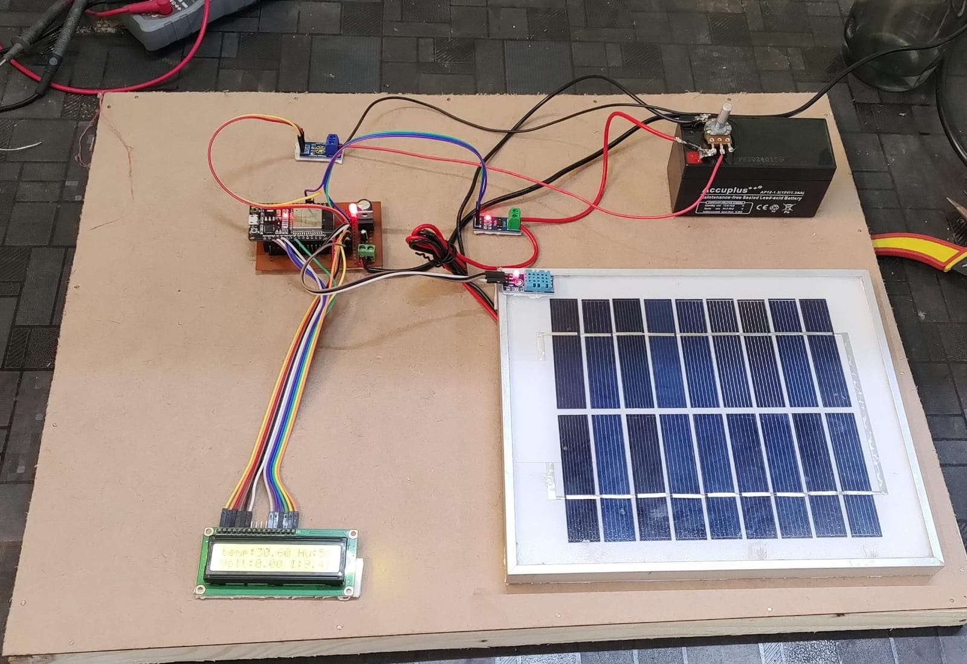

Smart-SOLAR energy harvesting system

Slide 3
Abstract with keyword
1.Abstract
2.Keyword
Solar energy, IoT, renewable energy, energy harvesting, monitoring, optimization
This presentation proposes a comprehensive IoT-based solar energy harvesting system to improve efficiency, monitoring, and control of renewable energy generation.

Slide 4
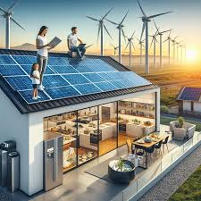
Introduction
A Smart Solar Energy Harvesting System using IoT collects solar energy with panels and stores it in batteries. IoT sensors track sunlight, battery levels, and temperature, sending this data to an app or platform so users can monitor and manage the system remotely.

Slide 5
Problem statement with Objective
Problem Statement
Objective
1.Develop an IoT-based solar energy harvesting system
2.Enhance energy generation, storage, and distribution efficiency 3.Provide real-time monitoring and intelligent control
Existing solar energy systems often suffer from suboptimal performance due to lack of real-time monitoring, automation, and intelligent control.

Slide 6
Algorithm or methods
1.Sensor integration
Deploy IoT sensors to monitor solar panel performance, weather conditions, and energy storage levels.
2.Data Analytics
Utilize data analysis techniques to optimize energy generation and distribution.
3.Automated Controls
Implement intelligent control algorithms to adjust solar panel orientation, storage, and distribution in real-time.

Slide 7
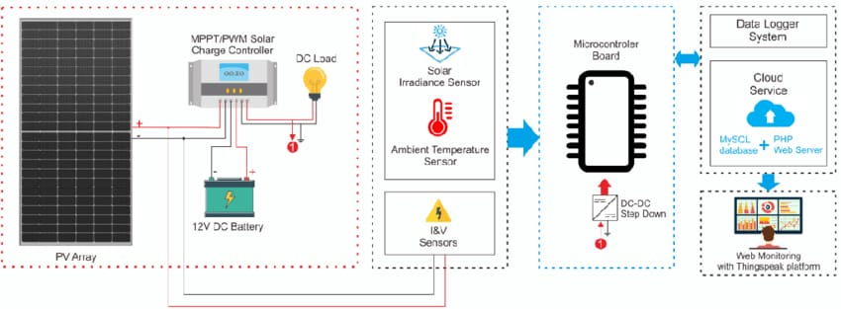

Slide 8




Modules
Solar panels
Photovoltaic panels to convert sunlight into electrical energy.
Energy storage
Batteries and other storage solutions to store excess energy.
IOT sensors
Monitoring devices to collect real-time data on system performance.
Control systems
Intelligent algorithms to optimize energy generation and distribution.

Slide 9
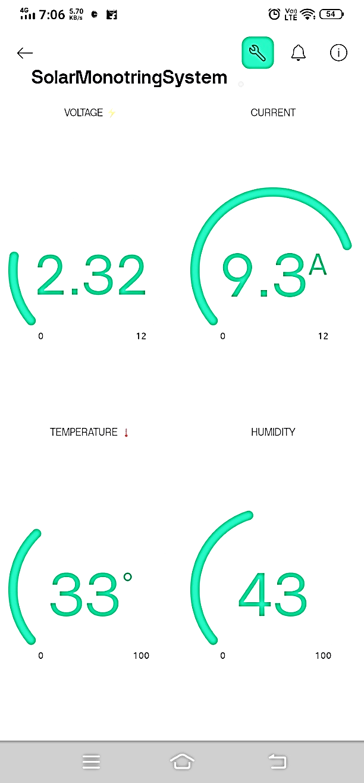
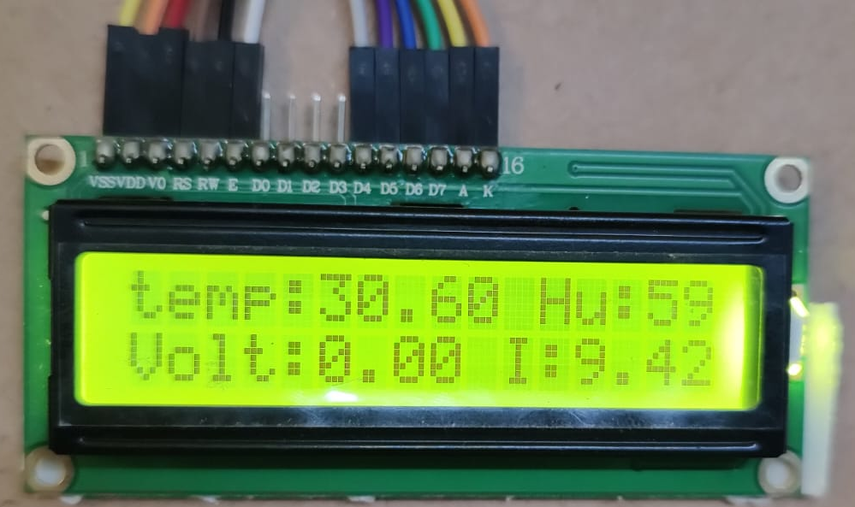
Output

Slide 10
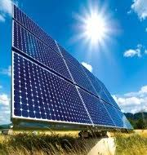
Conclusion
A smart solar system using IoT improves efficiency by tracking sunlight, weather, and energy needs in real time. This allows it to optimize energy capture, adjust storage, and integrate with the grid, making solar energy more reliable and adaptable.

Slide 11
References
Myriam Cumbajín¹, Patricio Sánchez¹, Maritza Núñez² and Carlos Gordón² IOP Conference Series: Earth and Environmental Science, Volume 1141, Congress on Sustainability, Energy and City 2022 12/09/2022 - 13/09/2022 Ambato, EcuadorCitation Myriam Cumbajín et al 2023 IOP Conf. Ser.: Earth Environ. Sci. 1141 012008DOI 10.1088/1755-1315/1141/1/012008
Dipak kumar sah ¹,Nabajoyti Mazumdar² ,Pankaj pal³ ,Tarachand Amgoth⁴ December 2022 DOI:10.1109/UPCON56432.2022.9986433 Conference: 2022 IEEE 9th Uttar Pradesh Section International Conference on Electrical, Electronics and Computer Engineering (UPCON)
Myriam Cumbajín¹, Patricio Sánchez¹, Maritza Núñez² and Carlos Gordón² Published under licence by IOP Publishing Ltd IOP Conference Series: Earth and Environmental Science, Volume 1141, Congress on Sustainability, Energy and City 2022 12/09/2022 - 13/09/2022 Ambato, EcuadorCitation Myriam Cumbajín et al 2023 IOP Conf. Ser.: Earth Environ. Sci. 1141 012008DOI 10.1088/1755-1315/1141/1/012008
Himanshu Sharma; Ahteshamul Haque; Zainul Abdin Jaffery 2018 2nd IEEE International Conference on Power Electronics, Intelligent Control and Energy Systems (ICPEICES) Electronic ISBN:978-1-5386-6625-8 Print on Demand(PoD) ISBN:978-1-5386-6624-1
Prof S.A Sheikh*1, Dimpal Dhuware*2, Ranju Gharsele*3, Abhishek Mishra*4, Shreyash Wakade*5, Saurabh Sadmake*6 *1Asst. Professor, Department Of Electronics And Power, Priyadarshini College Of Engineering, Nagpur, Maharashtra, India. *2,3,4,5,6Student, Department Of Electronics And Power, Priyadarshini College Of Engineering, Nagpur, Maharashtra, India. DOI : https://www.doi.org/10.56726/IRJMETS3622

