Slide 1
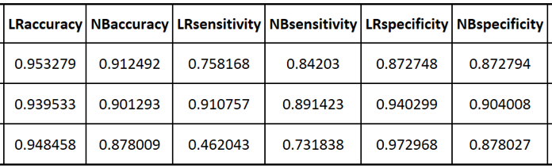

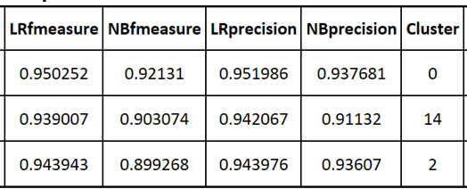
2017-2018 M.Sc. in Data Science and Analytics
BINARY CLASSFICIATION ON CLUSTERED DATA
Kakoli Chowdhury Supervisor: Dr. Ayse Bener
Objective
This MRP aims at studying the behavior of linear binary classification algorithm on the clustered data, taking into consideration the distinct behavior shown by each clusters and their effect on occupancy prediction.
Background
Results
Land-Mobile radio systems support many vital communication functions supporting government and private operators. The models produced will help in understanding the usage patterns at different times to predict occupancy by different channels
Layer 3 data is explored and processed under this MRP. Sub-setting of data is conducted based on clustering and descriptive statistical analysis designed to differentiate between channels exhibiting different occupancy % patterns.
Applying algorithms on clustered data is expected to show distinct behaviors that are further utilized to find the best prediction model for spectrum availability.
Existing work on predictive classification algorithms on clustered data is very limited.
Results for comparison of the prediction model has been captured in a tabular format and presented above. The result shows comparison between Logistic Regression and Naïve Bayes algorithms. For each prediction a confusion matrix has been built which has been further utilized to calculate a number of performance parameters that are measured. For e.g. Accuracy, Precision, F-measure, Sensitivity, Specificity.
Above results have been captured at the threshold of 70 across random 300 channels.
Cluster 0 indicates no clustering.
Cluster 14 indicates either occupied or unoccupied
Cluster 2 indicates partially occupied
Methodology
Data cleanup: task involves removing the channels that do not contain enough data to become useful in prediction model. 7000+ channels were reduced to approximately 2300 after cleanup.
Clustering: divided the channels into three separate clusters using unsupervised K-means clustering method. The outcome of the cluster resulted in Occupied, Partial, either occupied or unoccupied.
Data labelling: for the experiment has been done manually. Occupancy percent more than threshold is given label 1 otherwise 0.
Finding the threshold: running the first experiment to identify the threshold where maximum accuracy is achieved using Logistic regression and Naïve Bayes algorithm. Graph of accuracy vs threshold is plotted to find the right threshold.
Setting the baseline: on the selected threshold, experiment is ran on random 300 channels out of 2300. The data used is on Layer 3- 60min. K-fold is value taken 10 as well as number of iterations were set to 10. This experiment is ran on data without clustering.
Experiments: same steps are ran on data set for cluster 1 and 4 and a second experiment on cluster 2 keeping all other parameters same as baseline. Results are noted down and compared.
Conclusions
Logistic regression performed consistently better in terms of accuracy as compared to Naïve Bayes with or without clustering.
Across different data sets, accuracy of an occupancy prediction within a given model didn’t change much.
It can also be concluded that clustering did not add any specific benefits in binary classification prediction when compared with non-clustered data

