Slide 1
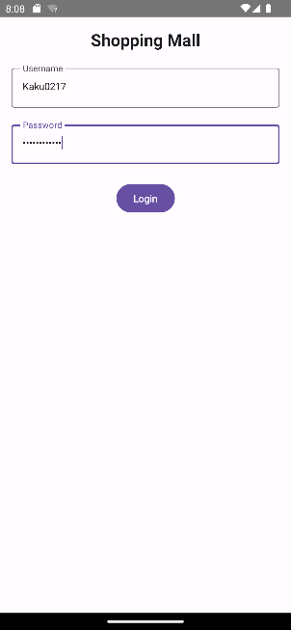
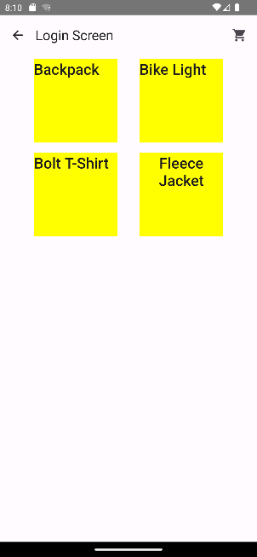
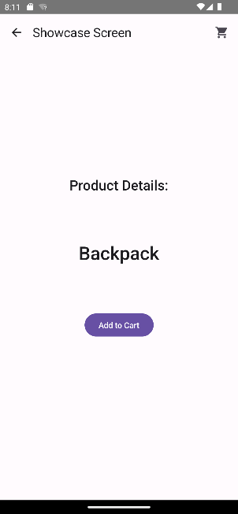
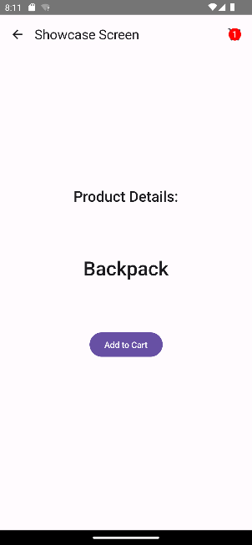
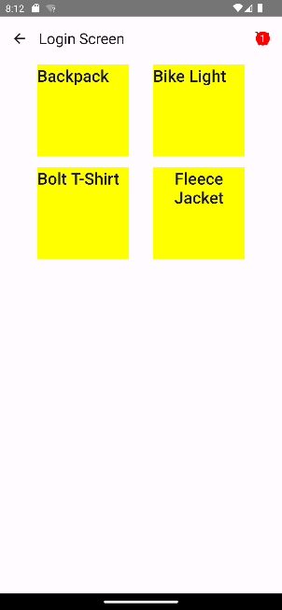
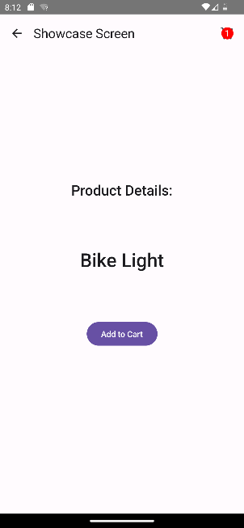
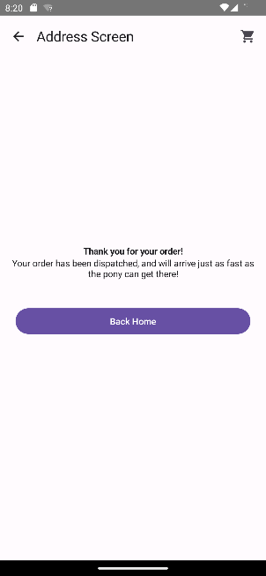
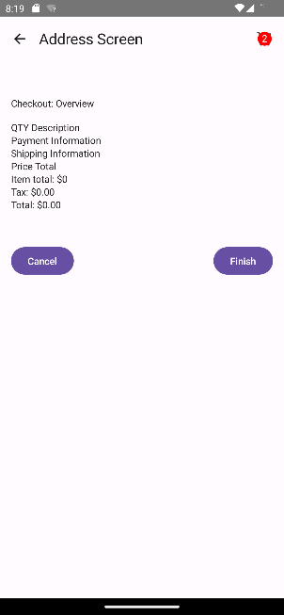
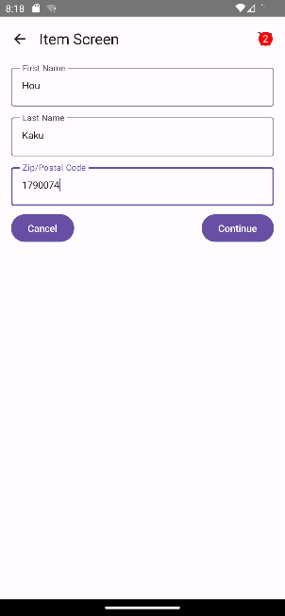
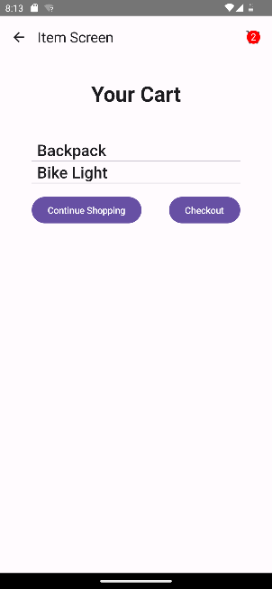

Shopping Mall App Flow Chart
testTag
(Item)
testTag
(Item)
testTag
(Back)
testTag
(Cart Badge)
testTag
(Item)
testTag
(Item)
testTag
(Item)
testTag
(Item)
testTag
(Item)
testTag
(Item)
testTag
(Login Button)
All items with same tag name
testTag
(Add to Cart)
testTag
(Add to Cart)
testTag
(Login Screen)
testTag
(Showcase Screen)
testTag
(Item Screen)
testTag
(Item Screen)
testTag
(Showcase Screen)
testTag
(Item Screen)
testTag
(Cart Badge)
testTag
(Cart Icon)
testTag(Cart Item)
testTag(Cart Item)
testTag
(Continue)
testTag
(Checkout)
testTag
(Finish)
testTag
(Back to Home)
All items with same tag name
testTag
(Thank-you Screen)
testTag
(Confirm Purchase)
testTag
(Address Screen)
testTag
(Cart Screen)
testTag
(Item Screen)

Slide 2
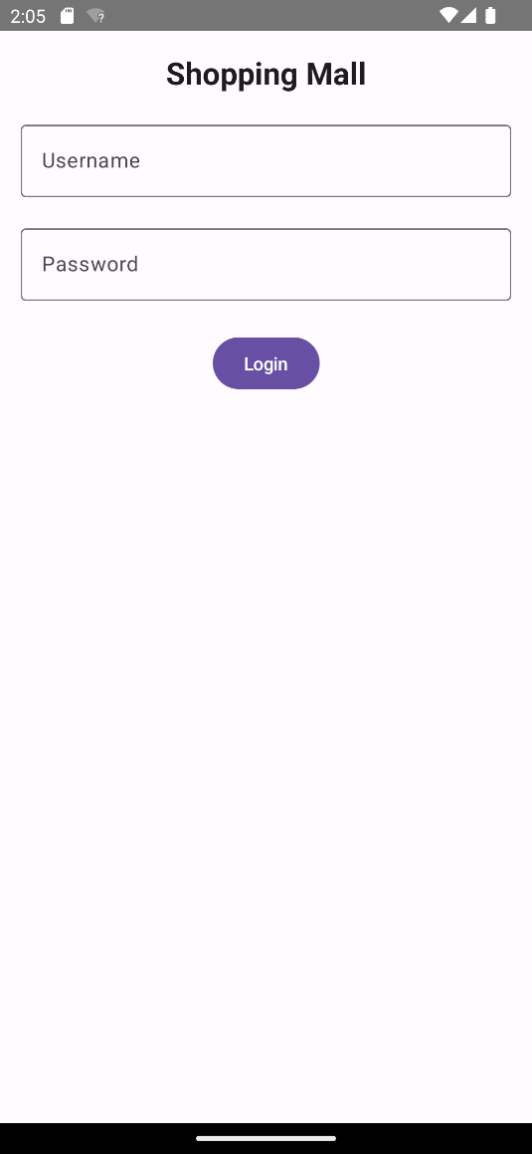
Jetpack Compose Test Framework
E2EScenarioTest
Test Cases
TestData
e2eTestDSL
ComposeTestRule
Configuration
DSL
Compose Library
E2ETestActions
Helper
testTag
Test tag

Slide 3
Class Diagram
TestData
E2EScenarioTest
ComposeTestRule
+ testAccount: Account
+ testAddress: Address
+ testProducts: List<Product>
+ testCartQuantity: Int
+ testData: TestData
+ ComposeTestRule: ComposeTestRule
+ setup()
+ testScenarioSuccess()
+ testScenarioFailure() + testScenario()
+ tearDown()
+ onNodeWithTag()
+ onAllNodes()
+ onNode()
+ waitForIdle()
E2ETestActions
testTag
+ login()
+ enterTextInNodeWithTestTag()
+ clickNodeWithTestTag()
+ verifyTagExists()
+ verifyTagDoesNotExist()
+ selectItem()
+ addToCart()
+ goToCart()
+ goCheckout()
+ inputAddress()
+ finishCheckout()
+ backHome()
+ backToShowcaseScreen()
e2eTestDSL
+ USERNAME_TAG
+ PASSWORD_TAG
+ LOGIN_BUTTON_TAG
+ SHOWCASE_SCREEN_TAG
+ CART_ICON_TAG
+ CART_SCREEN_TAG
+ CART_SCREEN_ITEM_TAG
+ FIRST_NAME_TAG
+ LAST_NAME_TAG
+ ZIP_CODE_TAG
+ ADDRESS_CONTINUE_TAG
+ CONFIRM_SCREEN_TAG
+ CHECKOUT_FINISH_TAG
+ BACK_HOME_TAG
+ E2ETestActions()

Slide 4
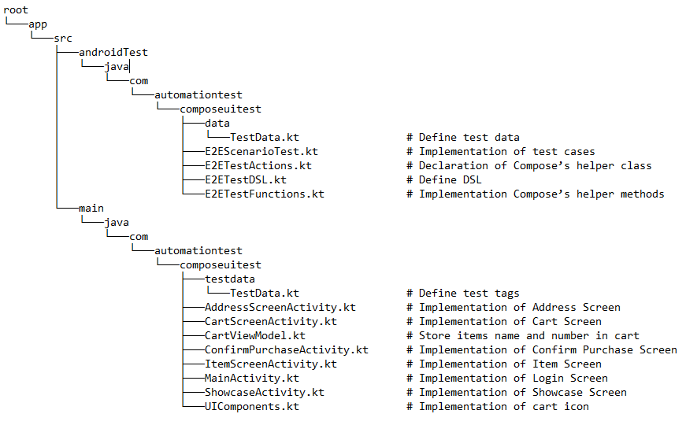
Folder Structure

Slide 5
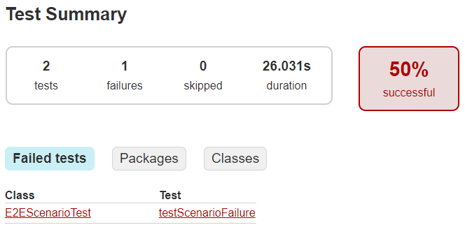
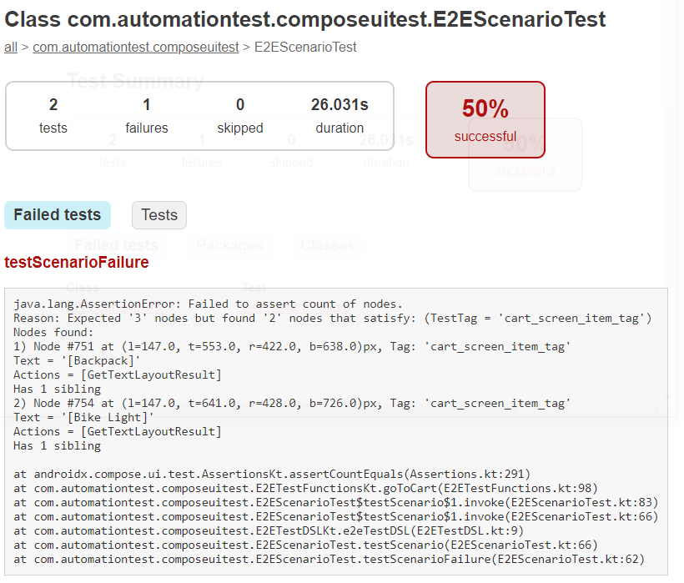
Test Report

